Slide 1
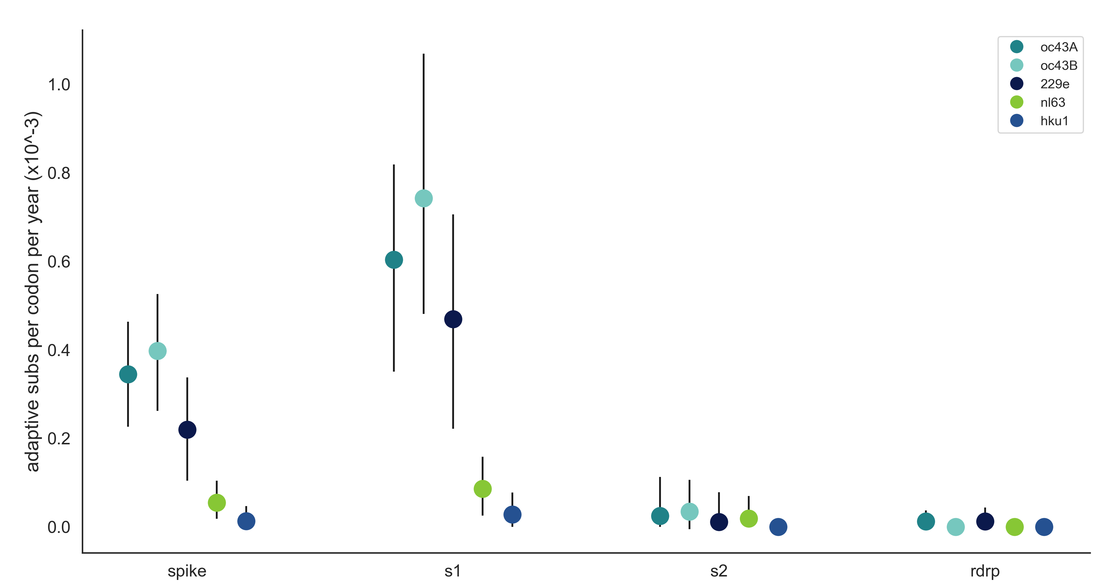
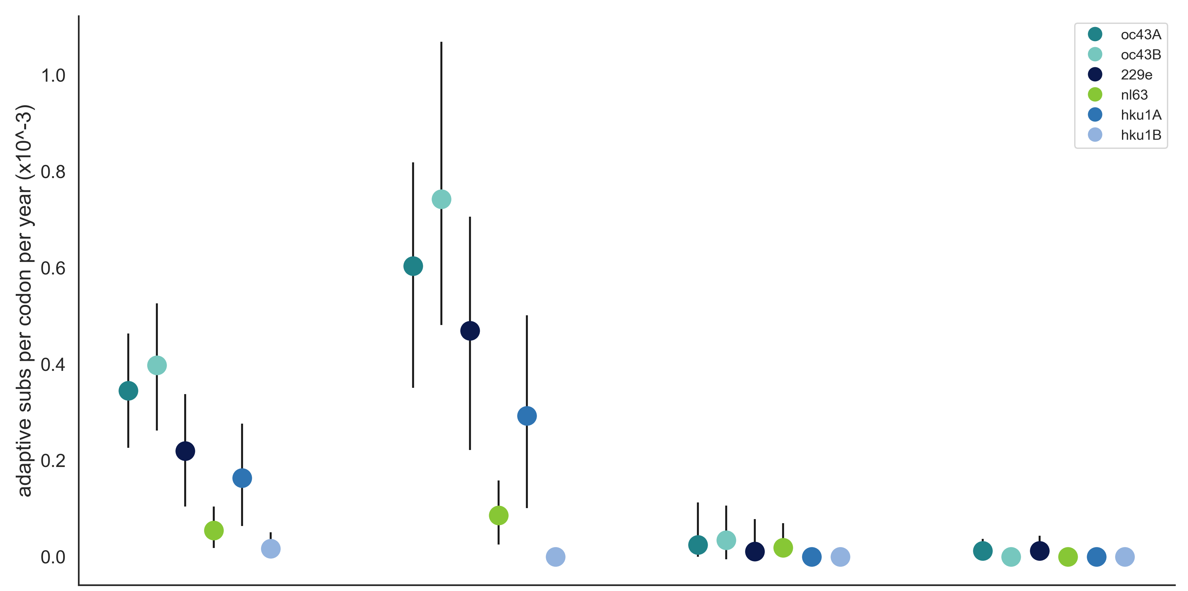
A
OC43 lineage A
OC43 lineage B
229E
NL63
HKU1
Adaptive Subs per Codon per Year (x10⁻³)
Spike
S1
S2
RdRp
B
OC43 lineage A
OC43 lineage B
229E
NL63
HKU1 lineage A
HKU1 lineage B
Adaptive Subs per Codon per Year (x10⁻³)
Spike
S1
S2
RdRp

