Slide 1
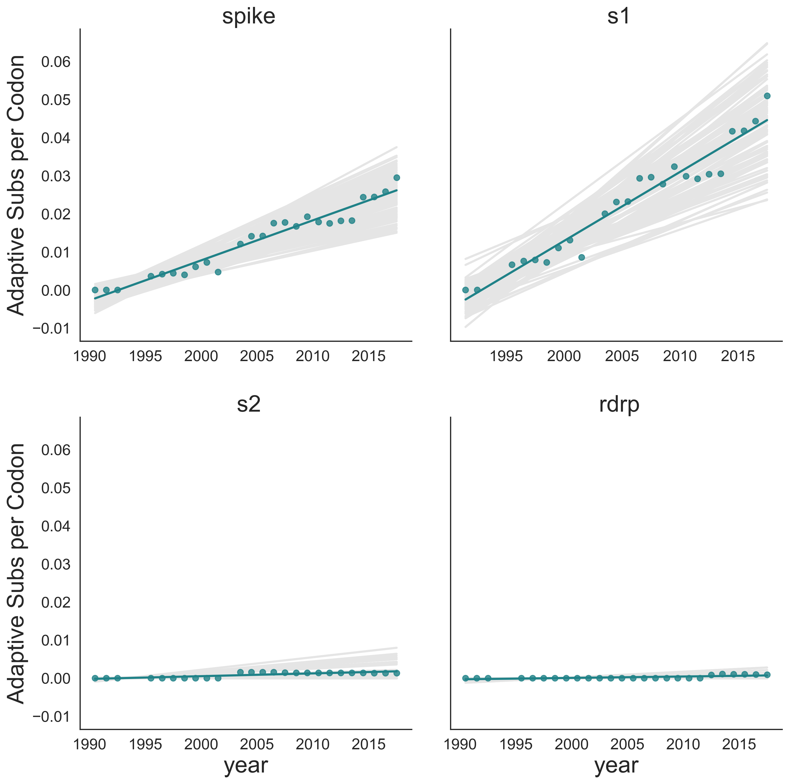
Spike
S1
Adaptive Mutations per Codon
S2
RdRp

