Slide 1
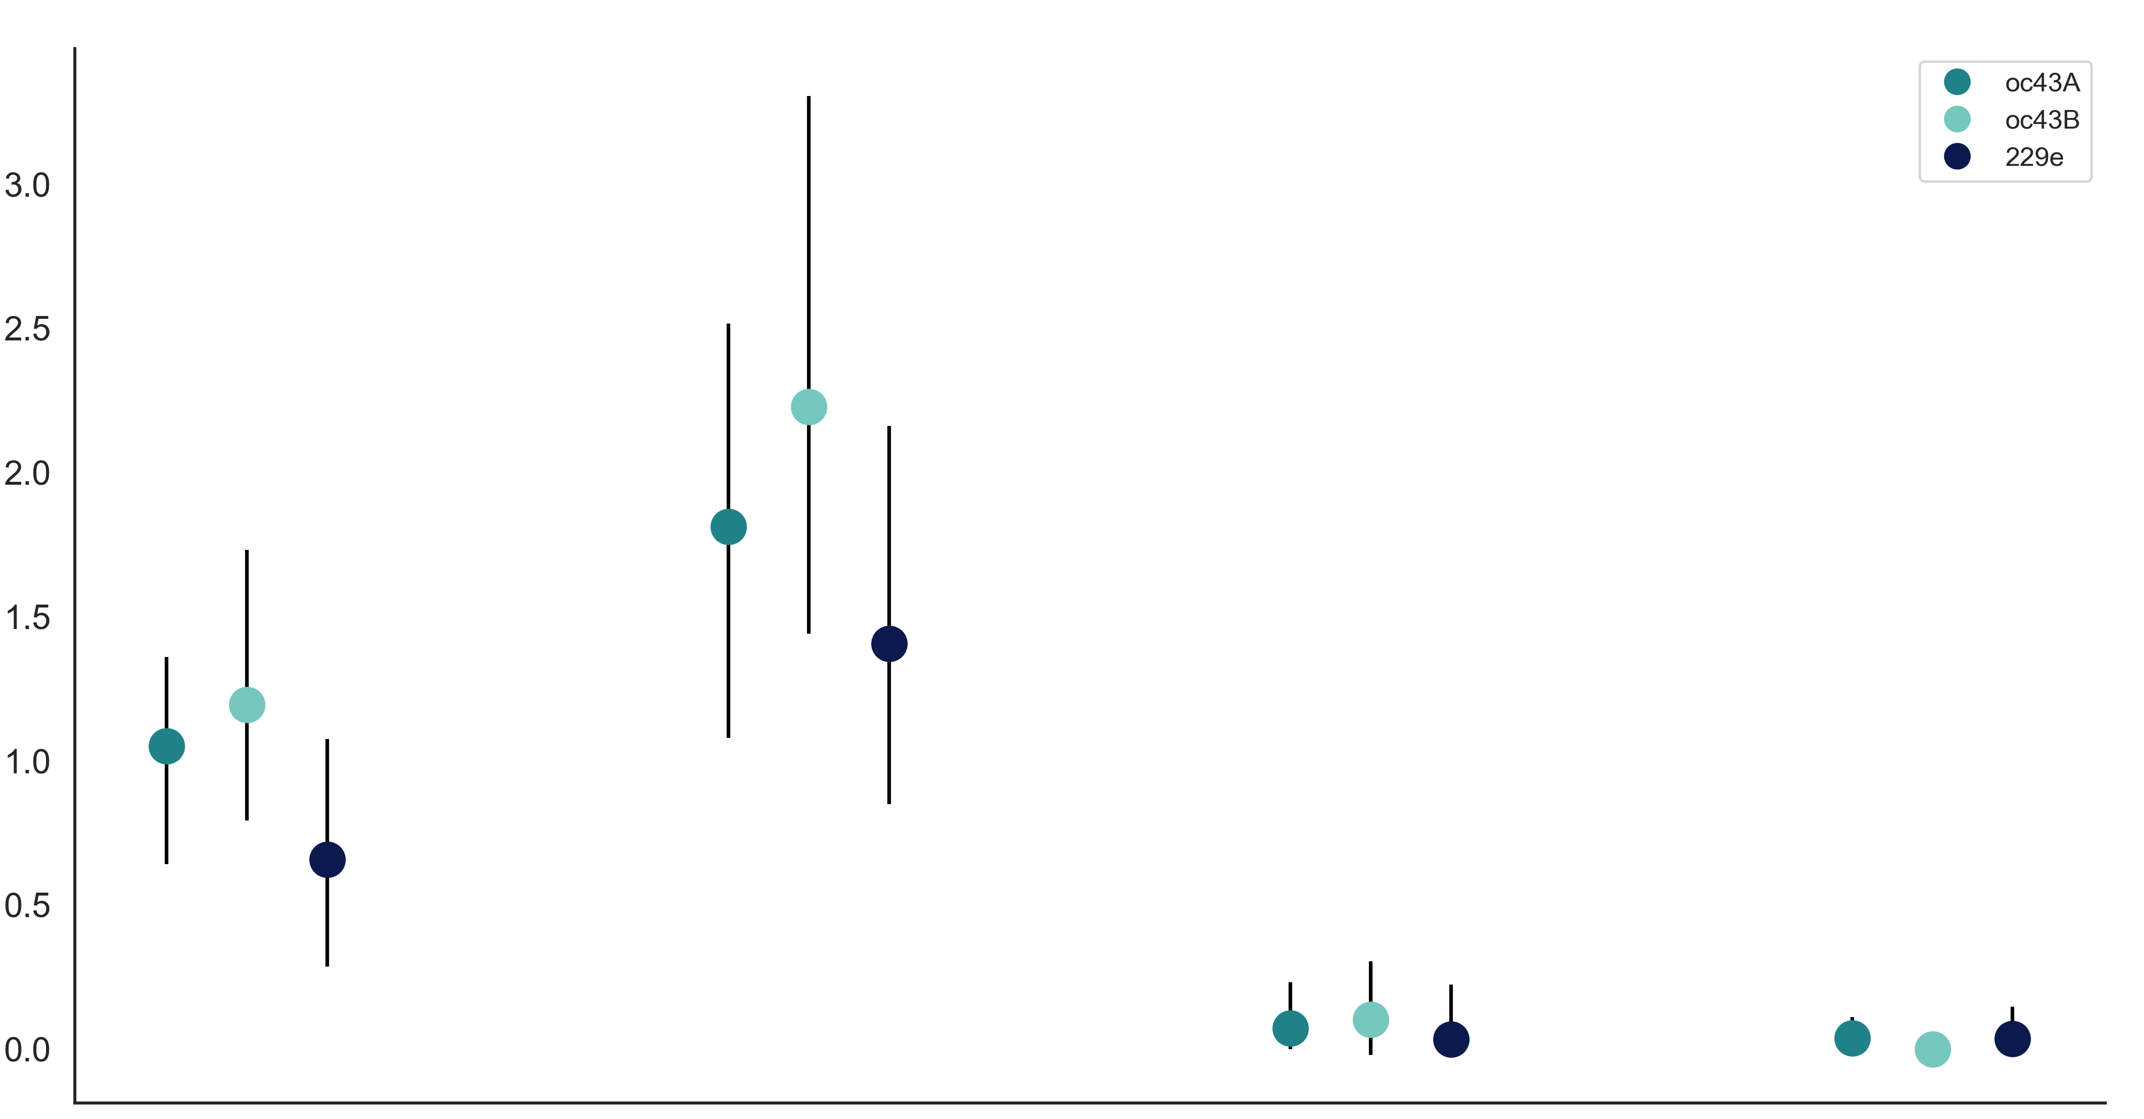
OC43 lineage A
OC43 lineage B
229E
Adaptive Muts per Codon per Year (x10⁻³)
Spike
S1
S2
RdRp

