Slide 1
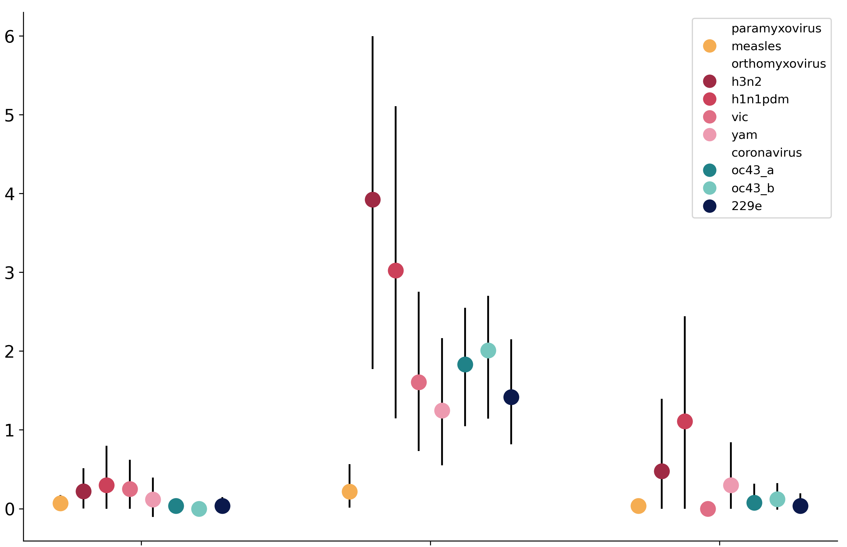
measles
A/H3N2
A/H1N1pdm
B/Vic
B/Yam
OC43 lineage A
OC43 lineage B
229E
Adaptive Muts per Codon per Year (x 10⁻³)
polymerase
receptor-binding
protein domain
membrane-fusion
protein domain

