Slide 1
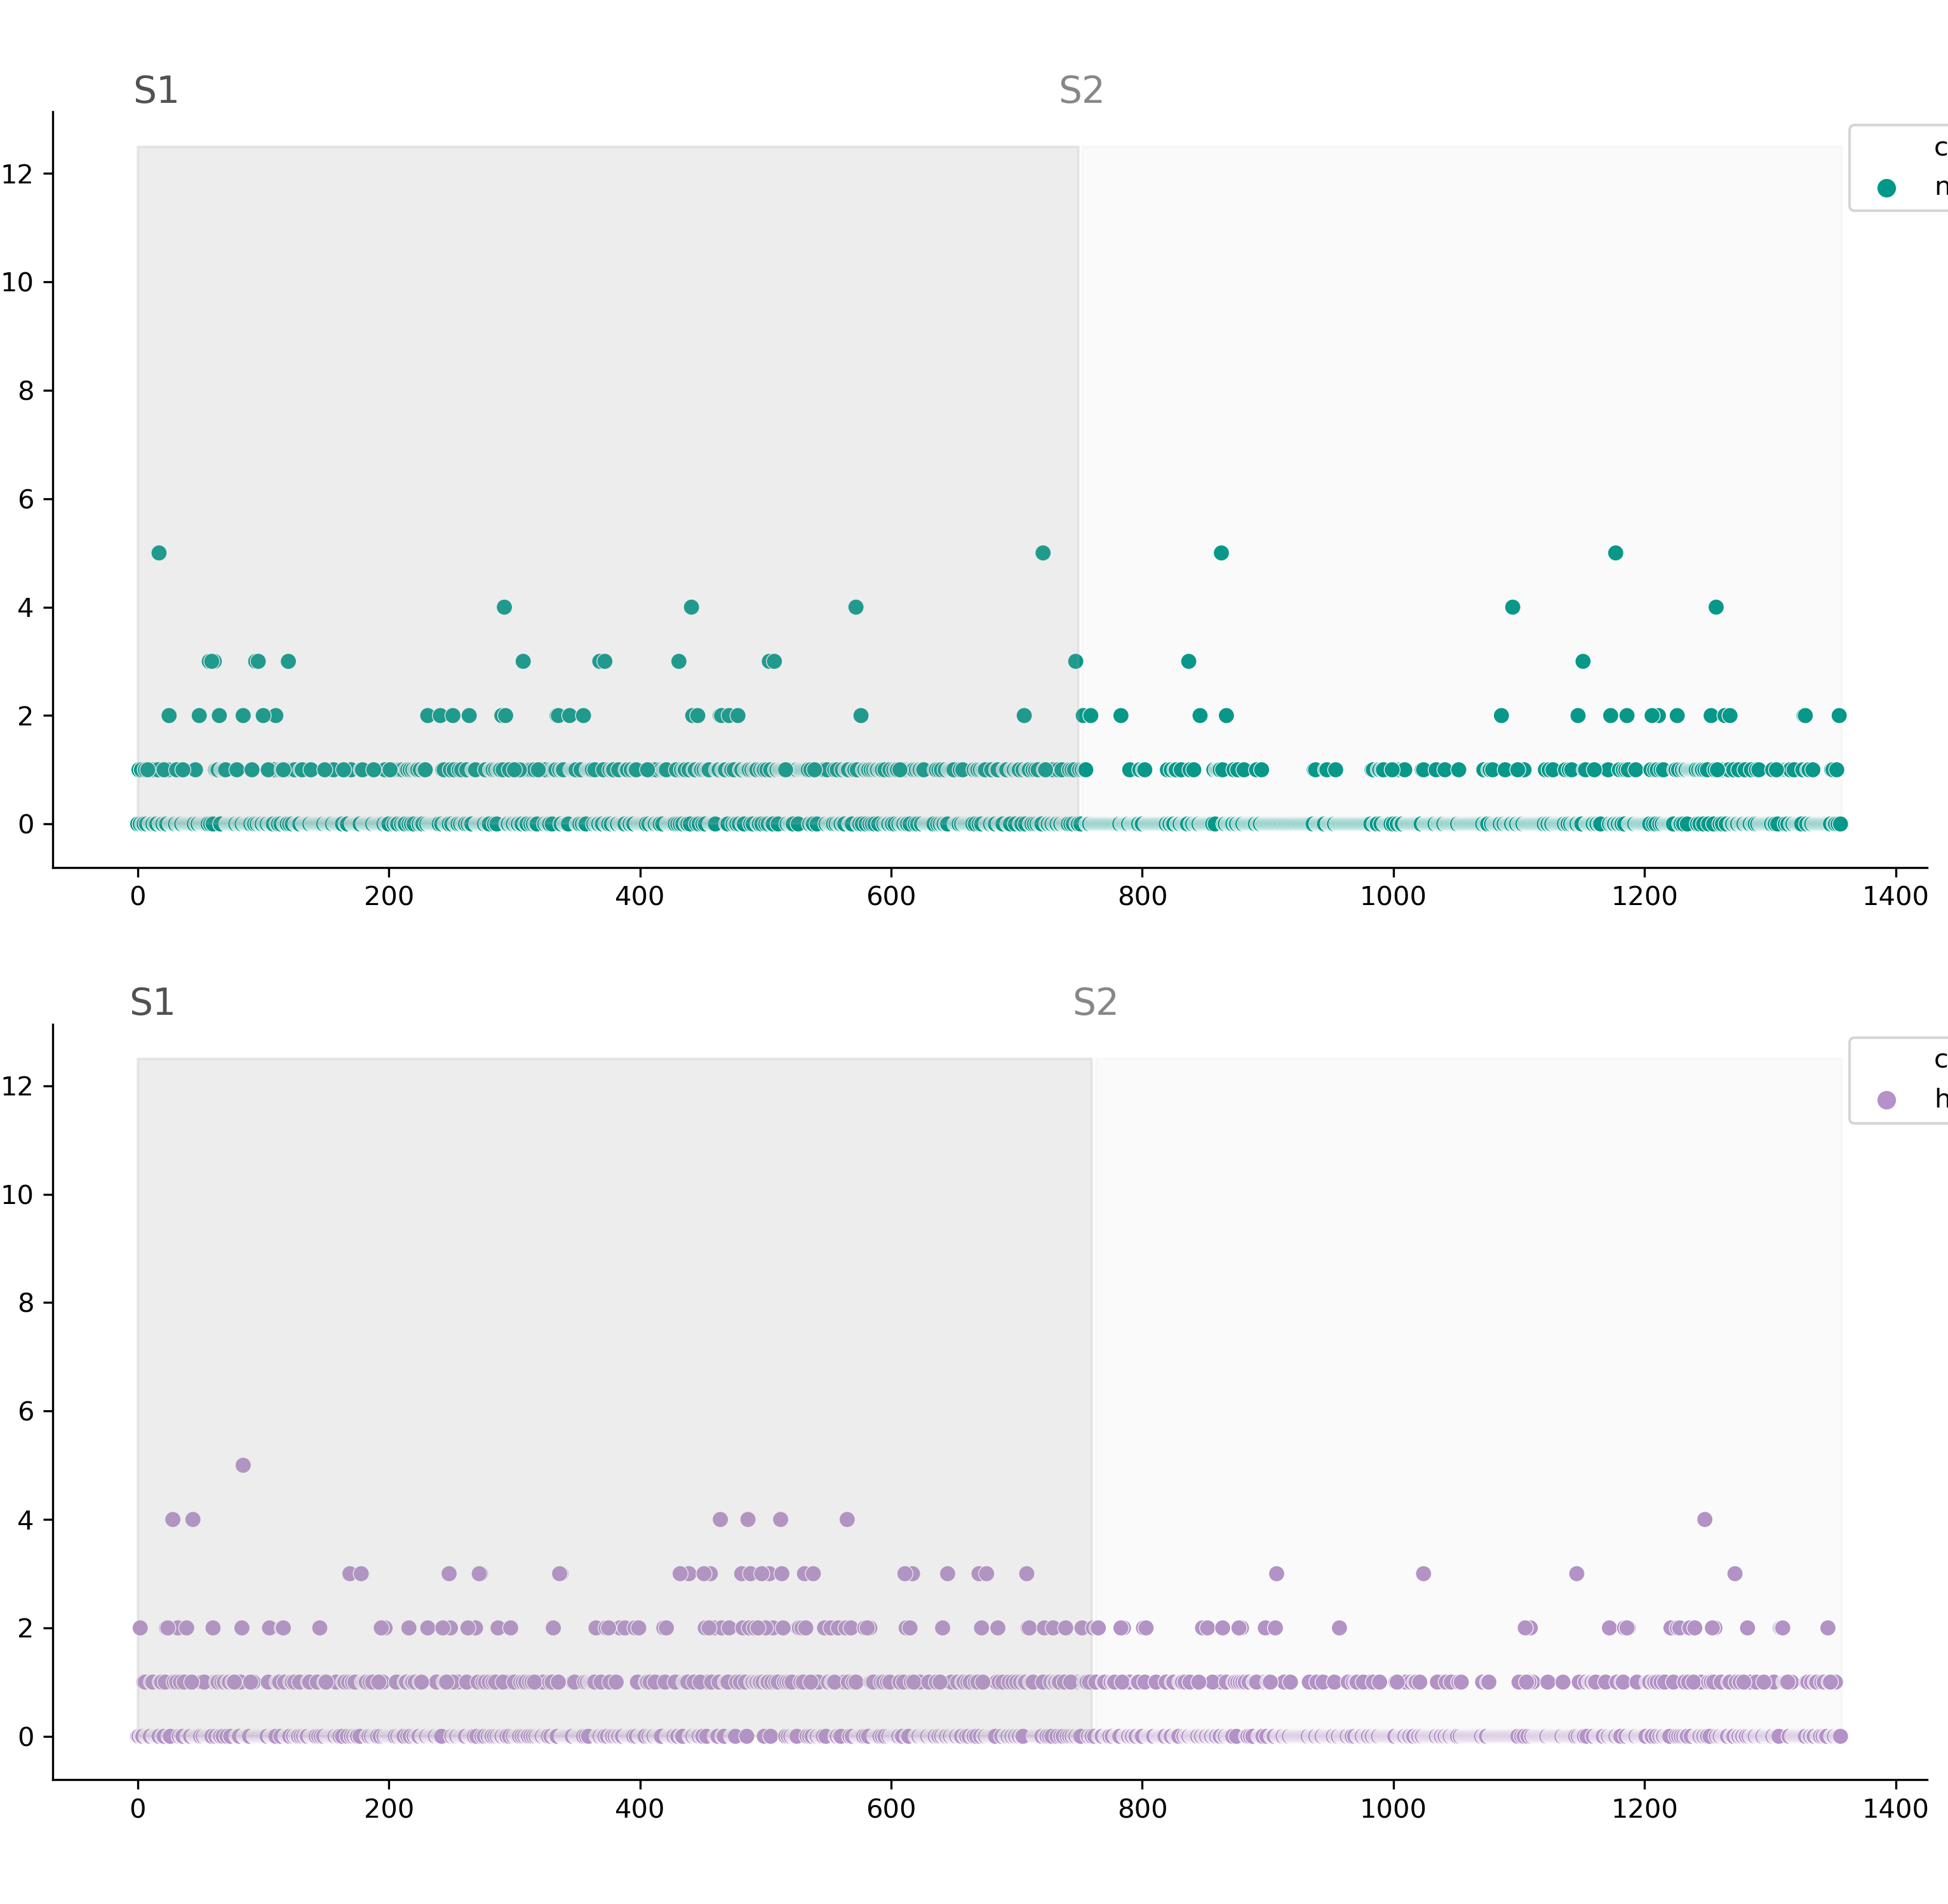
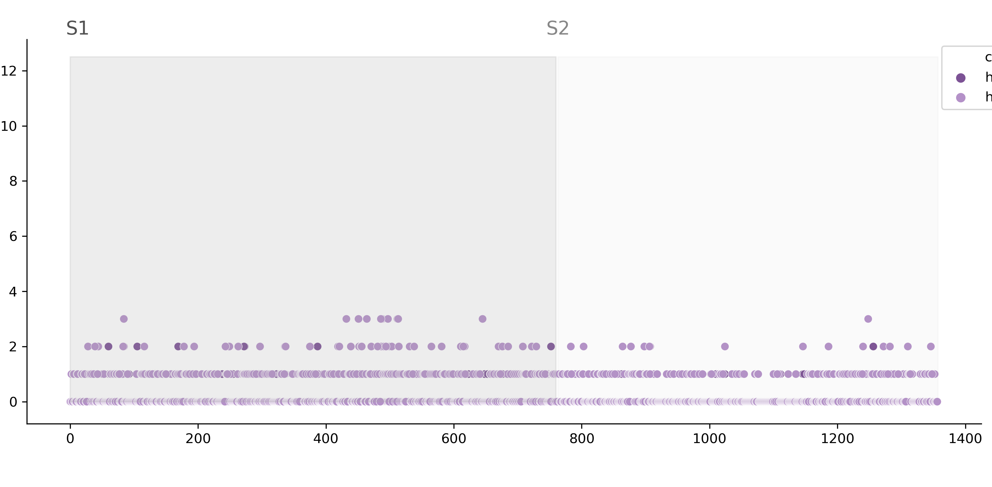
A
NL63
B
HKU1
Amino acid substitutions per site
C
HKU1
lineage A
lineage B
Spike amino acid position

