Slide 1
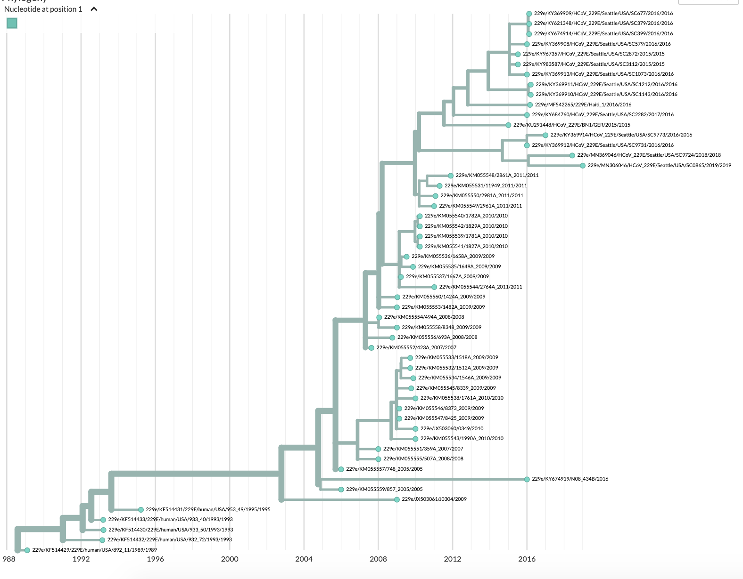
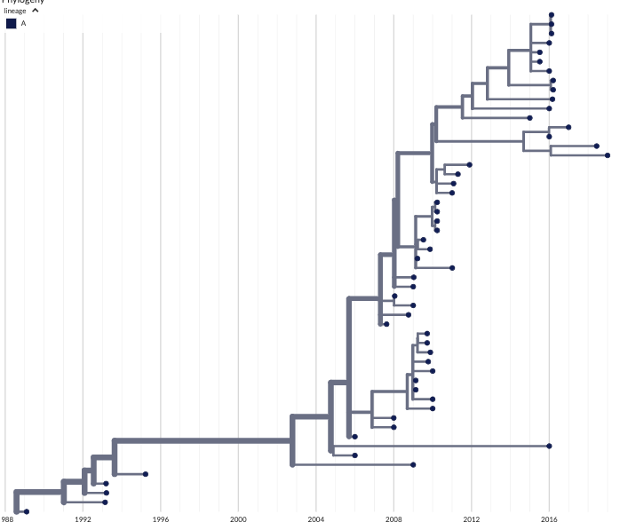
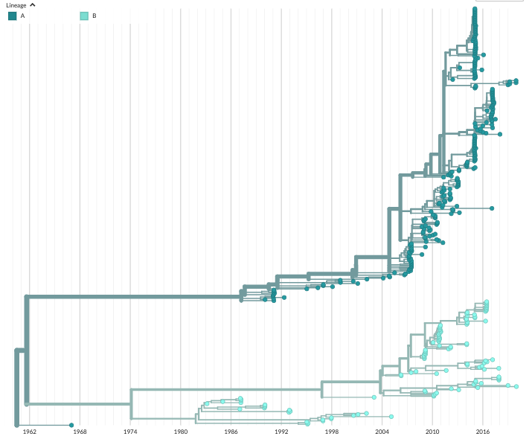
A
OC43
lineage A
lineage B
B
229E
1962 1968 1974 1980 1986 1992 1998 2004 2010 2016
1988 1992 1996 2000 2004 2008 2012 2016

