Slide 1
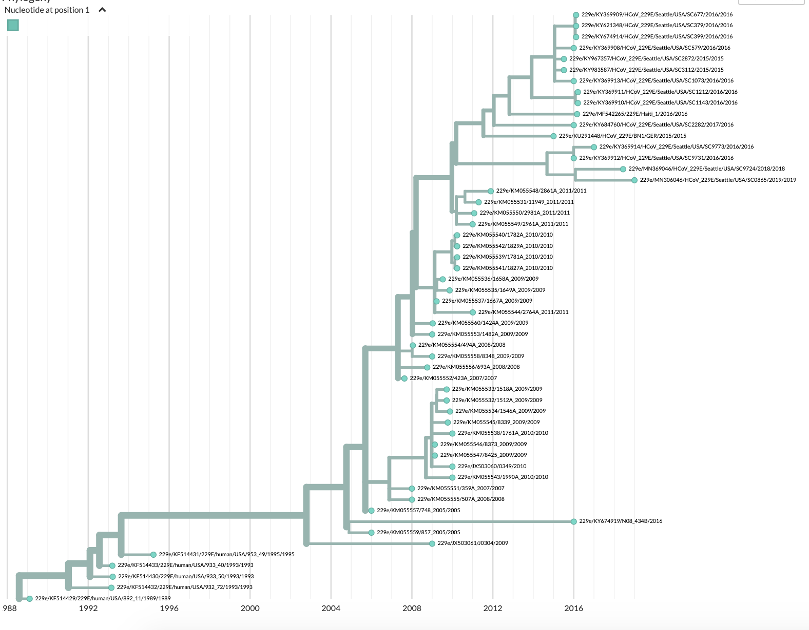
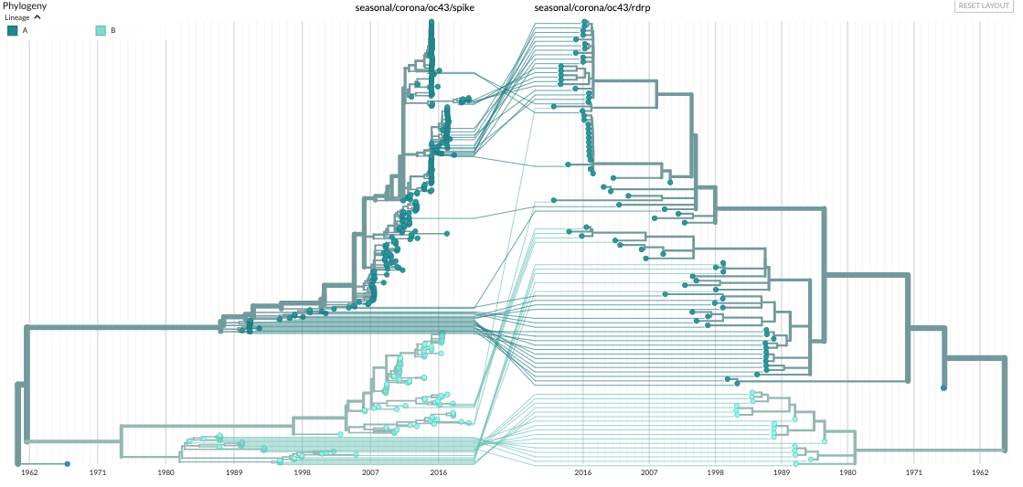
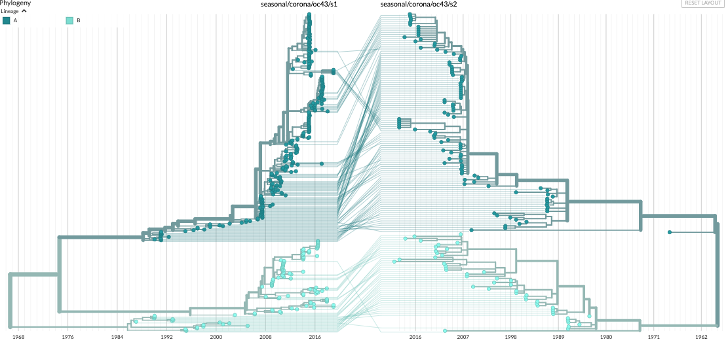
A
A
OC43 spike
lineage A
lineage B
OC43 RdRp
lineage A
lineage B
1962 1971 1980 1989 1998 2007 2016
2016 2007 1998 1989 1980 1971 1962
B
OC43 S1
lineage A
lineage B
OC43 S2
lineage A
lineage B
1968 1976 1984 1992 2000 2008 2016
2016 2007 1998 1989 1980 1971 1962

