Slide 1
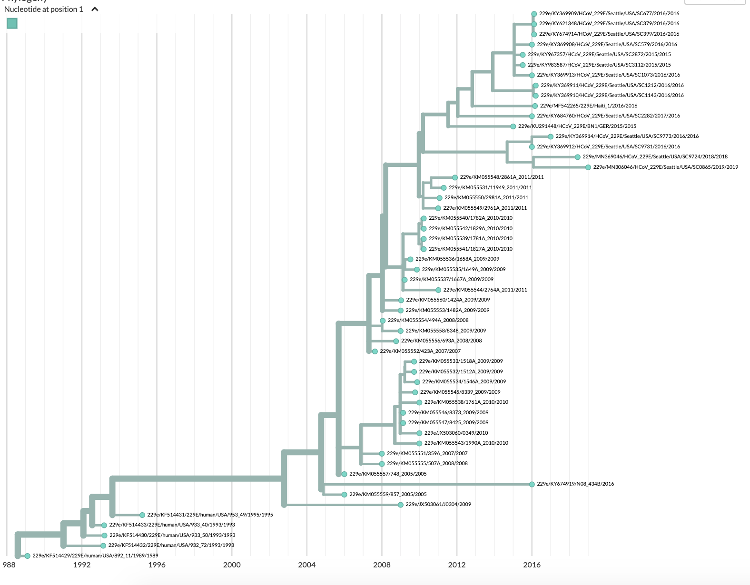
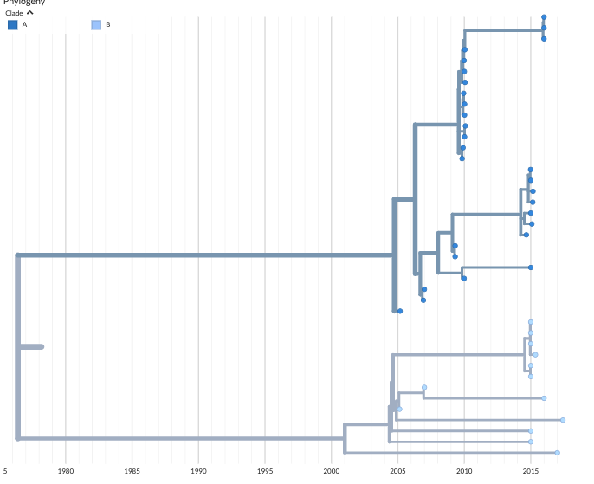
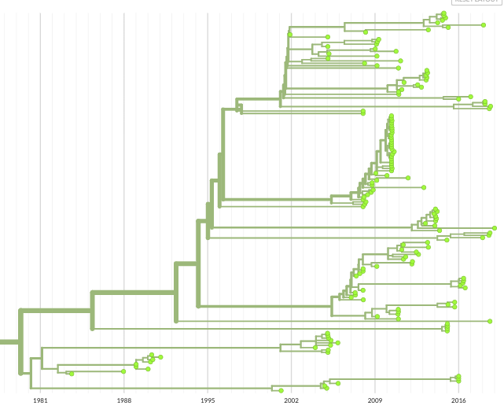
A
NL63
B
HKU1
lineage A
lineage B
1981 1988 1995 2002 2009 2016
1980 1985 1990 1995 2000 2005 2010 2015

