Slide 1
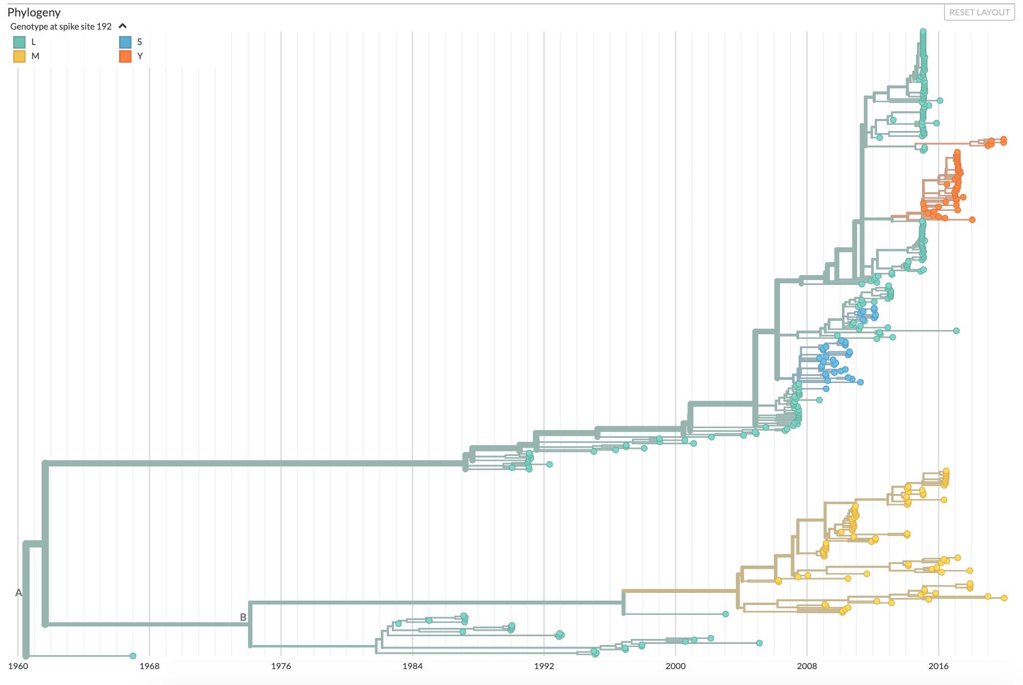
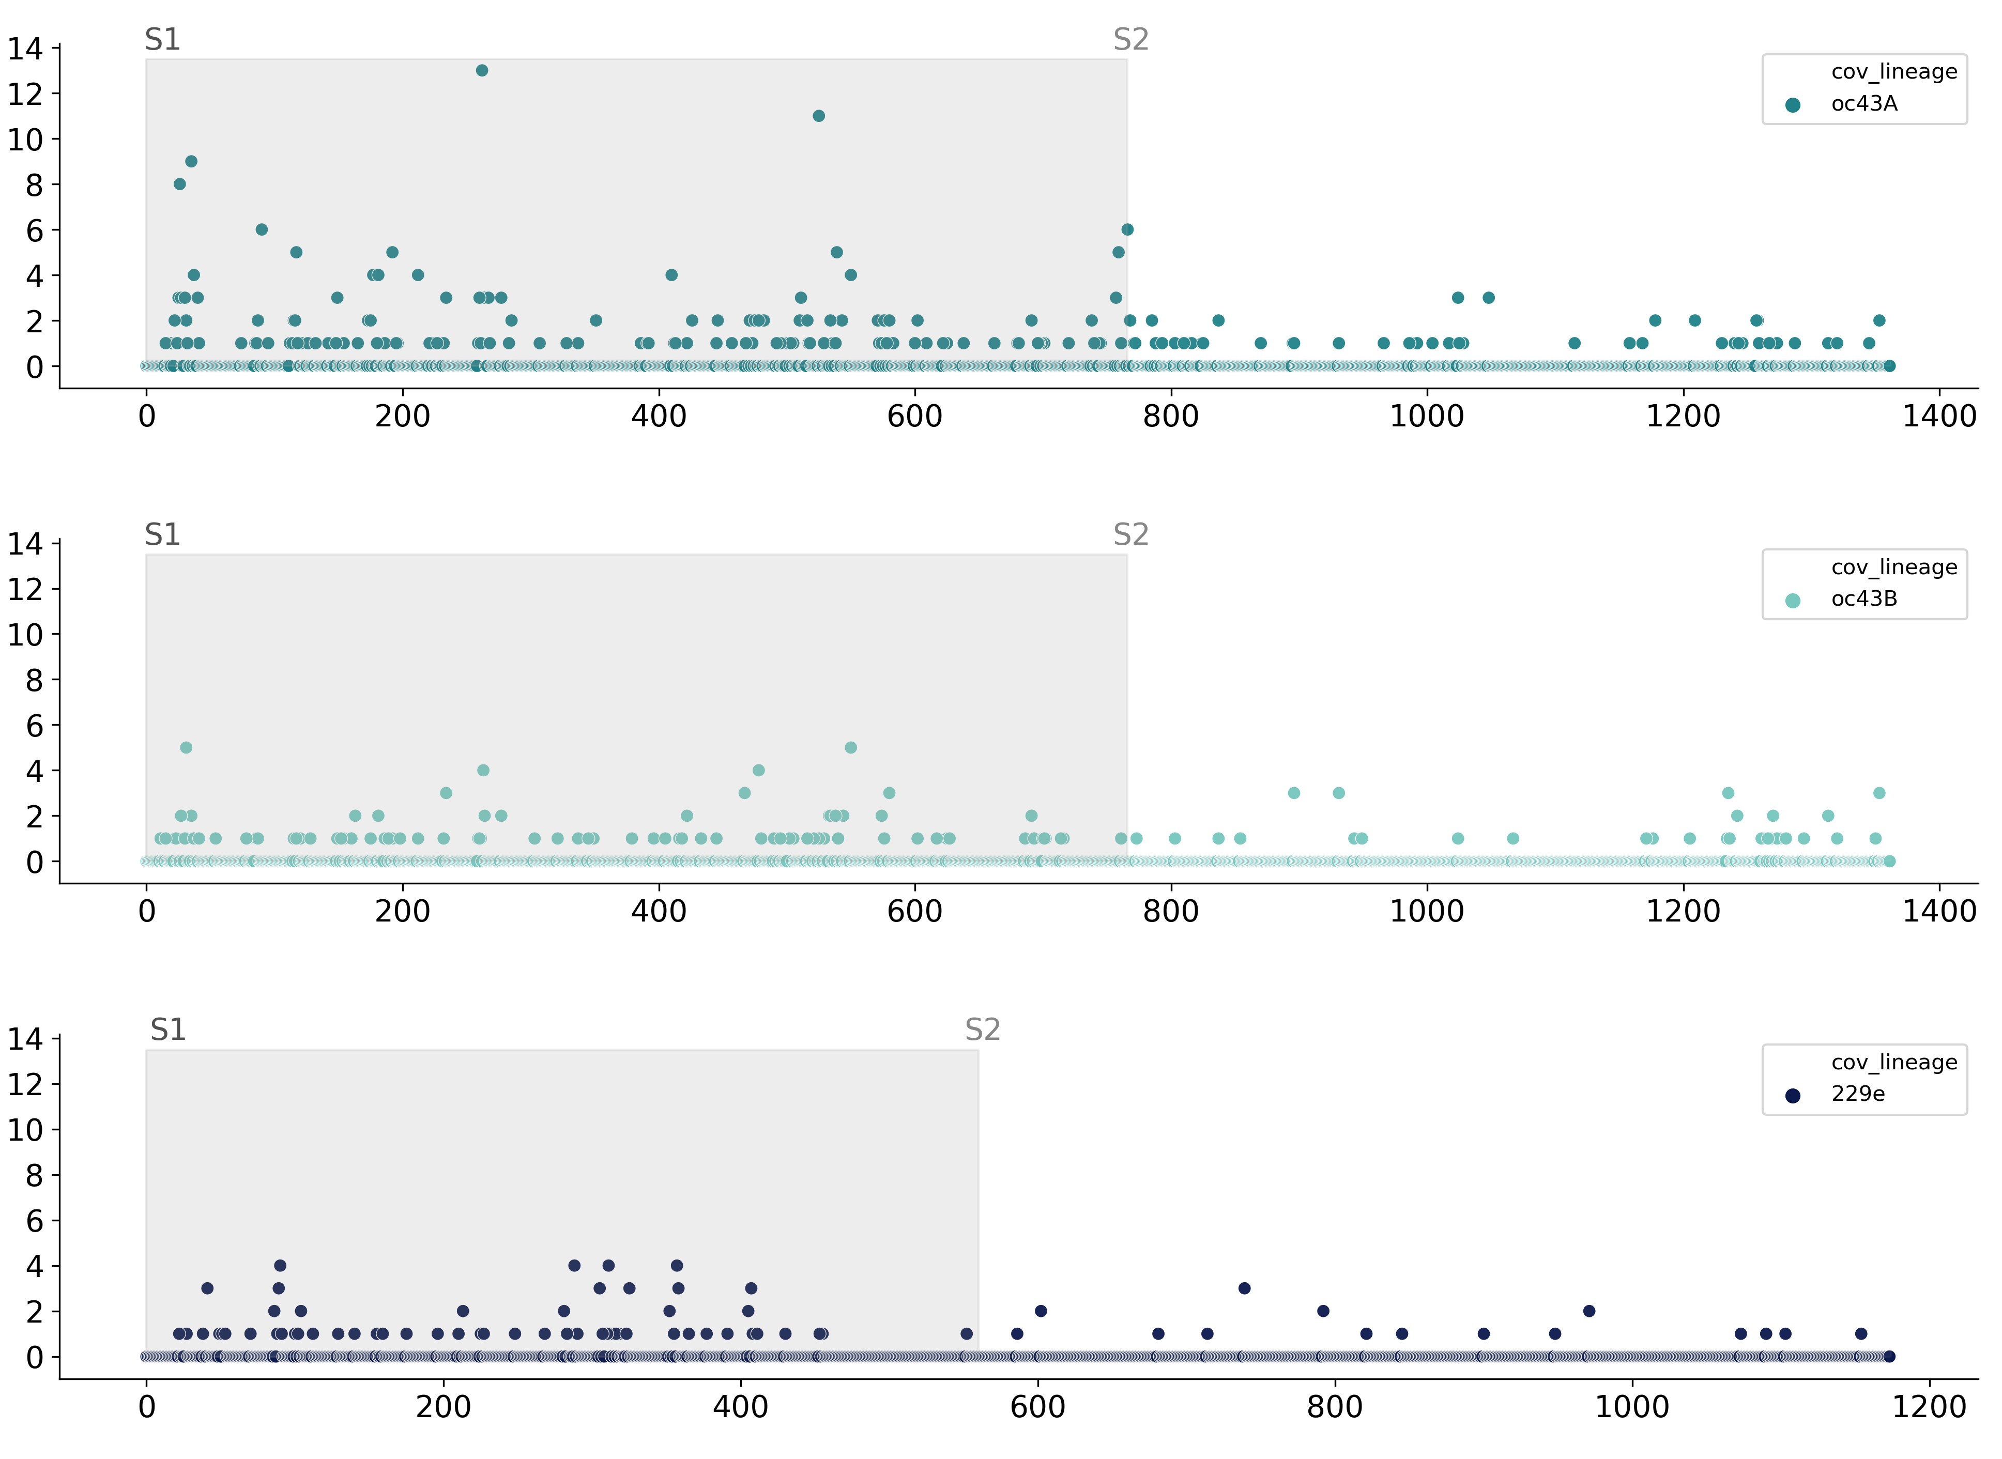
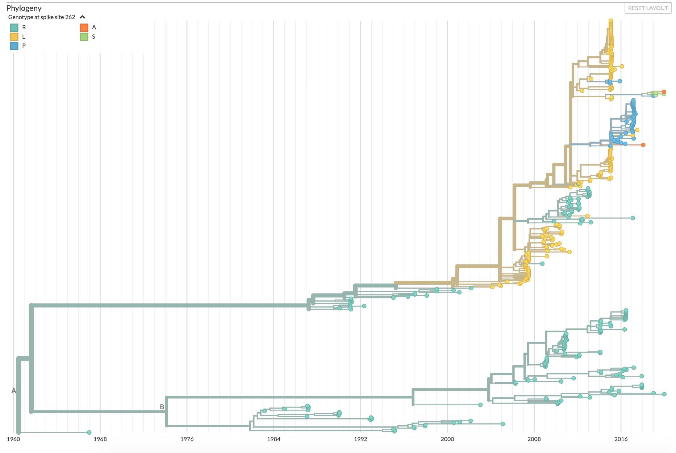
A
B
RBD
OC43 Spike 192 genotype
L
M
S
Y
*
OC43 lineage A
*
Lineage A
RBD
OC43 lineage B
Lineage B
Amino acid substitutions per site
1960 1968 1976 1984 1992 2000 2008 2016
C
OC43 Spike 262 genotype
R
L
P
A
S
RBD
229E
Lineage A
Lineage B
Spike amino acid position

