Slide 1
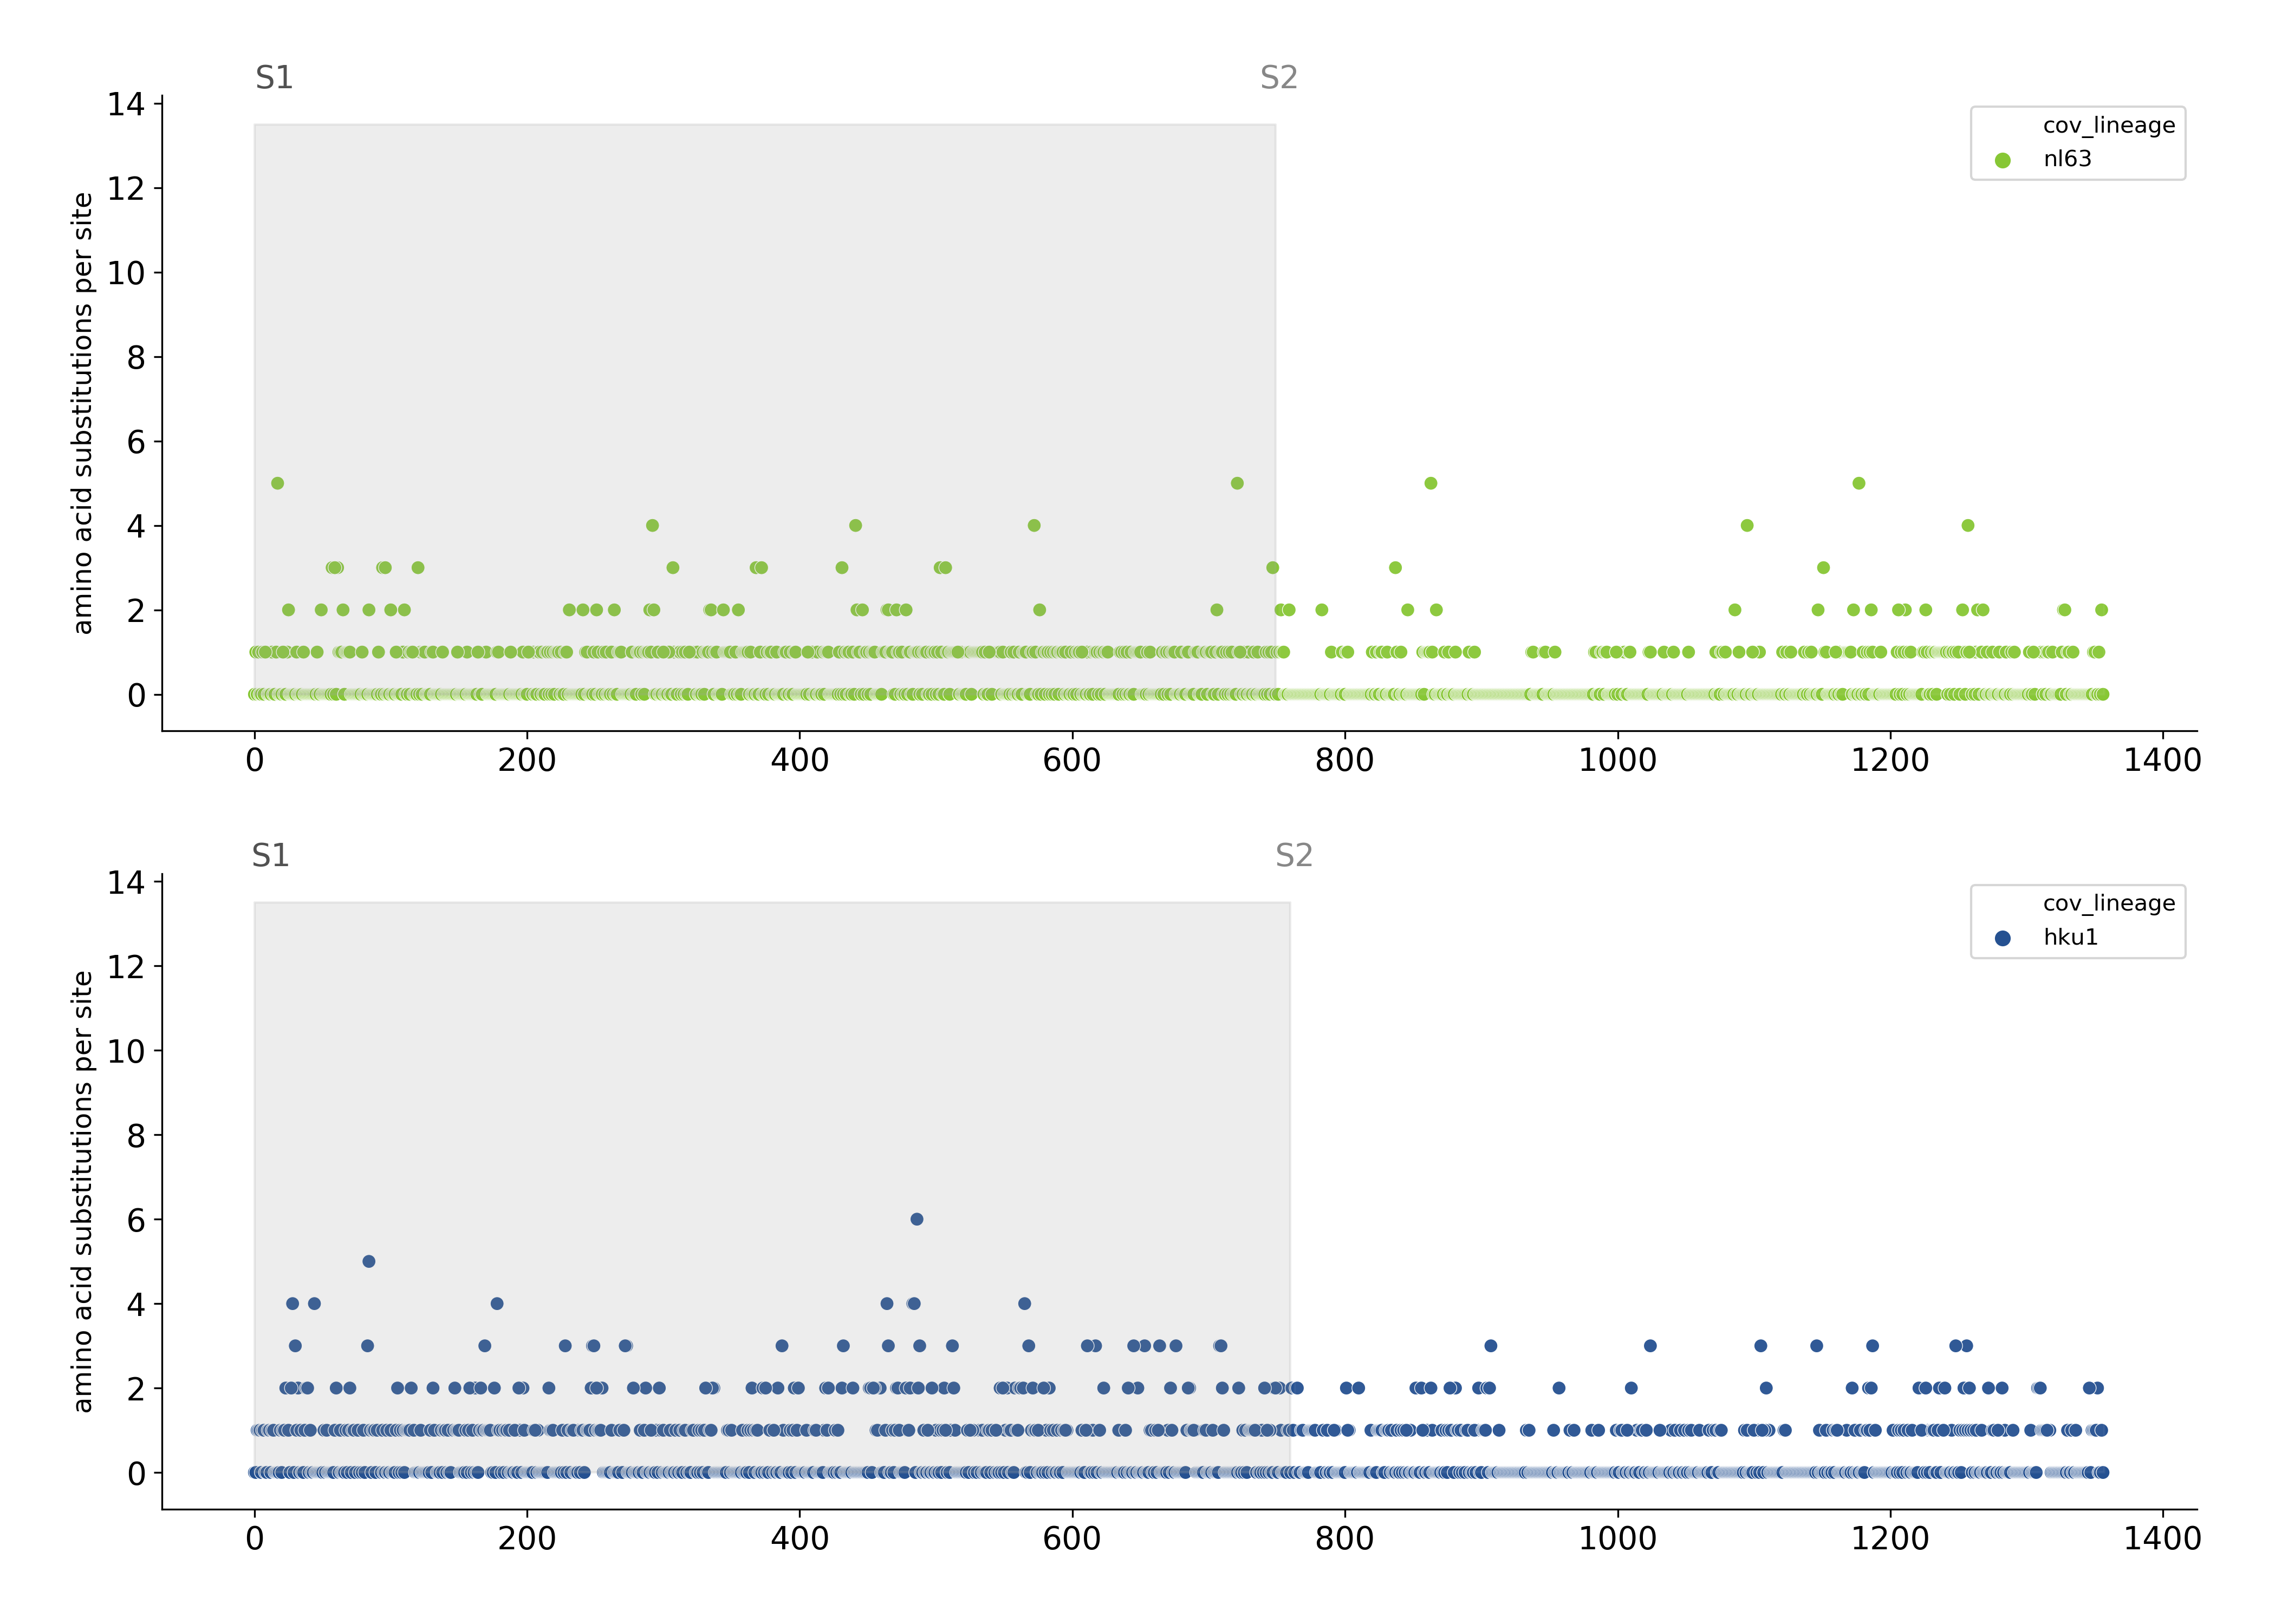
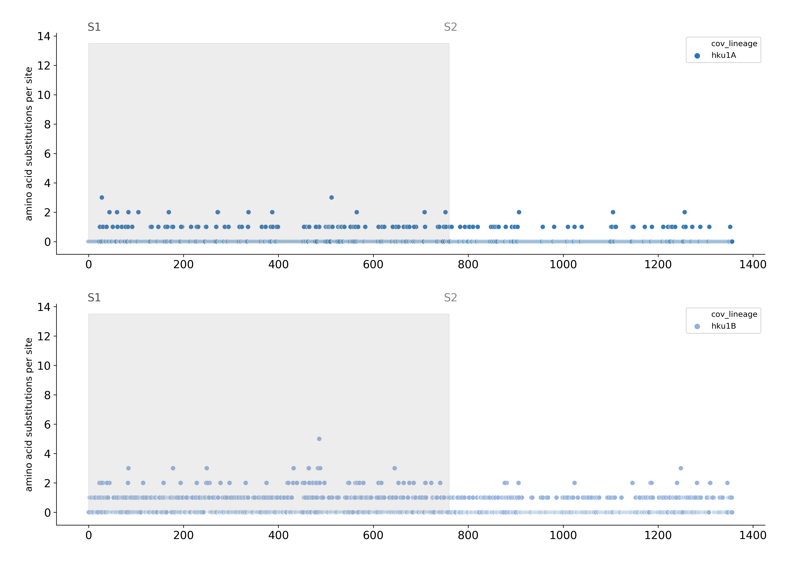
A
NL63
B
HKU1
C
HKU1 lineage A
D
HKU1 lineage B
Spike amino acid position

