Slide 1
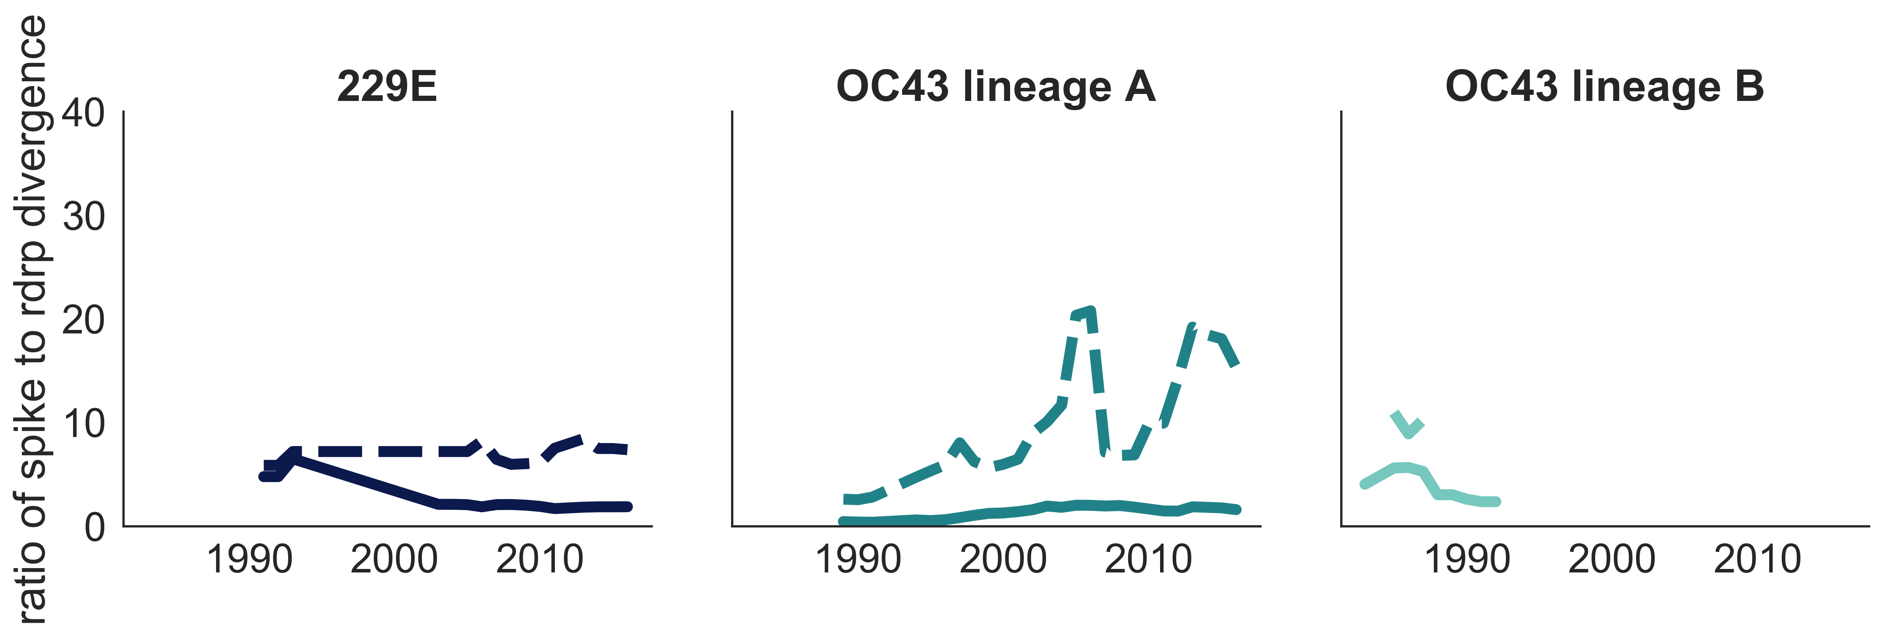

A
B
synonymous non-synonymous

