Slide 1
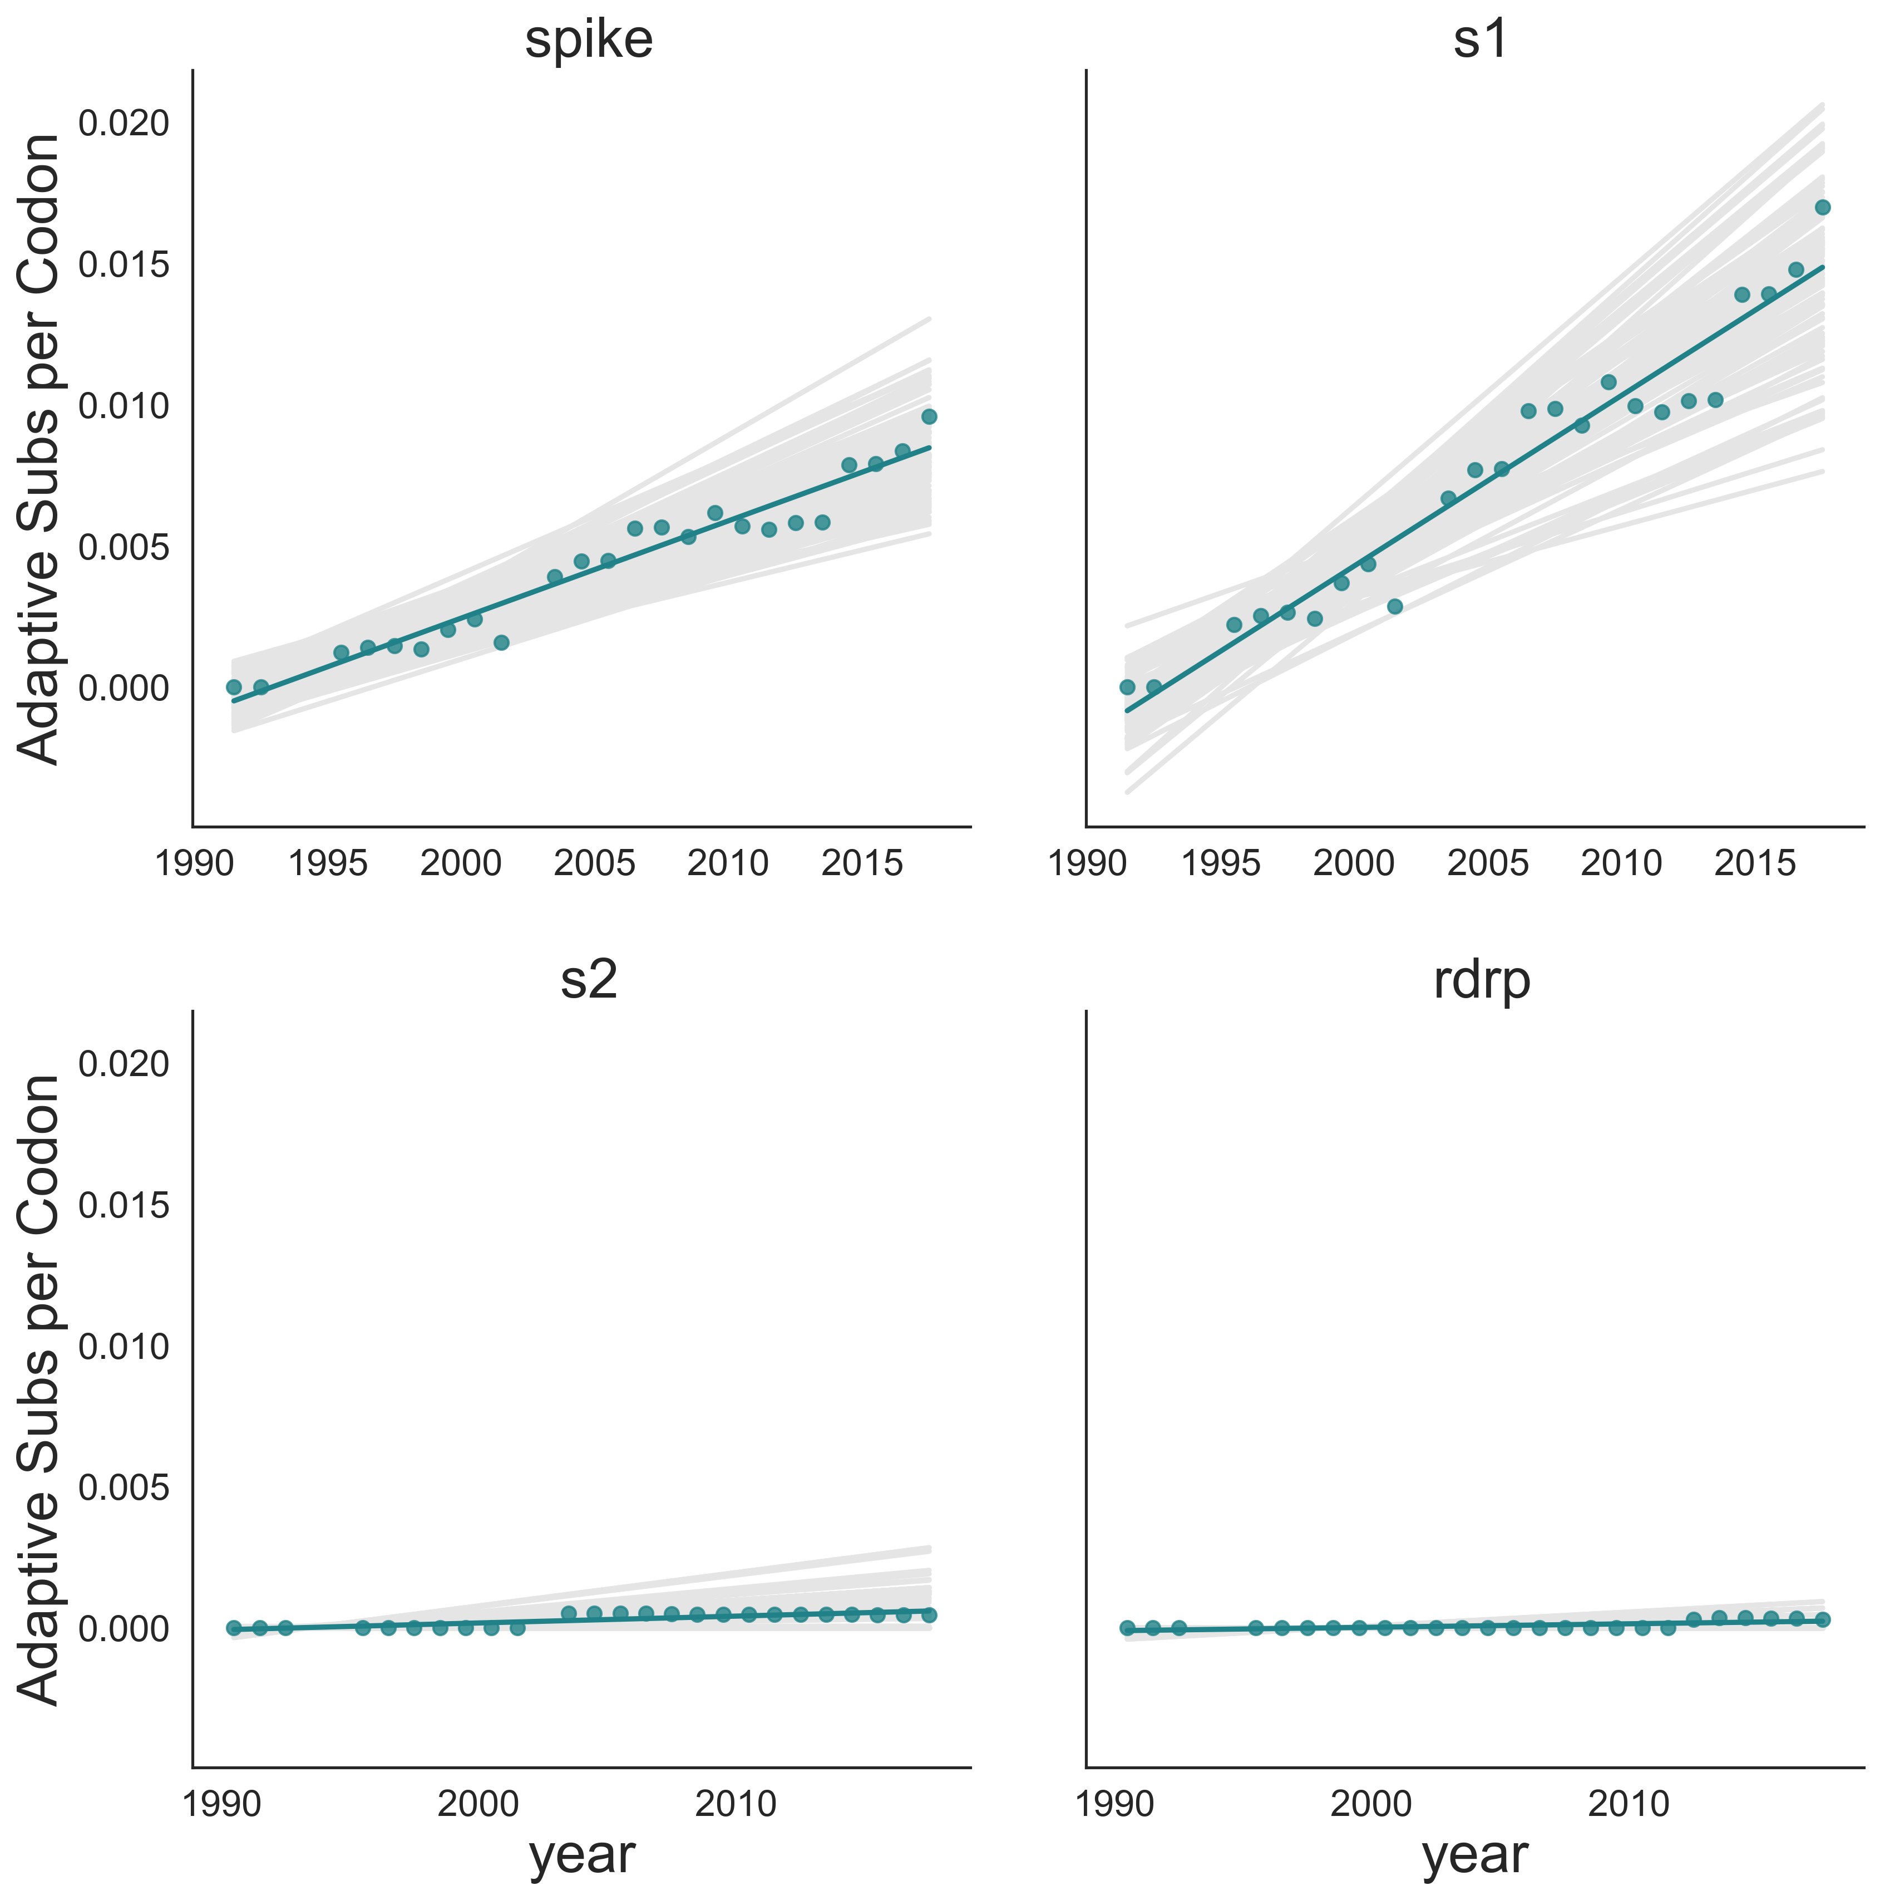
Spike
S1
Adaptive Substitutions per Codon
S2
RdRp

