Slide 1
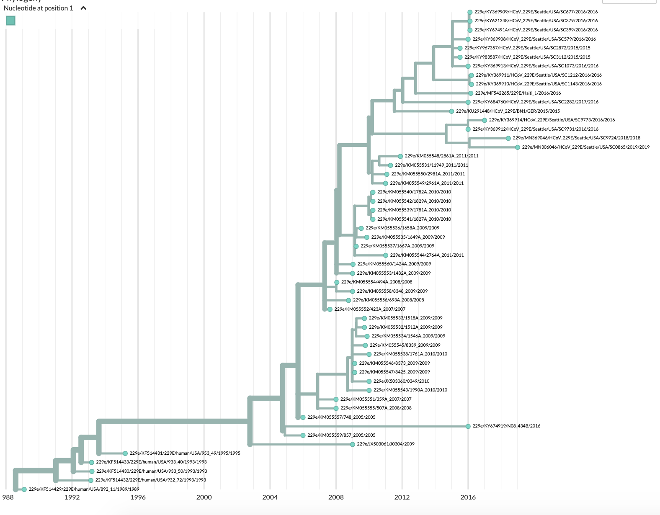
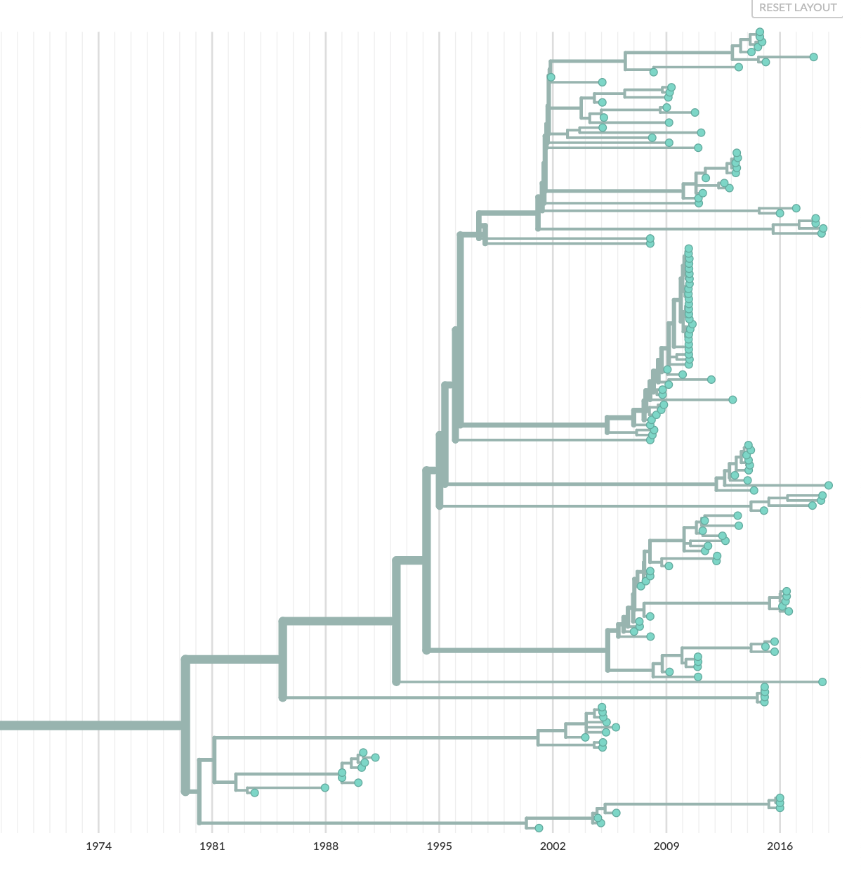
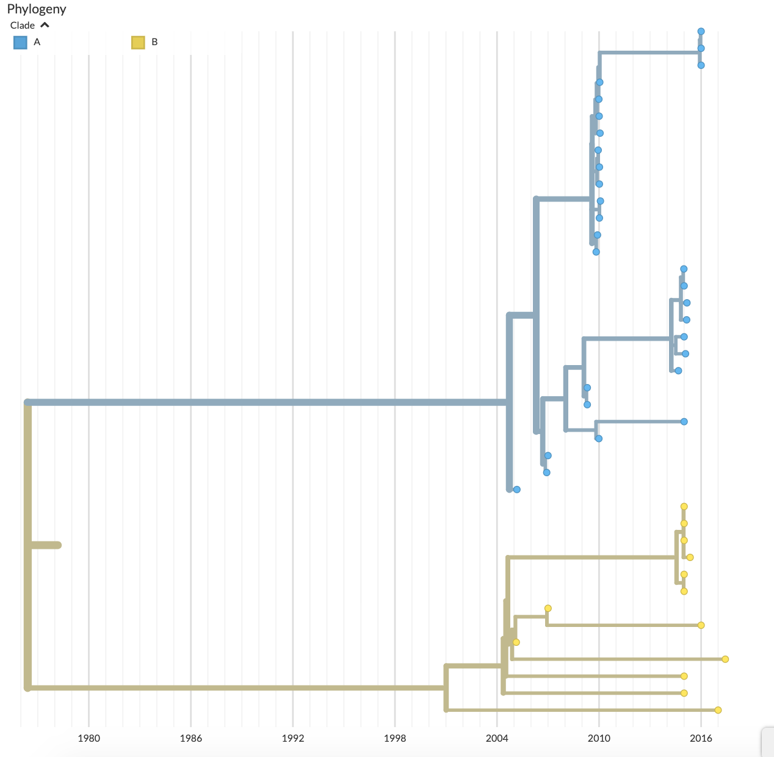
A
B
NL63
HKU1
1974 1981 1988 1995 2002 2009 2016
1980 1986 1992 1998 2004 2010 2016

