Slide 1
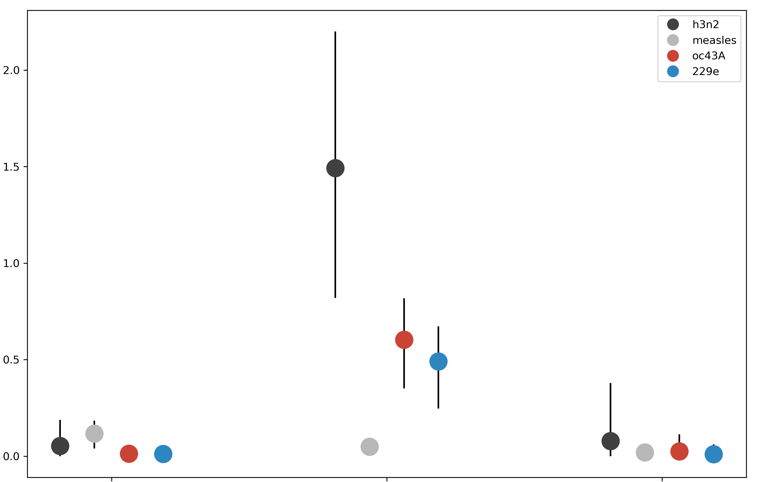
H3N2
measles
OC43A
229E
2.0
1.5
Adaptive Subs per Codon per Year (x 10⁻³)
1.0
0.5
0.0
polymerase
receptor-binding
protein domain
membrane-fusion
protein domain

