Slide 1
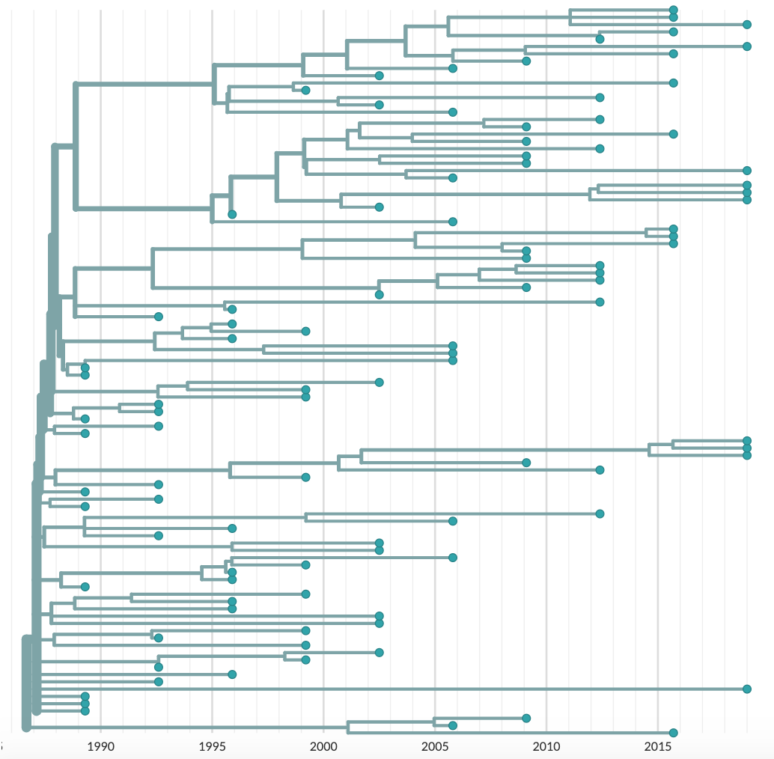
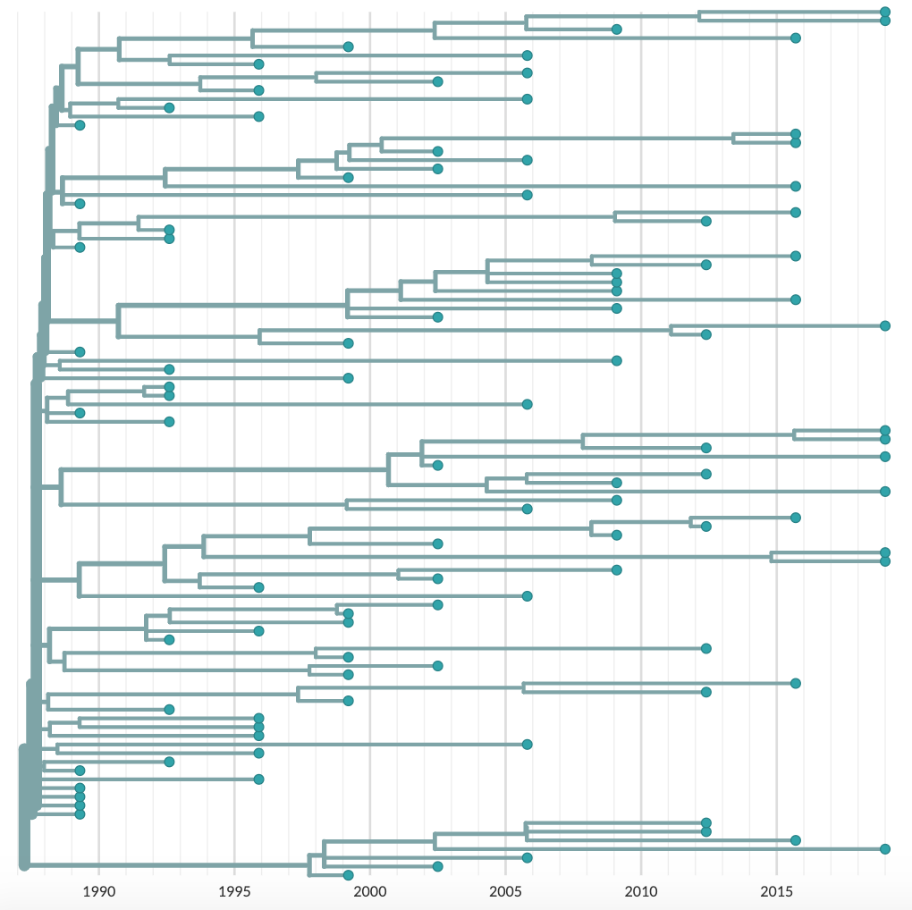
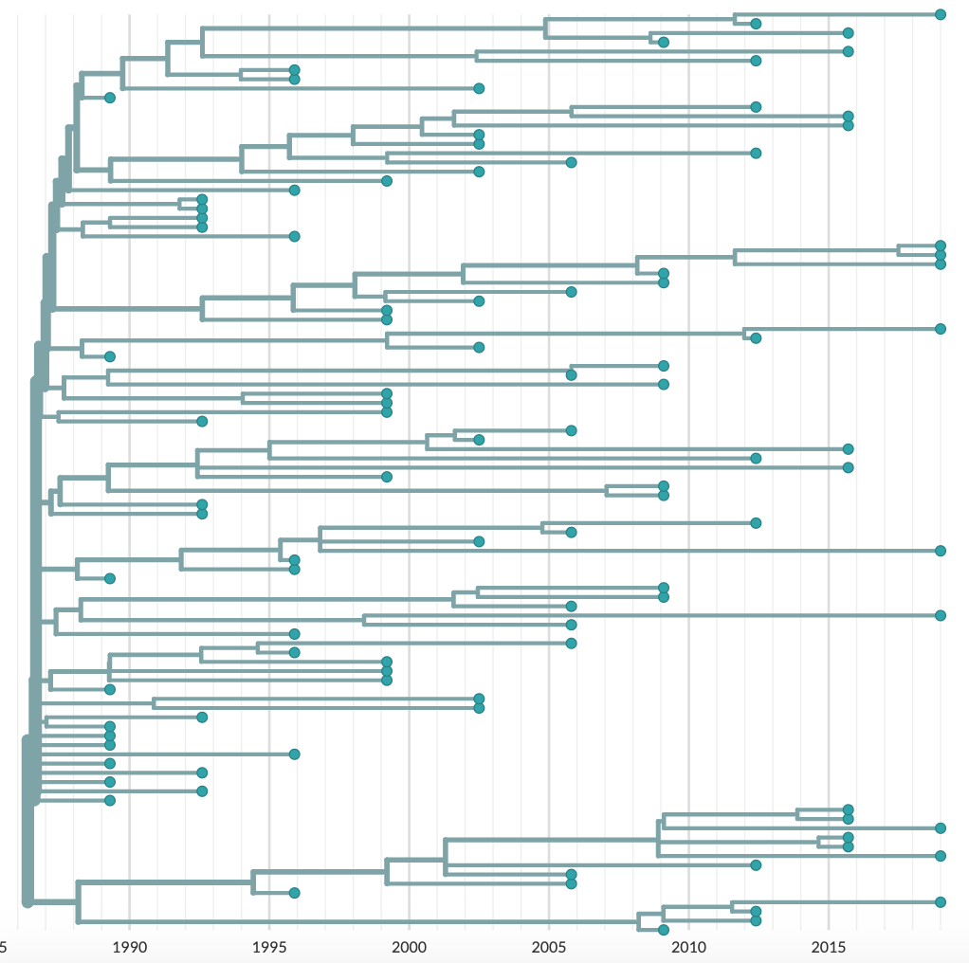
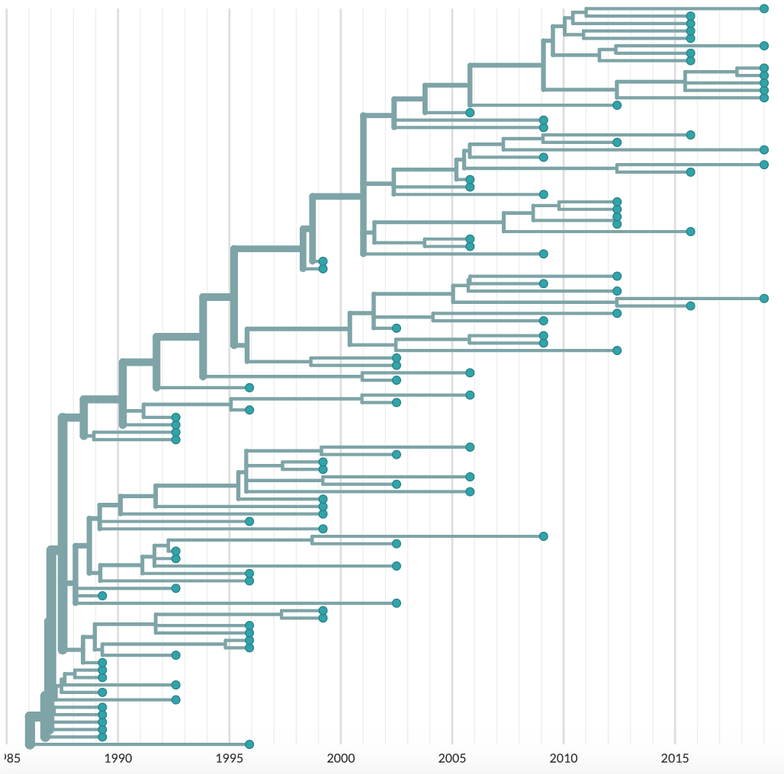
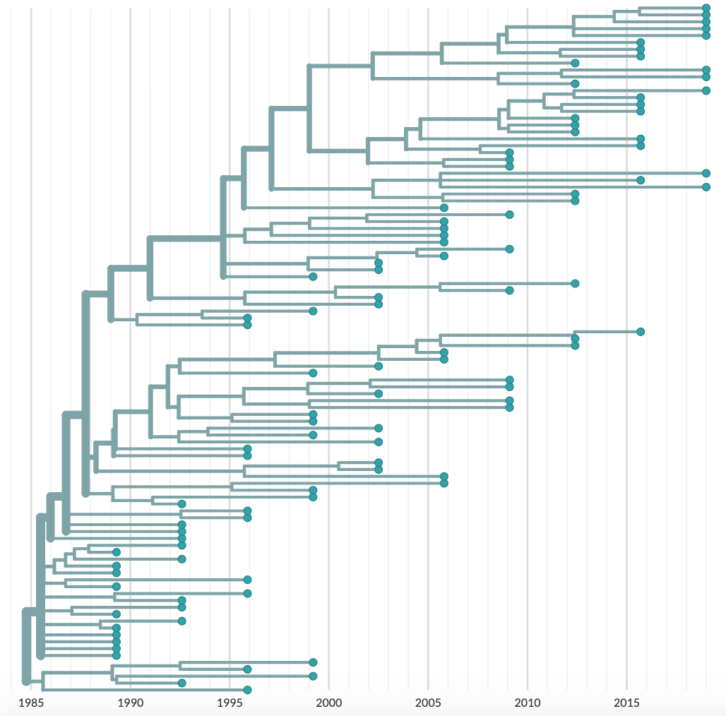
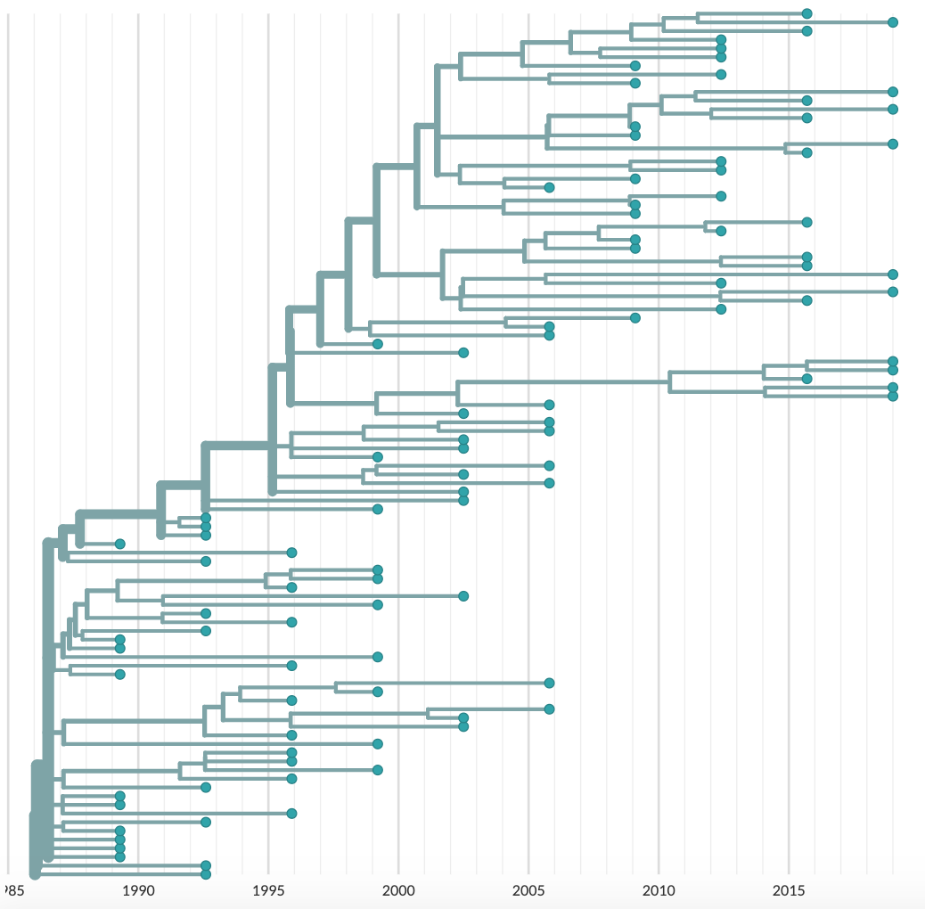
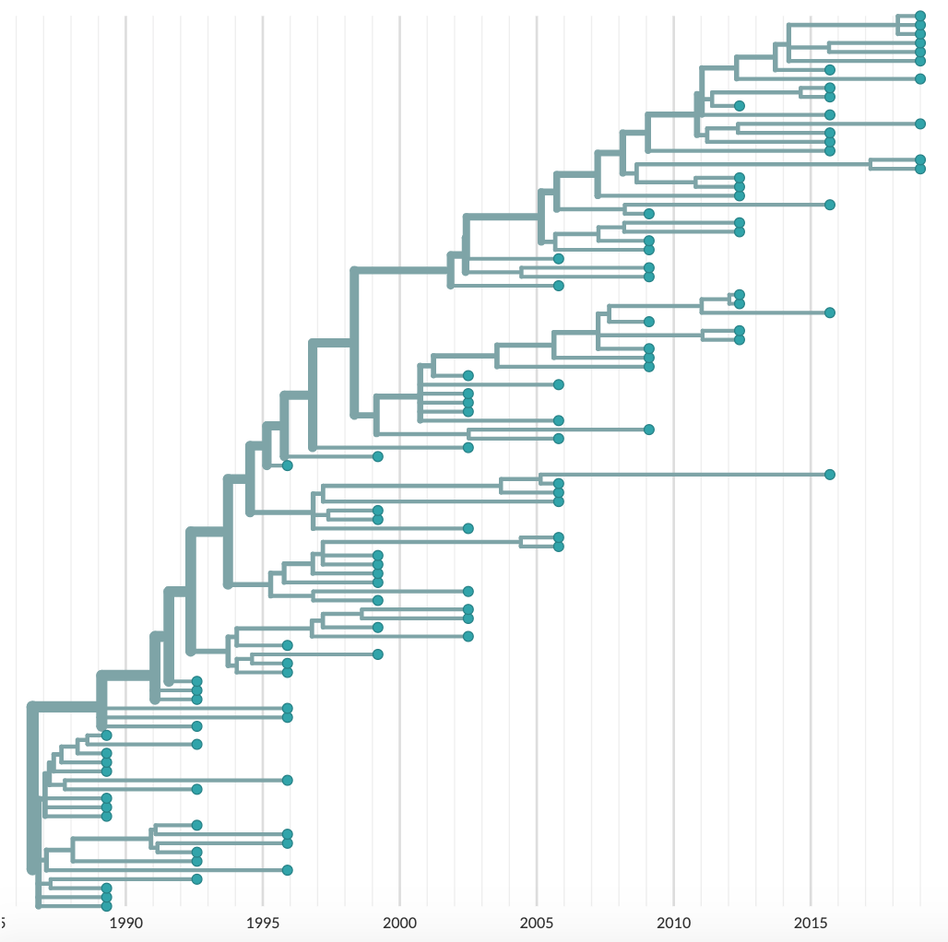
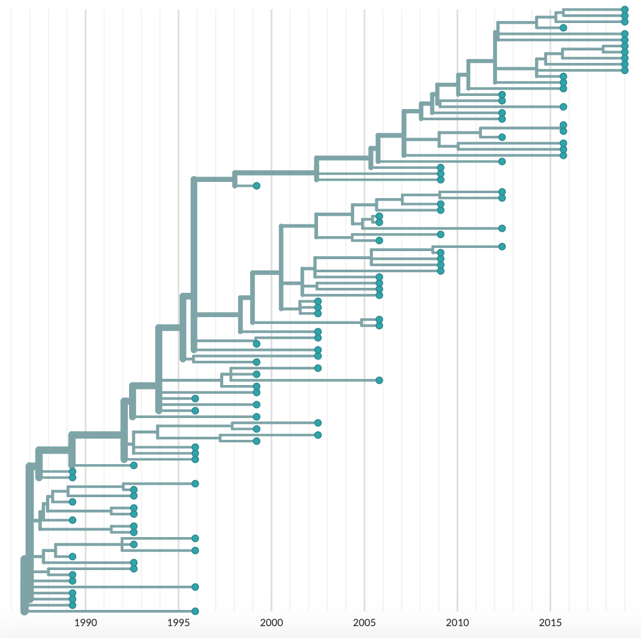
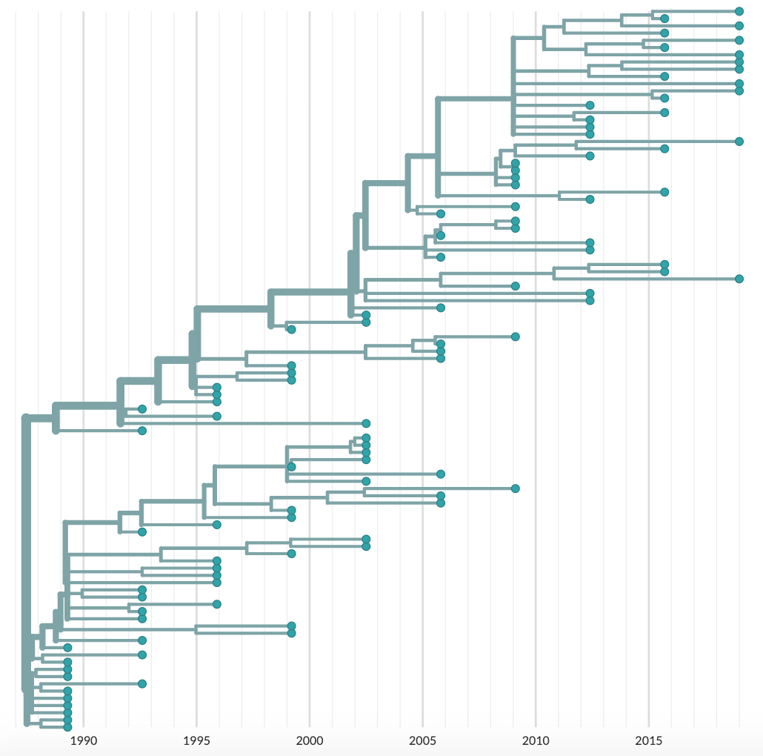
No Recombination
Moderate Recombination
High Recombination
No Positive Selection
1990 1995 2000 2005 2010 2015
1990 1995 2000 2005 2010 2015
1990 1995 2000 2005 2010 2015
Moderate Positive Selection
1990 1995 2000 2005 2010 2015
1990 1995 2000 2005 2010 2015
1990 1995 2000 2005 2010 2015
High Positive Selection
1990 1995 2000 2005 2010 2015
1990 1995 2000 2005 2010 2015
1990 1995 2000 2005 2010 2015

