Slide 1
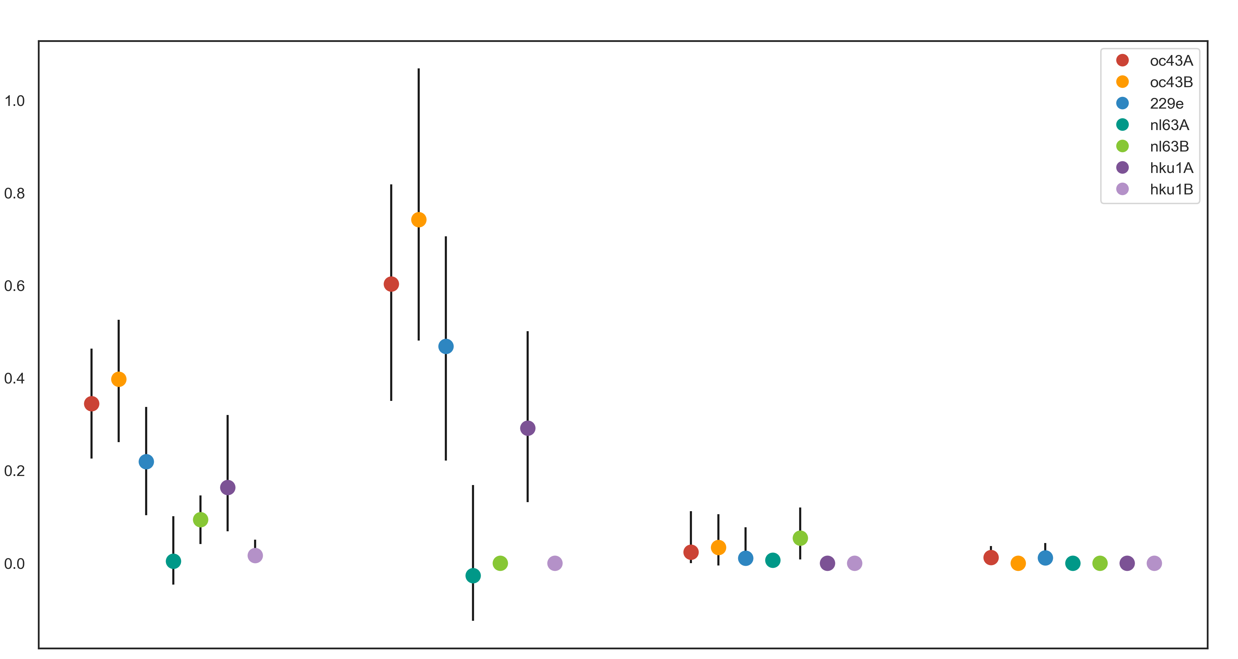
OC43A
OC43B
229E
NL63A
NL63B
HKU1A
HKU1B
1.0
0.8
0.6
Adaptive Subs per Codon per Year (x10⁻³)
0.4
0.2
0.0
Spike
S1
S2
RdRp

