Slide 1
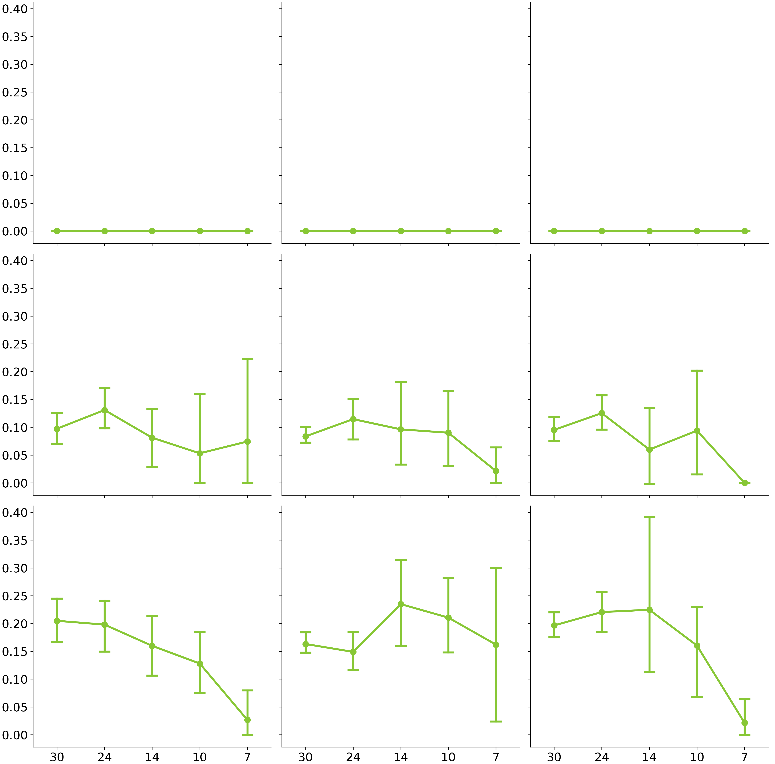
No Recombination
Moderate Recombination
High Recombination
No Positive Selection
Adaptive Subs per Codon per Year (x 10⁻³)
Moderate Positive Selection
High Positive Selection
Years of longitudinal samples included

