Slide 1
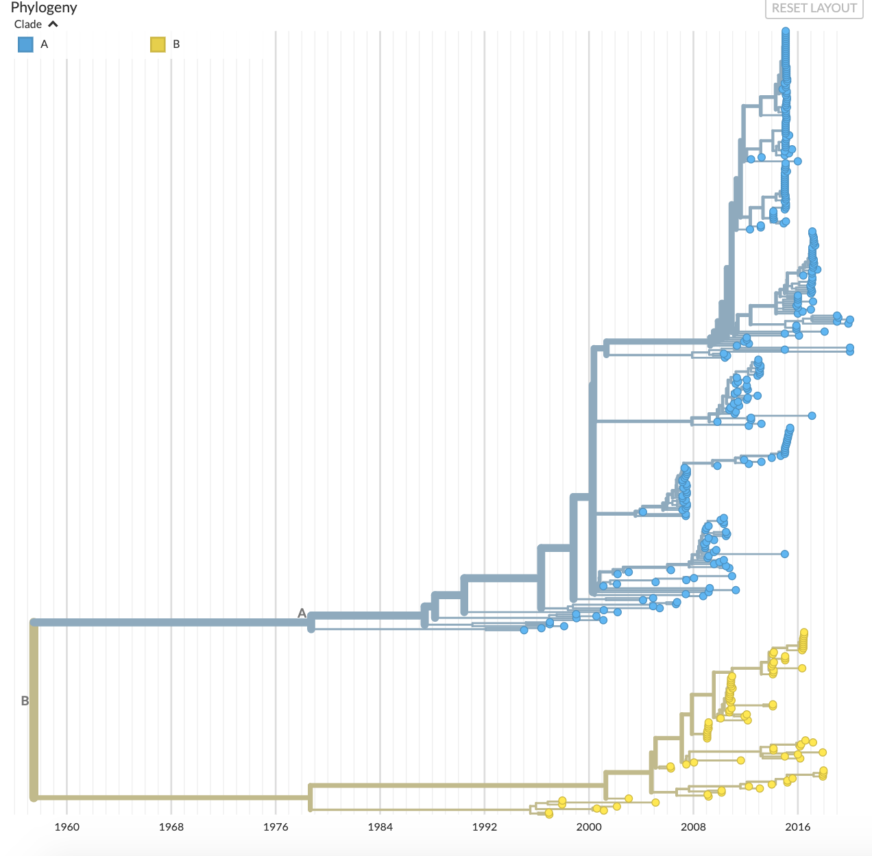
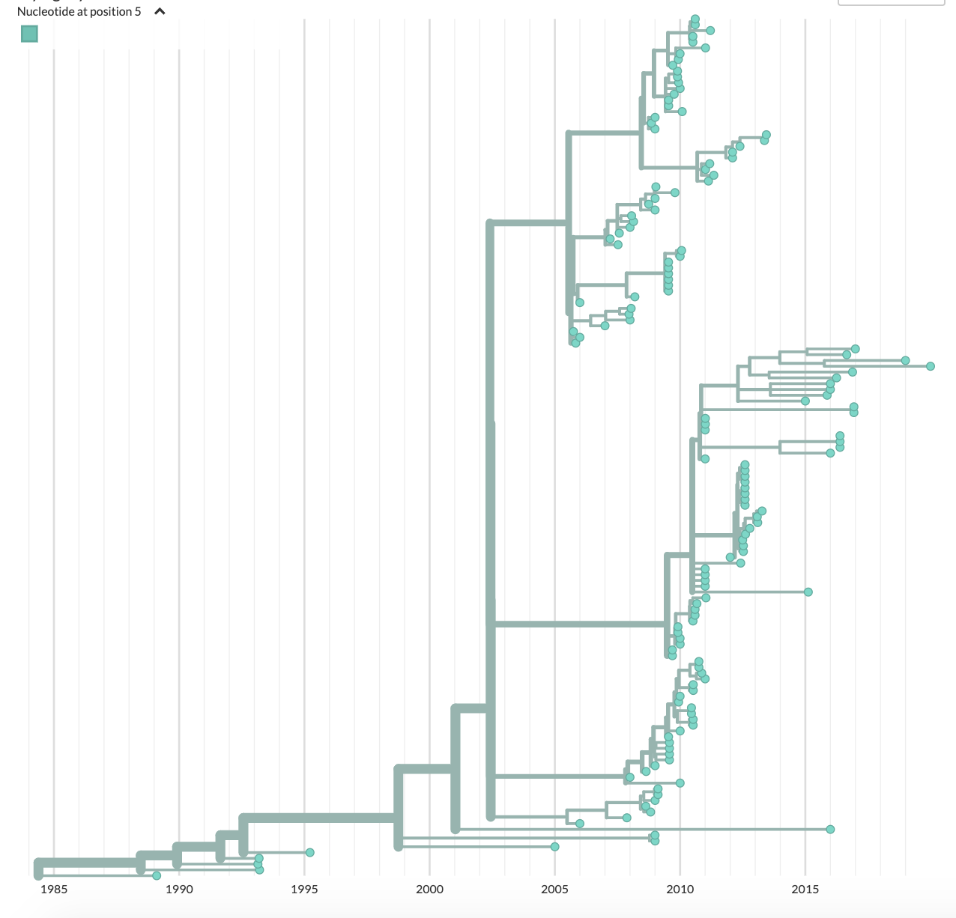
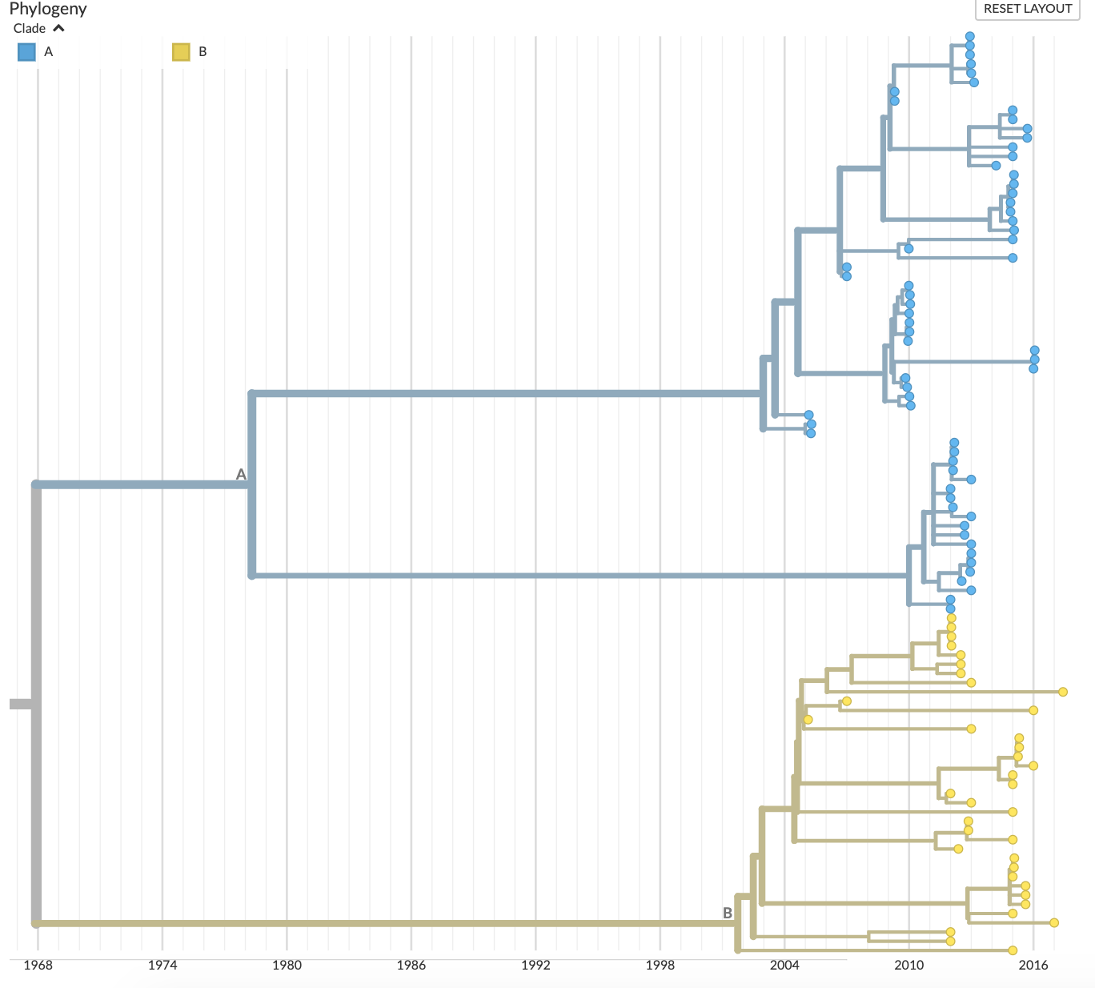
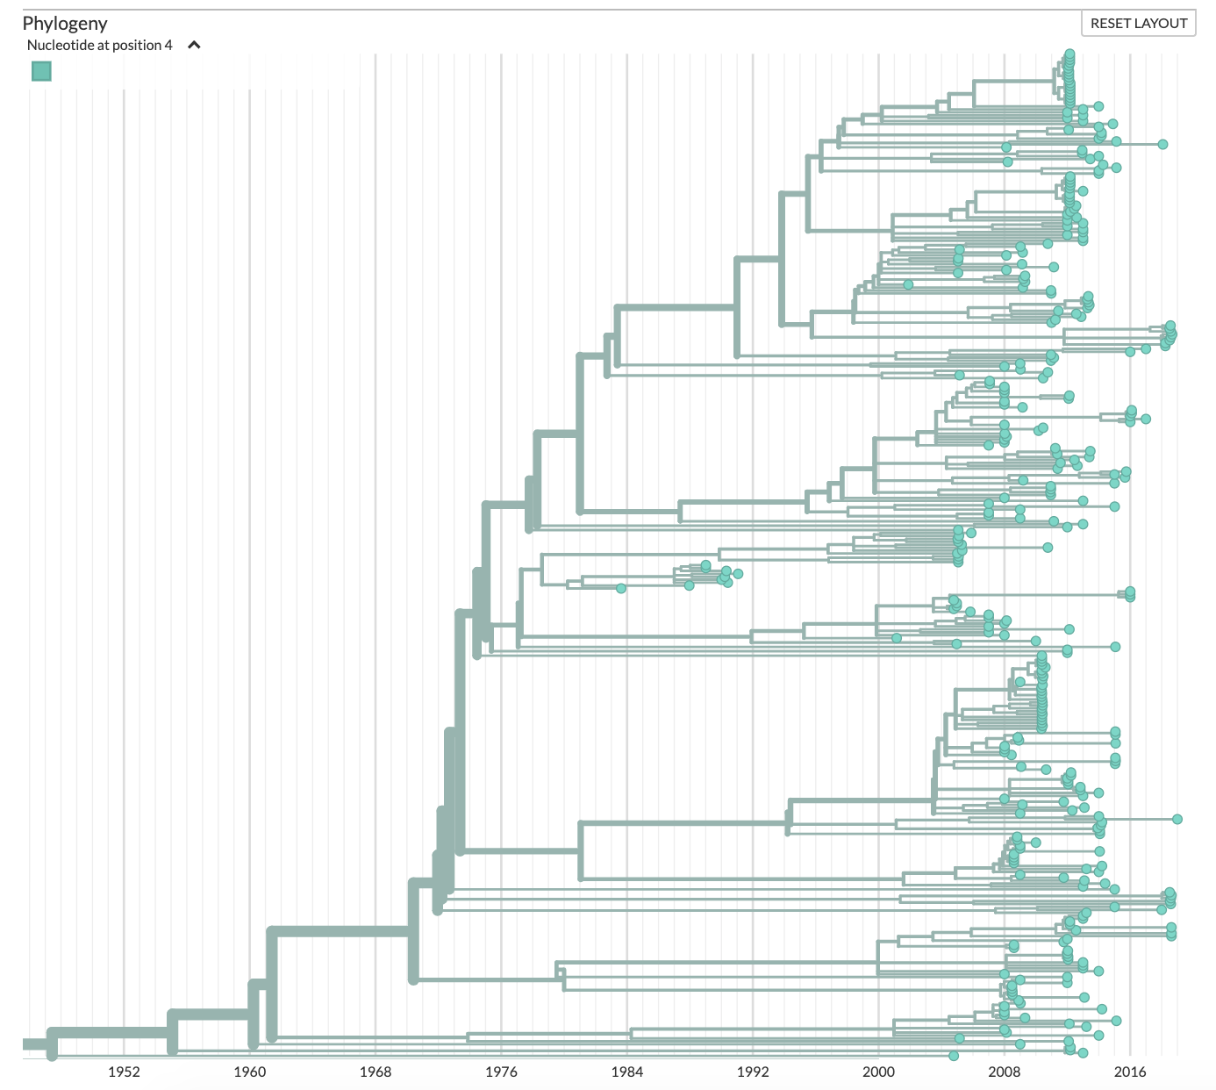
A
OC43
B
229E
1960 1968 1976 1984 1992 2000 2008 2016
1985 1990 1995 2000 2005 2010 2015
C
D
HKU1
NL63
1968 1974 1980 1986 1992 1998 2004 2010 2016
1952 1960 1968 1976 1984 1992 2000 2008 2016

