Slide 1
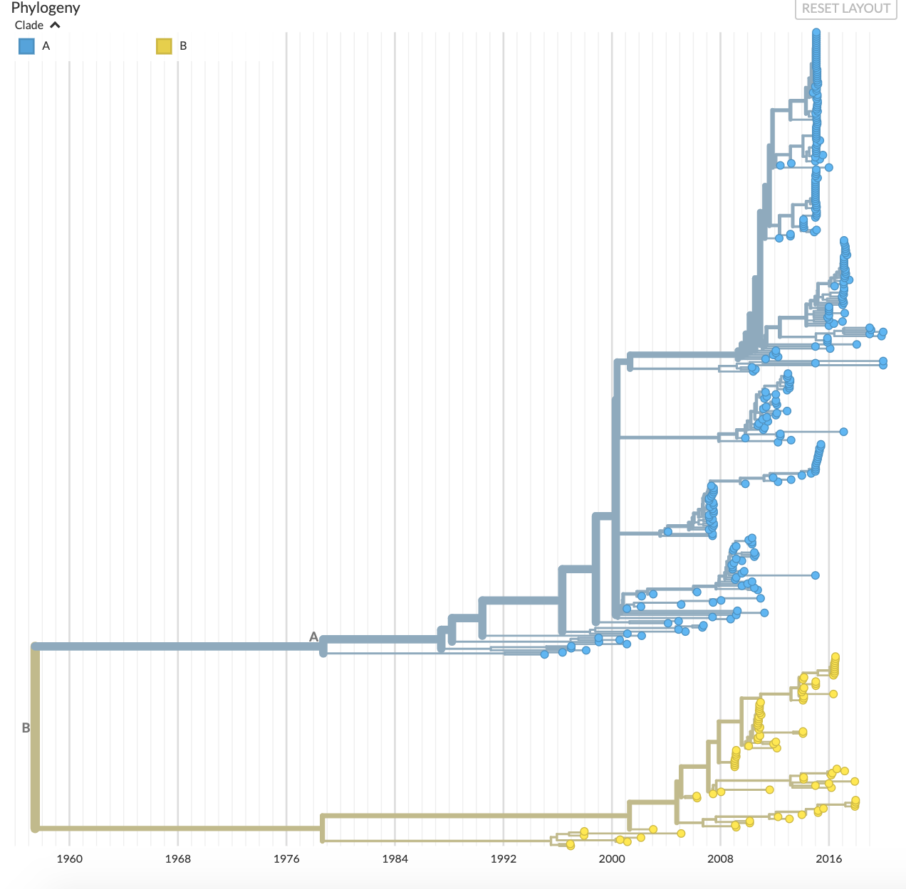
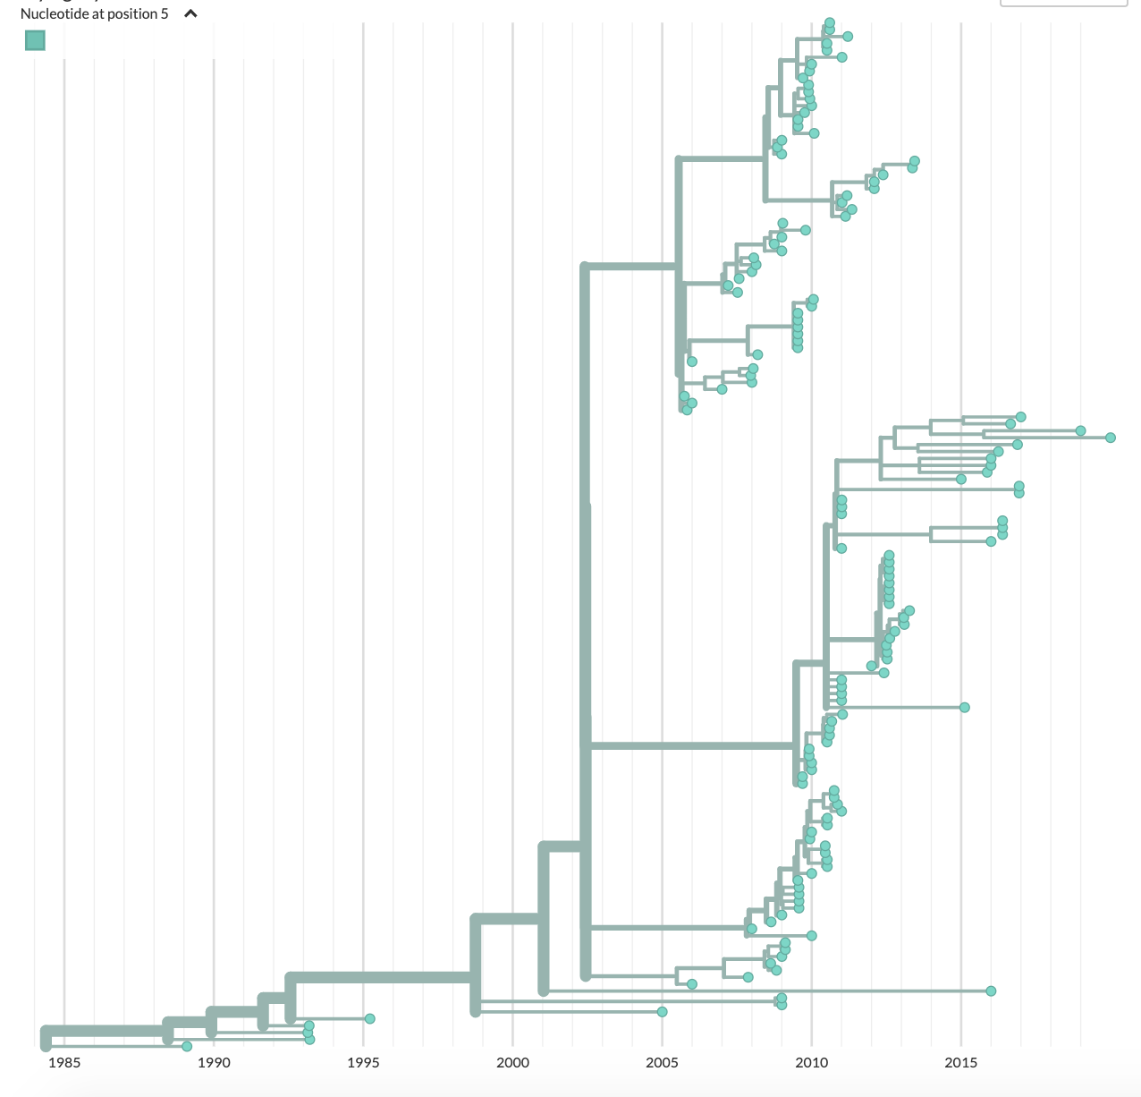
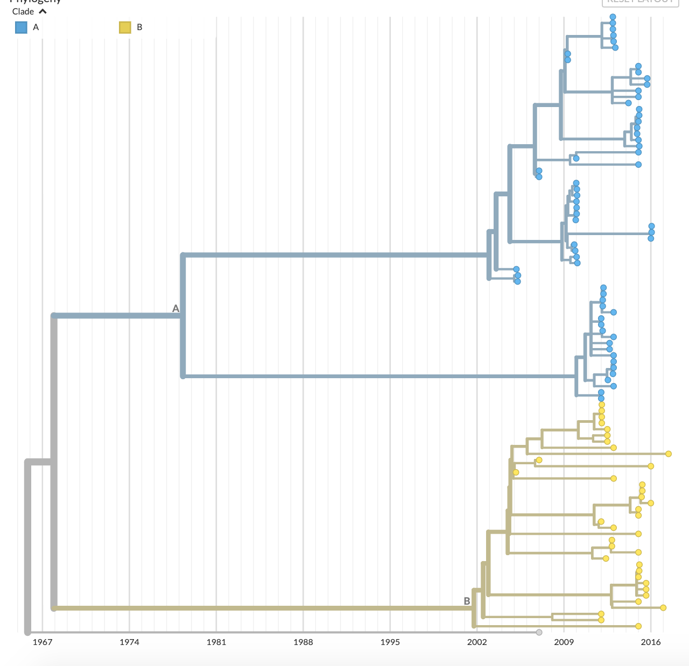
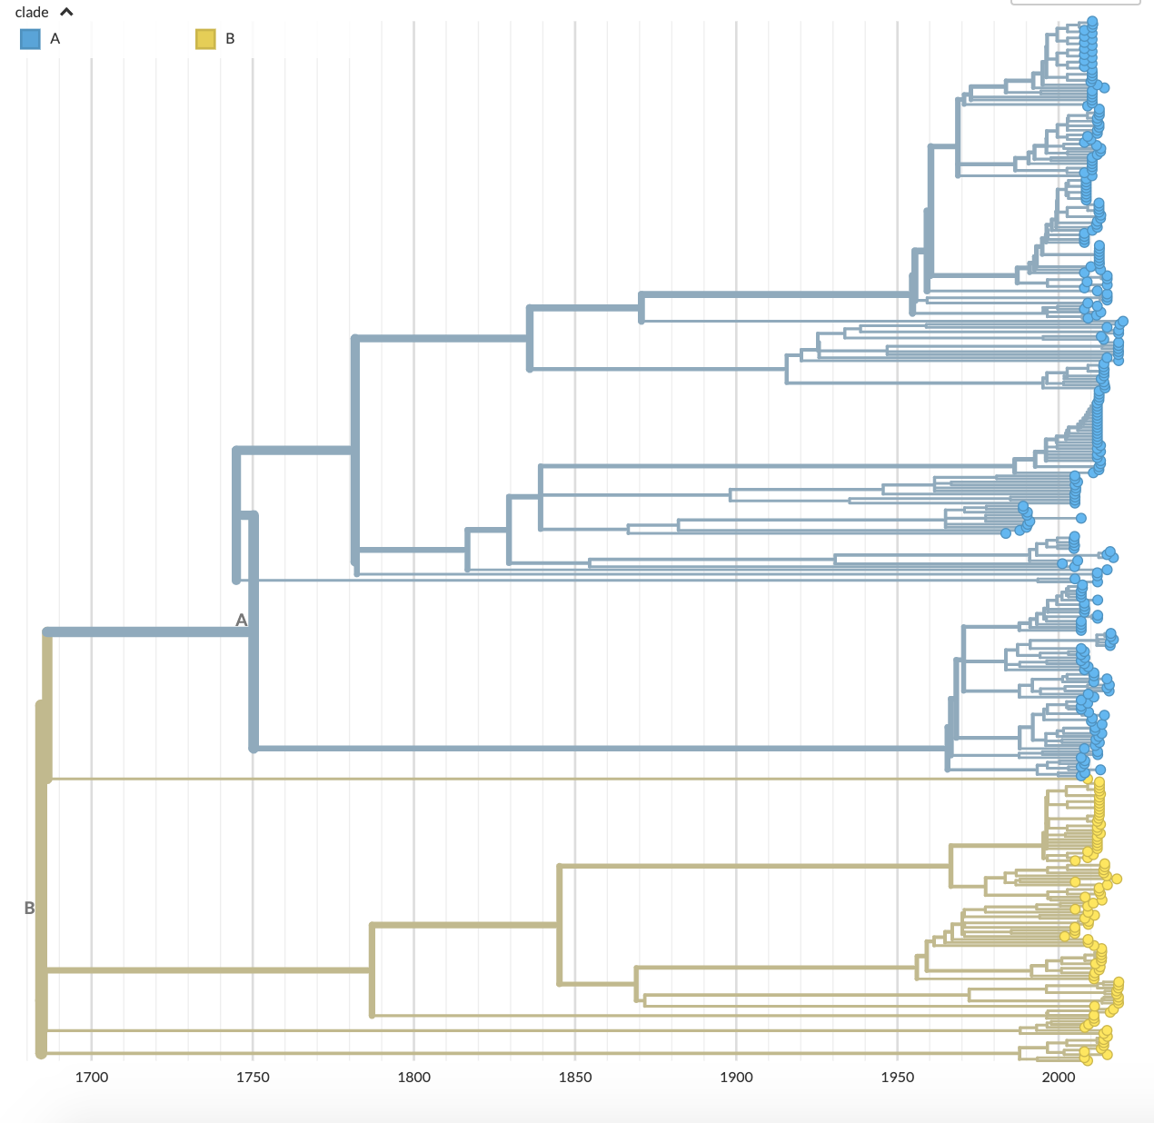
A
OC43
B
229E
1960 1968 1976 1984 1992 2000 2008 2016
1985 1990 1995 2000 2005 2010 2015
C
D
HKU1
NL63
1967 1974 1981 1988 1995 2002 2009 2016
1700 1750 1800 1850 1900 1950 2000

