Slide 1
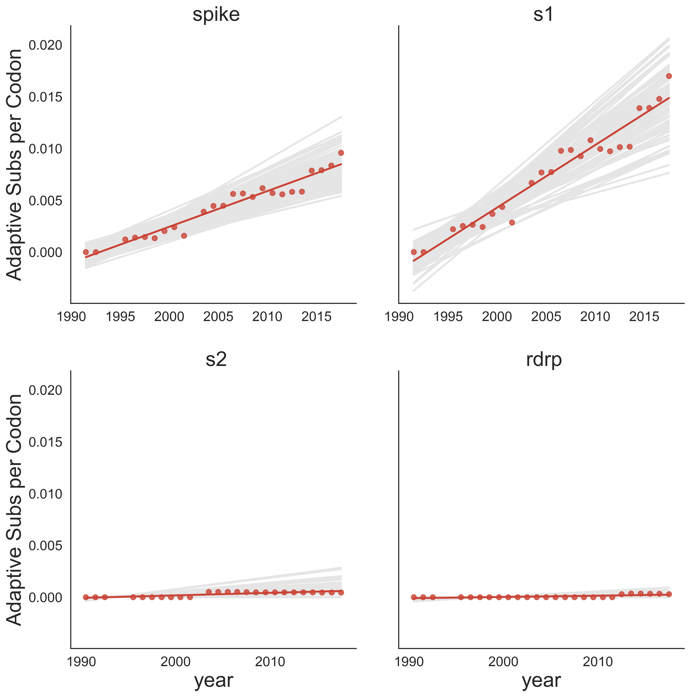
Spike
S1
S2
RdRp

