Slide 1
Business Analytics in R
Homework -2 Group Part
Group members
Anshu Mehta
Shrawani Tare
Justin Varghese
Tenzin Jangchup
Chenxiang Ma

Slide 2




Business Challenge & Data-Driven Solution
A data-driven approach to enhance conversion rates through predictive modeling
Current Situation:
A music streaming platform using a freemium model.
The latest campaign targeted 41,540 users but only achieved a 3.7% conversion rate, resulting in 1,540 upgrades to premium.
Key Players:
The marketing team leads the campaign strategy.
Data scientists analyze user patterns.
A collaborative approach focuses on user behavior analysis.
Challenges:
Low conversion rate from free users.
Inefficient marketing spend.
Need for improved user targeting.
Goal to improve campaign effectiveness.
Solution:
Build a predictive model to identify high-potential users.
Optimize targeting strategies.
Enhance conversion rates through data-driven campaigns.

Slide 3
Model Deliverables
Model 1
Profit Maximization Model:
To improve marketing efficiency by targeting users who are more likely to subscribe.
Higher conversion rates result in better ROI since the cost per successful conversion decreases, indicating fewer resources are wasted on users unlikely to convert.
Focus on optimizing which users receive promotional materials based on on high-probability subscribers.
Model 2
Customer Segmentation:
Segment users based on their likelihood of conversion.
Tailor marketing strategies to different user types.
Enables more personalized marketing, potentially increasing conversion rates by addressing specific user needs and interests.

Slide 4
Solution Map
Data Source
Feature Selection
Model Training and evaluation
Model Exploration

Slide 5
Data Source
The dataset contains 41,540 records with 27 attributes, each representing a user who was targeted in a previous marketing campaign on the XYZ platform. Here are key observations:
Target Variable (Adopter): The adopter attribute is the outcome variable, indicating whether a user upgraded to a premium subscription within six months (1 for adopters, 0 for non-adopters). The conversion rate in this dataset is low, with only about 3.7% adopters.
User Demographics: Attributes like age, male, and good_country capture basic demographic information.
The dataset contains: 1,540 adopters (users who upgraded to premium) 40,000 non-adopters (users who did not upgrade) ​ This makes the dataset highly skewed towards the non adopters(97%).

Slide 6
Feature Selection
Data Source Features:
The dataset can be divided into 6 categories.
1.Demographics
2.Social Connections
3.Platform Engagement
4.Tenure and Activity
5.Activity Changes
6.Target Variable
Automatic Feature Selection :
We have focused on these features for decision making:
1.delta_songsListened
2.lovedTracks
3.age
4.good_country
5.subscriber_friend_cnt
6.avg_friend_age
7.shouts
Data Source
Data Source

Slide 7
Model Training and evaluation
Our model is built on a decision tree framework, utilizing the rpart algorithm.
Performance Metrics:
Performance was evaluated using ROC curve and AUC (Area Under the Curve) metrics, with a high AUC score indicating the model’s strong ability to distinguish between adopters and non-adopters. This reliability enables confident identification of likely adopters.
Data Balancing:
To address the imbalance between adopters and non-adopters in the dataset, we used a hybrid sampling technique with the ROSE package. This approach (combining over-sampling and under-sampling) ensures a balanced representation, enhancing the model’s accuracy by preventing bias toward the non-adopter class.
Model Training:
We applied 10-fold cross-validation with the caret package, ensuring the model performs robustly across different data subsets. This step enhances the model’s ability to generalize, avoiding overfitting and maintaining predictive reliability.
We implemented and fine-tuned three classification techniques—KNN, decision tree, and Naive Bayes—to determine the best model for predicting potential adopters. After extensive tuning and testing, the decision tree model stood out, achieving a notably higher AUC score compared to the other models, making it the top choice for accurate prediction in our analysis.

Slide 8
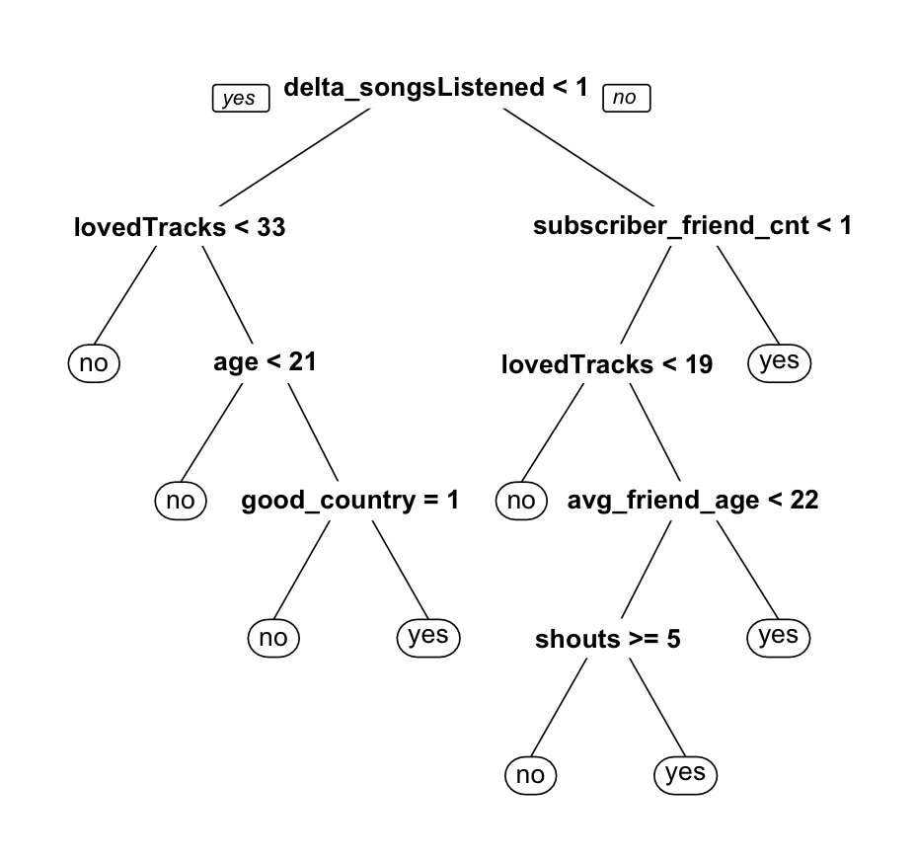
Decision Tree

Slide 9
MODEL EXPLORATION
MODEL 1: To maximize profit
In the previous market campaign data,The company targeted - 41,540 users out of which 1,540 user became a subscriber within the 6 month period after the marketing campaign.Hence, the Base Adoption Rate was 3.71%.
To evaluate the model we made the assumptions regarding the type of marketing campaign and the costs associated.

Slide 10
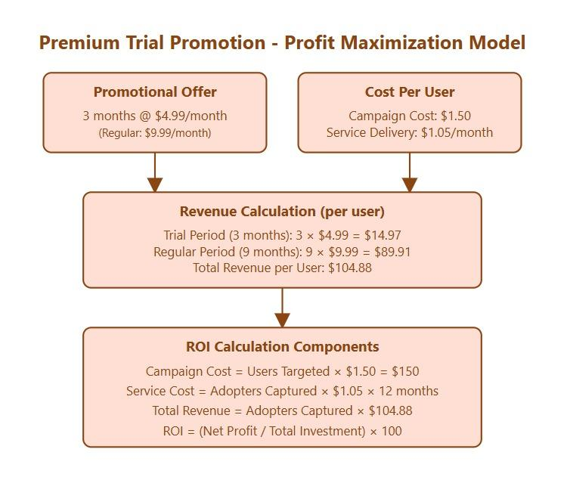
DETAILED MARKETING ANALYSIS
Targeting Level | Users Targeted | Adopters Captured by Model | % of Total Adopters | Total Costs | ROI | Net Profit
20% | 8,308 | 693 | 45% | 21,194 | 243% | 51,488
40% | 16,616 | 1,232 | 80% | 40,447 | 219% | 88,765
60% | 24,924 | 1,386 | 90% | 54,850 | 165% | 90,514
80% | 33,232 | 1,463 | 95% | 68,282 | 125% | 85,158
100% | 41,540 | 1,540 | 100% | 81,714 | 98% | 79,801

Slide 11
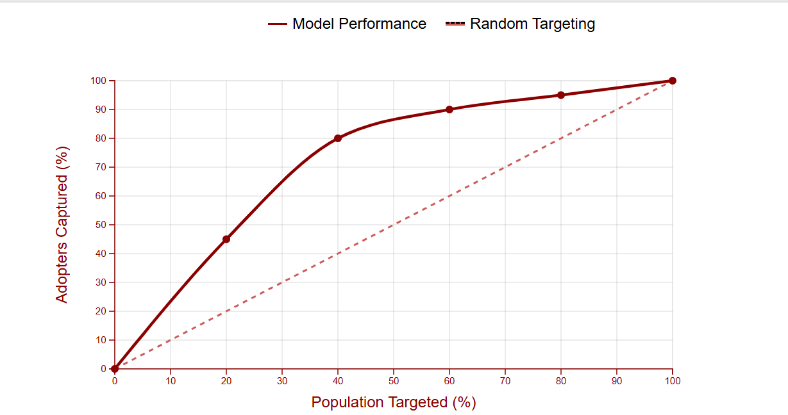
CUMULATIVE RESPONSE CURVE
100%, 100%
80%, 95%
60% , 90%
40% , 80%
20% , 45%

Slide 12
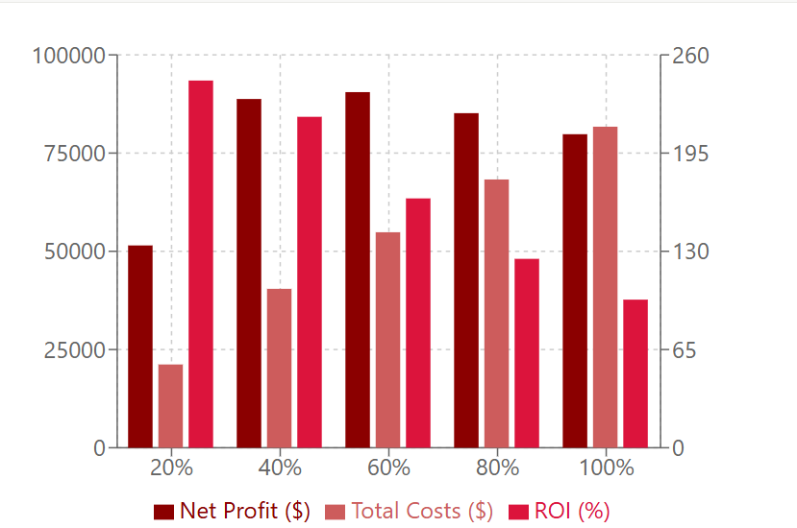
Optimal Target: 40%
Captures 80% of total adopters
Achieves $88,765 in net profit
Maintains high ROI of 219%
Moderate total costs of $40,447
Dollar Amount ($)
ROI (%)
Supporting Analysis
Beyond 40%, costs rise faster than profits
ROI drops significantly after 40% target
Most efficient cost-to-adoption ratio
Balances reach and resource utilization
Population Targeting Level
Recommendation: Target 40% of population for optimal balance between market capture, profitability, and resource efficiency.

Slide 13
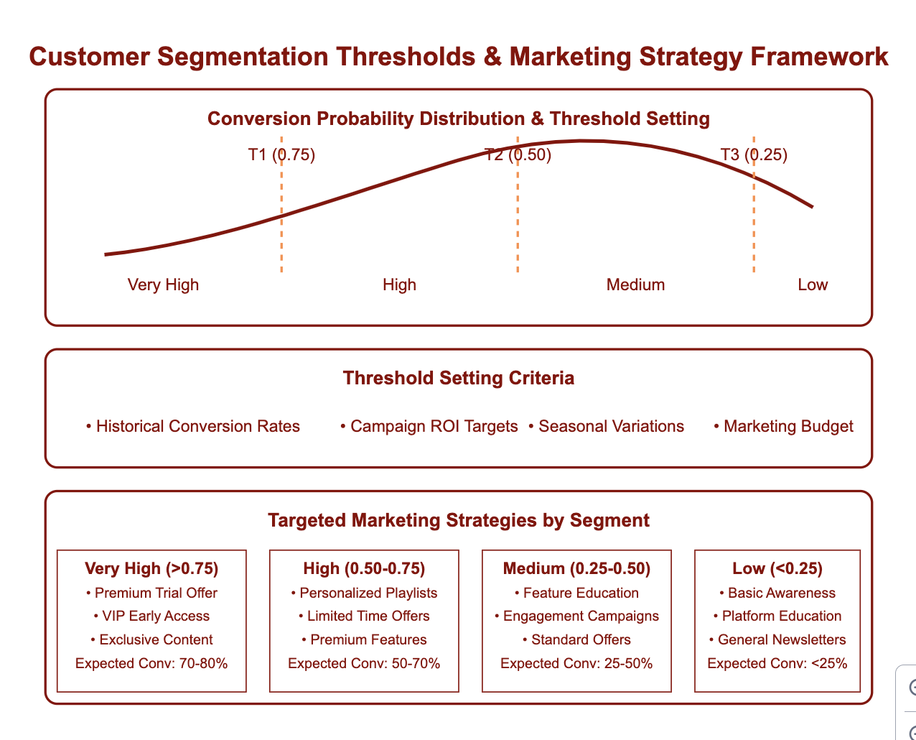

Slide 14
