Slide 1
Mathematical Modeling and Optimal Analysis of the Effect of Mental Stress Among University Students
Case study: AUL, UNILAG and LASU
BY
WILFRED LILIAN TIMIPREYE
Matric No: AUL/SCI/19/00686
Supervised by:
Dr. P. Evans
&
Dr. Okoro Samuel

Slide 2
PRESENTATION OUTLINE
Definition of terms
Motivation of Research work
Problem Statement
Aim
Objectives
Related Works
Research Methodology
Implementation and Desired Results
Conclusion
References

Slide 3
Definition of terms
Academic Performance
Mental Stress
Model
Academic performance refers to the measurable outcomes of a student's learning and educational achievements.
A model refers to a simplified or abstract representation of a system, concept, or object used to better understand or explain it.
Mental stress refers to emotional strain and pressure. It is a type of psychological pain

Slide 4
Definition of terms
Mathematical Modelling
Linear Regression Model
It involves creating mathematical representations or structures that describe real-world processes
A statistical method that models the relationship between a dependent variable and one or more independent variables using a linear equation.

Slide 5
Definition of terms
Optimization Analysis
It involves determining the most efficient or favorable conditions for a given outcome.

Slide 6
Problem Statement
Mental stress is a common concern among university students and management, which affects their academic performance and overall health . This study aims to model and analyze the effect of mental stress mathematically and propose effective interventions

Slide 7
Aim
The aim of this research is to develop a mathematical model to understand the dynamics of mental stress among university students and propose strategies for reducing stress levels

Slide 8
Objectives
The objectives of this project are:
To develop a mathematical model to study the effect of stress among university students
To analyze the impact of mental stress on academic performance and the general health of the students.
To develop an optimal stress reduction strategies based on the mathematical models and analysis.

Slide 9
Review of Related Literature
 | Author (Year) | Paper | Method | Strength | Weakness
1 | Robert L. Campbell, Lawrence W. Svenson, George K. Jarvis, (1992) | Perceived Level of Stress Among University Undergraduate Students in Edmonton, Canada | Statistical analysis. Survey (Questionnaire-based study) | gives baseline information for health education initiatives. | restricted to self-reported information and geographically specific.
2 | Michaela C. Pascoe, Sarah E. Hetrick, Alexandra G. Parker (2020) | The Impact of Stress on Students in Secondary School and Higher Education | Statistical analysis | thorough discussion of the different effects that academic stress has on students' achievements. | lack of primary data collection
3 | Innocent B. Mboya, Beatrice John, Eneck S. Kibopile, Lisbeth Mhando, Johnston George, James S. Ngocho(2020) | Factors Associated with Mental Distress Among Undergraduate Students in Northern Tanzania | . Statistical Analysis | highlights particular elements that contribute to mental anguish and recommends treatments like support groups and counseling. | Limited to one university; cross-sectional design cannot establish causality.

Slide 10
4 | Smith, J., Brown, L., & Kim, D.( 2023) | Mathematical Modeling of Stress Effects on University Students | Mathematical modeling and simulations | Innovative approach | A complex model could be difficult to generalize.
5 | Martinez, A., Singh, R., & Chen, H. ( 2023) | Optimal Analysis of Stress Interventions in University Settings | Optimal analysis using statistical methods | Practical implications | data exclusive to specific actions
6 | Johnson, M., Lee, S., & Green, P(2023) | Impact of Cognitive Behavioral Therapy on Stress Among University Students | Randomized controlled trials | outstanding evidence | Limited to CBT interventions

Slide 11

Research Methodology

Slide 12
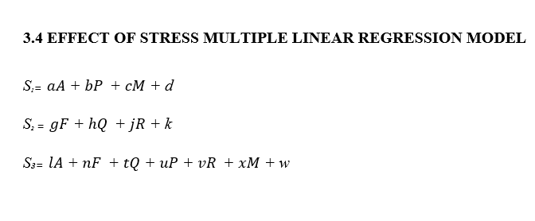
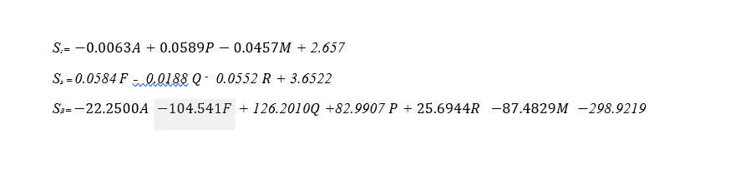
LINEAR REGRESSION MODEL

Slide 13
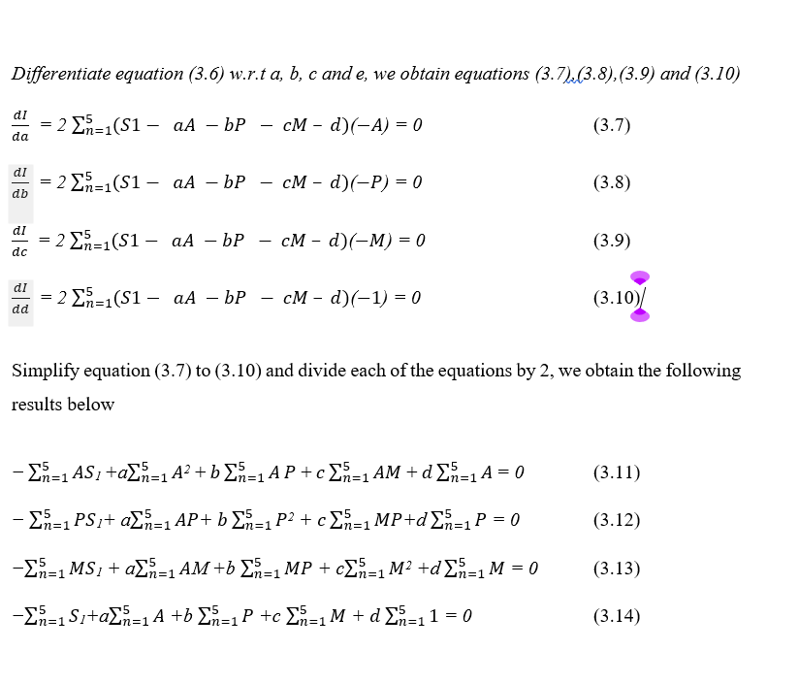
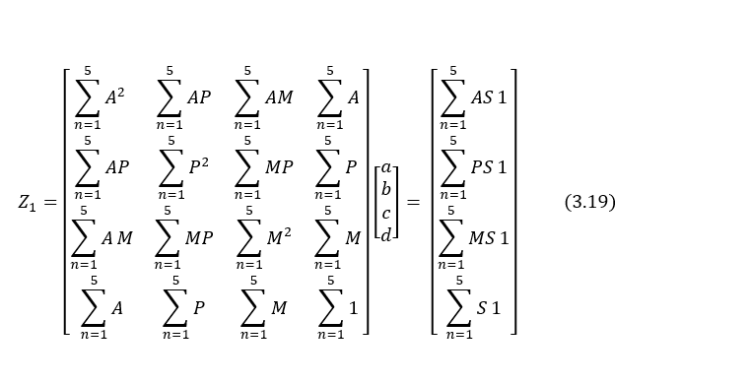
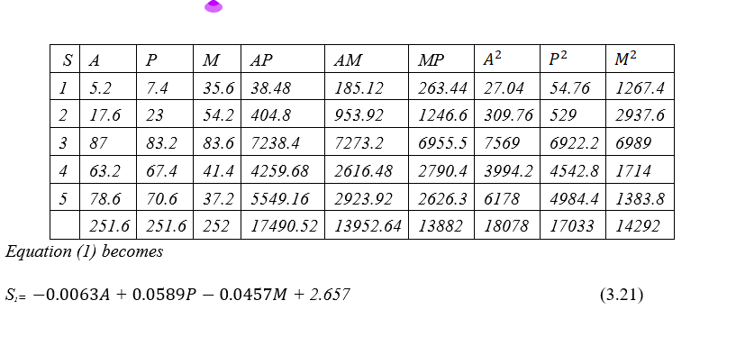
Mathematical Solutions

Slide 14
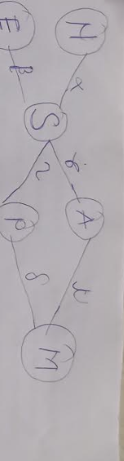
Mental stability model

Slide 15
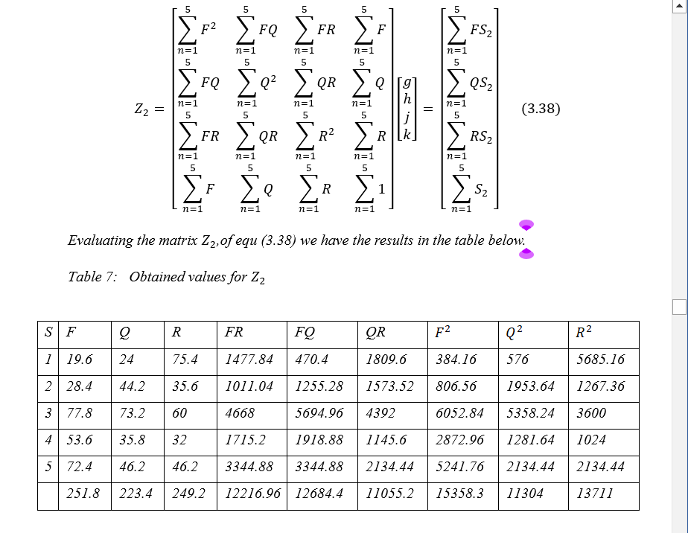
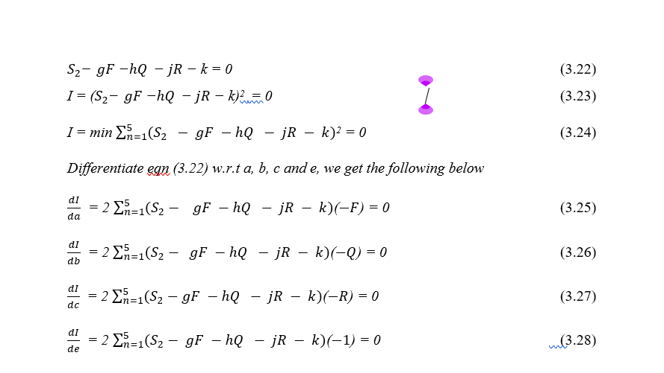


Slide 16
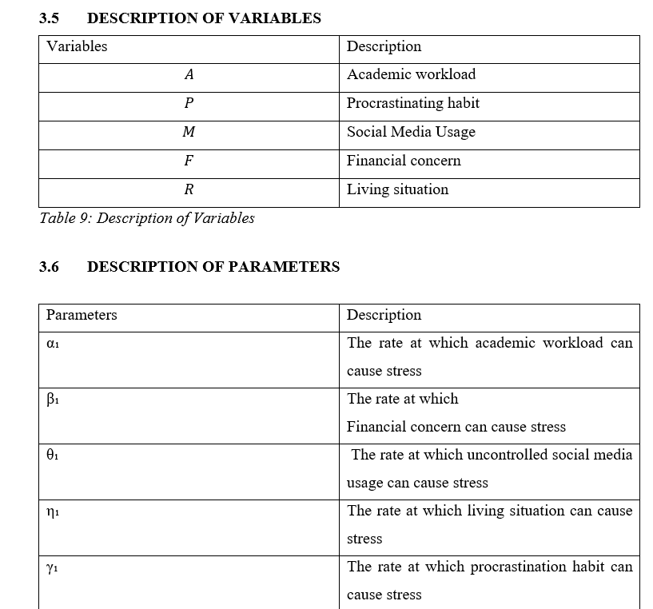
Implementation and Results

Slide 17
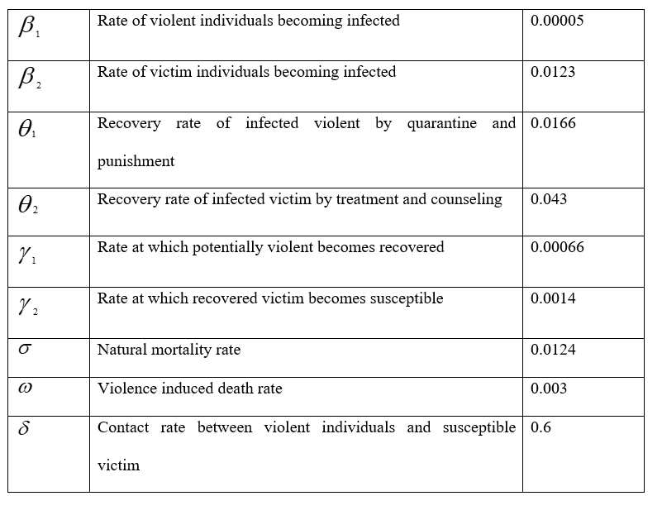

Slide 18
A numerical simulation is to be performed from time t=0 to t=10, for each of the compartments in consideration. After plotting the graphs for each compartment, then a general graph for all the compartments together will be simulated.
We shall also vary various variables with parameters.

Slide 19
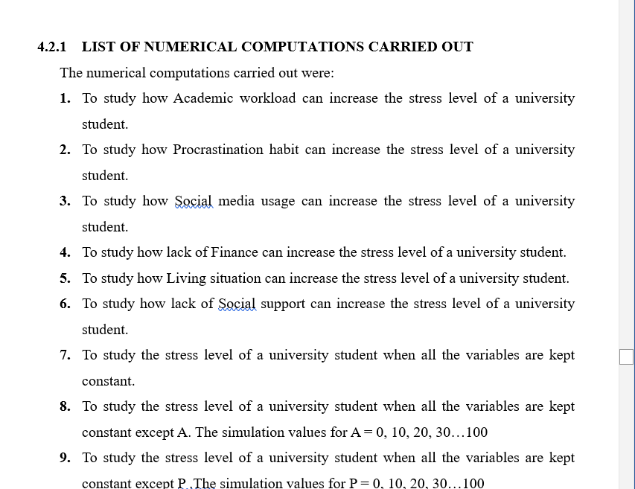
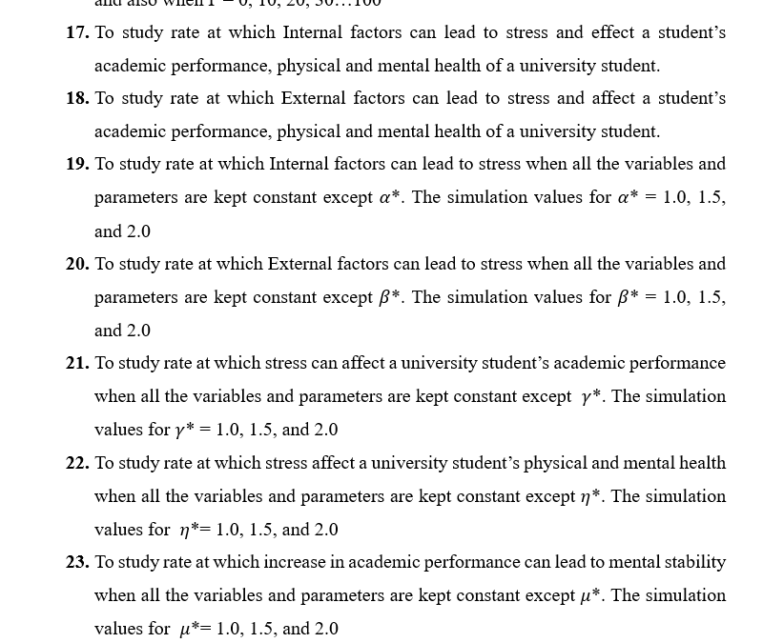
Computations Carried out

Slide 20
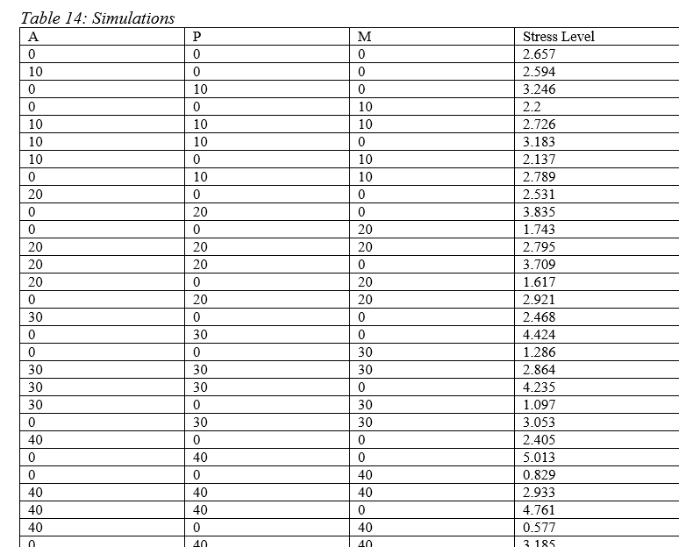
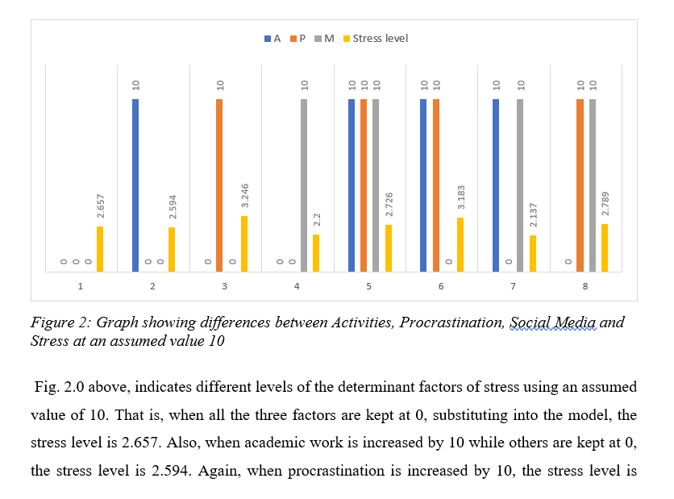
result

Slide 21
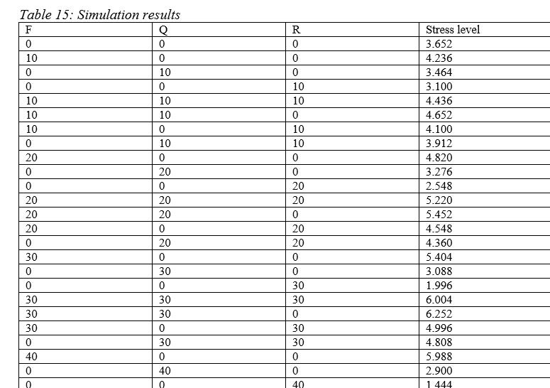
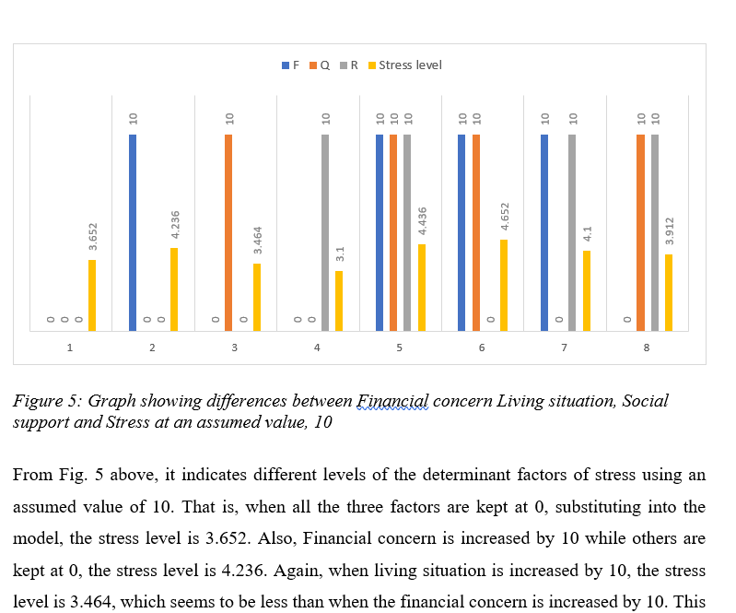

Slide 22
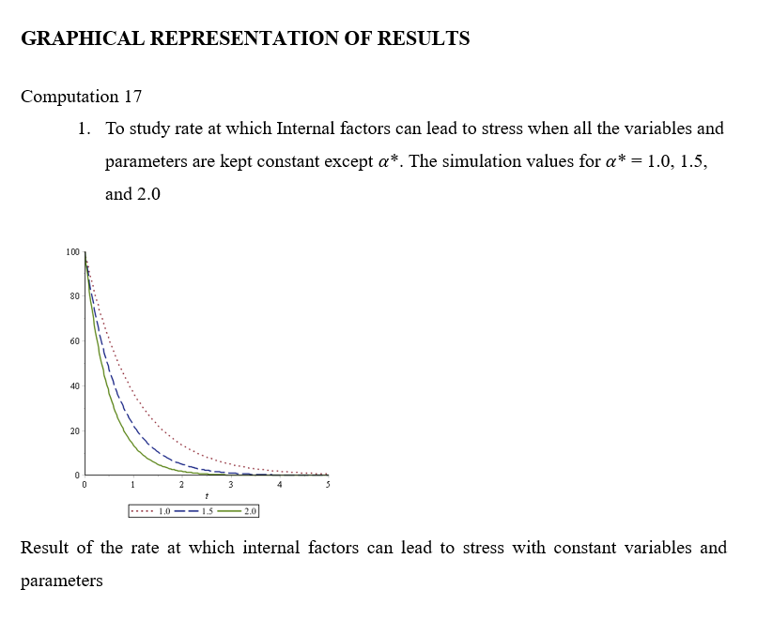
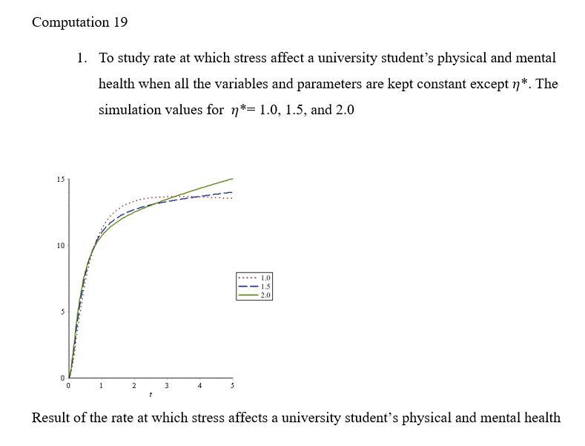
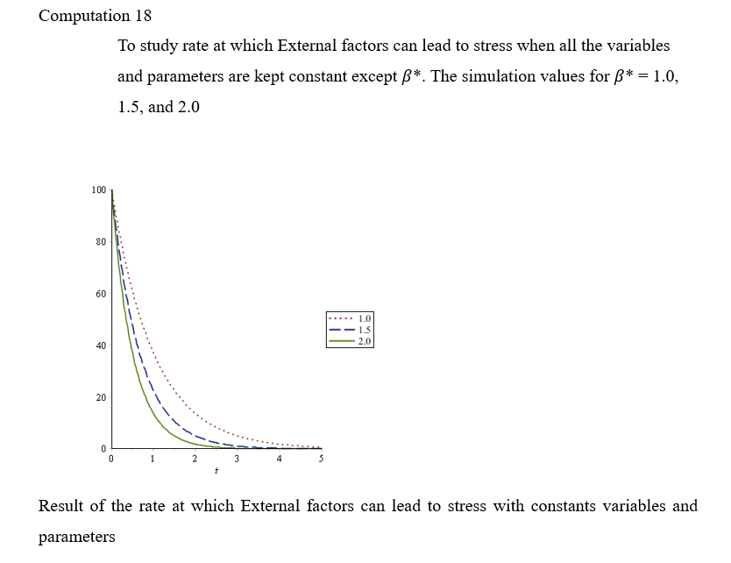

Slide 23
References
Chen, W., Li, M., & Huang, X. (2023). Stressors in university life and anxiety symptoms among international students: A sequential mediation model. Frontiers in Psychology, 14, 905260. https://doi.org/10.3389/fpsyg.2023.905260
Chopra, A. K. (2012). Dynamics of Structures: Theory and Applications to Earthquake Engineering (4th ed.). Pearson. Hashmi, I., Ann Ballad, C., Ibrahim, A., Al Sabei, S., Alsaraireh, A., Al Qadire, M., & ALBashtawy, M. (2023). Stress Factors, Stress Levels, and Coping Mechanisms among University Students. TheScientificWorldJournal, 2023, 2026971. https://doi.org/10.1155/2023/2026971
Cohen, S., Kessler, R. C., & Gordon, L. U. (1997). Measuring Stress: A Guide for Health and Social Scientists. Oxford University Press.
Creswell, J. W. (2014). Research Design: Qualitative, Quantitative, and Mixed Methods Approaches. SAGE Publications.
DuPre, E. P., & Durlak, J. A. (2008). A comprehensive review of evidence-based mental health promotion program implementation in schools. American Journal of Community Psychology, 41(3-4), 283-293. https://doi.org/10.1007/s10464-008-9165-3
El Ansari, W., & Stock, C. (2010). Is the health and wellbeing of university students associated with their academic performance? Cross sectional findings from the United Kingdom. International Journal of Environmental Research and Public Health, 7(2), 509–527. doi:10.3390/ijerph7020509

Slide 24
THANK YOU!

