Slide 1
` ONE-STEP HYBRID BLOCK METHOD FOR THE NUMERICAL SOLUTION OF SECOND ORDER ODEs External Defense BY AJAYI PHILIP OLUWADARA AUL/SCI/20/00546 Department of Mathematics Anchor University

Slide 2
PRESENTATION OUTLINE
Introduction
Motivation of Research Work
Problem Statement
Aim and Objectives
Review of Related Work
Research Methodology
Implementation and Result
References

Slide 3
INTRODUCTION
Ordinary Differential Equations (ODEs) are essential in scientific and engineering applications, providing a mathematical framework for understanding dynamic systems. When it comes to solving second-order ODEs, the choice of numerical methods becomes critical. Researchers have continually sought innovative approaches to enhance the accuracy and efficiency of numerical solutions. The One-Step Hybrid Block Method stands out as a recent advancement in this pursuit, offering a comprehensive strategy for addressing the challenges associated with second-order ODEs (Skwame and Sabo, 2019).
Notes:
Ordinary Differential Equations (ODEs) are essential in scientific and engineering applications. Researchers have continually sought innovative approaches to
enhance the accuracy and efficiency of numerical solutions. The One-Step Hybrid Block Method offers a strategy for addressing challenges associated with
second order ODEs

Slide 4
MOTIVATION OF RESEARCH WORK
The motivation for the project on the "One-Step Hybrid Block Method for the Numerical Solution of Second Order ODEs" is driven by the need to overcome challenges associated with traditional numerical methods when applied to second-order ODEs. Traditional methods face difficulties in maintaining stability and accuracy, particularly in areas involving stiff systems and nonlinearity. The project is motivated by a desire to create an innovative numerical solution method that excels in both accuracy and stability.
Notes:
The motivation for the project is driven by the need to overcome challenges associated with traditional numerical methods when applied to second-order ODEs. Traditional methods have challenges of maintaining stability particularly in areas involving stiff systems and nonlinearity.

Slide 5
PROBLEM STATEMENT
The numerical solution of second-order Ordinary Differential Equations (ODEs) poses significant challenges, particularly in terms of stability, accuracy, and adaptability when employing traditional numerical methods. The problem addressed by the "One-Step Hybrid Block Method for the Numerical Solution of Second Order ODEs" project is to develop a novel numerical method that combines the strengths of one-step and block methods. The goal is to create a technique that excels in accuracy, stability, and adaptability, offering a versatile solution for a broad range of second-order ODEs.
Notes:
The problem addressed by the project is to develop a novel numerical method that combines the strengths of one-step and block methods because of the
difficulties of the traditional methods maintaining stability.

Slide 6
AIM
The aim of the topic “One-Step Hybrid Block Method for the Numerical Solution of Second Order Ordinary Differential Equations (ODEs)” is to develop an efficient and accurate numerical method for solving second-order ODEs.

Slide 7
OBJECTIVES
1. To develop an effective numerical method for solving second-order ordinary differential equations (ODEs).
2. To evaluate the accuracy of the proposed method by comparing it with other existing numerical techniques.
3. To determine the stability of the numerical solution and ensure that the results are reliable.

Slide 8
REVIEW OF RELATED WORKS
S/N | TITLE | AUTHORS | METHOD | STRENGTH | WEAKNESS
1 | Three-Step Block Method for Solving Second Order Differential Equations | Abhulimen and Aigbiremhon (2018) | Three-Step Block Method | The numerical experiments demonstrates the effectiveness of the new method | It doesn’t delve deeply into how it can be effectively used in practical situations.
2 | Hybrid-Block Method for the Solution of Second Order Non-linear Differential Equations | James et al.(2022) | Hybrid-Block Method | It discusses the application of the novel hybrid block technique through the analysis of numerical examples | It didn’t delve deeply into the theoretical background of numerical analysis
3 | Modified Laguerre Collocation Block Method for Solving Second Order Ordinary Differential Equations | Edogbanya and Adesuyi (2020) | Modified Laguerre Collocation Block Method | It focuses on the necessary and sufficient conditions for LMM to be convergent | There is lack of detailed discussion on the practical implementation and application

Slide 9
REVIEW OF RELATED WORKS
S/N | TITLE | AUTHORS | METHOD | STRENGTH | WEAKNESS
4. | One-step Hybrid Block Method for Directly Solving Fifth-order Initial Value Problems of Ordinary Differential Equations | Duromola et al. (2022) | One-step Hybrid Block Method | This provides a solid theoretical foundation for the proposed approach | The method's generalizability to a wide range of fifth-order initial value problems may not be fully explored or demonstrated
5. | A New Hybrid Block Method for Solving First-Order Differential System Models in Applied Sciences and Engineering | Mufutau et al. | New Hybrid Block Method | It is a valuable tool for solving complex differential equations | It doesn’t extensively discuss resource requirements of the proposed method in comparison to existing techniques.

Slide 10

METHODOLOGY
DERIVATION OF THE HYBRID BLOCK METHOD
Creating a unique one-step hybrid approach that uses the basis function to solve second-order ODEs.
Therefore introducing the trial solution:
(1)
Where,
When $n=0, n=1$
$T_{n}\left(x\right)=cos⁡(n\cos^{−1}\left(x\right))$
When $n≥1$
`
are the parameters to be gotten
are the parameters of the Chebyshev polynomial below
(2)
(3)
The second derivative of (1) is
(4)

Slide 11
CONT’D OF METHODOLOGY
p = number of interpolations and q = number of collocation points
The points of interpolations are x = 0 and x =1/5 (means that p=2 points) and the points of collocations are x=0,1/5,2/5,3/5,4/5,1 (means q=6 points).
Putting the Chebyshev polynomials and the values of n, the equation
(5) is gotten. Equation (5) is differentiated twice to obtain:
Putting the interpolation points in (5) and collocation values in (6), is obtained.
(6)

Slide 12
CONT’D OF METHODOLOGY
Putting the values of into (5) we got the scheme
(7)
To obtain the scheme one after the other, we evaluate y[t] at the non-interpolating points (i.e. the points where we didn’t interpolate which are 2/5, 3/5, 4/5, 1). To obtain the additional method which is the derivatives, we evaluate the derivate y’[t] at the points (i.e. the points which are 0, 1/5, 2/5, 3/5, 4/5 and 1). The scheme is now:

Slide 13
CONT’D METHODOLOGY
,
,
,
,
,

Slide 14
CONT’D METHODOLOGY
,
,
,
,
(7)

Slide 15
IMPLEMENTATION
This research part addresses the initial value problems (IVPs) of the following second order ordinary differential equations (ODEs) in order to demonstrate how the method is put into practice.
Example : Consider the damped Duffing equation,
With the initial conditions,
The exact solution is given by

Slide 16
Results and errors of example and its comparison with James et al (2022).
x | Exact | Approximate | Hybrid Block Method(HBM) Error | James et al. Error
0.1 | 0.4569655926356141 | 0.4569655926356133 | 7.771561172376096 ×10−16 | 4.996004×10−16
0.2 | 0.41347956697168115 | 0.4134795669716799 | 1.2212453270876722 ×10−15 | 1.609823×10−15
0.3 | 0.37413178378928263 | 0.3741317837892819 | 7.216449660063518 ×10−16 | 2.997602×10−15
0.4 | 0.3385284372490823 | 0.33852843724908166 | 6.661338147750939 ×10−16 | 4.440892×10−15
0.5 | 0.30631319709220806 | 0.30631319709220783 | 2.220446049250313 ×10−16 | 5.717649×10−15
0.6 | 0.27716364236725355 | 0.27716364236725327 | 2.7755575615628914 ×10−16 | 6.772360×10−15
0.7 | 0.2507880345330278 | 0.2507880345330275 | 2.7755575615628914 ×10−16 | 7.577272×10−15
0.8 | 0.22692239764117791 | 0.22692239764117753 | 3.885780586188048 ×10−16 | 8.132384×10−15
0.9 | 0.20532787637617275 | 0.20532787637617247 | 2.7755575615628914 ×10−16 | 8.437695×10−15

Slide 17
Results and errors of example and its comparison with James et al. (2022).
x | Exact | Approximate | HBM Error | A.A. James et al. Error
1 | 0.18578834551102286 | 0.1857883455110229 | 5.551115123125783 ×10−17 | 8.493206×10−15

Slide 18
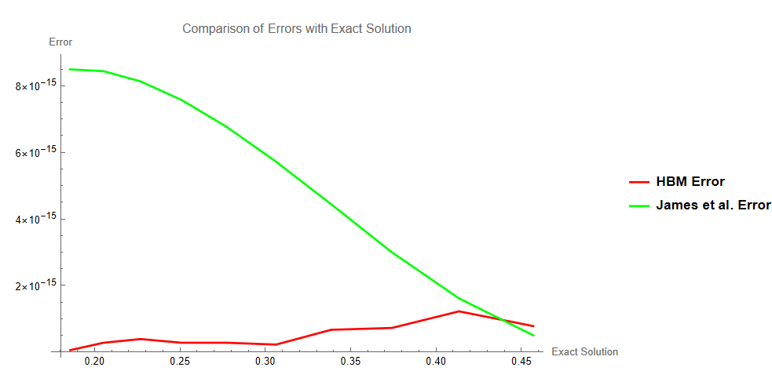

Slide 19
CONCLUSION
The table above shows the error of the new approach for solving the first example and it demonstrates that the new approach is more favourable compared to James et al. approach. This study presents a precise one-step hybrid numerical approach for directly solving second-order ordinary differential equations. The Hybrid Block Method proposed in this study more favourable in terms of its usability and properties. As a result, it is suggested for solving second order initial value problems of ODEs.

Slide 20
REFERENCES
Abhulimen, C. E., and Aigbiremhon, A. (2018). Three-step block method for solving second order differential equations. International Journal of Mathematical Analysis and Optimization: Theory and Applications, 2018, 364-381.
Adeniran, A. O., and Omotoye, A. E. (2016). One step hybrid block method for the numerical solution of general third order ordinary differential equations. EPH - International Journal of Mathematical Sciences, 2(5), 2.
Adeniran, A. O., and Omotoye, A. E. (2016). One step hybrid block method for the numerical solution of general third order ordinary differential equations. International Journal of Applied Mathematical Research, 5(1), 27-38.
Adesanya, A. O., Bishop, S. A., Anake, T. A., and Osilagun, J. A. (2009). Two steps block method for the solution of general second order initial value problems of ordinary differential equation. Journal of Natural Sciences, Engineering and Technology.
Adewale, A. J., Olaide, A., and Sunday, J. (2013). Continuous block method for the solution of second order initial value problems of ordinary differential equation. International Journal of Pure and Applied Mathematics, 83(3), 405-421.

Slide 21
REFERENCES
Akeremale, O. C., Kuboye, O. J., Hoe, S. Y., Abununyi, A. E., and Olaiju, S. (2024). Hybrid-block numerical method for solving second order ordinary differential equations. International Journal of Computational Analysis, 3(2), 26-35.
Arnold, V. I. (1992). Ordinary Differential Equations. In Ordinary Differential Equations (1-5). Springer.
Atkinson, K. E. (2008). An Introduction to Numerical Analysis (2nd ed., 362-364). Wiley.
Boyce, W. E., and DiPrima, R. C. (2017). Second Order Differential Equations. In Elementary Differential Equations and Boundary Value Problems (11th ed., 59-61). Wiley.
Brown, P. N., and Hindmarsh, A. C. (2009). Hybrid methods in numerical ODEs. In Numerical Analysis (213-217). Springer.

Slide 22
THANK YOU

