Slide 1

Unified Code For Collocation multistep method for solving stiff system of boundary value problem.
OKWHAROBO, Solomon Monday
AUL/SCI/20/00605

Slide 2
Introduction
Stiff system: differential equation or a set of differential equations that exhibits a property known as stiffness
Fields that Exhibit stiff bvp are : Chemical engineering, Astronomy, Economics, …
Challenges associated with stiff bvp: Computational cost, Choosing methods, numerically unstable(Explicit method)
Notes:
Stiffness is characterized by the presence of some terms in the equation that can lead to rapid variations in the solution. This rapid variation can pose challenges when integrating the equation numerically, as it requires the step size to be taken to be extremely small to ensure numerical stability
Standard methods for solving differential equations may not work well for stiff systems due to the requirement for very small step sizes.
This can lead to increased computational cost and potential difficulties in achieving desired levels of accuracy
Specialized methods, such as implicit Runge-Kutta methods or collocation methods, are often used to handle stiff systems
Astronomers often encounter stiff BVPs when modeling the behavior of celestial bodies or the propagation of electromagnetic waves through space
stiff BVPs can arise when modeling the behavior of chemical reactions. The rates of different reactions can change rapidly, leading to stiff systems
INCASE:
Explicit methods are unsuitable for solving stiff boundary value problems due to their stability restrictions, inefficient handling of varying timescales, and susceptibility to numerical instabilities.

Slide 3

Example of system of first order stiff system

Slide 4
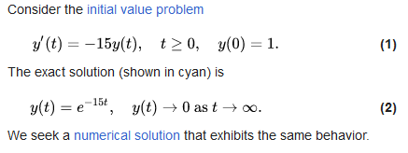
Example of system of first order stiff system

Slide 5
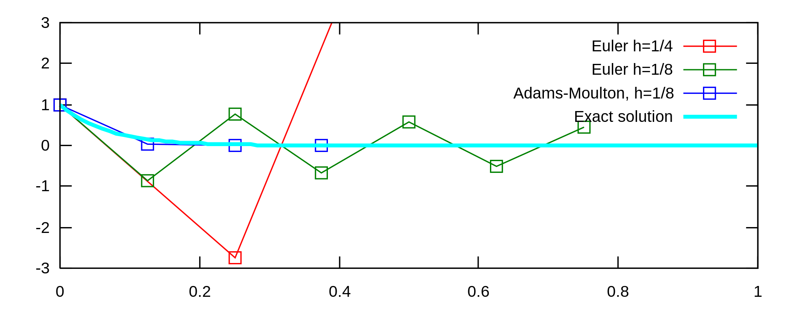
Example of system of first order stiff system

Slide 6
Problem Statement
Problem: Stiff systems of Boundary Value Problems (BVPs)
Challenges: Step Size Sensitivity, mesh-refinement
Notes:
These challenges arise from the rapid variations in solution components,
Mesh refinement: It involves dividing the domain of the problem into smaller subdomains, or cells, and then solving the problem separately in each cell
The quality of the solution depends heavily on the quality of the mesh, i.e., the arrangement and size of the cells
Adaptive Mesh refinement, and Manually Defining mesh refinement
Many numerical methods used in MATLAB, such as ode45, ode23, bvp4c, and bvp5c, use mesh refinement to handle stiff BVPs.

Slide 7
Objectives
Aim
The primary goal of this project is to develop a unified Python-based numerical code that seamlessly integrates collocation and multistep methods for the efficient and accurate solution of stiff systems of boundary value problems (BVPs)
Develop a unified code integrating collocation and multistep methods
Assess the accuracy, efficiency, and versatility of the proposed code
Provide a user-friendly tool for researchers and practitioners
Notes:
The existing stiff bvp solvers which are bvp4c, bvp5c, ode15, ode23, RKF45(Runge-Kutta-Fehlberg)

Slide 8
Scope of Study
Scope: To develop a unified code integrating collocation and multistep methods for solving stiff Boundary Value Problems (BVPs)
Research coverage: stiff BVPs, using collocation multistep method
Limitation: Limited to Two point boundary value
Notes:
Categorised based on number and location of boundary condition: Two-Point Boundary Value Problems (2PBVP)2. Multipoint Boundary Value Problems3. Periodic Boundary Value Problems4. Eigenvalue problems e.g Sturm-liouville problem

Slide 9
Literature Review
Title | Author | Summary | Limitation
Chebyshev collocation methods for ordinary differential equations | K. Wright | The paper describes some properties and advantages of these methods, which use finite Chebyshev series to approximate the solution and satisfy the ODE at certain points within the range. | -No multistep method discussed - Not implemented in code
A Numerical Algorithm for Solving Stiff Ordinary Differential Equations | S. A. M. Yatim,¹Z. B. Ibrahim,²K. I. Othman,³and M. B. Suleiman² | The paper compares the performance of the VSVO-BBDF method with MATLAB’s ode15s and ode23s solvers on three test problems arising from physics | -Limited to IVPs
Super implicit multistep collocation methods for nonlinear Volterra integral equations | S. Fazeli, G. Hojjati, S. Shahmorad | construct a new class of multistep collocation methods for solving two types of nonlinear Volterra integral equations including nonstiff and stiff problems. | Limited to VIPs
Notes:
Variable Stepsize, Variable Order Block Backward Differentiation Formulae.
VIPs : Volterra integral equations

Slide 10
Methodology
Research Steps:
The proposed methodology involves a systematic approach to develop a unified code for stiff Boundary Value Problems using Python as the primary programming language."
"We'll implement the user interface using Flutter for a seamless user experience."
Choice of Methods:
"In Python, we'll leverage specific collocation methods, such as Gaussian, Lagrange Collocation, for capturing local behavior. For time-stepping, we'll employ [mention multistep methods] to ensure effective temporal evolution."
Validation and Optimization:
"To validate our implementation, we'll compare results with established benchmark problems and analytical solutions, ensuring the accuracy of our code."
"Optimization will be achieved through techniques like Solver and compiler Optimization, optimizing both the computational and user interface aspects

Slide 11
Conclusion
At the end of my research, I hope to accomplish my proposed Objectives.
THANK YOU

