Slide 1
Weekly Report
Xuan-Thuy Vo
xthuy@islab.ulsan.ac.kr
April 17th, 2019

Slide 2
Activities
Last week:
implemented U-Net with MS COCO.
https://github.com/zijundeng/pytorch-semantic-segmentation
tried to implement YOLO: You Only Look Once
https://blog.paperspace.com/how-to-implement-a-yolo-object-detector-in-pytorch/
This week:
continue with U-Net.
learn about Attention module.

Slide 3
Activities
Last week:
Understood Focal loss
Learned about U-Net: Convolutional Networks for Biomedical ImageSegmentation.
Read this paper
Implement code
This week:
Continue with U-Net

Slide 4
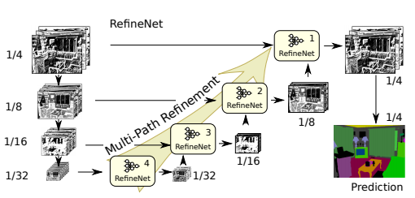
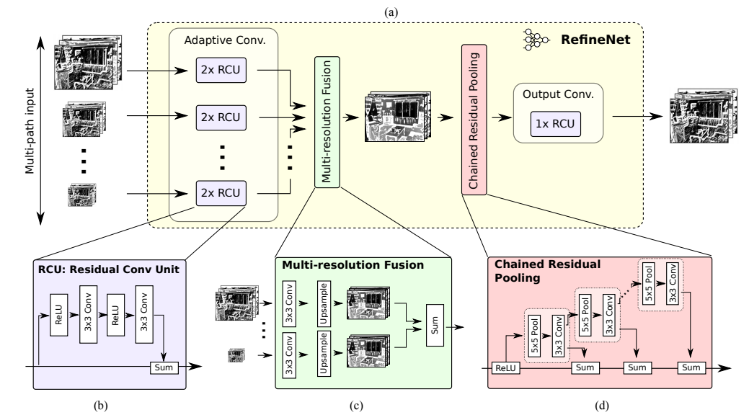

Slide 5
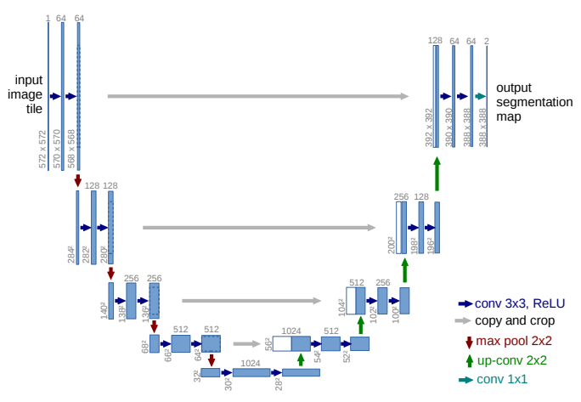
Activities

Slide 6
Thank you

