Slide 1
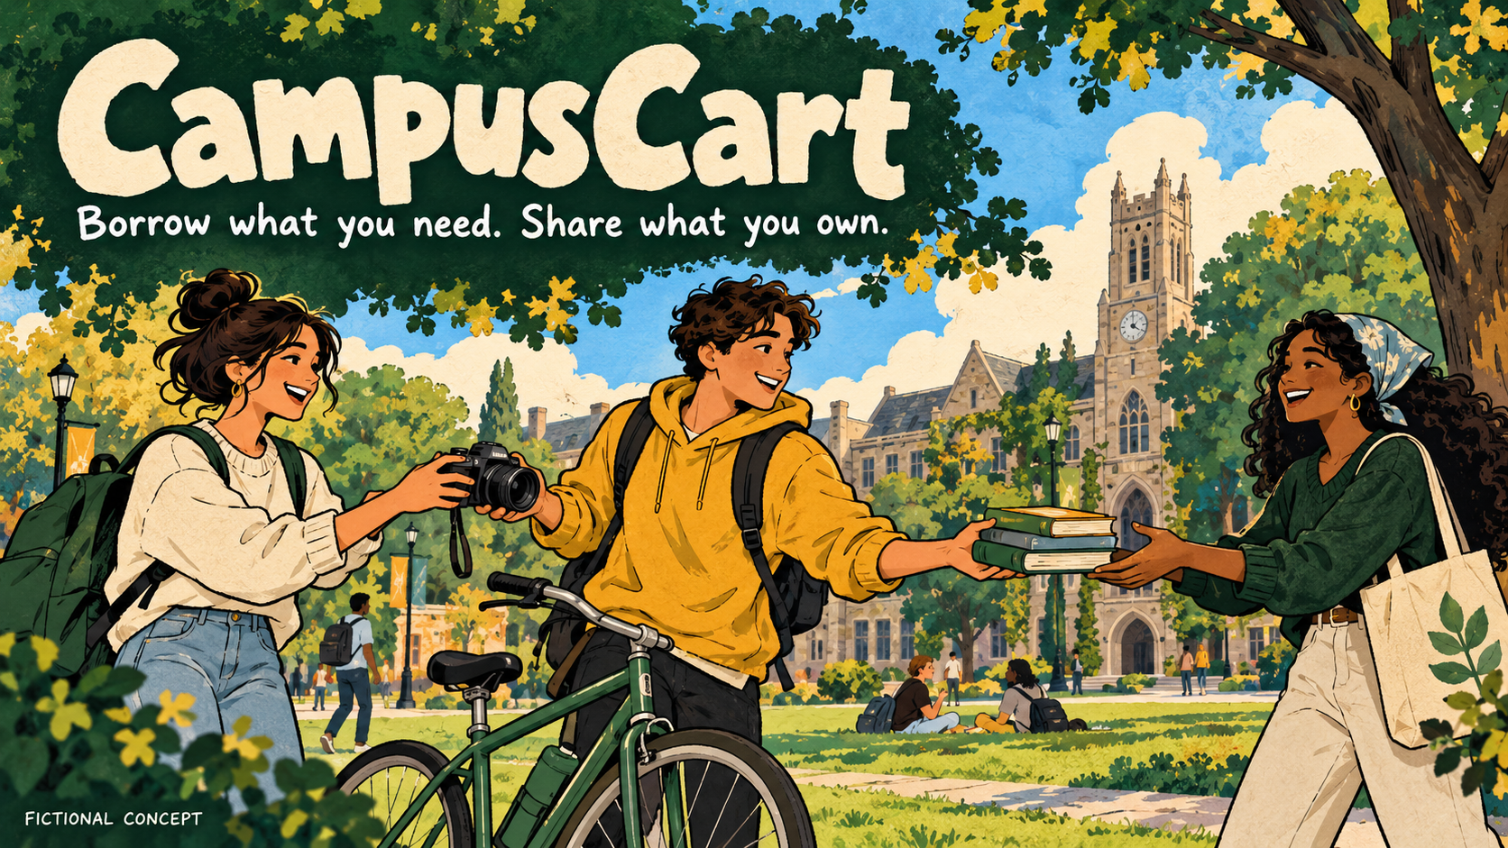
Notes:
CampusCart
Borrow what you need. Share what you own.
FICTIONAL CONCEPT

Slide 2

Notes:
Good things sit unused.
Students need them for a day.
FICTIONAL CONCEPT

Slide 3
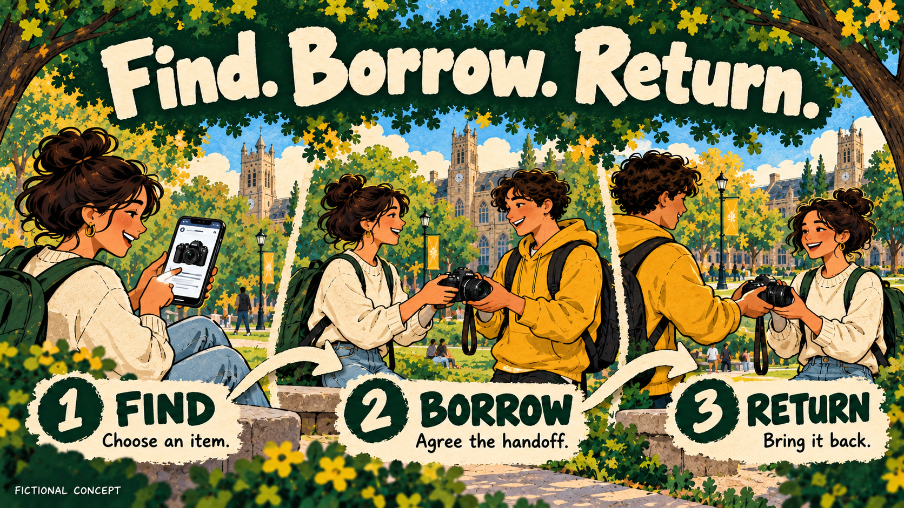
Notes:
Find. Borrow. Return.
1 FIND
Choose an item.
2 BORROW
Agree the handoff.
3 RETURN
Bring it back.
FICTIONAL CONCEPT

