Slide 1
Cascading Style Sheets
Eduardo Rosado
Eduardo Juárez

Slide 2
Cascading Style Sheets
CSS have the capability to impose consistency of the style in web documents
CSS are called cascading because they can be defined at three levels to specify the style of a document.
Lower-level style sheets override higher-level style sheets

Slide 3
Levels of Style Sheets
Inline (lowest level)
  Single XHTML element
Document
  Whole body of a document
External (highest level)
  Bodies of any number of documents

Slide 4
Levels of Style Sheets
The properties of a specific tag are those that result from a merge of all applicable style sheets
If no style sheet information is specified, the browser default property values are used.

Slide 5
Inline level
Appear within the opening tag in the style attribute
  <p style="font-size: 20pt; color: #6666ff">
Do not separate presentation from content
Deprecated in XHTML 1.1 by the W3C

Slide 6
Document level
Appear embedded in the document head section in the tag <style>
  <head>
  <style type="text/css">
  p { font-size: 20pt;
  color: #6666ff }
  </style>
  </head>

Slide 7
External level
Are not part of any of the documents to which they apply.
CSS are written as text files with the MIME type text/css
The <link> tag is used to specify external style sheets
  <link rel="stylesheet" type= "text/css" href="mycss.css" />

Slide 8
External style sheet
mycss.css
  /* External style sheet comment */
  /* Simple selector format:
  XHTMLtag { style-rules }
  */
  body { font-family: arial, helvetica, sans-serif }
  h1 { font-size: 24pt; }
  ul, li { margin-left: 20px } /* Applies to both tags */
  li em { font-weight: bold } /* Applies to <em> tag insdide <li> */
  ul ul { font-size: .8em; } /* Applies to <ul> tag insdide <ul> */

Slide 9
Class selectors
Are used to allow different ocurrences of the same tag to use different style specifications
A style class is defined in a style element by giving it a name
  p.normal { font-size: 95%; }
  p.warning { background-color: #FFD700; }
  <p class="normal">Normal presentation</p>
  <p class="warning">Warning presentation</p>

Slide 10
Generic selectors
Apply to the content of more than one kind of tag
  .info { background-color: #00AACC; }
  <p class="info">Information in a paragraph</p>
  <h3 class="warning">Information in a level 3 header</h3>
  <li class="warning">Information in a list item</li>
  <div class="info">…</div>

Slide 11
id selectors
Allows the application of a style to one specific element (workaround for inline styles)
  #paragraph2 { font-size: 20pt; color: #6666ff; }
  <p id="paragraph2">Paragraph 2 information</p>

Slide 12
Universal selectors
Apply to all elements in the document
  * { color: red; }

Slide 13
Pseudo classes
Apply when something happens
  Input:hover { color: red; }
  Input:focus { color: green; }

Slide 14
Color properties
Color names: red, green, blue
RGC: rgb(255, 255, 255)
Hexadecimal: #0077FF

Slide 15
Font properties
font-family: serif, sans-serif, cursive, fantasy, monospace
font-size:
  Relative: xx-small, x-small, small, medium, large, x.large, xx-large, 50%, 90%, 1.5em (M-height of the font)
  Absolute: 10pt
font-style: italic
font-weight: bold

Slide 16
List properties
list-style-image: url(bullet.gif)
List styles:
  ol { list-style-type: upper-roman }
  ol ol { list-style-type: upper-alpha }
  ol ol ol { list-style-type: decimal }

Slide 17
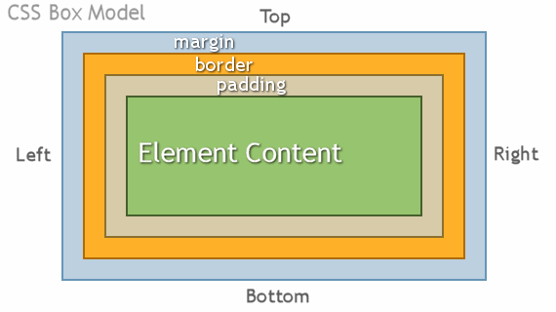
The box model

Slide 18
The box model
CSS controls the border using three properties: border-width, border-color, border-style
padding: Distance between the content inside an element and the inside of the element’s border
padding and margin can have a specific value for individual sides: margin-top, padding-bottom, margin-right, padding-left, etc.

Slide 19
Conflict resolution
!important
  Property values can be declared as !important
Precedence
  Id selectors
  Class and pseudo-class selectors
  Contextual selectors (more element type names means they are more specific)
  Universal selectors

