Slide 1
Introduction to JEE

Slide 2
JEE Components
Servlets
Java Beans
Custom Tags
Tag Libraries
Java Server Pages
Frameworks:
Java Server Faces
Application Presentation (Frontend)
Components &
Tools
(Backend)

Slide 3
What are Java Servlets?
Java programs that are executed in the server and have interaction with multiple users through http:
Intermediate layer between light clients (in browsers) and other server applications
RDBMS
Java Servlet
Browser
Web Service
Browser
Java Application
Browser

Slide 4
Java Servlet vs. CGI execution schema
CGI based web server
Request 1
Child Process 1
Request 2
Child Process 2
Request 3
Child Process 3
JEE Servlet Application Server
JVM
Request 1
Request 2
Threads
Servlet
Request 3

Slide 5



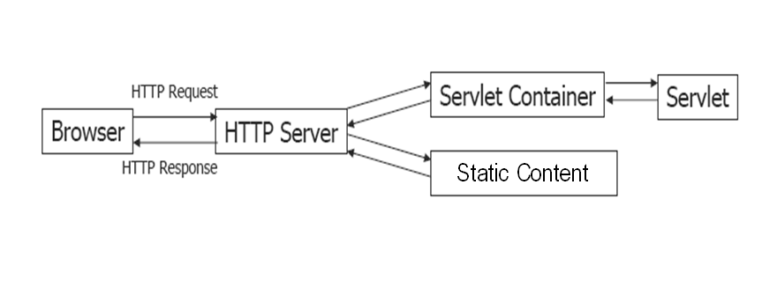





General Architecture JEE Servlet Application Server

Slide 6
Folder structure for a web application based in Java Servlets (sample structure for Tomcat)
jakarta
webapps
*.html *.jpg
application
src
*.java
WEB-INF
web.xml
classes
*.class

Slide 7
Life cycle of a Servlet

Slide 8
Servlet Tasks
Read client explicit data
Read implicit HTTP data sent by the client
Generate results (if necessary, calls other applications to generate results)
Send explicit results to client
Sent additional implicit HTTP data to the client

Slide 9
Class hierachy
interface
abstract class
class
developer defined class

Slide 10
Implementation of a Servlet
The implementation of a particular servlet, is made extending the class HttpServlet
The main methods that can be overwritten to give the servlet specific functionality are:
public void doGet(HttpServletRequest request,
HttpServletResponse response)
public void doPost(HttpServletRequest request,
HttpServletResponse response)

Slide 11
HttpServletRequest: Main methods
HttpServletRequest
String getParameter(String paramName) //Returns the parameter value(in POST value of the corresponding name or in GET value of the parameter of the corresponding URL)
String [] getParameterValues(String paramName) //For parameters with multiple values
Enumeration getParameterNames() //Returns the names of all the parameters

Slide 12
HttpServletRequest: main methods(cont.)
HttpSession getSession() // Returns the active session
Methods of the class HttpSession:
getAttribute(String id) // Returns the session attribute
setAttribute(String id,Object valor) // Saves an attribute in the session
logout() // Terminates the session
getCreationTime() // Time of creation of the session
getLastAccessedTime() // Time of last access to the session

Slide 13
HttpServletResponse: main methods
HttpServletResponse
PrintWriter getWriter() //Returns an output stream, which printing methods (ex. println()) allow to send text to the http client.
setStatus(int status) // Establishes a status code
setContentType(String mime) //Establishes the content type
sendRedirect(String url) // Remits to another URL
sendError(String message) // Indicates error situation

Slide 14
Creating a webapp
Open the Netbeans IDE
Create a new project with File-New Project
Select as type of project Web-Web application and press Next.
Name the project ServletsExercise and indicated in Project Location an identifiable folder, in which you will save the project. Save the rest of the default settings and press Finish (we will not define Framework)
After a pause, the IDE will prepare the structure for the project.

Slide 15
Incorporating a Servlet to the webapp
In the Project section choose Source Packages.
With right click, indicate New Java Package
Name the package myServlets; save the defaults and press Finish.
Select the package myServets; with right click indicate New Servlet
Name the Servlet FirstServlet, save the defaults and press Next.
Watch in the next step that the IDE offers an automatic option of adding the necessary specifications to the web.xml for the name of the servlet and the URL pattern. This will be the URL associated to the servlet.
Indicate Finish.

Slide 16
Content of FirstServlet
Watch the code that the IDE generated for FirstServlet
Open the sign + in the line that indicates HttpServlet methods …
Which method does the IDE propose to be executed by the methods doGet() and doPost()?
Modify the comment section /* ALL output your page here… for the servlet to show your name
Test FirstServlet with the Run – File option; the first time you execute it, it will take more time because it will activate Glassfish (application server). It also provides the possibility to choose a different URL than the default, for example passing parameters.
Once Glassfish is active, you can test the servlet from the browser; Glassfish will deactivate when exiting Netbeans.

