Slide 1
Computer Network
Multimedia Networking
School of Electric and Computer Engineering
Pusan National University, KOREA
Younghwan Yoo

Slide 2

Textbook
Computer Networking A Top-Down Approach 7th edition Jim Kurose, Keith Ross Pearson April 2016

Slide 3
01. Multimedia Applications
02. Streaming Stored Video
03. Voice-over-IP
04. Real-time Transport Protocol

Slide 4
05. Session Initiation Protocol
06. Network Support for Multimedia

Slide 5
01. Multimedia Applications

Slide 6

Properties of Video
spatial coding example: instead of sending N values of same color (all purple), send only two values: color value (purple) and number of repeated values (N)
High bit rate
video: sequence of images displayed at constant rate
e.g., 24 or 30 images/sec
Compressibility
using redundancy within and between images to decrease # bits used to encode image
spatial (within image)
temporal (from one image to next)
multiple versions of the same video
trade-off between video quality and bit rate
……………………..
……………….…….
frame i
temporal coding example: instead of sending complete frame at i+1, send only differences from frame i
frame i+1

Slide 7
Properties of Audio
quantization error
Analog audio signal sampled at constant rate
telephone: 8,000 samples/sec
CD music: 44,100 samples/sec
Each sample quantized, i.e., rounded
e.g., 2⁸=256 possible quantized values
each quantized value represented by 8 bits
8,000 samples/sec x 8 bits = 64,000 bps
Receiver converts bits back to analog signal: some quality reduction
Example rates
CD (1.411 Mbps), MP3 (96, 128, 160 kbps), Internet telephony (5.3 kbps and up)
quantized value of
analog value
analog
signal
audio signal amplitude
time
sampling rate
(N sample/sec)

Slide 8
Types of Multimedia Network Applications
Streaming stored audio and video
Conversational voice-/video-over-IP
Streaming live audio and video
has similar features to streaming stored video, e.g., live sporting or ongoing news event
Features | Key perfor. metric | Applications
streaming: client can begin video playout before downloading entire file prerecorded: entire file is already stored at server and transmitted through video-on-demand service interactivity: can do pause/play, forward/backward continuous playout: proceed according to the original timing of the recording | average throughput | YouTube Netflix Amazon
Features | Key perfor. metric | Applications
voice-over-IP is highly delay-sensitive loss-tolerant, further error concealment possible | low delay (<150 ms) | Skype

Slide 9
02. Streaming Stored Video

Slide 10
Streaming Stored Video
Three categories
UDP streaming
HTTP streaming
adaptive HTTP streaming
Client application buffering
common characteristic of streaming videos to mitigate the effects of varying end-to-end delay and available bandwidth
delay and bandwidth fluctuation will not be noticed as long as the buffer does not become completely drained
majority of today’s system

Slide 11
Client-Side Buffering
constant bit
rate video
transmission
client video
reception
constant bit rate video playout at client (30 frames/sec)
Cumulative data
varying
network
delay
buffered
video
client playout
delay
time
Client-side buffering and playout delay: compensate for varying network-added delay

Slide 12

Client-Side Buffering & Playout
buffer fill level,
Q(t)
variable fill rate, x(t)
playout rate,
e.g., CBR r
client application
buffer, size B
video server
Initial playout delay tradeoff: buffer starvation less likely with larger delay, but larger delay until user begins watching
client
Initially fill buffer up to the predetermined level
Playout begins
Buffer fill level varies over time as fill rate x(t ) varies and playout rate r is constant

Slide 13
UDP Streaming
Server simply sends at the consumption rate of the video at client
often, sending rate = encoding rate: constant
transmission rate can be oblivious to congestion levels
Short playout delay (2-5 seconds) to remove network jitter
Error recovery: application-level, time permitting
Drawbacks
freezing or skipped frames due to unpredictable and varying available bandwidth
requirement of a separate media control server to process client-to-server interactivity requests and track client state
UDP traffic may not go through firewalls

Slide 14


HTTP Streaming
Multimedia file retrieved via HTTP GET
Send at maximum possible rate under TCP
Fill rate fluctuates due to TCP congestion control and retransmissions
Prefetching to smooth delivery rate larger playout delay larger client buffer
HTTP/TCP passes more easily through firewalls
variable rate, x(t)
video
file
TCP send buffer
TCP receive buffer
application playout buffer
server
client

Slide 15
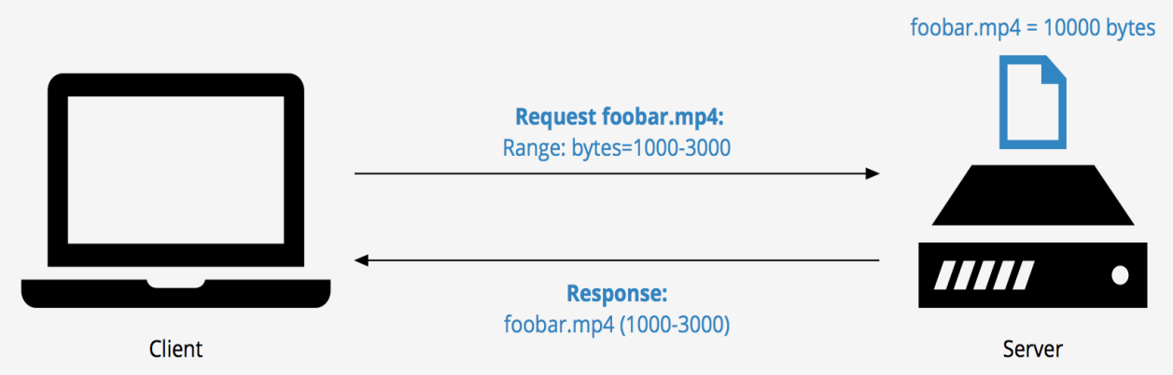
Repositioning & Early Termination of Video
HTTP byte-range header in the HTTP GET message
specifies the range of bytes the client currently wants to retrieve from the desired video
useful for repositioning to a future point in time in the video
receiving the new HTTP request, the server forgets about any earlier request
Repositioning and early termination make prefetched-but-not-yet-viewed data useless, or Internet bandwidth wasted; thus many streaming systems
use only a moderate-size client application buffer, or
limit the amount of prefetched video
출처 - https://cdn.keycdn.com/support/wp-content/uploads/2015/12/byte-range.png

Slide 16
Adaptive HTTP Streaming
Shortcoming of the HTTP streaming
“All clients receive the same encoding of the video, despite the large variations in the amount of bandwidth available to a client, both across different clients and also over time for the same client.”
DASH: Dynamic, Adaptive Streaming over HTTP
“intelligence” at client: client determines
when to request chunk (so that buffer starvation, or overflow does not occur)
what encoding rate to request (higher quality when more bandwidth available)
where to request chunk (can request from URL server that is “close” to client or has high available bandwidth)

Slide 17
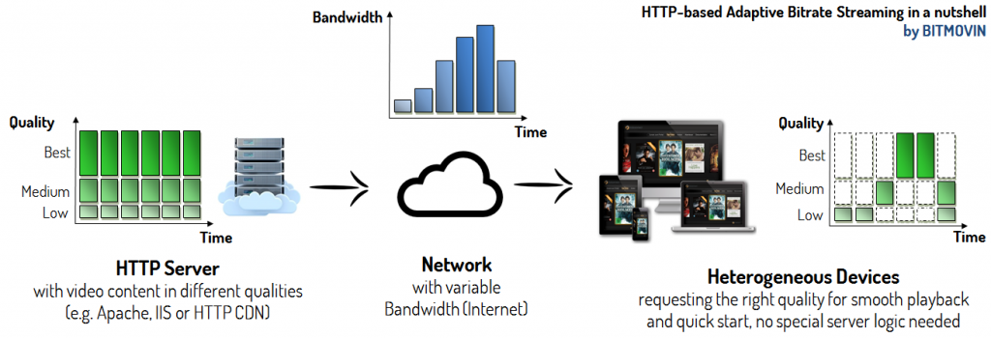
DASH Operation: Server
Divides video file into multiple chunks
Each chunk stored, encoded at different rates
Manifest file: provides URLs for different chunks
출처 - https://www.google.co.kr/url?sa=i&source=images&cd=&cad=rja&uact=8&ved=2ahUKEwiTvK3ozd_cAhWJvLwKHSN9DFAQjRx6BAgBEAU&url=https%3A%2F%2Fwww.cybrary.it%2F0p3n%2Fdes-data-encryption-standard%2F&psig=AOvVaw2_WnSkznQSMsvNEZRfqstQ&ust=1533891577506204
출처 - https://www.google.co.kr/url?sa=i&rct=j&q=&esrc=s&source=images&cd=&cad=rja&uact=8&ved=2ahUKEwj3tJ6ptKjdAhWEwbwKHT1oBlsQjRx6BAgBEAU&url=https%3A%2F%2Fbitmovin.com%2Fdynamic-adaptive-streaming-http-mpeg-dash%2F&psig=AOvVaw0uFSUJZ78UIAFa7MNlAZ6c&ust=1536393064483960

Slide 18
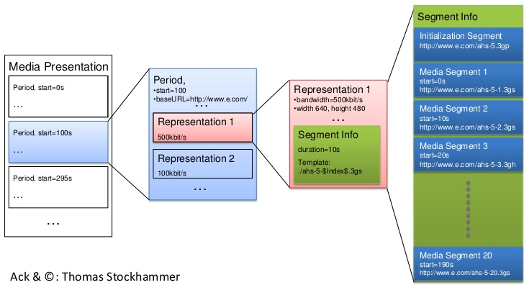
DASH Operation: Client
Periodically measures server-to-client bandwidth
Consulting manifest, requests one chunk at a time
chooses maximum coding rate sustainable given current bandwidth
can choose different coding rates at different points in time (depending on available bandwidth at time)
출처 - https://www.google.co.kr/url?sa=i&rct=j&q=&esrc=s&source=images&cd=&cad=rja&uact=8&ved=2ahUKEwiO3IyrtajdAhVN6bwKHYLkCqYQjRx6BAgBEAU&url=https%3A%2F%2Fwww.slideshare.net%2Fchristian.timmerer%2Fdynamic-adaptive-streaming-over-http-dash&psig=AOvVaw0uFSUJZ78UIAFa7MNlAZ6c&ust=1536393064483960

Slide 19
03. Voice-over-IP

Slide 20
Limitations of IP for Internet Telephony
End-to-end delay: needed to maintain “conversational” aspect
higher delay is noticeable and impairs interactivity
< 150 msec: good
> 400 msec: bad
the accumulation of transmission, processing, and queuing delays in routers; propagation delays in links; and end-system processing delays
Packet loss
loss could be eliminated by using TCP; however, TCP retransmission and congestion control are often unacceptable because they increase end-to-end delay
most existing VoIP applications run over UDP by default
packet loss rates less than 20 percent can be tolerated, depending on the type of source encoding and loss concealment scheme

Slide 21
Delay Jitter
Jitter: fluctuation of the time from when a packet is generated at the source until it is received at the receiver
constant bit
rate
transmission
client
reception
constant bit
rate playout
at client
Cumulative data
variable
network
delay
(jitter)
buffered
data
client playout
delay
time

Slide 22
Removing Jitter at the Receiver
Jitter is removed typically by combining the following two mechanisms:
timestamp: sender stamps each chunk with the time at which the chunk was generated
delaying playout
fixed playout delay
adaptive playout delay
Fixed playout delay
receiver attempts to playout each chunk exactly q msecs after chunk was generated
chunk with timestamp t: played out at t+q
chunk arriving after t+q: too late for playout, so considered “lost”
tradeoff in choosing q
large q: less packet loss
small q: better interactive experience
The adaptive playout delay system dynamically controls the q value depending on the network situation.

Slide 23
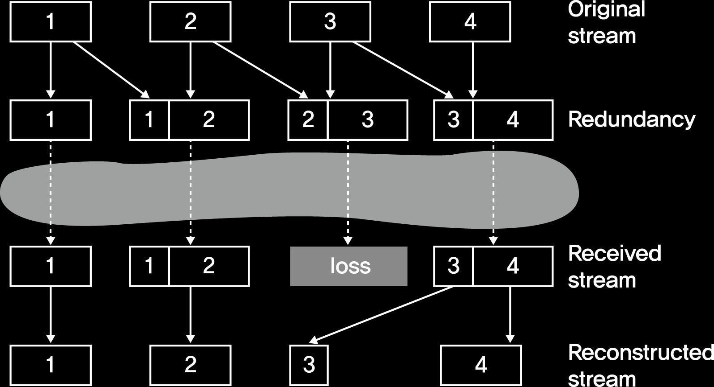
Packet Loss Recovery: Forward Error Correction
Exclusive OR-ing of every n chunks
create a redundant encoded chunk after every n chunks by exclusive OR-ing the n original chunks
send the n+1 chunks to transfer the n original chunks of data
if any one packet of the group of n+1 packets is lost, the receiver can fully reconstruct the lost packet
Lower-resolution audio stream
append lower resolution audio stream of the nth chunk to the (n+1)th chunk
receiver can conceal nonconsecutive packet loss

Slide 24
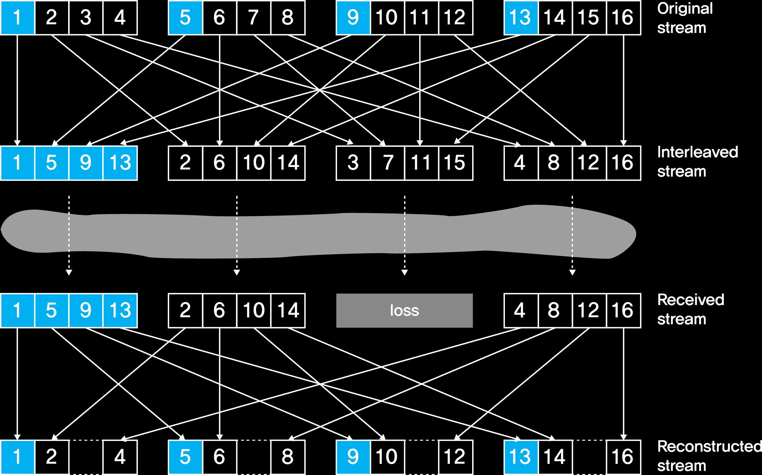
Packet Loss Recovery: Interleaving
Interleaving to conceal loss as an alternative to redundant transmission
audio chunks divided into smaller units, e.g., four 5 msec units per 20 msec audio chunk
every packet contains small units from different chunks
if a packet is lost, receiver still have most of every original chunk

Slide 25




Case Study: Skype
Services: host-to-phone, phone-to-host, and multi-party host-to-host video conferencing
Application-layer protocol: proprietary (inferred via reverse engineering)
based on P2P techniques
Transport-layer protocol
UDP: audio and video packets (default)
TCP: control packets
Skype
login server

Slide 26
Case Study: Skype
Architecture: hierarchical overlay network
Login server
maintain an index that maps Skype usernames to current IP addresses and port numbers
distribute the index over the super peers
Super peer
cache the index from the server
inform client of callee’s IP address
relay between client peers
client peers
Skype
login server
super peer (SP)
overlay
network

Slide 27
Case Study: Skype
Client operation
logs-in (username, password) to centralized Skype login server
allocated to a super peer and joins Skype network by using TCP
obtains IP address for callee from the super peer or super peer overlay
or client buddy list
initiates a call directly to callee
client peers
Skype
login server
super peer (SP)
overlay
network

Slide 28


Case Study: Skype
NAT traversal
both Alice, Bob are behind NATs
NAT prevents outside peer from initiating connection to insider peer
Relay solution: Alice, Bob maintain open connection to their super peers
Alice signals her SP to connect to Bob
Alice’s SP connects to Bob’s SP
Bob’s SP connects to Bob over open connection Bob initially initiated to his SP
super peer
super peer

Slide 29
04. Real-time Transport Protocol

Slide 30
Real-time Transport Protocol (RTP) Basics
RFC 3550
Defines a standardized packet structure that includes fields for most audio/video data such as
payload type identification
sequence number
timestamp
Interoperability: if two VoIP applications run RTP, they may be able to work together
Runs in end systems, typically on top of UDP
Example: sending 64 kbps PCM-encoded voice over RTP
application collects encoded data in chunks
audio chunk + RTP header form RTP packet, encapsulated in UDP segment
RTP header indicates type of audio encoding in each packet
Application
RTP
UDP
IP
Data Link
Physical
Transport
layer

Slide 31
Limitation of RTP
RTP does not provide any mechanism to ensure timely data delivery or other QoS guarantees
RTP encapsulation only seen at end systems (not by intermediate routers)
routers provide best-effort service, making no special effort to ensure that RTP packets arrive at destination in timely matter
Notes:
* nonce adj. 한번뿐인

Slide 32
RTP Header
payload type
sequence number
Synchronization
Source ID
Miscellaneous fields
Payload type (7 bits): indicates type of encoding currently being used
Sequence number (16 bits): increment by one for each RTP packet sent
detect packet loss, restore packet sequence
Timestamp field (32 bits): sampling instant of first byte in this RTP packet
for audio, timestamp clock increments by one for each sampling period
if a chunk has 160 encoded samples, timestamp increases by 160 for each RTP packet
SSRC field (32 bits): identifies source of RTP stream; each stream in an RTP session has distinct SSRC
time stamp
payload type 0: PCM mu-law, 64 kbps
payload type 3: GSM, 13 kbps
…
payload type 31: H.261
payload type 33: MPEG2 video
Notes:
RTP packets are not limited to unicast applications. They can also be sent over one-to-many and many-to-many multicast trees. For a many-to-many multicast session, all of the session’s senders and sources typically use the same multicast group for sending their RTP streams. RTP multicast streams belonging together, such as audio and video streams emanating from multiple senders in a video conference application, belong to an RTP session.

Slide 33


RTCP and RTSP
sender
RTP
Real-time Transport Control Protocol
works with RTP for quality of service monitoring, statistics collection, and control of a related RTP stream
used to periodically report packet reception statistics to the sender to adapt to network changes during an ongoing session
to limit its traffic (to 5% of session bandwidth), each participant reduces RTCP traffic as number of conference participants increases
Real-Time Streaming Protocol
a separate control connection over which the client sends commands regarding session state changes such as pause, resume, reposition, etc.
runs over TCP to maintain connection
RTCP
RTCP
RTCP
receivers

Slide 34
05. Session Initiation Protocol

Slide 35
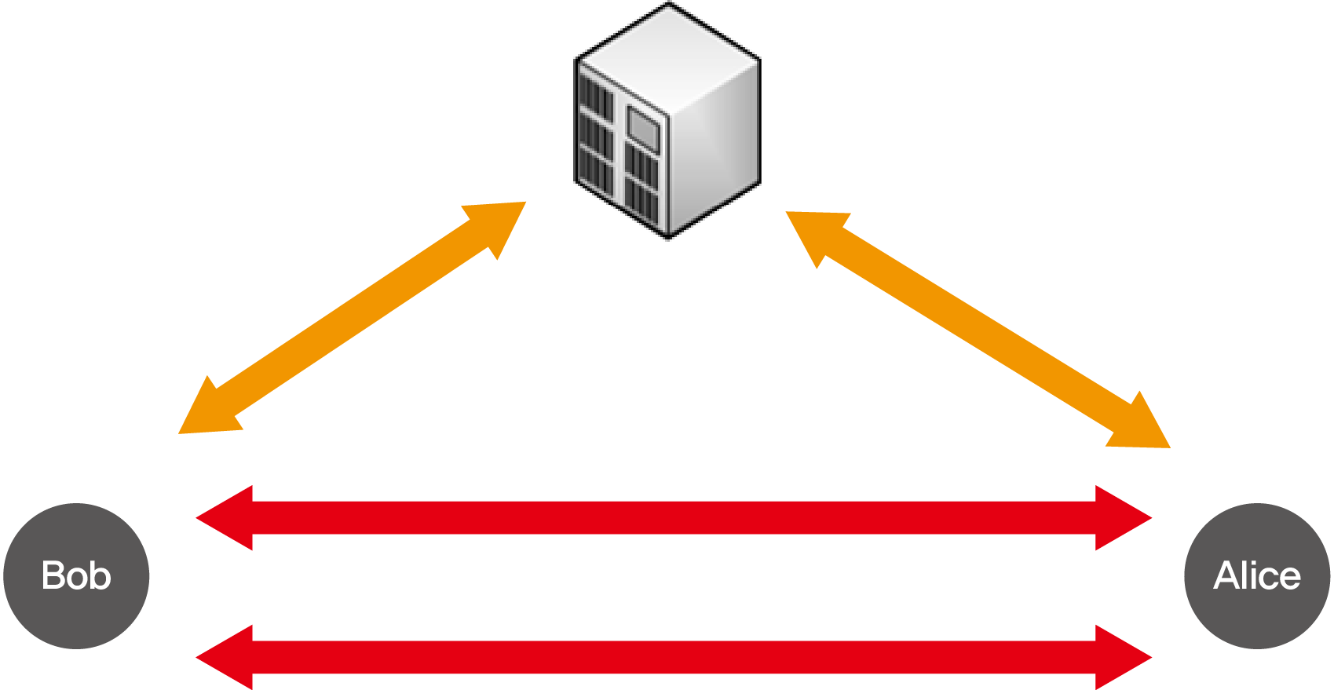
Session Initiation Protocol (SIP)
Long-term vision:
All telephone calls and video conference calls take place over Internet
People identified by names or e-mail addresses, rather than by phone numbers
Can reach callee (if callee so desires), no matter where callee roams, no matter what IP device callee is currently using
SIP and RTP
SIP: initiate a session between two endpoints
RTP: transfer multimedia traffic
출처 - https://www.google.co.kr/url?sa=i&source=images&cd=&cad=rja&uact=8&ved=2ahUKEwjIxP6MiKneAhUKzLwKHSICBXYQjRx6BAgBEAU&url=https%3A%2F%2Fblogs.technet.microsoft.com%2Fisablog%2F2009%2F10%2F20%2Fforefront-tmg-is-sip-aware%2F&psig=AOvVaw3gT0AbyBw4qaVOPjaNBUd0&ust=1540813043001118

Slide 36
SIP Services
SIP mechanisms
establish calls between a caller and a callee over an IP network
allows the caller to notify the callee that it wants to start a call
allows the participants to agree on media encodings
allows participants to end calls
enable the caller to determine the current IP address of the callee
users may have a dynamically assigned IP or multiple IP addresses for multiple devices
provide call management
such as adding new media streams during the call, changing the encoding during the call, inviting new participants during the call, call transfer, and call holding

Slide 37
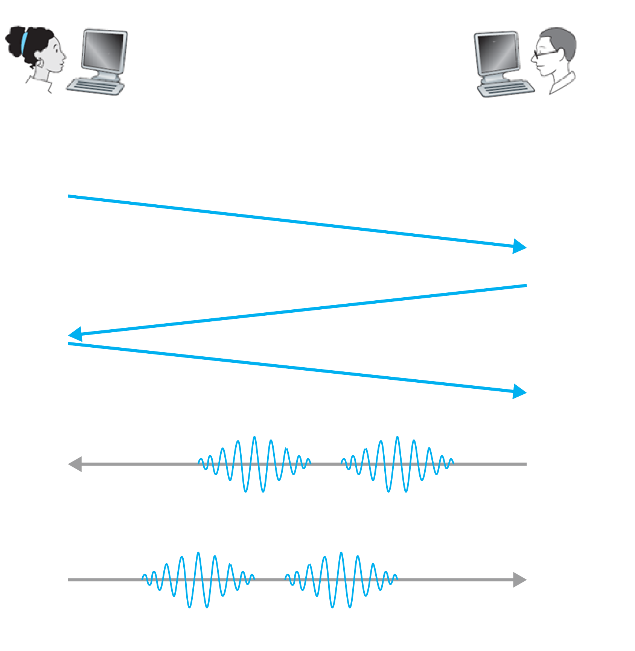
Example: Setting Up a Call to a Known IP Address
Alice’s SIP invite message indicates her port number, IP address, encoding she prefers to receive (PCM μ law)
Bob’s 200 OK message indicates his port number, IP address, preferred encoding (GSM)
Default SIP port number: 5060

Slide 38
SIP Characteristics
SIP is an out-of-band protocol
SIP messages are sent and received in sockets that are different from those used for sending and receiving the media data
SIP messages themselves are ASCII-readable and resemble HTTP messages
SIP requires all messages to be acknowledged, so it can run over UDP or TCP
INVITE sip:bob@domain.com SIP/2.0
Via: SIP/2.0/UDP 167.180.112.24
From: sip:alice@167.180.112.24
To: sip:bob@193.64.210.89
Call-ID: a2e3a@pigeon.hereway.com
Content-Type: application/sdp
Content-Length: 885
c=IN IP4 167.180.112.24
m=audio 38060 RTP/AVP 0
… indicates that Alice desires to receive audio, which is to be encoded in format AVP 0 (PCM encoded μ-law) and encapsulated in RTP, through port 38060.
Notes:
an indication that Alice desires to receive audio, which is to be encoded in format AVP 0 (PCM encoded μ-law) and encapsulated in RTP, and that she wants to receive the RTP packets on port 38060

Slide 39
Name Translation and User Location
Usually, callee’s IP address is not known
user moves around
DHCP protocol
user has different IP devices (PC, smartphone, car device)
Caller wants to call callee only with callee’s name or e-mail address
needs to obtain the IP address of the device that the user (e.g., bob@domain.com) is currently using
SIP proxy to resolve this problem
INVITE sip:bob@domain.com SIP/2.0
Via: SIP/2.0/UDP 167.180.112.24
From: sip:alice@hereway.com
To: sip:bob@domain.com
Call-ID: a2e3a@pigeon.hereway.com
Content-Type: application/sdp
Content-Length: 885
c=IN IP4 167.180.112.24
m=audio 38060 RTP/AVP 0
Notes:
* SPI: Security Parameter Index

Slide 40
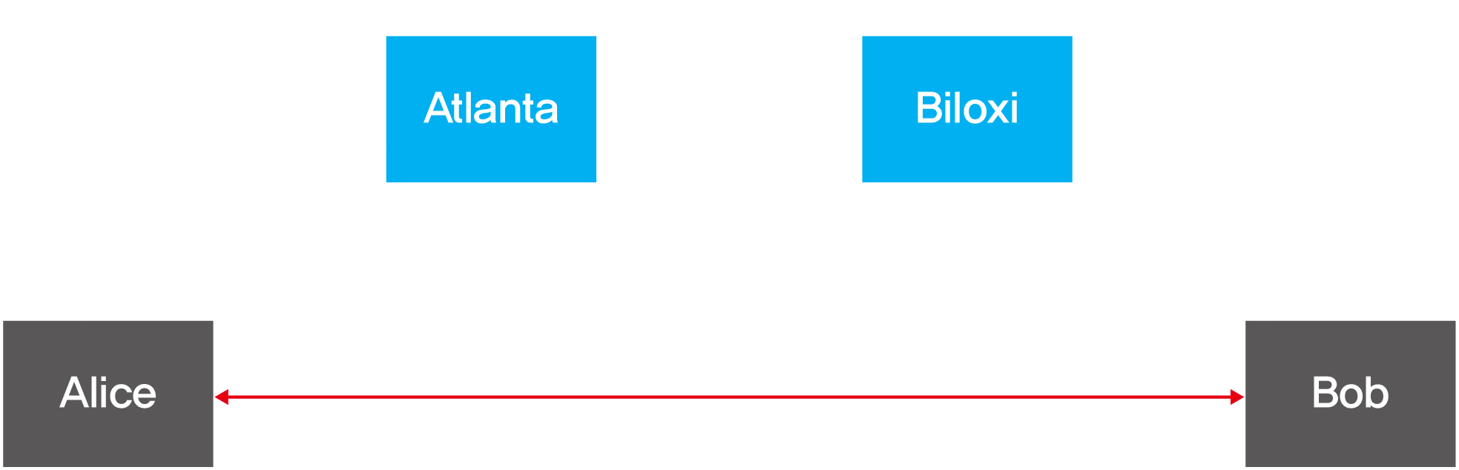
SIP Proxy
Alice sends invite message to her proxy server
contains address sip:bob@domain.com
proxy responsible for routing SIP messages to callee, possibly through multiple proxies
Bob sends response back through same set of SIP proxies
Proxy returns Bob’s SIP response message to Alice
contains Bob’s IP address
출처 - https://www.google.co.kr/url?sa=i&source=images&cd=&cad=rja&uact=8&ved=2ahUKEwiOto_LnaneAhXPM94KHX3RBW0QjRx6BAgBEAU&url=https%3A%2F%2Fslideplayer.com%2Fslide%2F3131742%2F&psig=AOvVaw3gT0AbyBw4qaVOPjaNBUd0&ust=1540813043001118

Slide 41
SIP Registrar
Q: “How can the proxy server determine the current IP address?” A: Thanks to SIP registrar
Operation of registrar
every SIP user has an associated registrar, analogous to an authoritative DNS server
whenever a user launches an SIP application on a device, the application sends an SIP register message to the registrar, informing the registrar of its current IP address
e.g., when Bob launches his SIP application on his PDA, the application would send a message along the lines of:
REGISTER sip:domain.com SIP/2.0
Via: SIP/2.0/UDP 193.64.210.89
From: sip:bob@domain.com
To: sip:bob@domain.com
Expires: 3600
Notes:
Bob’s registrar keeps track of Bob’s current IP address. Whenever Bob switches to a new SIP device, the new device sends a new register message, indicating the new IP address. Also, if Bob remains at the same device for an extended period of time, the device will send refresh register messages, indicating that the most recently sent IP address is still valid. (In the example above, refresh messages need to be sent every 3600 seconds to maintain the address at the registrar server.)

Slide 42
06. Network Support for Multimedia

Slide 43
Network-Level Support for Multimedia
Making the best of best-effort service
deployment of additional bandwidth and switching capacity to continue to ensure satisfactory delay and packet-loss performance
network dimensioning: how to design a network topology to achieve a given level of end-to-end performance
Differentiated service
different classes of service for different types of traffic
Per-connection Quality-of-Service guarantees
explicit reservation of end-to-end resource for each instance of an application
the network needs new mechanisms for packet marking, scheduling, and more
new and complex software in hosts and routers

Slide 44
Dimensioning Best-Effort Networks
Approach: deploy enough link capacity so that congestion may not occur and multimedia traffic may flow without delay or loss
pros: low complexity of network mechanisms (can use current “best effort” network)
cons: high costs
Challenges
bandwidth provisioning: “how much capacity at network links is enough in a given topology?”
network dimensioning: “how to design a network topology to achieve a given level of end-to-end performance?”

Slide 45
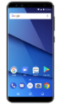

Providing Multiple Classes of Service
Approach: different levels of service to the different classes of traffic
Motivating scenario: 1 Mbps VoIP application shares a 1.5 Mbps link with HTTP
HTTP bursts can congest router, causing audio loss
want to give strict priority to audio over HTTP
Granularity: differential service among multiple classes, not among individual connections (Type-of-Service field in IPv4)
R1
R2
R1 output
interface
queue
1.5 Mbps link
Insight 1
Packet marking needed for router to distinguish between different classes; and new router policy to treat packets accordingly

Slide 46
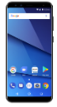

Problem with Strict Priority
Q: What if applications misbehave? E.g., VoIP sends faster than declared rate?
A: The HTTP packets will starve, that is, they will not receive any service
Traffic isolation through policing
policing: force source adherence to bandwidth allocation
1 Mbps
phone
R1
R2
1.5 Mbps link
packet marking and policing
Insight 2
Provide protection (traffic isolation) for one class from others

Slide 47
Problem with Traffic Isolation
Q: What if flows does not use its allocation after fixed (non-sharable) bandwidth is allocated?
A: Inefficient use of bandwidth
1 Mbps logical link
1 Mbps
phone
R1
R2
1.5 Mbps link
0.5 Mbps logical link
Insight 3
While providing traffic isolation, it is desirable to use resources as efficiently as possible link scheduling

Slide 48
Link Scheduling
Packet scheduling: choose next queued packet to send on outgoing link
Previously covered in Chapter 4:
FCFS: first come first served
simply multi-class priority
round robin
weighted fair queueing (WFQ)
packet
arrivals
packet
departures
queue
(waiting area)
link
(server)

Slide 49
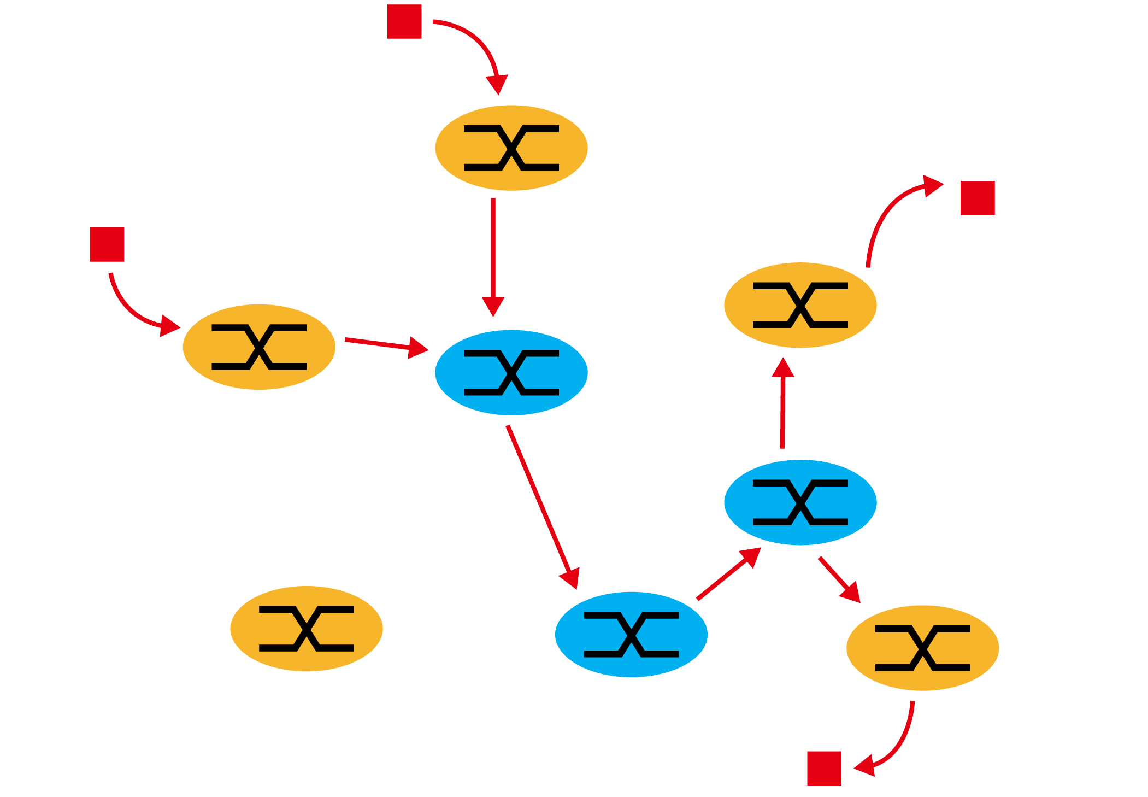
Case Study: Diffserv Architecture
For scalability, only simple functionality is placed within the network core, with more complex control operations being implemented at the network’s edge
Edge functions: packet classification and traffic conditioning
Core function: forwarding
based on only packet markings, without distinguishing packet sources
출처 - https://www.google.co.kr/url?sa=i&source=images&cd=&cad=rja&uact=8&ved=2ahUKEwjd1MT0javeAhUMvrwKHezhBDAQjRx6BAgBEAU&url=http%3A%2F%2Fwww2.ic.uff.br%2F~michael%2Fkr1999%2F6-multimedia%2F6_09-diffserv.htm&psig=AOvVaw004KmDX6BlqJEEdPE3qYty&ust=1540883709487404

Slide 50
Per-Connection QoS Guarantees
Q: Can the differentiated service guarantee that an ongoing flow in a high-priority traffic class will continue to receive such service throughout the flow’s duration?
A: No.
New network mechanisms are needed for
resource reservation: resource reserved to meet the desired QoS at each and every network router along the source-to-destination path
call admission: decision on whether a call is admitted or not
call setup signaling
Insight 4
Call admission: flow declares its needs, network may block call (e.g., busy signal) if it cannot meet the needs

Slide 51

Resource Reservation during Call Setup Signaling
Resource reservation
call setup signaling (the RSVP protocol)
traffic profile, QoS declaration
per-element admission control
request/
reply

Slide 52
Summary

Slide 53
Summary (1/2)
01
Multimedia Applications
properties of video: high bit rate, compressibility
properties of audio: sampling at constant rate
02
Streaming Stored Video
UDP streaming and HTTP streaming
varying network delay: resolved through playout delay with client-side buffering
03
Voice-over-IP
the most important QoS: end-to-end delay
loss tolerable depending on encoding or error concealment
04
Real-time Transport Protocol
a standardized packet structure that includes fields for most audio/video data
runs in end systems, typically on top of UDP

Slide 54
Summary (2/2)
05
Session Initiation Protocol
session initiation between two endpoints
name translation and user location, analogous to DNS
06
Network Support for Multimedia
network dimensioning
differentiated service per-class or per-connection

