Slide 1
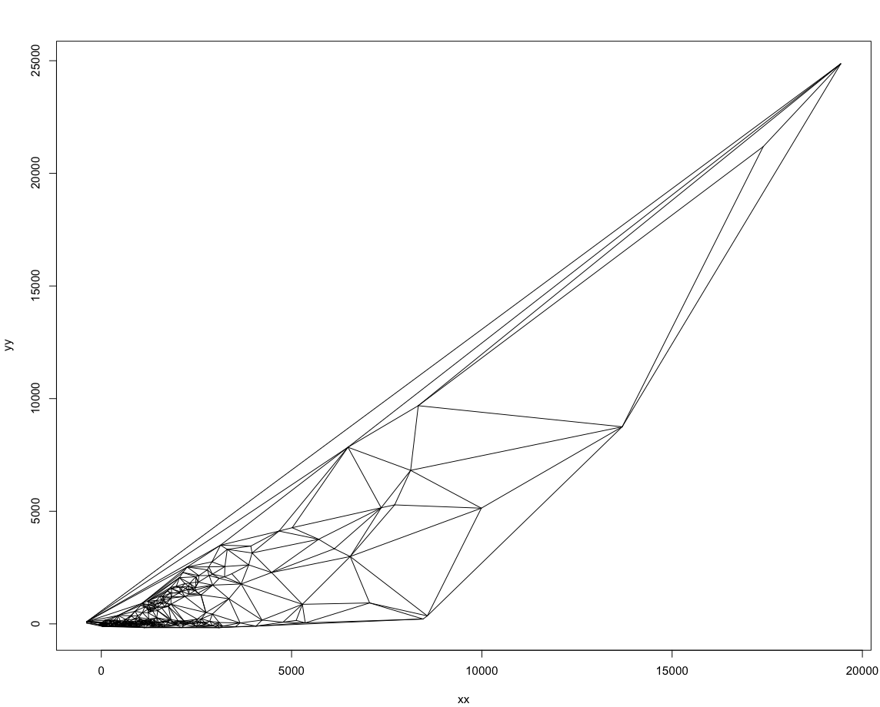
Notes:
First 500 points that are less than 50000

Slide 2
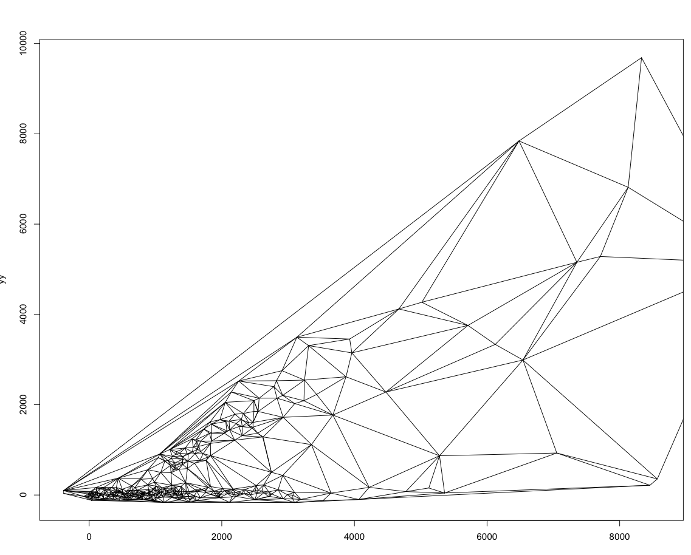

Slide 3
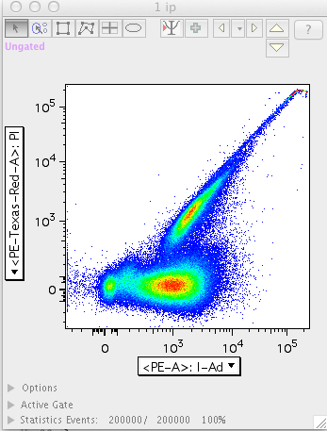
Notes:
1_ip_C.fcs PE x PE-Texas Red

Slide 4
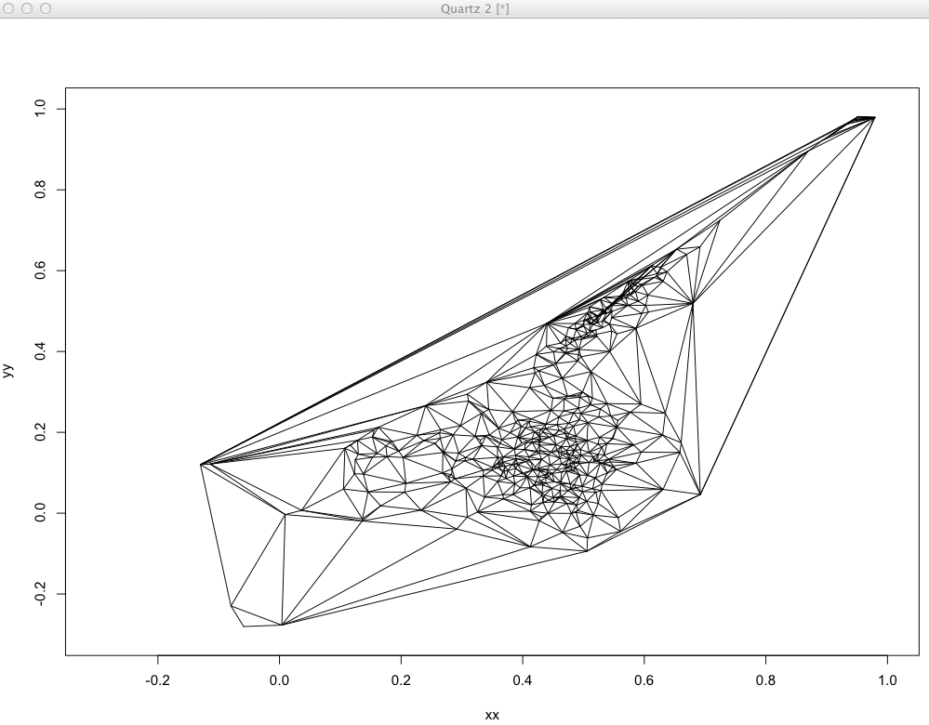
Notes:
500 data points that have gone through the logical transformation.

