Slide 1
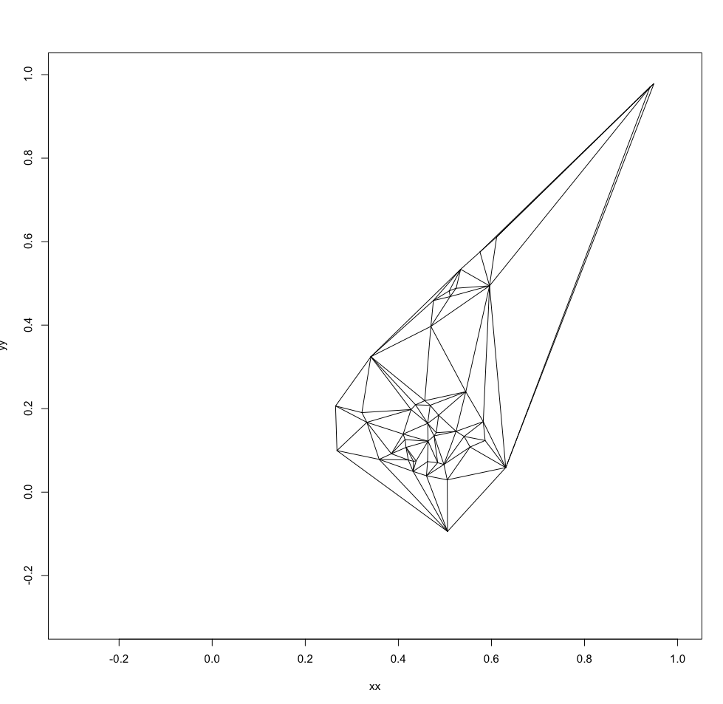
Notes:
printRR.r

Slide 2
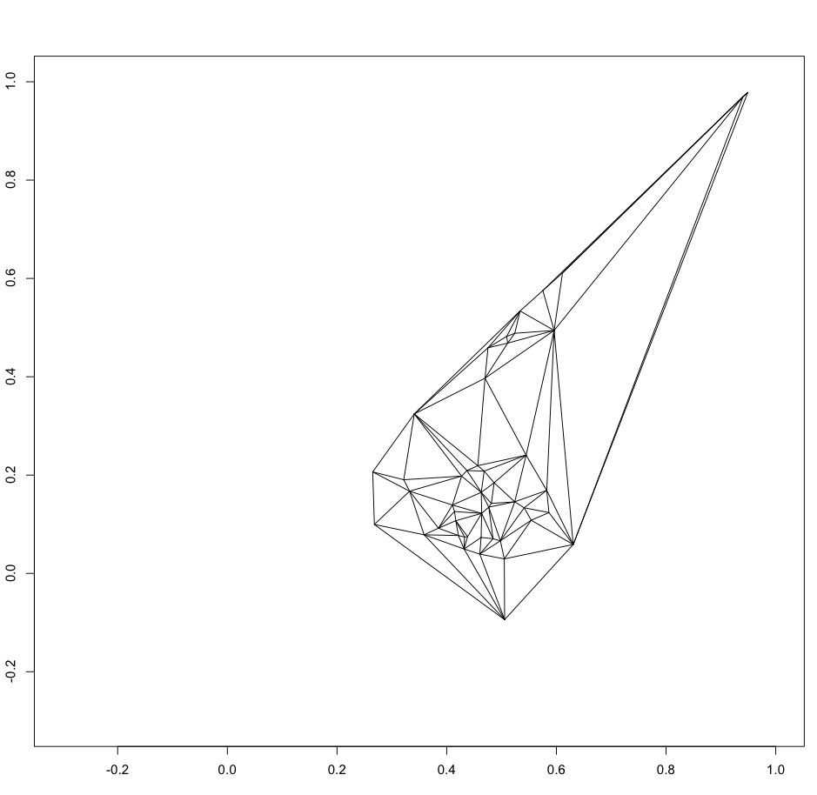
Notes:
From the level list of lines.

Slide 3
