Slide 1

PRACTICAL IN CLOUD COMPUTING · MR AJAYI
Full Cloud
Infrastructure System
Designing and deploying a production-grade AWS architecture from scratch
Designed and presented by Abdoul Malick LAWAL
with live demonstration

Slide 2



THE CHALLENGE
Why traditional infrastructure falls short
Modern applications demand more than what on-premise servers can provide.
No Scalability
Security Gaps
Storage Limits
On-premise servers cannot scale on demand. Traffic spikes cause performance bottlenecks, downtime, and lost users — while idle hardware wastes resources during quiet periods.
Without centralized identity management, systems expose hardcoded credentials, weak access controls, and unauditable actions — leading to data breaches and compliance failures.
Local storage is expensive to scale, fragile against hardware failure, and not globally accessible. A single disk failure can destroy years of data without proper redundancy.
The solution: a cloud-native architecture that scales, secures, and stores by design.

Slide 3



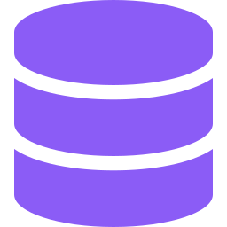




THE STACK
Tools used
Eight AWS services working together to form one complete cloud system.
IAM
VPC
EC2
RDS
Identity & access management. Roles, policies, MFA enforced.
Isolated network. Public + private subnets, IGW, NAT Gateway.
t2.micro backend. Apache + PHP serving the REST API.
Managed MySQL 8.4 in a private subnet. Encrypted at rest.
S3
CloudFront
CloudWatch
Secrets
Object storage for the static frontend. Versioning enabled.
Global CDN with HTTPS, edge caching, permanent URL.
Metrics, alarms, dashboards, log streams from every layer.
Encrypted vault. EC2 retrieves credentials via IAM role.
Plus supporting services: CloudTrail (audit), SNS (alerts), KMS (encryption keys).

Slide 4


THE BLUEPRINT
System architecture
How a user's request flows through every layer of the cloud stack.
USER
Browser
HTTPS request
EDGE
CloudFront
Global CDN · HTTPS · edge cache
FRONTEND
S3 Bucket
Static HTML / CSS / JavaScript
BACKEND
EC2 + Apache
Secrets Manager
PHP REST API · public subnet
Encrypted credentials · IAM role
DATA
RDS MySQL
appdb · private subnet · encrypted
Request flow: User → CloudFront → S3 → fetch() → EC2 → Secrets Manager → RDS → JSON → browser

Slide 5


IMPLEMENTATION
01
IAM Setup
Securing the foundation before launching any service
Locked the root account. admin-user created with AdministratorAccess, MFA enforced on both root and admin.
Built ec2-project-role. Three scoped policies: S3 read, CloudWatch agent, custom ec2-s3-scoped-policy for the project bucket.
Applied least-privilege. No wildcard permissions. Every policy scoped to the minimum required action and resource.
Set a billing safety net. Monthly budget alert at $10 with email notification. Status: Healthy.
Outcome: Least-privilege identity layer in place before any server, network, or database was launched.

Slide 6
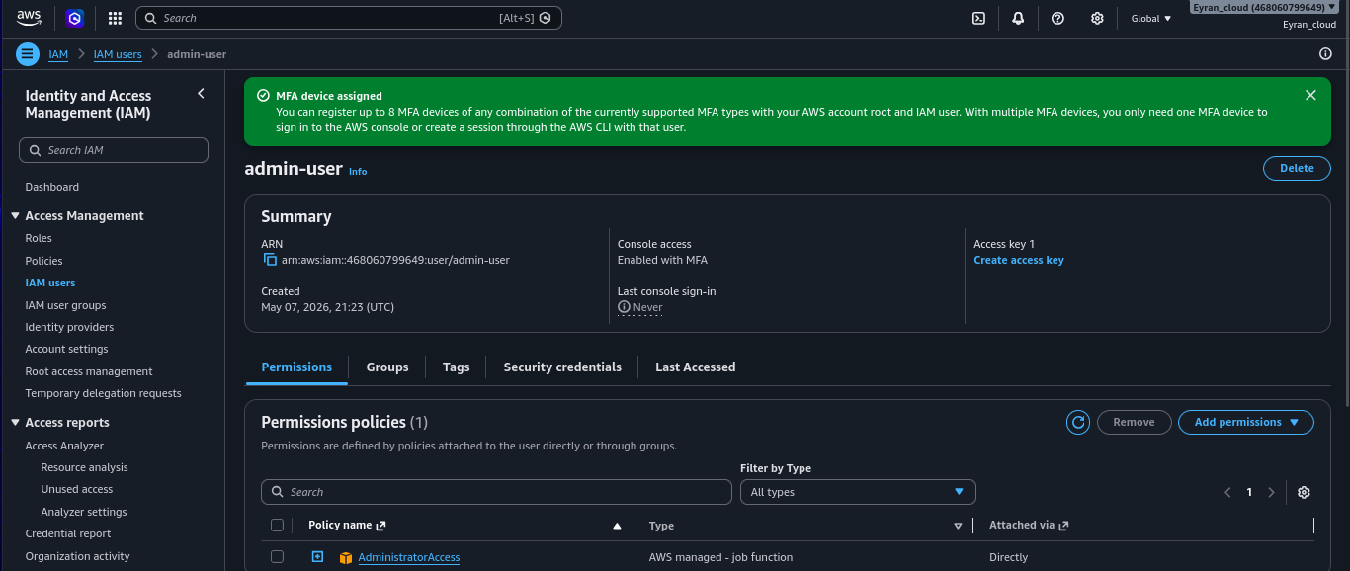
PHASE 01 · EVIDENCE
IAM Setup
admin-user · Console access enabled with MFA
IAM → Users → admin-user · AdministratorAccess attached directly

Slide 7
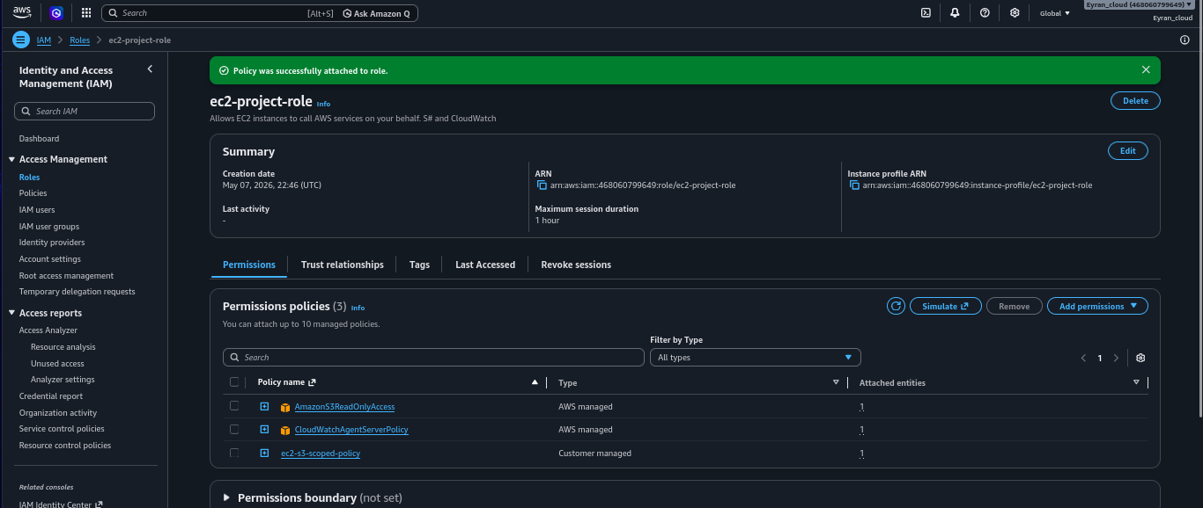
PHASE 01 · EVIDENCE
IAM Setup
ec2-project-role · 3 policies attached
AmazonS3ReadOnlyAccess · CloudWatchAgentServerPolicy · ec2-s3-scoped-policy (customer managed)

Slide 8
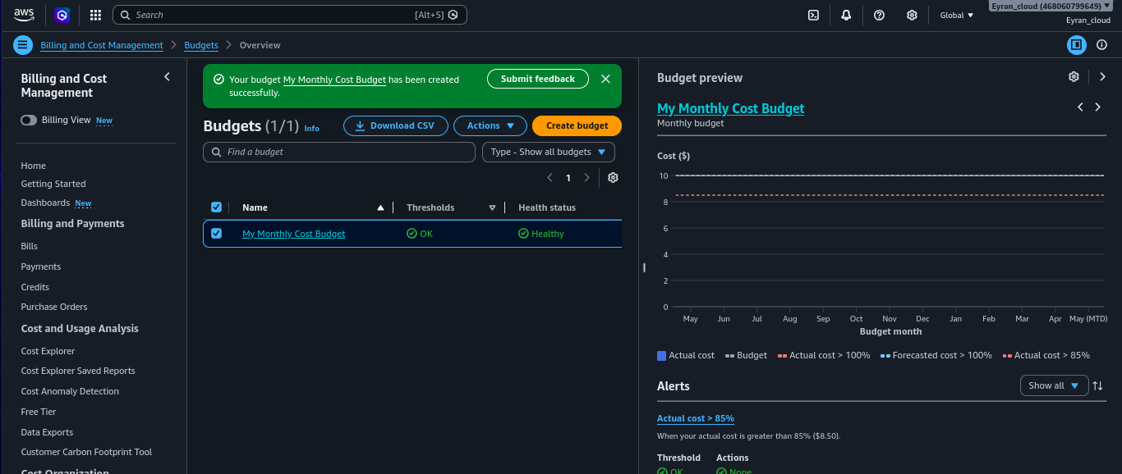
PHASE 01 · EVIDENCE
IAM Setup
Monthly Cost Budget · Status: Healthy
Billing alert at $10 threshold — protection against unexpected charges during the build

Slide 9

IMPLEMENTATION
02
VPC & Networking
Building the isolated network before launching any resource
Created cloud-project-vpc. CIDR 10.0.0.0/16. Fully isolated from other AWS accounts and default infrastructure.
Public + private subnet architecture. 4 subnets across 2 AZs: public-1a/1b for EC2, private-1a/1b for RDS. DB never in a public subnet.
Internet Gateway + NAT Gateway. IGW for two-way public internet. NAT in public-subnet-1a (with EIP) for private outbound-only access.
Route tables configured. Public: 0.0.0.0/0 → IGW. Private: 0.0.0.0/0 → NAT. Local 10.0.0.0/16 traffic stays inside VPC.
Outcome: Public services are reachable. Private data resources are invisible from the internet — enforced by routing design.

Slide 10
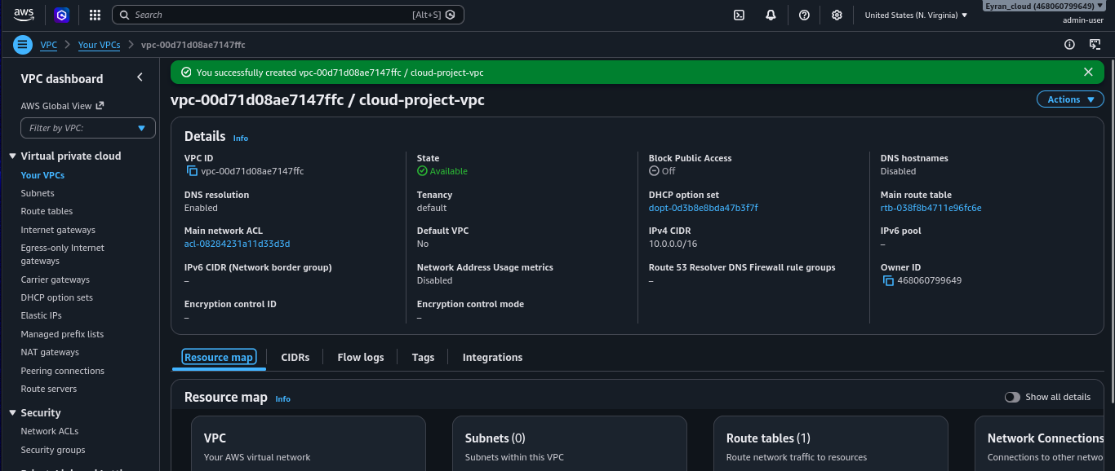
PHASE 02 · EVIDENCE
VPC & Networking
cloud-project-vpc · CIDR 10.0.0.0/16 · State: Available
VPC successfully created — the isolated network container for all project resources

Slide 11
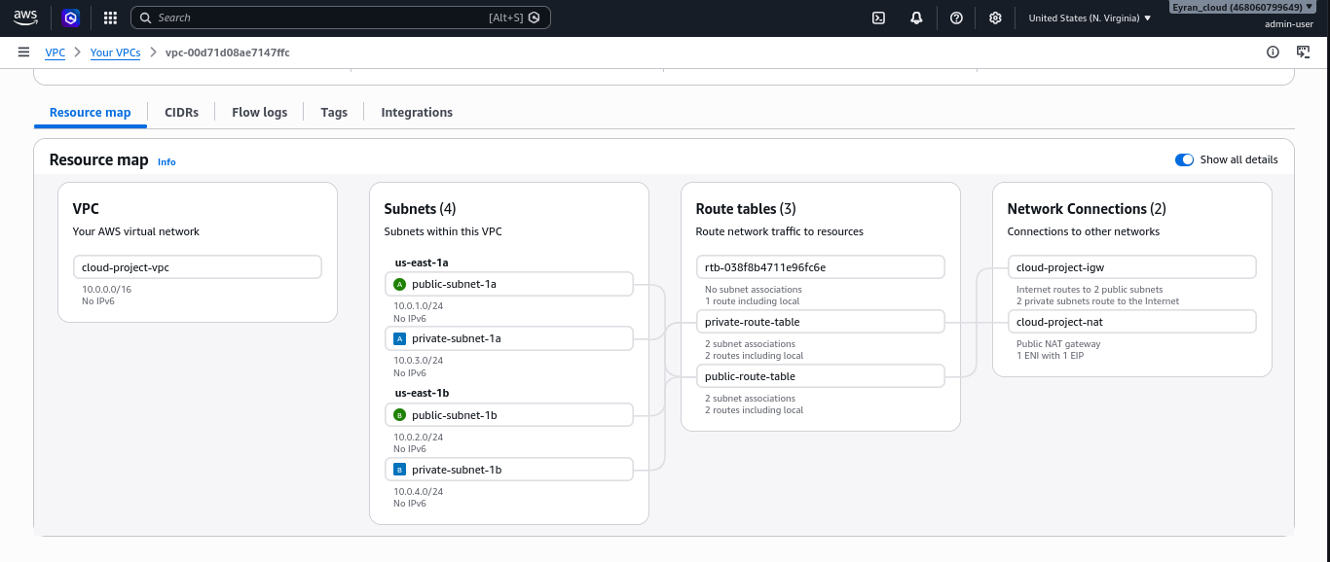
PHASE 02 · EVIDENCE
VPC & Networking
Resource map · 4 subnets · 3 route tables · IGW + NAT Gateway
All network components deployed and connected: public/private subnets across us-east-1a and us-east-1b

Slide 12

IMPLEMENTATION
03
Security Groups
Stateful virtual firewalls controlling traffic to every resource
Created ec2-sg. Inbound: HTTP 80 (all), HTTPS 443 (all), SSH 22 (admin IP 102.67.234.219/32 only). 3 rules.
Created rds-sg. Inbound: MySQL 3306, source = ec2-sg only. Security group chaining — not IP-based.
SG chaining is the key pattern. Even if EC2's IP changes, only instances wearing ec2-sg can reach the database. No IP to maintain.
S3 · CloudFront · IAM need no SGs. Managed services outside the VPC. They use bucket policies, OAC, and identity policies respectively.
Outcome: Internet reaches EC2 on 80/443. EC2 reaches RDS on 3306. Internet has zero path to RDS on any port.

Slide 13
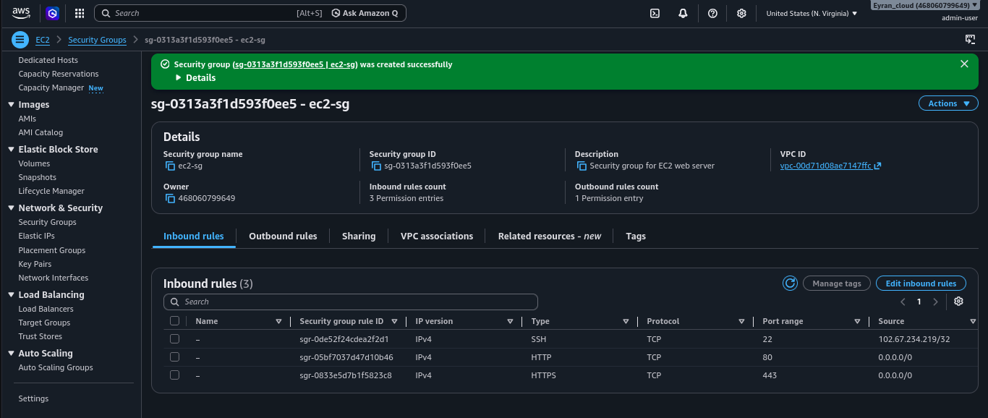
PHASE 03 · EVIDENCE
Security Groups
ec2-sg · 3 inbound rules · SSH locked to admin IP only
HTTP 80 + HTTPS 443 open to 0.0.0.0/0 · SSH 22 restricted to 102.67.234.219/32

Slide 14
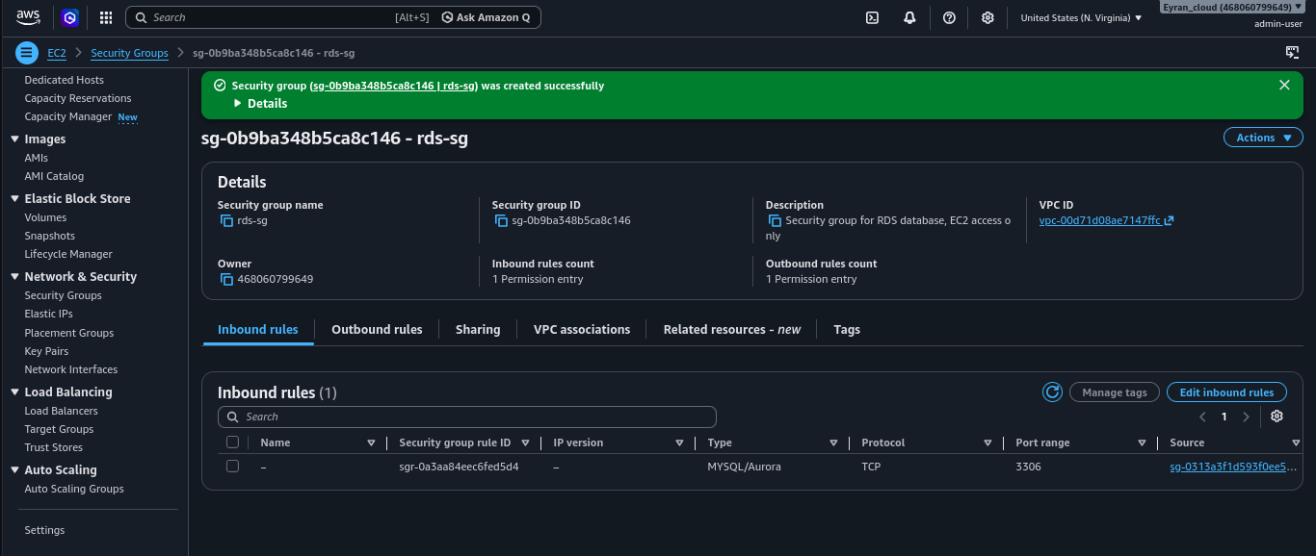
PHASE 03 · EVIDENCE
Security Groups
rds-sg · MySQL port 3306 · Source = ec2-sg (not an IP)
Security group chaining: only EC2 instances wearing ec2-sg can reach the database

Slide 15

IMPLEMENTATION
04
RDS Database
Managed MySQL in the private subnet — never publicly accessible
Created rds-subnet-group. Locked RDS to private-subnet-1a and private-subnet-1b across us-east-1a and us-east-1b.
Launched cloud-project-db. MySQL 8.4 · db.t4g.micro · 20GiB gp2 · Public access: No · Security group: rds-sg.
Database name: appdb. Logical database inside the instance. EC2 connects to the instance endpoint and queries appdb.
Credentials stored in Secrets Manager. rds/cloud-project/credentials — encrypted, retrieved by EC2 via IAM role at runtime. Zero hardcoded secrets.
Outcome: Database is live, private, encrypted at rest, and reachable only by EC2 through the security group chain.

Slide 16
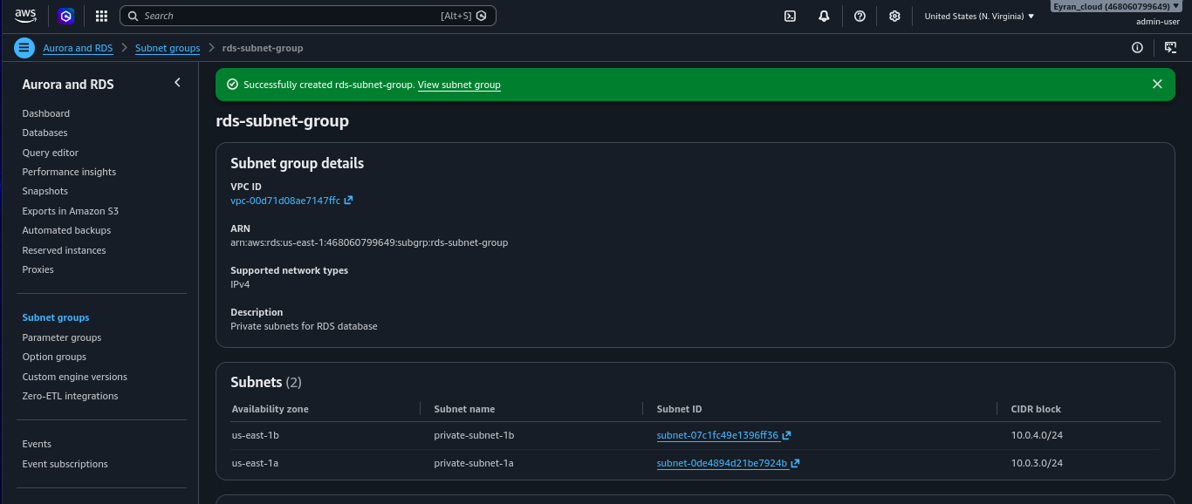
PHASE 04 · EVIDENCE
RDS Database
rds-subnet-group · private-subnet-1a (10.0.3.0/24) + private-subnet-1b (10.0.4.0/24)
RDS locked to private subnets only — cannot be launched into a public subnet

Slide 17
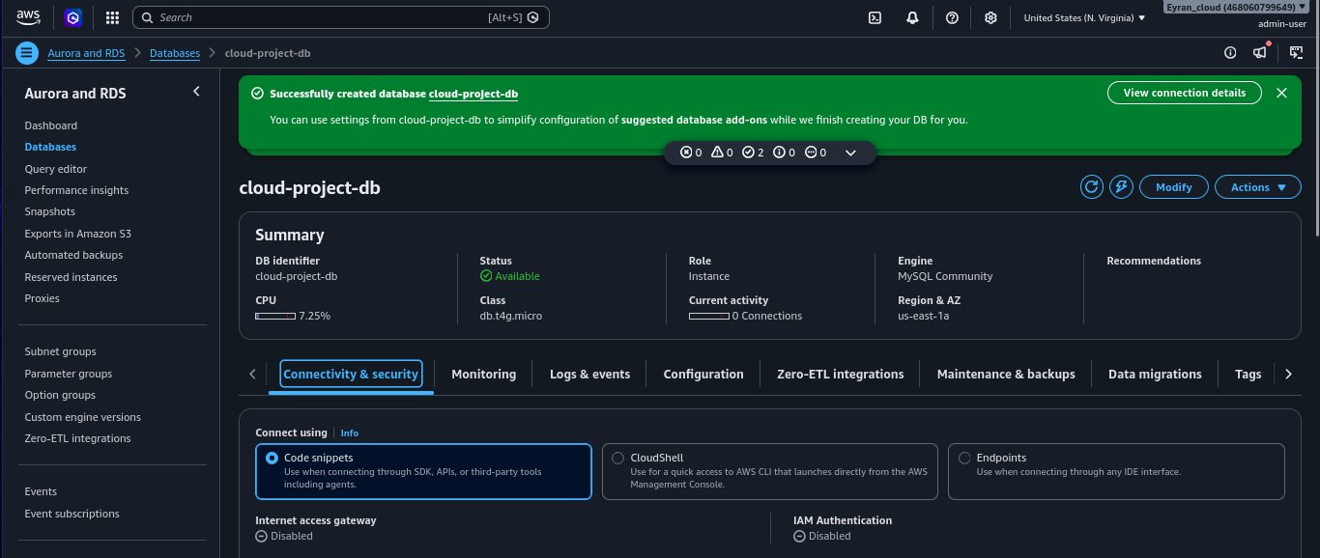
PHASE 04 · EVIDENCE
RDS Database
cloud-project-db · Status: Available · MySQL Community · db.t4g.micro · us-east-1a
Internet access gateway: Disabled · IAM authentication: Disabled · Connectivity via rds-sg only

Slide 18
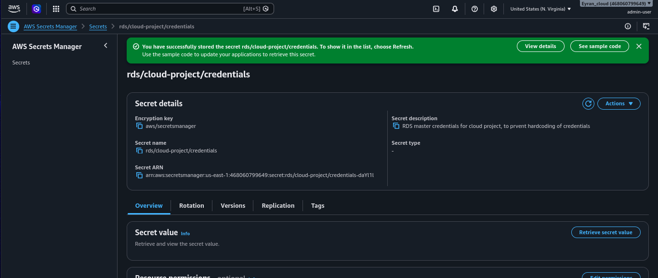
PHASE 04 · EVIDENCE
RDS Database
rds/cloud-project/credentials · Stored in AWS Secrets Manager
Encrypted with aws/secretsmanager key · Retrieved by EC2 via ec2-project-role at runtime — no hardcoded passwords

Slide 19


IMPLEMENTATION
05
EC2 Backend Server
Virtual server running the API, connecting EC2 to RDS through the private network
Launched cloud-project-backend. t2.micro · Amazon Linux 2023 · public-subnet-1a · ec2-sg · IAM role: ec2-project-role attached.
Installed Apache + PHP 8.5.5. Web server active and running. PHP with pdo_mysql and mysqlnd extensions. SELinux network permissions enabled.
Connected to RDS from EC2. MySQL client connected to cloud-project-db endpoint. appdb confirmed reachable. Products table created and seeded with 3 rows.
Deployed PHP app with Secrets Manager. index.php and api.php retrieve credentials via AWS SDK — ec2-project-role authenticates automatically. Zero hardcoded passwords.
Outcome: Live server running Apache + PHP, serving data from RDS via a credential chain that never exposes a password in code.

Slide 20
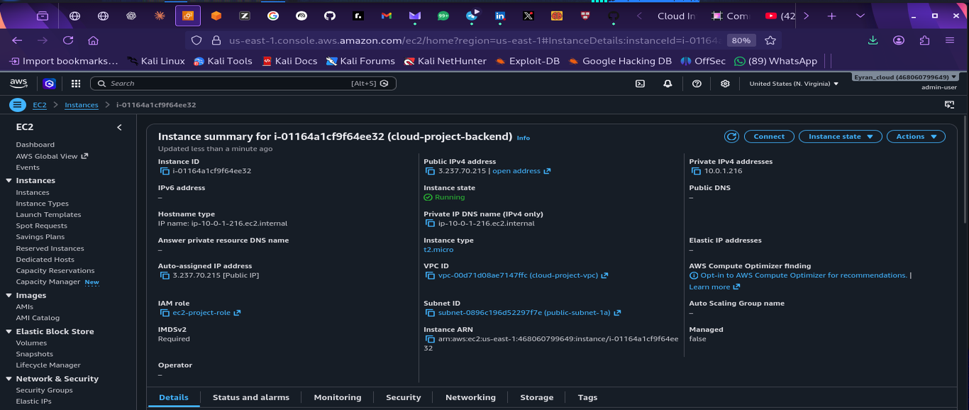
PHASE 05 · EVIDENCE
EC2 Backend Server
EC2 instance · Running · Public IP 3.237.70.215 · IAM role: ec2-project-role attached
EC2 console → cloud-project-backend · t2.micro · public-subnet-1a · Status checks: 2/2 passed

Slide 21
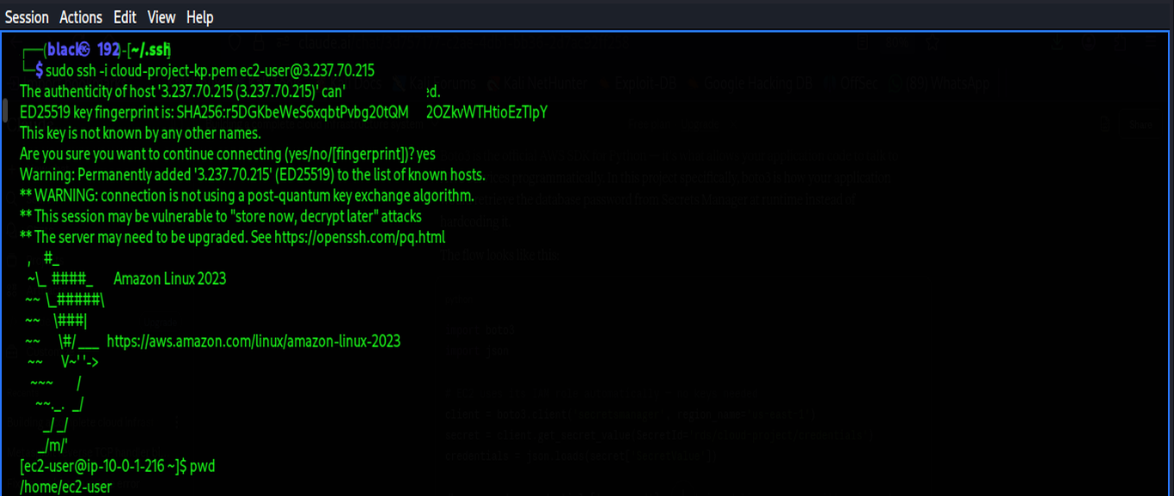
PHASE 05 · EVIDENCE
EC2 Backend Server
SSH terminal · ec2-user connected · Amazon Linux 2023 · Apache active (running)
ssh -i cloud-project-key.pem ec2-user@3.237.70.215 · pwd /home/ec2-user · Amazon Linux 2023

Slide 22
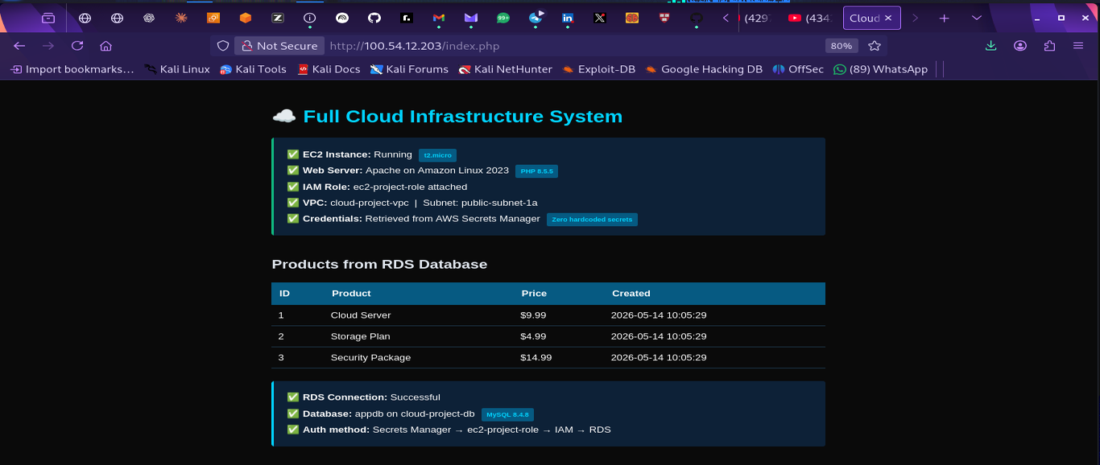
PHASE 05 · EVIDENCE
EC2 Backend Server
Live browser · http://3.237.70.215/index.php · Products from RDS · Secrets Manager auth confirmed
EC2 Instance: Running t2.micro · Web Server: Apache PHP 8.5.5 · Auth: Secrets Manager → IAM → RDS

Slide 23
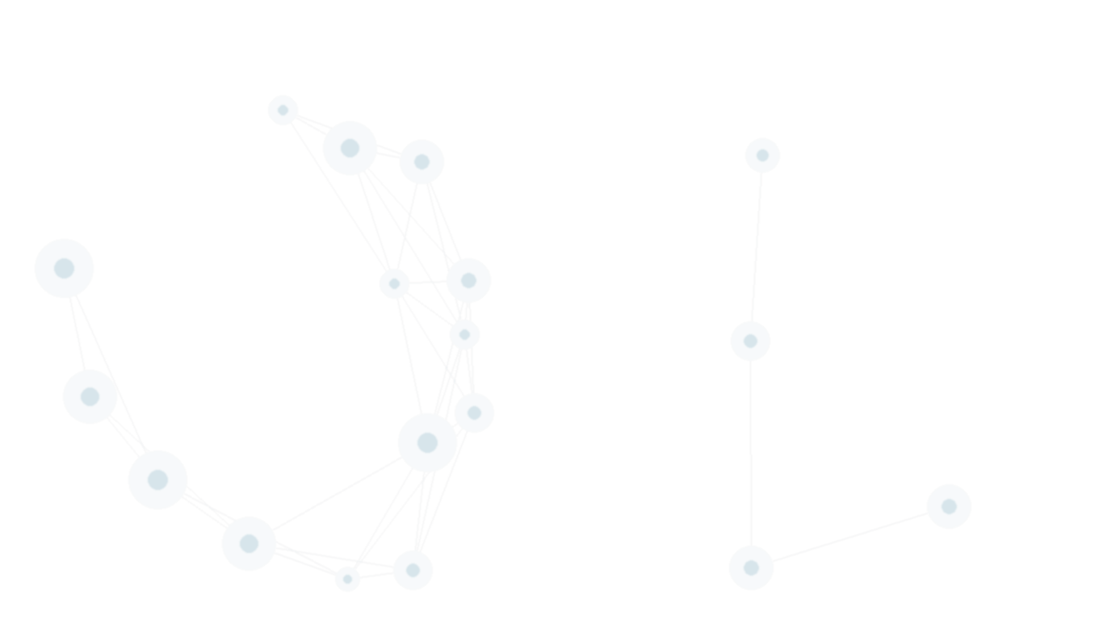
IMPLEMENTATION
06
S3 Frontend Hosting
Static frontend separated from the backend — served from object storage
Created cloud-project-front-mike. Public access unblocked · versioning enabled · SSE-S3 encryption · PublicReadGetObject bucket policy.
Enabled static website hosting. Index document: index.html · Error document: error.html · Website endpoint generated.
Built and uploaded the frontend. HTML/CSS/JS page with architecture cards for all 6 services and a live data section. Uploaded via S3 console.
Created api.php on EC2. Dedicated JSON API endpoint with CORS headers. Calls Secrets Manager → RDS → returns product array to browser fetch().
Outcome: Frontend and backend fully separated. S3 serves static files at near-zero cost. EC2 handles only actual data processing.

Slide 24
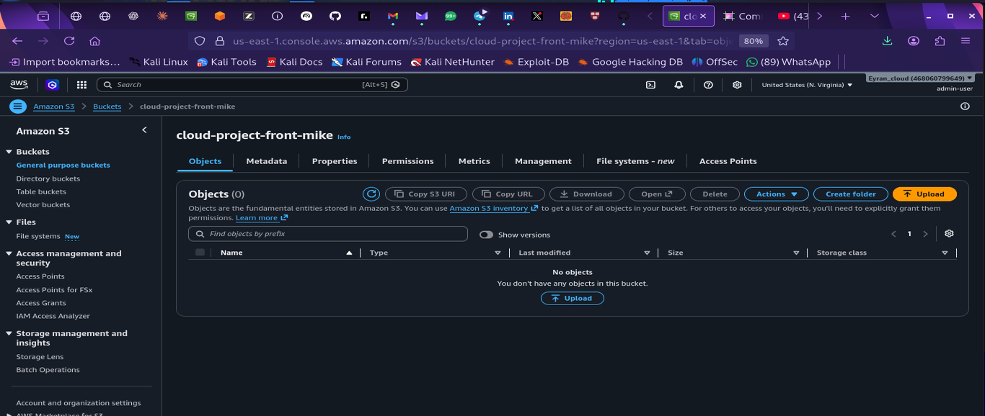
PHASE 06 · EVIDENCE
S3 Frontend Hosting
cloud-project-front-mike · S3 bucket created · Objects (0) — ready for upload
Public access unblocked · Versioning enabled · SSE-S3 encryption · PublicReadGetObject policy

Slide 25
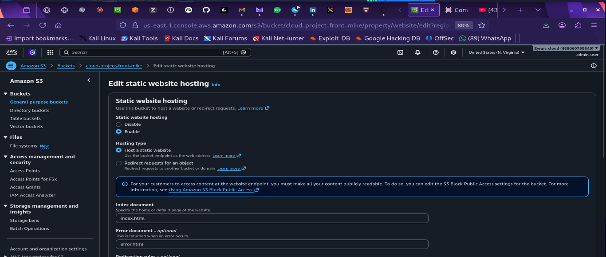
PHASE 06 · EVIDENCE
S3 Frontend Hosting
Static website hosting · Enabled · Index: index.html · Error: error.html
Hosting type: Host a static website · bucket endpoint as web address · Block Public Access unblocked

Slide 26
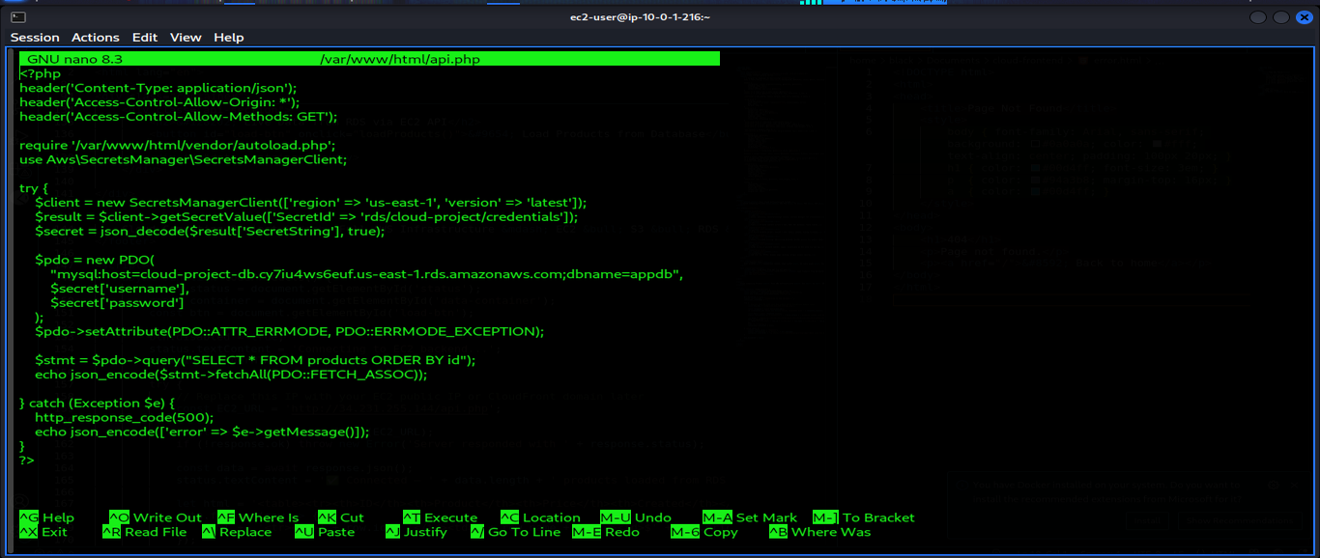
PHASE 06 · EVIDENCE
S3 Frontend Hosting
api.php on EC2 · Secrets Manager SDK · PDO → cloud-project-db · JSON API for S3 frontend
SecretsManagerClient → getSecretValue('rds/cloud-project/credentials') → new PDO → SELECT * FROM products

Slide 27
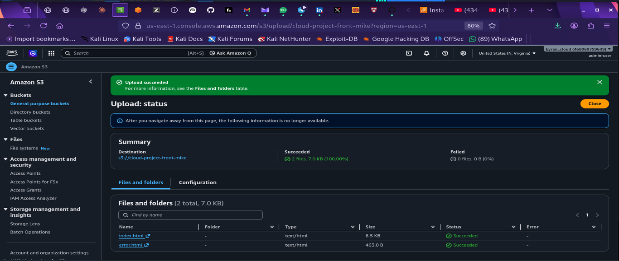
PHASE 06 · EVIDENCE
S3 Frontend Hosting
S3 upload succeeded · index.html + error.html · 2 files · 7.0 KB · 100%
Destination: s3://cloud-project-front-mike · 2 files succeeded · 0 failed · Static frontend deployed

Slide 28
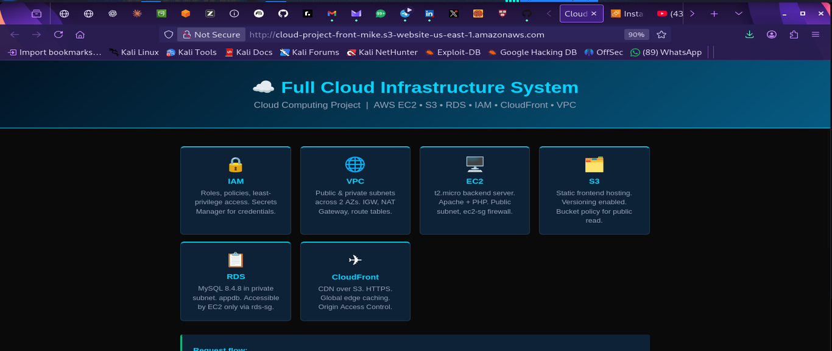
PHASE 06 · EVIDENCE
S3 Frontend Hosting
S3 website endpoint loading · http://cloud-project-front-mike.s3-website-us-east-1.amazonaws.com
Full Cloud Infrastructure System page · IAM · VPC · EC2 · S3 · RDS · CloudFront service cards

Slide 29
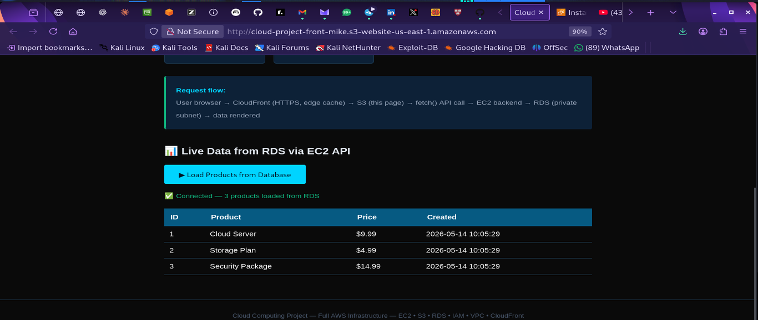
PHASE 06 · EVIDENCE
S3 Frontend Hosting
S3 website · Load Products → Connected — 3 products loaded from RDS via EC2 API
fetch() → EC2 api.php → Secrets Manager → RDS → JSON · Cloud Server $9.99 · Storage Plan $4.99

Slide 30
IMPLEMENTATION
07
CloudFront CDN
Global edge delivery with HTTPS, caching, and a permanent URL
Created cloud-project-distribution. Origin: S3 website endpoint · HTTP → HTTPS redirect · Free plan · Domain: dlwztrz85p46c.cloudfront.net.
HTTPS auto-provisioned. TLS certificate issued by AWS for *.cloudfront.net. Viewer protocol: Redirect HTTP to HTTPS. HTTP/2 supported.
Edge caching demonstrated live. x-cache: Miss from cloudfront on first load. x-cache: Hit from cloudfront on reload. Load time dropped measurably.
CORS locked to CloudFront domain. api.php updated: Access-Control-Allow-Origin set to https://dlwztrz85p46c.cloudfront.net. S3 endpoint now blocked — correct.
Outcome: Frontend served over HTTPS from a permanent URL with global edge caching. S3 endpoint inaccessible directly — CloudFront is the only door.

Slide 31
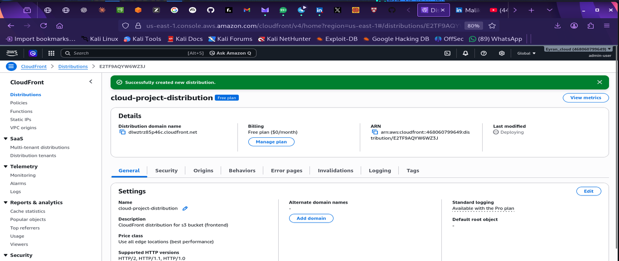
PHASE 07 · EVIDENCE
CloudFront CDN
CloudFront distribution · cloud-project-distribution · Successfully created · dlwztrz85p46c.cloudfront.net
Free plan ($0/month) · Price class: Use all edge locations · Deploying · Origin: S3 website endpoint

Slide 32
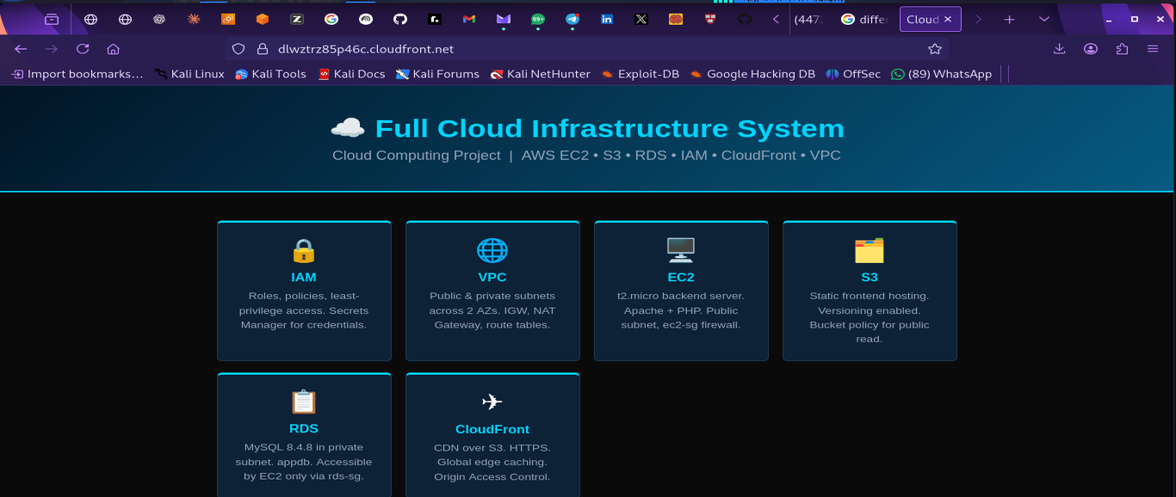
PHASE 07 · EVIDENCE
CloudFront CDN
Browser at https://dlwztrz85p46c.cloudfront.net · HTTPS · Full Cloud Infrastructure System loaded
CloudFront → S3 → fetch() → EC2 api.php → Secrets Manager → RDS → JSON → browser renders

Slide 33
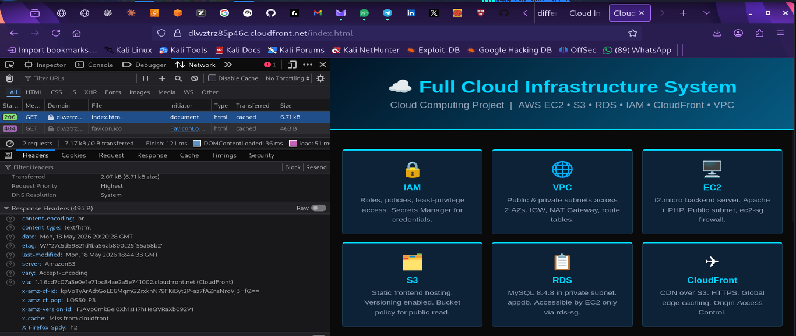
PHASE 07 · EVIDENCE
CloudFront CDN
DevTools Network · x-cache: Miss from cloudfront · First load · HTTP/2 · server: AmazonS3
https://dlwztrz85p46c.cloudfront.net/index.html · Status 200 · content-encoding: br · via: CloudFront

Slide 34
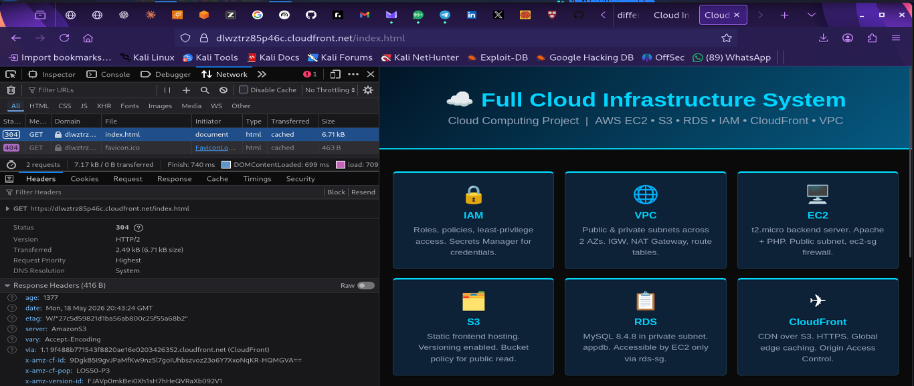
PHASE 07 · EVIDENCE
CloudFront CDN
DevTools Network · x-cache: Hit from cloudfront · Reload · 304 · load: 740ms → 121ms cached
age: 1377 · etag matched · x-amz-cf-pop: LOS50-P3 · Edge cache serving — EC2 not hit on reload

Slide 35

IMPLEMENTATION
08
CloudWatch Monitoring
Full observability across every layer of the infrastructure
Built cloud-project-dashboard. 4 widgets: EC2 CPU, EC2 NetworkIn/Out, RDS CPUUtilization, RDS DatabaseConnections. Real data visible.
Created EC2-High-CPU-Alarm. CPUUtilization > 80% for 1 datapoint in 5 minutes → SNS email alert. Actions enabled. Metric: Average.
Enabled CloudTrail. cloud-project-trail: multi-region, logs to S3, CloudWatch Logs integration. Every API call audited. GetSecretValue events visible.
Deployed CloudWatch Agent. Apache access_log and error_log streaming to cloud-project-apache-access log group. Every HTTP request logged.
Outcome: Dashboard shows infrastructure health. Alarms alert proactively. CloudTrail audits every action. Logs show application behavior.

Slide 36
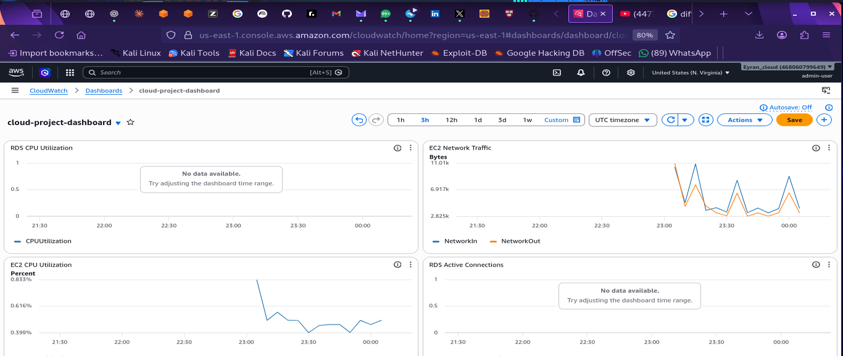
PHASE 08 · EVIDENCE
CloudWatch Monitoring
cloud-project-dashboard · EC2 CPU + Network Traffic + RDS CPU + RDS Active Connections
EC2 Network Traffic: NetworkIn/NetworkOut spikes visible · EC2 CPU 0.833% · 4 widgets all live data

Slide 37
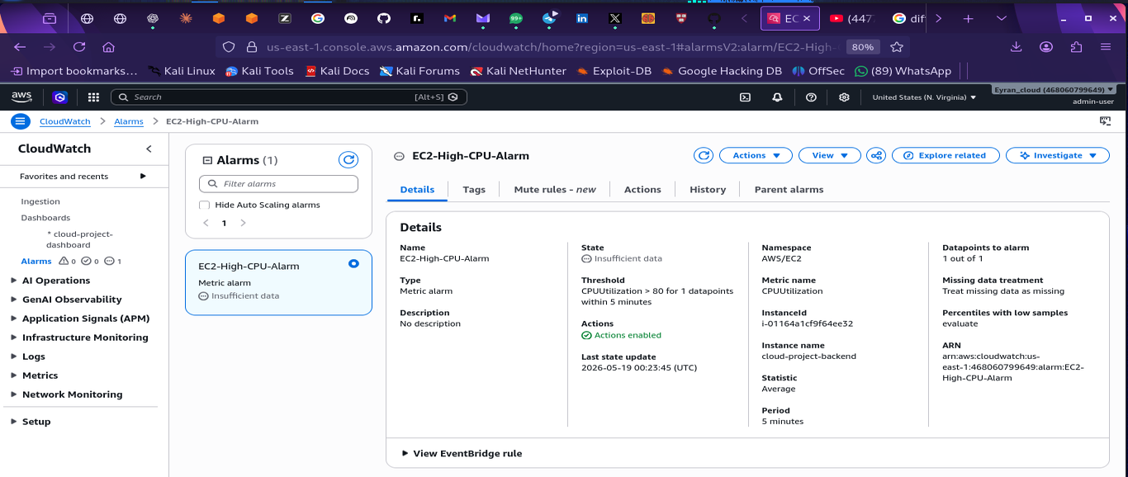
PHASE 08 · EVIDENCE
CloudWatch Monitoring
EC2-High-CPU-Alarm · CPUUtilization > 80% for 1 datapoint in 5 minutes · Actions enabled
Namespace: AWS/EC2 · Instance: cloud-project-backend (i-01164a1cf9f64ee32) · Statistic: Average · Period: 5 min

Slide 38
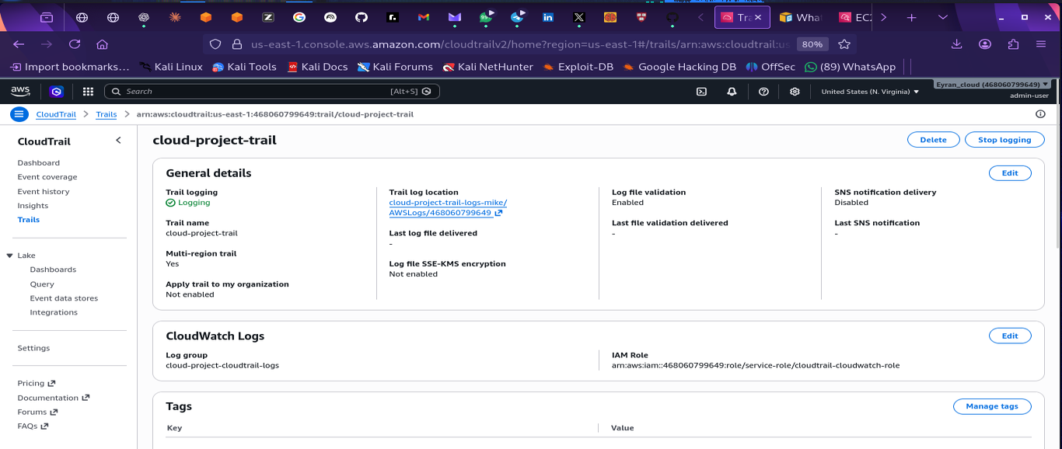
PHASE 08 · EVIDENCE
CloudWatch Monitoring
cloud-project-trail · Trail logging: Active · Multi-region · CloudWatch Logs integration
Log group: cloud-project-cloudtrail-logs · IAM role: cloudtrail-cloudwatch-role · S3: cloud-project-trail-logs-mike/

Slide 39
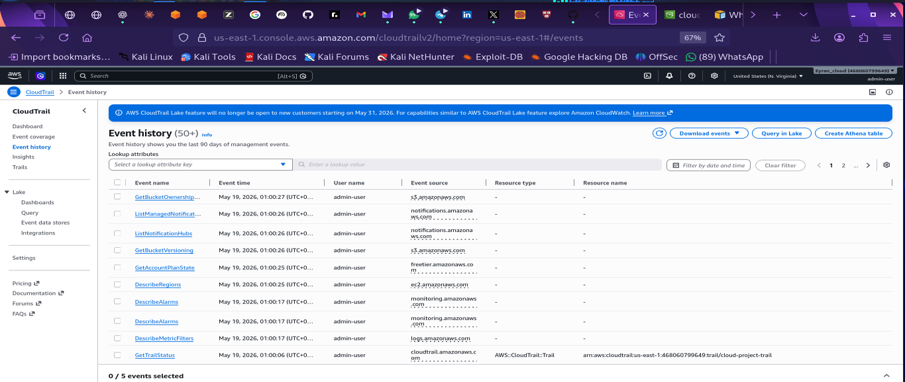
PHASE 08 · EVIDENCE
CloudWatch Monitoring
CloudTrail Event History (50+) · All management events audited · admin-user · multi-service
GetBucketOwnership · GetBucketVersioning · DescribeRegions · DescribeAlarms · GetTrailStatus — full audit trail

Slide 40
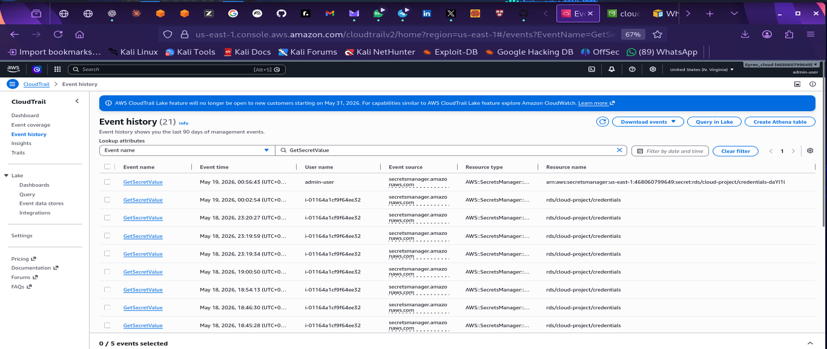
PHASE 08 · EVIDENCE
CloudWatch Monitoring
CloudTrail Event History · GetSecretValue · 21 audit events · Caller: i-01164a1cf9f64ee32
Every time EC2 retrieved DB credentials from Secrets Manager — timestamped · attributed · auditable

Slide 41
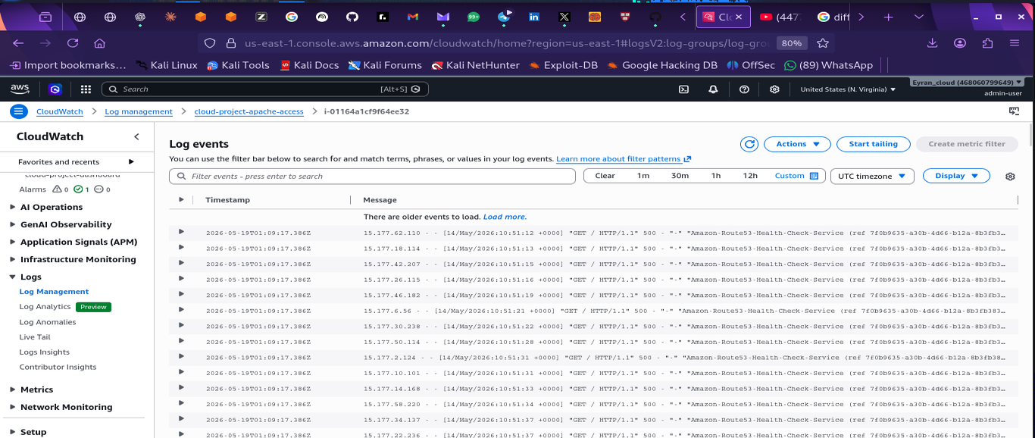
PHASE 08 · EVIDENCE
CloudWatch Monitoring
CloudWatch Logs · cloud-project-apache-access · i-01164a1cf9f64ee32 · Live Apache log stream
Every HTTP request to EC2 captured: timestamp · client IP · URL · response code · bytes transferred

Slide 42

SECURITY
Security architecture
Multiple layers of security applied at every tier of the stack.
Identity
Network
Firewall
MFA on all accounts
Public/private subnet isolation
ec2-sg: HTTP/HTTPS open · SSH admin-IP only
Least-privilege IAM roles
IGW for EC2 · NAT for RDS (outbound only)
rds-sg: port 3306 from ec2-sg only
No hardcoded credentials — Secrets Manager
RDS has no public IP or DNS
Security group chaining — not IP-based
Data
Audit
RDS encryption at rest (AWS KMS)
CloudTrail: every API call logged
CloudFront enforces HTTPS — HTTP redirected
GetSecretValue events attributed to EC2 instance
S3 server-side encryption (SSE-S3)
CloudWatch Logs: all HTTP requests captured

Slide 43
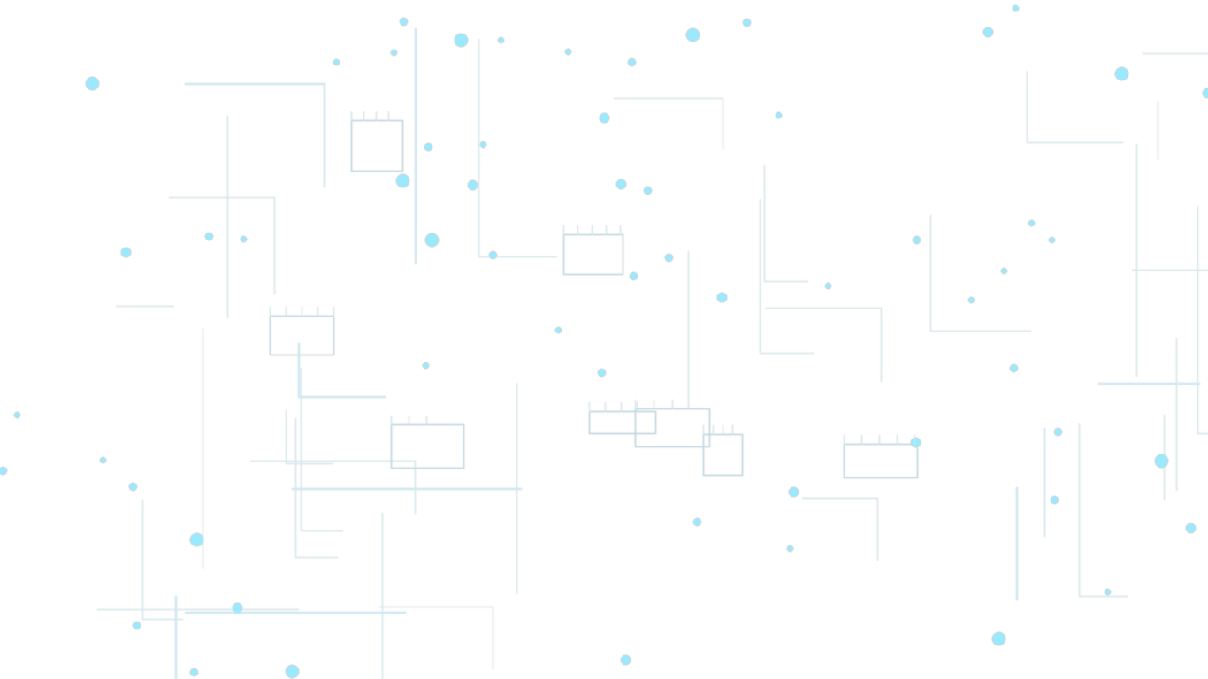
DEMONSTRATION
Live demo — 7 Acts
Live URL
dlwztrz85p46c.cloudfront.net
ACT 01
Identity and Security Foundation
ACT 05
Frontend and CDN
IAM admin-user · ec2-project-role · Secrets Manager · ec2-s3-scoped-policy
S3 website · CloudFront HTTPS · DevTools x-cache Miss → Hit · fetch() → RDS live
ACT 02
Network Architecture
ACT 06
Monitoring and Audit
cloud-project-vpc · 4 subnets · IGW · NAT Gateway · route tables · SG chaining
cloud-project-dashboard · EC2-High-CPU-Alarm · CloudTrail 21 GetSecretValue events
ACT 03
Database
ACT 07
Architecture Summary
cloud-project-db · Available · Private subnet · Public access: No · rds-sg only
Browser → CF → S3 → EC2 → Secrets Manager → RDS · all services live end-to-end
ACT 04
Live Server (SSH)
EC2 Running · SSH live · curl /api.php · JSON returned · systemctl httpd · php -v

Slide 44
CHALLENGES
Challenges & solutions
Real engineering problems encountered and resolved during the build.
⚠ Secrets Manager prompt: 'select a database'
⚠ NAT Gateway created without a subnet or EIP
✓ RDS didn't exist yet. Used 'Other type of secret' with key-value pairs. Linked to RDS in Phase 4 after the instance was created.
✓ Deleted and recreated correctly: placed in public-subnet-1a, Elastic IP allocated. State moved from Pending to Available.
⚠ MySQL: ERROR 1045 Access Denied
⚠ HTTP 500 on first PHP page load
✓ Space between -p and password caused mysql to treat the password as the database name. Fixed: -p'password' (no space, single quotes).
✓ Missing closing single quote on $host variable. PHP crashed silently. Fix: rewrote entire file cleanly with tee command.
⚠ SELinux blocking Apache → RDS connection
⚠ EC2 public IP changed between sessions
✓ Amazon Linux 2023 runs SELinux enforcing by default. Fix: setsebool -P httpd_can_network_connect 1 and httpd_can_network_connect_db 1.
✓ EC2 public IPs are ephemeral — they change on stop/start. Noted as expected behavior. CloudFront provides the permanent URL.

Slide 45
RELEVANCE
Sustainable Development Goals
UN 2030 Agenda — how this cloud infrastructure supports global development goals.
SDG 9
SDG 4
Industry, Innovation & Infrastructure
Quality Education
Cloud democratises access to scalable infrastructure. Startups and SMEs in developing nations can build without massive capital investment — pay-per-use removes the hardware barrier.
Cloud-hosted platforms deliver e-learning globally. AWS Educate provides students with free cloud access. This project itself is evidence of hands-on technical education at scale.
SDG 10
SDG 13
Reduced Inequalities
Climate Action
Pay-per-use pricing removes barriers for low-income organisations to access enterprise-grade technology previously available only to large corporations with expensive hardware.
AWS data centres run on 90%+ renewable energy. Shared cloud infrastructure reduces carbon footprint versus redundant on-premise servers running at low utilisation globally.

Slide 46


CONCLUSION
Full Cloud Infrastructure System
A production-grade AWS stack built from scratch — eight phases, fully deployed and demonstrated live.
IAM + Secrets Manager Least-privilege roles, MFA, zero hardcoded credentials, audit trail via CloudTrail.
EC2 + Apache + PHP Live backend server, Secrets Manager SDK integration, REST API serving JSON.
VPC + Security Groups Isolated network, public/private subnet architecture, SG chaining for DB protection.
S3 + CloudFront Static frontend separated from backend. HTTPS globally via CDN. Permanent URL.
RDS MySQL Private subnet, encrypted at rest, reachable only through security group chain.
CloudWatch + CloudTrail Real-time metrics, CPU alarms, Apache log streaming, API call auditing.

Slide 47
Practical in Cloud Computing · Mr Ajayi · Project 1
Thank You
Abdoul Malick LAWAL
Full Cloud Infrastructure System · IAM · VPC · EC2 · RDS · S3 · CloudFront · CloudWatch
dlwztrz85p46c.cloudfront.net

