Slide 1

9. Peer-to-Peer Systems
Sistemes Distribuïts en Xarxa (SDX)
Facultat d’Informàtica de Barcelona (FIB)
Universitat Politècnica de Catalunya (UPC)
2017/2018 Q2

Slide 2
Contents
Introduction
Unstructured P2P systems
Structured P2P systems

Slide 3
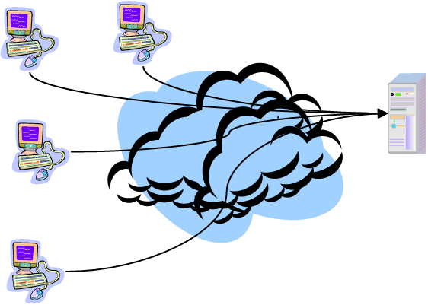
Introduction
Client-server systems have been common (and successful) until now, but incur some scalability and robustness problems in modern scenarios
Need for data and resource sharing on a very large scale
Sudden spikes in demand for data and resources
Instability of nodes and links (can come and go at any time)

Slide 4
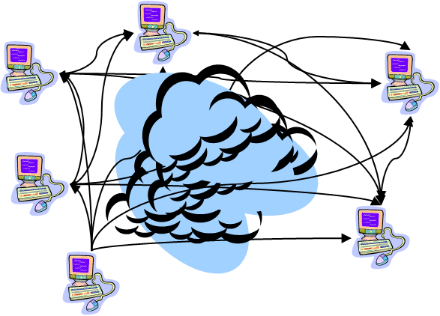
Introduction
Peer-to-Peer (P2P) systems do not distinct between clients and servers
High scalability & availability
Huge amount of computation and storage resources
No performance bottlenecks or single points of failure
Peer functionality is symmetric, all peers contribute resources
Loads are balanced between all peers
Operation independent of any central node

Slide 5
Introduction
Peers are organized in an overlay network
The nodes are formed by the peers and the links represent the possible communication channels
When peers cannot communicate directly with each other, messages have to be routed through the available links
Efficient and fault-tolerant placement of data items across peers and their subsequent access is the main challenge in P2P systems
There is a huge number of peers, and they are volatile (they can join/leave/fail at any time)

Slide 6
Introduction
Two types of overlay networks exist:
Unstructured P2P systems
Overlay topology is constructed ad hoc (random graph)
Items end up placed arbitrarily (must be searched)
Insert is easy, search is hard or imprecise
Examples: Napster, Gnutella, KaZaA
Structured P2P systems
Overlay follows a specific deterministic topology
Items are stored deterministically at specific peers
Insert is hard, search is easy
Examples: DHT-based systems
Kademlia, Chord, Pastry, Tapestry, CAN

Slide 7
Contents
Introduction
Unstructured P2P systems
Structured P2P systems

Slide 8
Contents
Introduction
Unstructured P2P systems
Centralized model
Decentralized model
Hierarchical model
Structured P2P systems

Slide 9
Centralized model: Napster
Query a centralized index system that returns the peer/s that stores the required file
Transfer the file from the given peer/s
m5
Insert(“E”, m5)
m6
E
F
D
E?
E
m1 A
m2 B
m3 C
m4 D
m5 E
m6 F
m4
E?
m5
Lookup(“E”)
C
A
B
m3
m1
m2

Slide 10
Centralized model: Napster
Advantages
Simple and locates files quickly and efficiently
Easy to implement sophisticated search engines on top of the index system
Disadvantages
Lack of robustness: single point of failure
Scalability / performance bottleneck
Resources are distributed, but index service is not
Easy to detect copyright infringements
For this reason, Napster could be shut down

Slide 11
READING REPORT
[Cohen03] Cohen, B., Incentives Build Robustness in BitTorrent, 1st Workshop on Economics of Peer-to-Peer Systems, Berkeley, CA, USA, June 2003

Slide 12
Centralized model: BitTorrent
Collaborative system providing efficient content distribution using file swarming
Each file split into smaller pieces
Nodes request desired pieces from neighbors
Encourages contribution by all nodes
Combines a client-server model for locating the pieces with a P2P download protocol
Usually does not perform all the functions of a typical P2P system, like searching
Written by Bram Cohen (in Python) in 2001

Slide 13
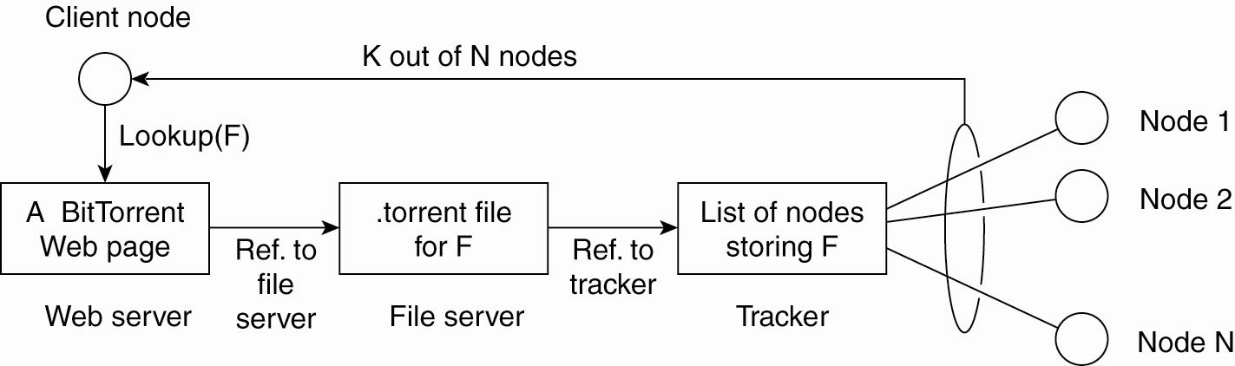
Centralized model: BitTorrent
Peers obtain a .torrent file, hosted in a web server
Peers connect to the tracker specified there
Tracker responds with contact information about the peers that are downloading the same file
Peers then use this information to connect to each other and distribute file pieces among them

Slide 14
Centralized model: BitTorrent
.torrent file contains:
Metadata about the file to be shared
Name, length, piece length, SHA-1 hash of each piece
URL of the tracker
Tracker
Keeps track of all the peers who have the file (seeds/leechers) and which chunks each peer has
When asked for a list of peers, the tracker returns a random subset of the peers, typically 50 peers
Can receive statistics about what peers are doing

Slide 15
Centralized model: BitTorrent
Seeds
Peers that have a complete copy of the file
They are usually selfish and do not want to wait after they get the file
Initial seed: a peer that provides the initial copy
At least the initial seed has to stay to serve one complete copy of the file
Leechers
Any peer who does not have a complete file
He stays a leecher and eventually becomes a seed

Slide 16
BitTorrent: Piece selection
Each file is split into smaller pieces
This is the unit for uploading, typically 256Kb
Pieces are further divided in sub-pieces
This is the unit for downloading, typically 16Kb
The order in which pieces are selected is critical for good performance
Avoid ending with peers having all the same set of available pieces, and none of the missing ones
If the initial seed is prematurely taken down, then the file cannot be completely downloaded

Slide 17
BitTorrent: Piece selection
Rarest Piece First
This is the general rule: download first the pieces that are most rare among your peers
Most commonly available pieces are left until the end to download
Increases diversity in the pieces downloaded
You are going to be useful to others
Avoids the case where all peers have exactly the same pieces
Increases likelihood that all pieces are still available even if the initial seed leaves

Slide 18
BitTorrent: Piece selection
The behavior of the ‘Rarest Piece First’ policy can be modified by three additional policies:
Strict Priority, Random First Piece, Endgame Mode
Strict Priority
Once a single sub-piece has been requested, the other sub-pieces from that piece are requested before sub-pieces from any other piece
As only complete pieces can be sent, it is important to minimize the number of partially-received pieces

Slide 19
BitTorrent: Piece selection
Random First Piece
Special case at the beginning of the download
A peer has nothing to trade so it is important to get a complete piece as soon as possible
‘Rarest Piece First’ is not a good option
Rare pieces are present on few peers, so they would be downloaded slower
Select a random piece of the file and download it
When first complete piece is assembled, switch to ‘Rarest Piece First’

Slide 20
BitTorrent: Piece selection
End Game Mode
Special case at the end of the download
The completion of a download can be delayed due to a single peer with a slow transfer rate
When all missing sub-pieces have been requested, those not received yet are requested from every peer containing them
When a sub-piece arrives, the pending requests for that sub-piece are cancelled
Some bandwidth is wasted, but in practice, this is not too much

Slide 21
BitTorrent: Choking
Want to encourage all peers to contribute
Guarantee a reasonable level of upload and download reciprocation
Avoid ‘free riders’
Choking is a temporary refusal to upload
A chokes B if A decides not to upload to B
A given peer can unchoke only 4 remote peers at a given time
Not because you are connected to somebody you can download from him

Slide 22
BitTorrent: Choking
Unchoking decision reconsidered periodically
Every 10 seconds, the interested remote peers are ordered according to their upload rate to the local peer and the 3 fastest peers are unchoked
i.e. initially they should have unchoked the local peer
Every 30 seconds, one additional interested remote peer from the remaining connections is unchoked at random
This is called optimistic unchoke
Allows to replace peers with better upload capacity and bootstrap new peers that do not have any piece to share

Slide 23
Centralized model: BitTorrent
Advantages
Very good download performance
Slow nodes do not slow down other nodes
Proficient in utilizing partially downloaded files
Discourages ‘freeloading’ by rewarding fastest uploaders
‘Rarest Piece First’ extends the lifetime of swarm, increasing the likelihood all pieces are available
Users use well-known, trusted sources to locate content, as there is not search feature
Avoids the pollution problem, where garbage is passed off as authentic content

Slide 24
Centralized model: BitTorrent
Disadvantages
All interested peers should be active at same time: performance deteriorates if swarm “cools off”
The centralized tracker is a single point of failure
New nodes cannot enter the swarm if tracker goes down
BitTorrent variants without a centralized tracker
e.g. Vuze (former Azureus)
Official client also supports distributed tracking
Mainline DHT (based on Kademlia)
Lack of search feature
Users need to resort to out-of-band search

Slide 25
Contents
Introduction
Unstructured P2P systems
Centralized model
Decentralized model
Hierarchical model
Structured P2P systems

Slide 26
Decentralized model: Gnutella
Based on query flooding
Hot to find a file:
Peer sends Query descriptor to all neighbors
All peers connected to it
Neighbors recursively multicast the descriptor
Eventually a peer that has the file receives the descriptor, and sends back a QueryHit (retracing the path of Query)
Peer requests file to this peer (direct connection)

Slide 27
Decentralized model: Gnutella
Example
Assumption: m1’s neighbors are m2 and m3; m3’s neighbors are m4 and m5;…
m5
m6
E
F
D
E
E?
E?
m4
E?
E?
Lookup(“E”)
C
A
B
m3
m1
m2

Slide 28
Decentralized model: Gnutella
Advantages
Highly decentralized
Location service distributed over peers
Peers have similar responsibilities
No centralized directory
System harder to shut down
Disadvantages
Slow information discovery
Scalability problem due to excessive query traffic
Queries for contents that are not widely replicated must be sent to a large fraction of peers

Slide 29
Decentralized model: Gnutella
Need some mechanisms to control flooding
Add TTL (Time-to-Live) to each message
Number of hops that message may travel before giving up (default in Gnutella is 7)
How to adjust properly TTL value?
For popular objects, small TTLs suffice
For rare objects, large TTLs are necessary
Number of messages grow exponentially with TTL
Expanding ring
Start querying with TTL=1
Keep increasing TTL until search succeeds

Slide 30
Decentralized model: Gnutella
Need some mechanisms to control flooding
Random walk: Ask one neighbor randomly, who asks one neighbor, etc.
Reduces the number of flooded messages
Tradeoff: longer delay, fewer messages
Multiple-walker random walk
Initiate several random walks in parallel
State keeping: Keep track of recently routed messages
Avoids re-broadcasting Query messages
Can choose another neighbor if random walk used

Slide 31
Contents
Introduction
Unstructured P2P systems
Centralized model
Decentralized model
Hierarchical model
Structured P2P systems

Slide 32
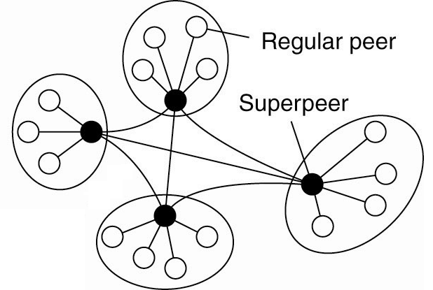
Hierarchical model: FastTrack
Few special nodes (super-peers)
A peer is either a super-peer or assigned to one
Super-peer knows the files in all its peers
Peer queries its super-peer, which may query other super-peers using flooding
Download among peers

Slide 33
Hierarchical model: FastTrack
Advantages
Combines advantages of centralized and decentralized models
Directory is decentralized
Less flooding than decentralized model
Disadvantages
Super-peers can suffer the same problems that the centralized directory
Scalability problems by using flooding
Used in KaZaA, Skype

Slide 34
Contents
Introduction
Unstructured P2P systems
Structured P2P systems

Slide 35
Distributed Hash Tables (DHT)
Goals
Make sure that an item identified is always found
Directed search: Organize peers following a specific distributed data structure + deterministic mapping of data items to peers based only on their ID
Distribute the responsibilities ‘evenly’ among the existing peers
Adapt to peers joining or leaving (or failing)
Scale to large number of peers
Examples
Chord, Kademlia, Pastry, Tapestry, CAN

Slide 36
Distributed Hash Tables (DHT)
A hash table associates data with keys
Key is hashed to find bucket in hash table
In a DHT, nodes are the hash buckets
Key is hashed to find responsible peer node
hash table
lookup (key) → data
insert (key, data)
0
x
1
key
hash function
pos
2
y
z
3
“Beatles”
2
...
N-1
hash bucket
0
lookup (key) → data
insert (key, data)
1
key
hash function
pos
2
“Beatles”
2
...
N-1
node

Slide 37
Contents
Introduction
Unstructured P2P systems
Structured P2P systems
Chord
Kademlia

Slide 38
Chord
m bit identifier space for both keys and nodes
Identifiers are ordered on an identifier circle modulo 2^{m} (they go from 0 to 2^{m}-1)
Map nodes & keys to identifiers with SHA-1 hash function
How to map key IDs to node IDs?
Use consistent hashing
Map key IDs to nodes with ‘closest’ IDs
A key identified by ID is stored on the successor node of ID (node with next higher ID)
Each node is responsible for O(K/N) keys

Slide 39
Chord: Item insertion
Example:
Identifier space with m=3
identifier
node
6
X
key
1
0
successor(1) = 1
7
1
successor(6) = 0
6
6
2
2
successor(2) = 3
5
3
4
2

Slide 40
Chord: Item insertion
Item management with node joins and departures
6
6
1
successor(6) = 7
0
7
1
successor(1) = 3
6
2
5
3
4
2
1

Slide 41
Chord: Item lookup
Basic Chord
Each node knows only two other nodes
Successor
Predecessor (for ring management)
Lookup by forwarding requests around the ring through successor pointers
Requires O(N) hops
m=6
2^{m}-1 0
N1
N56
N8
K54
lookup(K54)
N51
N48
N14
N42
N21
N38
N32

Slide 42
Chord: Item lookup
Finger tables for accelerating lookup
Every node knows m other nodes
Entry i in the finger table of node n points to node n + 2^{i} (if any) or to its successor
Increase hop distance exponentially
Lookups take O(Log N) hops
N112
N16
80 + 2⁵
80 + 2⁶
N96
80 + 2⁴
80 + 2³
80 + 2²
80 + 2¹
80 + 2⁰
N80

Slide 43
Chord: Managing finger tables
Example:
Node n1:(1) joins
All entries in its finger table are initialized to itself
finger table
0
i id+2^{i} succ
0 2 1
1 3 1
2 5 1
7
1
6
2
5
3
4

Slide 44
Chord: Managing finger tables
Example:
Node n2:(2) joins
finger table
0
i id+2^{i} succ
0 2 2
1 3 1
2 5 1
7
1
6
2
finger table
5
3
i id+2^{i} succ
0 3 1
1 4 1
2 6 1
4

Slide 45
Chord: Managing finger tables
finger table
Example:
Nodes n3:(0) & n4:(6) join
i id+2^{i} succ
0 1 1
1 2 2
2 4 6
finger table
0
i id+2^{i} succ
0 2 2
1 3 6
2 5 6
7
1
finger table
i id+2^{i} succ
0 7 0
1 0 0
2 2 2
6
2
finger table
5
3
i id+2^{i} succ
0 3 6
1 4 6
2 6 6
4

Slide 46
Chord: Managing finger tables
Example:
Insert keys f1:(7) & f2:(1)
A key identified by ID is stored on the successor node of ID
finger table
keys
i id+2^{i} succ
0 1 1
1 2 2
2 4 6
7
0
finger table
keys
7
1
i id+2^{i} succ
0 2 2
1 3 6
2 5 6
1
finger table
6
2
i id+2^{i} succ
0 7 0
1 0 0
2 2 2
finger table
5
3
i id+2^{i} succ
0 3 6
1 4 6
2 6 6
4

Slide 47
Chord: Managing finger tables
Example 2:
Item management when node 6 joins
finger table
keys
i
id+2^{i}
succ
6
0
1
2
1
2
4
1
3
0
6
0
finger table
keys
i
id+2^{i}
succ
1
7
1
0
1
2
2
3
5
3
3
0
6
finger table
keys
i
id+2^{i}
succ
6
2
0
1
2
7
0
2
0
0
3
finger table
keys
5
3
i
id+2^{i}
succ
2
0
1
2
4
5
7
0
0
0
4
6
6

Slide 48
Chord: Managing finger tables
Example 2:
Item management when node 1 departures
finger table
keys
i
id+2^{i}
succ
0
1
2
1
2
4
1
3
0
3
6
0
finger table
keys
i
id+2^{i}
succ
1
7
1
0
1
2
2
3
5
3
3
0
6
finger table
keys
i
id+2^{i}
succ.
6
6
2
0
1
2
7
0
2
0
0
3
finger table
keys
5
3
i
id+2^{i}
succ
2
4
0
1
2
4
5
7
6
6
0
0

Slide 49
Chord: Item lookup with finger tables
Is the key stored locally?
If key ID ∈ (node ID, succ ID], forward query to successor
finger table
keys
i id+2^{i} succ
0 1 1
1 2 2
2 4 6
7
Else, forward query to the largest node in finger table not exceeding key ID
finger table
keys
0
1
i id+2^{i} succ
0 2 2
1 3 6
2 5 6
1
7
query(7)
6
2
finger table
i id+2^{i} succ
0 7 0
1 0 0
2 2 2
finger table
i id+2^{i} succ
0 3 6
1 4 6
2 6 6
5
3
4

Slide 50
Chord: Item lookup with finger tables
Finger table
Example 2:
N8+1
N14
N8+2
N14
m=6
N8+4
N14
2^{m}-1 0
N8+8
N21
Finger table
N1
N8+16
N32
N51+1
N56
N8+32
N42
N51+2
N56
N56
lookup(K54)
N8
N51+4
N56
K54
+1
N51+8
N1
N51+16
N8
N51
+2
N51+32
N21
+4
N48
+8
N14
+16
Finger table
+32
N42+1
N48
N42+2
N48
N42
N42+4
N48
N21
N42+8
N51
N42+16
N1
N38
N42+32
N14
N32

Slide 51
Chord: Node joining
Basic process for joining the ring (3 steps):
Initialize fingers and predecessor of new node j
Locate any node n in the ring
Ask n to lookup the peers at j+2⁰, j+2¹, j+2²…
Use results to populate finger table of j
pred(j) = pred(j.finger[0])
pred(j.finger[0]) = j
N5
N20
N99
N36
Lookup(37,38,40,…,100,164)
N40
N80
N60

Slide 52
Chord: Node joining
Update finger tables of existing nodes
For each entry i in the finger table, new node j calls update function on existing nodes that must point to j
Nodes in the ranges [pred(j)-2^{i}+1, j-2^{i}]
O(log N) nodes must be updated
N8+1
N14
N8+2
N14
m=6
N8+4
N14
2^{m}-1 0
N8+8
N21
N1
N8+16
N32
N28
N6
N8+32
N42
N56
N8
N51
N12
N48
N14
+16
-16
N42
N21
N38
N28
N32

Slide 53
Chord: Node joining
Transfer keys responsibility
Connect to successor and transfer keys in the range from successor to new node
N5
N20
N99
N36
K30
Copy keys 21..36
from N40 to N36
N40
K38
K30
K38
N80
N60

Slide 54
Chord: Node joining
Stabilization: Less aggressive mechanism to deal with concurrent joins
The goal is to keep successor pointers up to date
This is sufficient to guarantee correctness of lookups (although they may be slower)
Finger entries are updated in a lazy fashion
Join only initializes the finger to successor node
All nodes run a stabilization procedure that periodically verifies successor and predecessor
All nodes also refresh periodically finger table entries

Slide 55
Chord: Stabilization
n joins
predecessor = nil
n acquires n_{s} as successor via some node in the ring
n runs stabilization procedure
n asks n_{s} for its predecessor
n_{s} responds (pred(n_{s})= n_{p}) to n
n confirms n_{s} as successor and notifies n_{s} that it is its new predecessor
otherwise, n updates its successor and stabilizes again
n_{s} checks and acquires n as its predecessor
n_{s} transfers keys in the range to n
n_{p} also runs stabilization procedure
n_{p} asks n_{s} for its predecessor (now n)
n_{p} acquires n as its successor
n_{p} notifies n that it is its new predecessor
n acquires n_{p} as its predecessor
n_{s}
pred(n_{s}) = n
succ(n) = n_{s}
n
pred(n_{s}) = n_{p}
succ(n_{p}) = n_{s}
nil
pred(n) = n_{p}
succ(n_{p}) = n
n_{p}

Slide 56
Chord: Dealing with node failures
Failure of nodes might cause incorrect lookups
Lookup(K19) fails: N8 returns the first alive node it knows (N32) instead of the correct successor (N21)
N8+1
N14
m=6
N8+2
N14
2^{m}-1 0
N8+4
N14
N1
N8+8
N18
N8+16
N32
N8+32
N42
N56
N8
lookup(K19) ?
+1
N51
+2
+4
N14
N48
+16
+8
N18
K19
N42
N21
N38
N32

Slide 57
Chord: Dealing with node failures
Solution: successor-list
Each node knows its r immediate successors
If a node notices that its successor has failed, it replaces it with the first alive process in the list
Eventually, stabilize will correct finger table entries and successor-list entries pointing to failed nodes
N8+1
N21
m=6
N8+2
N21
2^{m}-1 0
N8+4
N21
N1
N8+8
N21
N8+16
N32
N8+32
N42
N56
SL (r=3): N14, N18, N21
SL (r=3): N21, N32, N38
N8
N51
N14
N48
N18
N42
N21
N38
N32

Slide 58
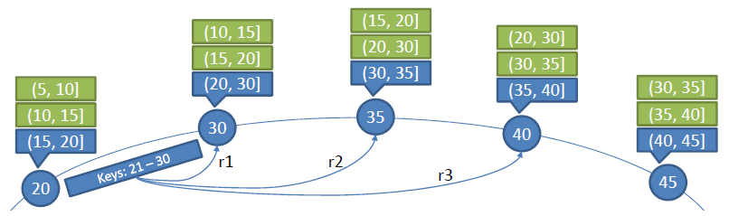
Chord: Dealing with node failures
Successor-list can also be used for replication
For a replication degree of d, a key is stored on the responsible node n and the first d−1 members of n's successor-list (d−1 ≤ r)
As nodes join/leave, successor-lists are updated, leading to changes in the placement of replicas

Slide 59
Chord
Advantages
Efficient: O(Log N) messages per lookup
Scalable: O(Log N) state per node
Robust: survives massive changes in membership
Disadvantages
Member joining is complicated
Asymmetric: in- and out- traffic distributions are exactly opposite
Incoming traffic cannot be used to reinforce finger table
Finger table rigidity precludes proximity-based routing
N is the total number of nodes

Slide 60
SEMINAR PREPARATION – Chordy
[Stoica03] Stoica, I., Morris. R., Liben-Nowell, D., Karger, D.R., Kaashoek, M.F., Dabek, F., Balakrishnan, H., Chord: A Scalable Peer-to-peer Lookup Protocol for Internet Applications, IEEE/ACM Transactions on Networking, Vol. 11, No. 1, pp. 17-32, February 2003

Slide 61
Contents
Introduction
Unstructured P2P systems
Structured P2P systems
Chord
Kademlia

Slide 62
Kademlia
160-bit identifier space for both keys & nodes
Map nodes & keys to identifiers with SHA-1 hash
How to map key IDs to node IDs?
Use consistent hashing
Map key IDs to nodes with ‘closest’ IDs
The closeness between two objects measured as their bitwise XOR interpreted as an integer
d(x, y) = x XOR y
XOR is symmetric (unlike Chord)
d(x, y) = d(y, x) ∀x, y

Slide 63
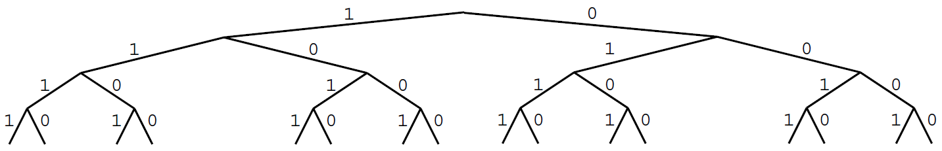
Kademlia: Binary tree
Treat nodes as leaves in a binary tree
The prefix of the node ID determines its position
For any given node, the tree is divided into a series of successively lower subtrees that do not contain the node
subtrees for node 0100
no common prefix
common prefix: 01
common prefix: 010
common prefix: 0

Slide 64
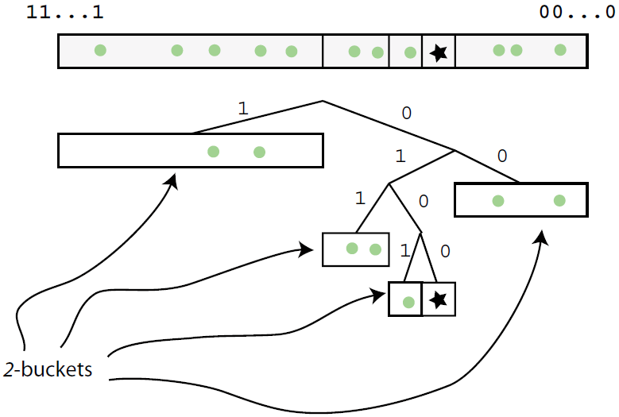
Kademlia: Node state
For each of its subtrees, each node keeps a k-bucket: list of references for up to k nodes from that subtree
2-buckets for node 0100

Slide 65
Kademlia: Node state
Formally, ∀i 0≤i<[#bits in node ID], k-bucket_{i} in node P keeps [@IP, UDP port, node ID] triples for up to k nodes of distance between 2^{i} and 2^{i+1} from P
k is normally 20
k-buckets are kept sorted: most-recently seen at the tail
k-buckets
i | distance | node-reference₀ |  | node-reference_{k-1}
0 | [2⁰,2¹) | [@IP, UDP port, node ID] | … | [@IP, UDP port, node ID]
1 | [2¹,2²) | [@IP, UDP port, node ID] | … | [@IP, UDP port, node ID]
… | … | … | … | …
i | [2^{i},2^{i+1}) | [@IP, UDP port, node ID] | … | [@IP, UDP port, node ID]
… | … | … | … | …
159 | [2¹⁵⁹,2¹⁶⁰) | [@IP, UDP port, node ID] | … | [@IP, UDP port, node ID]

Slide 66
Kademlia: Node state
When P receives any message from Q, P updates the k-bucket that corresponds to Q:
If Q is already in the k-bucket, move it to the tail
Otherwise, if the k-bucket has fewer than k entries, insert Q at the tail
Otherwise, ping the least-recently seen node in the k-bucket: if responds, move it to the tail and discard Q
Otherwise, evict it from the k-bucket and insert Q at the tail
Keeps the oldest live nodes in the k-bucket
Maximizes probability that those nodes will remain online
Avoids some DoS attacks, as k-buckets cannot be flushed by flooding the system with new nodes

Slide 67
Kademlia: Protocol
The Kademlia protocol consists of four RPCs:
PING: probes the recipient to see if it is online
STORE: the recipient stores locally the key/value pair contained in the message
FIND_NODE: the recipient returns [@IP, UDP port, node ID] triples for the k nodes it knows closest to the target ID
These triples can come from a single k-bucket or multiple k-buckets if the closest k-bucket is not full
FIND_VALUE: behaves like FIND_NODE with one exception: if the recipient has received a STORE RPC for the key, it just returns the stored value

Slide 68
Kademlia: Node lookup
Basic idea: Iterative routing by prefix-matching
Origin node is responsible for the entire lookup process
Each step pivots to a peer one bit closer to the target
Guarantees that the lookup requires at most O(log N) steps
2
1
4
node 0100 lookups 1110
(worst case)
3

Slide 69
Kademlia: Node lookup
Use parallel routing to speed up lookups
Node P performs a lookup of target key T
P picks α nodes from its non-empty k-bucket closest to T (if that bucket has fewer than α entries, P just takes the closest nodes it knows)
α parameter (=3) configures the degree of concurrency
P creates a results list of the k closest nodes to T that it is aware of (k-candidate list) and initially populates it with the first α nodes selected
P sends parallel, asynchronous FIND_NODE to the α nodes it has chosen

Slide 70
Kademlia: Node lookup
Node P performs a lookup of target key T
Each recipient of FIND_NODE returns to P the k closest nodes to T that it is aware of
On receiving a reply, P uses those nodes to update its k-candidate list so that it holds the k closest nodes to T that it knows at this stage
If any of the α nodes fails to reply, it is removed from the k-candidate list
P selects another α nodes from the k-candidate list and sends FIND_NODE to each in parallel
The only condition for this selection is that those nodes have not already been contacted

Slide 71
Kademlia: Node lookup
Node P performs a lookup of target key T
This continues until replied nodes are not closer to T than the k-candidates and P has queried and gotten responses from all the k-candidates
They are the k active contacts closest to T
Messages generated due to lookups keep buckets generally fresh
If there is not traffic in the range of a k-bucket within an hour, the node refreshes it by looking up a random key within the k-bucket range

Slide 72
Kademlia: Node join
To join, node P must know a node Q already in the system (a.k.a. bootstrap node)
P inserts Q into the appropriate k-bucket
P performs a node lookup for its own ID to obtain its closest neighbors
Lookup goes through Q, the only other node P knows
P refreshes all k-buckets further away than its closest neighbor k-bucket by looking up a random key within each k-bucket range
This populates the k-buckets of P and inserts P into the k-buckets of the other nodes

Slide 73
Kademlia: Key/value pairs
Storing a key/value pair
Perform a node lookup (with FIND_NODE RPCs) to locate the k closest nodes to the key and send each of them a STORE RPC
Replicates the pair at the k closest nodes to the key
Finding a key/value pair
Perform a node lookup (with FIND_VALUE RPCs)
A node receiving FIND_VALUE returns the value (if it has stored it) or the k closest nodes to the key it knows
Procedure halts when any node returns the value
key/value pair is cached at the closest node to the key seen during the lookup that did not return the value

Slide 74
Kademlia: Key/value pairs
Every key/value pair has an associated expiration time
Lifetime of new key/value pairs (from original publishers) is 24 hours
Original publishers must republish (store again) them every 24 hours
Lifetime of cached key/value pairs is exponentially inversely proportional to the number of nodes between the caching node ID and the node closest to the key
The longer the distance between the node closest to the key and the caching node ID, the shorter the lifetime

Slide 75
Kademlia: Key/value pairs
Each key/value pair must be available in the k closest nodes to the key to ensure lookups correctness, even when nodes join or leave
Each node republishes each key/value pair it contains in k closest nodes to the key every hour
This compensates for nodes leaving the system
When joining node P is added to k-buckets of the other nodes, they check whether P is closer to any of the stored key/value pairs, and (if it is) replicate them to P
Nodes republish key/value pairs keeping their remaining time for expiration

Slide 76
Kademlia: Use cases
BitTorrent distributed tracker
key: info-hash of torrent file metadata
value: list of peers currently sharing the file
get_peers: get peers associated with an info-hash
IT_FIND_VALUE(info-hash)
announce_peer: announce that the peer is downloading a torrent on a port
IT_FIND_NODE(info-hash) + STORE(info-hash, peer) at the K (=8) closest nodes to info-hash
They will add the announcing peer to the peer list stored for that info-hash
http://bittorrent.org/beps/bep_0005.html

Slide 77
Kademlia: Use cases
Kad network (used by eMule)
Two different types of keys (MD4 128 bits hash):
source key: hash of the content of the file
value: list of peers currently sharing the file
keyword key: hash of each token of the filename
value: list of files {name, hash} containing the keyword
Source publication
Obtain hashes from file content and each token of the filename + IT_FIND_NODE(hash) + PUBLISH_REQUEST (hash, value) at the K (=10) closest nodes to hash
Source or keyword search
IT_FIND_NODE(hash) + SEARCH_REQUEST(hash)

Slide 78
Kademlia
Advantages
Efficient: O(Log N) messages per lookup
Scalable: k O(Log N) state per node
Robust: survives massive changes in membership
Symmetric in- and out- traffic distributions
Asynchronous parallel lookup: avoids slow links
Flexibility to route through closer/faster nodes
Disadvantages
Key/value pairs have to be refreshed every 24h
Possible convoy effects because of bursts of activity (e.g. key/value republishing)
N is the total number of nodes

Slide 79
Summary
P2P: model for high availability & scalability
Removes distinction between clients and servers
Peers are symmetric in functionality and responsibilities
Operation is independent of any central node
Peers are organized in an overlay network
Two types of P2P systems
Unstructured P2P systems: Gnutella, KaZaA, BitTorrent
Structured P2P systems: DHT systems: Chord, Kademlia
Further details:
[Tanenbaum]: chapters 2.2.2 and 2.2.3
[Coulouris]: chapters 10 and 20.6.2

