Slide 1
WebWorks Build Script
Ant Script with Lint Checking and Optimization

Slide 2
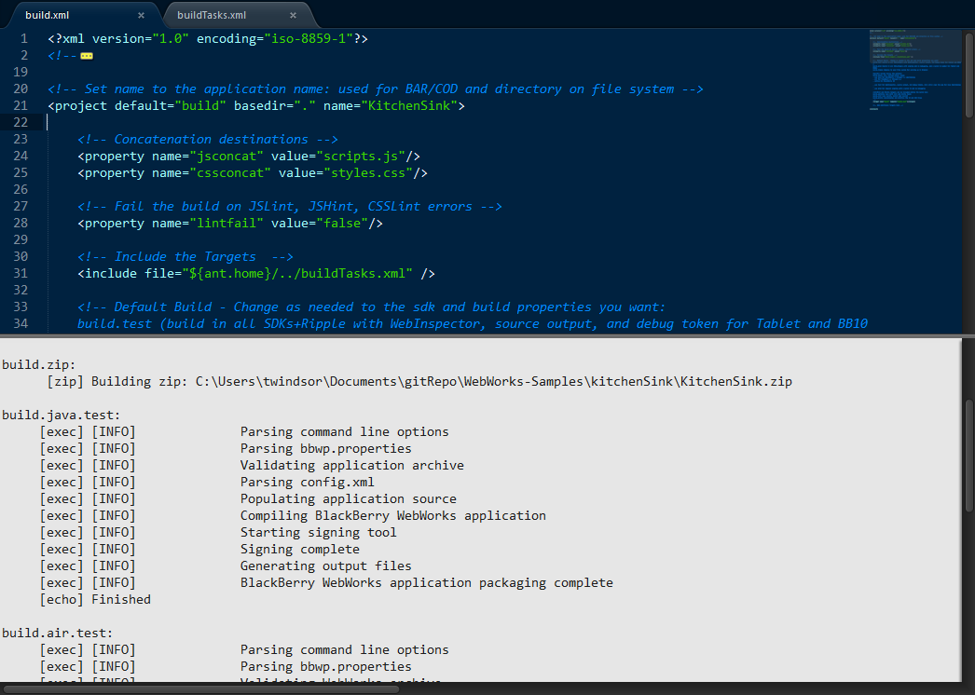
WebWorks Build Script
Ant based
JSLint, JSHint, CSSLint
YUICompressor
Build at once for BlackBerry OS, PlayBook and BlackBerry 10
Deploy to local Webserver for Ripple Emulator
Integrate with IDE’s

Slide 3
Two Part Script
Main Script and Tools in one place
SDK’s
Signing Password
Build Targets
Project Specific Build.xml
Project Name
Current Build Target
→ Main Script and Tools in one central place
→ Drop in Build.xml to enable building

Slide 4
Build Targets
build.test (build in all SDKs+Ripple with WebInspector, source output, and debug token for Tablet and BB10)
build.prod (build in all SDKs+Ripple with signing and no debugging, and a build id number for Tablet and BB10)
build.beta (build in all SDKs+Ripple with signing and WebInspector, and a build id number for Tablet and BB10)
build.ripple (deploy to your file system for serving up in Ripple)
build.[bbos, tablet, bb10].[test, prod, beta]
- bbos for BlackBerry 5 through 7.x smartphones
- tablet for PlayBook 1.x through 2.x
- bb10 for BlackBerry 10
- test for WebInspector, source output, and debug tokens. Java builds will only run on simulators.
- prod for regular signing with a build id and no debugging.
- beta for regular signing with a build id and WebInspector turned on
build.optimize runs both lint and minify tasks
build.lint runs jslint, jshint and csslint
build.minify concatenates and minifies the JS and CSS files

Slide 5
Deploy Targets
Deployment to device is supported through these commands, which will pull the built files from the appropriate directory.
build.deploy.[bb10.[device, sim], tablet, bbos].[test, prod, beta]
- bbos for BlackBerry 5 through 7.x smartphones
- tablet for PlayBook 1.x through 2.x
- bb10 for BlackBerry 10 also requires defining simulator build or device
- test, prod, beta to load the matched build (from the build commands)
Set device.[bb10, tablet].ip and/or device.[bb10, tablet, bbos].pw properties
<property name="device.bb10.ip" value=“169.254.0.1"/>
<property name="device.bb10.pw" value=“******" />

Slide 6
Get it from Github
Visit Github Repo to download
Download Tools directory and set Ant Home, Path, signing password
Copy build.xml to your project and edit project name
→ https://github.com/blackberry/BB10-WebWorks-Community-Samples/tree/master/Ant-Build-Script
→ %ANT_HOME% = C:\BuildTools\apache-ant-1.8.2
→ %PATH% = %PATH%;%ANT_HOME%\bin

