Slide 1
WebWorks Build Script
Ant Script with Lint Checking and Optimization

Slide 2
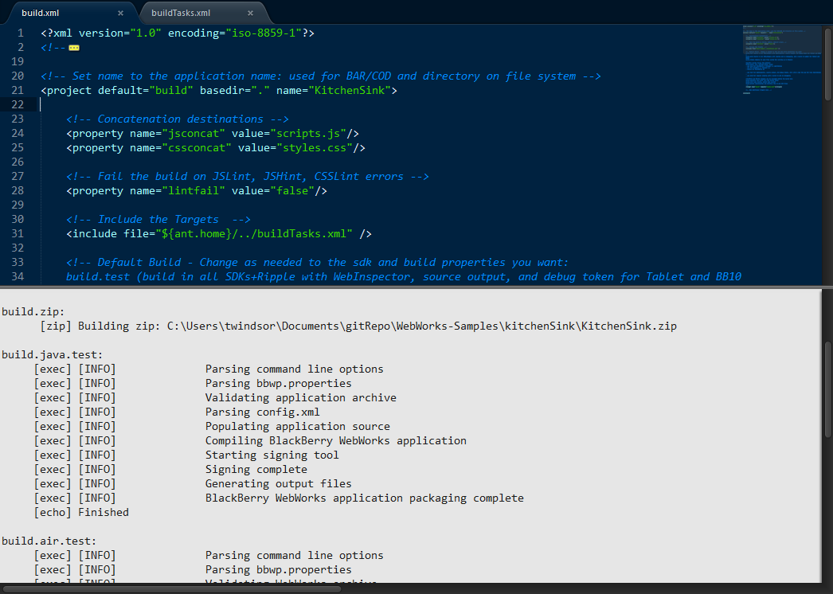
WebWorks Build Script
Ant based
JSLint, JSHint, CSSLint
YUICompressor
Build at once for BlackBerry OS, PlayBook and BlackBerry 10
Deploy to local Webserver for Ripple Emulator
Integrate with IDE’s

Slide 3
Two Part Script
Main Script and Tools in one place
SDK’s
Signing Password
Build Targets
Project Specific Build.xml
Project Name
Current Build Target
→ Main Script and Tools in one central place
→ Drop in Build.xml to enable building

Slide 4
Build Targets
build.test (build in all SDKs+Ripple with WebInspector, source output, and debug token for Tablet and BB10)
build.prod (build in all SDKs+Ripple with signing and no debugging, and a build id number for Tablet and BB10)
build.beta (build in all SDKs+Ripple with signing and WebInspector, and a build id number for Tablet and BB10)
build.ripple (deploy to your file system for serving up in Ripple)
build.[bbos, tablet, bb10].[test, prod, beta]
- bbos for BlackBerry 5 through 7.x smartphones
- tablet for PlayBook 1.x through 2.x
- bb10 for BlackBerry 10
- test for WebInspector, source output, and debug tokens. Java builds will only run on simulators.
- prod for regular signing with a build id and no debugging.
- beta for regular signing with a build id and WebInspector turned on
build.optimize runs both lint and minify tasks
build.lint runs jslint, jshint and csslint
build.minify concatenates and minifies the JS and CSS files

Slide 5
Deploy Targets
Deployment to device is supported through these commands, which will pull the built files from the appropriate directory.
build.deploy.[bb10.[device, sim], tablet, bbos].[test, prod, beta]
- bbos for BlackBerry 5 through 7.x smartphones
- tablet for PlayBook 1.x through 2.x
- bb10 for BlackBerry 10 also requires defining simulator build or device
- test, prod, beta to load the matched build (from the build commands)
Set device.[bb10, tablet].ip and/or device.[bb10, tablet, bbos].pw properties
<property name="device.bb10.ip" value=“169.254.0.1"/>
<property name="device.bb10.pw" value=“******" />

Slide 6
Debug Token Targets
Creation and Deployment of Debug Tokens are supplied by these commands
build.[createDebugToken, deployDebugToken].[bb10, tablet]
- bbos for BlackBerry 5 through 7.x smartphones
- tablet for PlayBook 1.x through 2.x
- bb10 for BlackBerry 10 also requires defining simulator build or device
- test, prod, beta to load the matched build (from the build commands)
Set device.[bb10, tablet].pin properties
<property name="device.bb10.pin" value=“2AB00001"/>

Slide 7
Get it from Github
Visit Github Repo to download
Download Tools directory and set Ant Home, Path, signing password
Copy build.xml to your project and edit project name
View Video on setup with Command Line and Sublime
→ https://github.com/blackberry/BB10-WebWorks-Community-Samples/tree/master/Ant-Build-Script
→ %ANT_HOME% = C:\BuildTools\apache-ant-1.8.2
→ %PATH% = %PATH%;%ANT_HOME%\bin

