Slide 1
Leveraging BlackBerry Services: BBM
JAM 47
Nick Kalkounis – Product Manager
Mark Sohm – Developer Relations
September 25-27, 2012

Slide 2
For More Information…
Come to the Lab! JAM 49 - BBM Integration in the NDK (Today @ 1pm)
http://developer.blackberry.com/bbm
Let us know about the cool things you’ve done!
nkalkounis@rim.com - @nickkalkounis
msohm@rim.com MSohm in the BlackBerry Developer Forums

Slide 3


Agenda
$$$
developer.blackberry.com/bbm
What.
Why.
How.

Slide 4
BBM: A Vibrant Social Network
60 Million+ Monthly Active Users
2 Million+ New users every month
70% of BBM users use BBM daily
> 150B messages sent/month
+1% of Apps are BBM Connected
…But they make up 20% of App World Downloads!
Notes:
Number was 56M in May

Slide 5






The BBM Social Platform
Discoverability
App Stickiness
Engagement
Monetization
Notes:
To understand what the BBM social platform is, we need to go back to why we created it…
First thing we did was allow you to update your profile, status message
Next thing we did was X
Using BBM Social Platform APIs allow you to create a more personalized, social experience. It gives developers the opportunity to deeply integrate into the BBM experience, including profile updates, avatars, invitations, etc.
Examples from Nobex
52% increase in downloads after application was BBM Connected – people noticed their friends were using the app – social listening,etc.
Discoverability
Over 56 Million users worldwide - Word of your app travels fast
Engagement and App Stickiness
Social apps increase engagement – We’ve built the social network for you
Monetization

Slide 6
BBM Social Platform APIs
BBM Contact List & Invitations
User Profile Updates
Application Box Updates in User Profile
Streaming data between applications
Chat

Slide 7
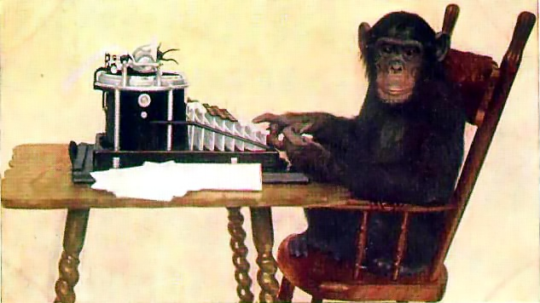
Is it hard to use?
developer.blackberry.com/bbm
Source: By New York Zoological Society (Picture on Early Office Museum) [Public domain], via Wikimedia Commons
Notes:
We’ve heard your feedback and have made it much easier to use…in the past the SDK was a separate download.
For BB10, the APIs are now build into the standard BB10 NDK tools
Mark will walk you through the technical details in the next couple of slides …

Slide 8
BBM Social Platform APIs
BlackBerry 10
C BlackBerry Platform Services (bps) APIs
Add to existing applications using bps
Qt style APIs
Integration with Cascades applications
WebWorks APIs
BlackBerry OS 5-7
Java APIs
WebWorks APIs

Slide 9
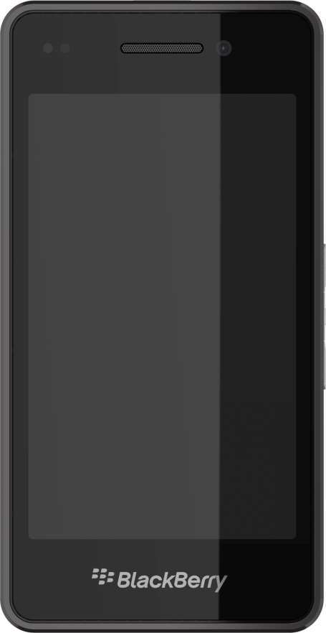
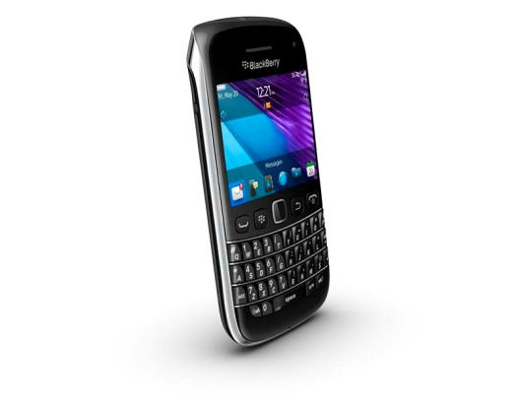
BBM Social Platform APIs
Use the BBM SP seamlessly between BlackBerry 10 and BlackBerry OS 5-7!
BBM Social Platform
IMPORTANT – Use the same SKU in App World!!!

Slide 10
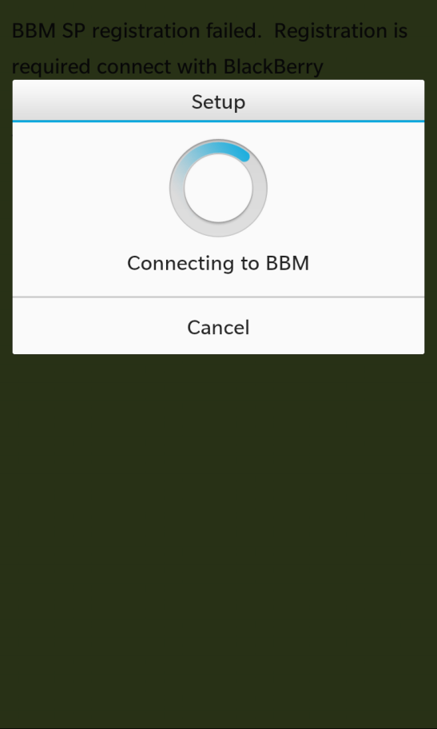
BBM SP Registration
First step for any BBM Social Platform application
User must allow the registration
User can enable/disable BBM SP access at any time

Slide 11
BBM SP Registration
//TODO: Define your own UUID. You can generate one here:
// http://www.guidgenerator.com/
QString m_uuid = QString::fromUtf8("c0fef20e-5f94-4eb1-be1e-e055f2c2391c");
bb::platform::bbm::Context* m_context = new bb::platform::bbm::Context(QUuid(m_uuid));
QObject::connect(m_context, SIGNAL(registrationStateUpdated(bb::platform::bbm::RegistrationState::Type)),
this, SLOT(registrationStatus(bb::platform::bbm::RegistrationState::Type)));
m_context->requestRegisterApplication();

Slide 12
BBM SP Registration
//Receive Registration Response
void RegistrationHandler::registrationStatus
(bb::platform::bbm::RegistrationState::Type state) {
switch(state){
case bb::platform::bbm::RegistrationState::Allowed:
//Success!!!
break;
//… Also handle errors and pending states.
}
}

Slide 13
BBM SP Invite to Download
Users can invite their BBM contacts to download your app
Integrates directly with BlackBerry App World
Viral Distribution

Slide 14
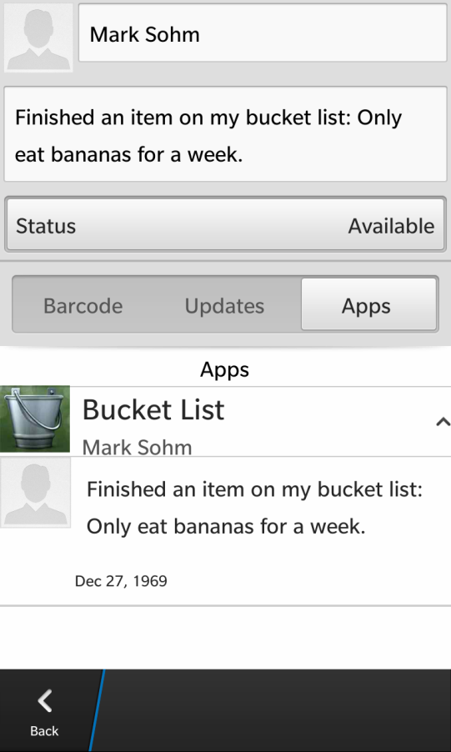
BBM SP Profile Boxes
BBM SP Connected apps are listed in a users BBM Profile
Add items within your app’s Profile Box
Achievements, high scores, current track, important news

Slide 15
BBM SP Profile Boxes
//Create a profile box with item
bb::platform::bbm::ProfileBox* m_profileBox m_profileBox = new bb::platform::bbm::ProfileBox(m_context, this);
m_profileBox->requestRegisterIcon(iconId[id],
bb::platform::bbm::ImageType::Png, iconArray);
m_profileBox->requestAddItem(QString(“New High Score: 2!"),
QString(iconId[id]), QString("cookie").append(iconId[id]));

Slide 16
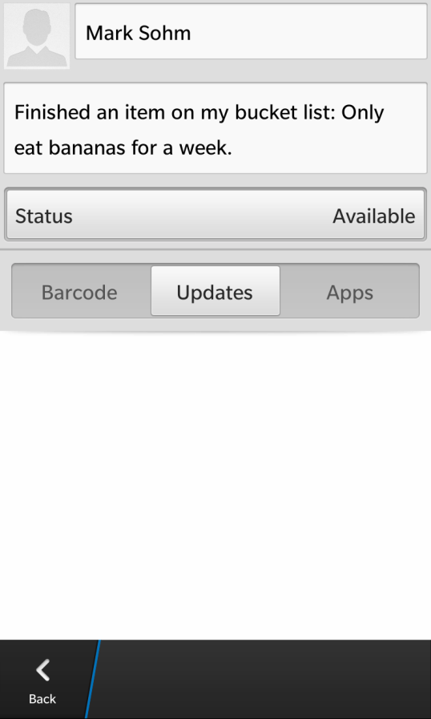
BBM SP Profile Page
Access and customize the users BBM Profile Page
Avatar Image
Status Message
Personal Message
Availability
Handle (read only)

Slide 17
BBM SP Profile Page
//Grab the user's Profile.
bb::platform::bbm::UserProfile m_userProfile = new
bb::platform::bbm::UserProfile(m_context, this);
//Update the user's personal message.
m_userProfile->requestUpdatePersonalMessage("New Message");

Slide 18
BBM SP Contacts
Obtain a list of BBM contacts that have the application installed and registered
Listen for changes to profiles of these contacts
Status change to -> “Wants to play SlingShot 5000 with someone”
Local app could prompt the user to start a multiplayer game

Slide 19
BBM SP Channels
Use BBM SP as a transport between users
BBM Social Platform
IMPORTANT – Use the same SKU in App World!!!

Slide 20
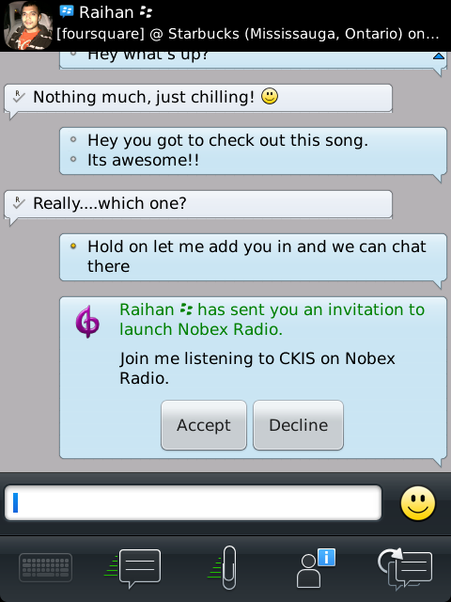
BBM SP Channels
Channels and allow the user to invite others to join in an activity
Invite Users
User events: invited, joined, declined, left
Send data to all/subset of users

Slide 21
BBM SP Channels
Example Use Cases
Transport for multiplayer game
Nobex Radio – Listen Together
Magazine Book Reader – Turn Page / Comment Together
Productivity Tool – Share Sketch Diagram
Your cool idea…?

Slide 22
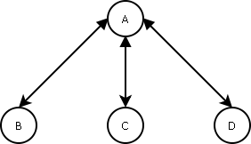
BBM SP Channels
Channel enable private activities
Visible to only his/her invitees and inviter
Channels are one-to-many:
Users can NOT broadcast to all users
Users can send data to users that are only visible to them
Otherwise it is identical to a session

Slide 23

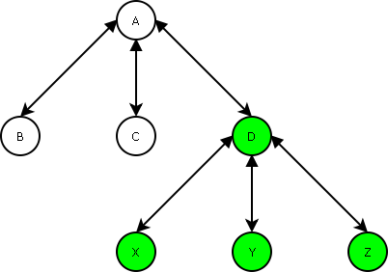
BBM SP Channels
User A invites B, C, and D, and they join
Every user has their own ‘view’ of the channel
User D can invite users X, Y, and Z, but they are not added to A’s channel

Slide 24
BBM SP Channels
No limit to the number of channels per app
Max of 24 users in each connection
Max of 100KB/min in data transfer
This limit can be changed anytime by RIM
No limits on how creatively you can use connections
Embedded Chat
Multiplayer game transport
Etc…

Slide 25
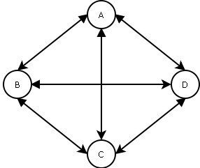
BBM SP Sessions
Similar to Channels except they are many to many
Every user can see every other user in a session
Every user can invite other users
Users can broadcast message to all users
These capabilities can be limited by the application
Available now in BB OS 5-7
Coming to BlackBerry 10 Post Launch

Slide 26

BBM SP Roadmap - Features
Feature | Native & Java Availability
 | BlackBerry 10 | BlackBerry OS 5-7
Registration
Profile Boxes
Profile Page
Invite to Download
Channels | Beta 4
Sessions | Post BlackBerry 10 Launch
BBM Chat | Post BlackBerry 10 Launch
Invite to BBM | Post BlackBerry 10 Launch

Slide 27
BBM SP Roadmap - Features
Feature | WebWorks Availability
 | BlackBerry 10 | BlackBerry OS 5-7
Registration
Profile Boxes | Planning
Profile Page
Invite to Download
Channels | Planning
Sessions | Post BlackBerry 10 Launch
BBM Chat | Post BlackBerry 10 Launch
Invite to BBM | Post BlackBerry 10 Launch

Slide 28

BBM SP Roadmap - Tools
Tool | Platform Availability
 | BlackBerry 10 | BlackBerry OS 5-7
Native SDK
WebWorks SDK
Java SDK

Slide 29
For More Information…
Come to the Lab! JAM 49 - BBM Integration in the NDK (Today @ 1pm)
http://developer.blackberry.com/bbm
We want to hear from you!
Let us know about the cool things you’ve done!
nkalkounis@rim.com - @nickkalkounis
msohm@rim.com MSohm in the BlackBerry Developer Forums

Slide 30
THANK YOU
[JAM 47]
[Nick Kalkounis & Mark Sohm]
September 25-27, 2012

