Slide 1
Native API Deep Dive: Leverage PIM in Your Apps and Get Flow with the Invocation Framework
Jam 318
Mark Sohm
Kamel Lajili
ekke (Ekkehard Gentz)
5 – 6 February, 2013

Slide 2
Invocation Framework
Mark Sohm
MSohm in the BlackBerry Developer Forum

Slide 3



Invocation Framework
Part of the BlackBerry 10 Flow
Smooth, integrated, frictionless UX
Increased
App discovery
Engagement
User Efficiency

Slide 4
Invocation Framework
Invoking Another Application
Bound & Unbound invocation
Getting Invoked
Cards
Embeds a Screen from target instead of launching full app

Slide 5


Bound Invocation
I want Dr. Doc to open this .doc file.
I can open .doc files
Dr. Doc
Invocation Framework

Slide 6
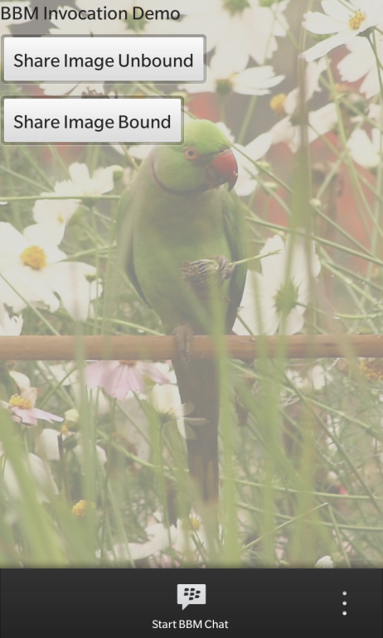
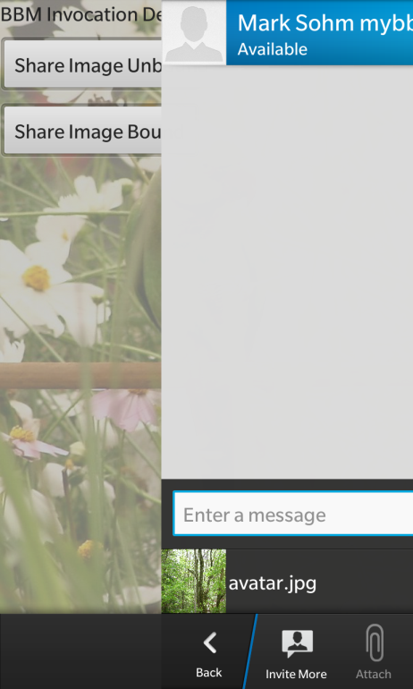
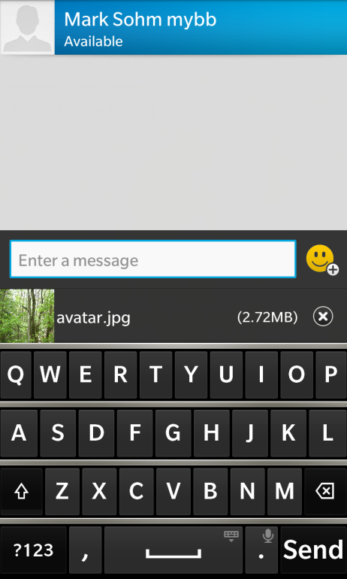
Bound Invocation
Share a PNG over BBM

Slide 7
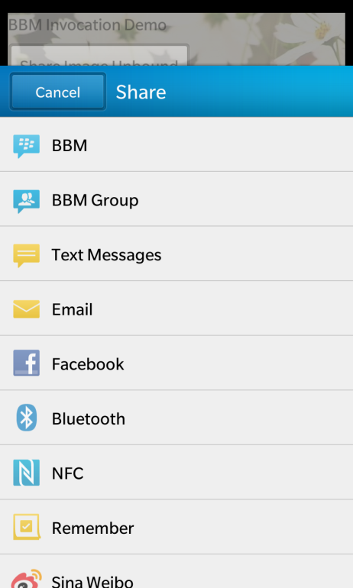
Bound Invocation
Share a PNG, allow the user to choose the application

Slide 8
Unbound Invocation
I can open .doc files
I need to open this .doc file. Anyone?
I can open .doc files
Invocation Framework
I can open .png files

Slide 9
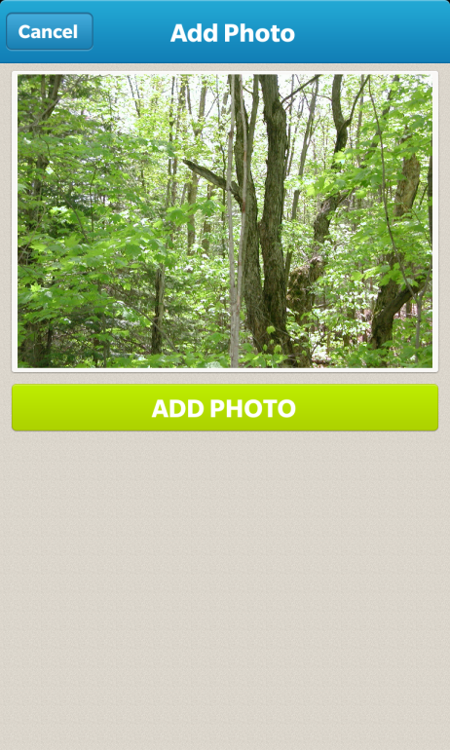
Unbound Invocation
Share a PNG, allow the invocation framework to choose the application

Slide 10
Invoke Basics
Client
Initiates the invocation
Target
Handles the invocation
Action
Identifies the action to be performed
Data
The data to be acted on

Slide 11
Actions
Defines the task
E.g. bb.action.OPEN
Targets define what actions they can handle
Client specifies what action it needs to invoke
3rd parties can define Custom Actions
com.example.MYACTION

Slide 12
Data
URI (out-of-band)
Describes the location of the data
If not specified, data is assumed to be “data://local” (in-band)
MIME Type
Describes the data type (in-band or out-of-band)
Data type may be inferred from URI
http://www.example.com/picture.png image/png
MIME type takes precedence
Data (in-band)
Actual data is attached in the invocation request

Slide 13
Cards
Embeds a Screen from Target
Instead of launching the full app
No App Grid presence
Supports peeking
A leap ahead of the competition
BlackBerry 10 Flow at its best!
Invoked in the same way!

Slide 14
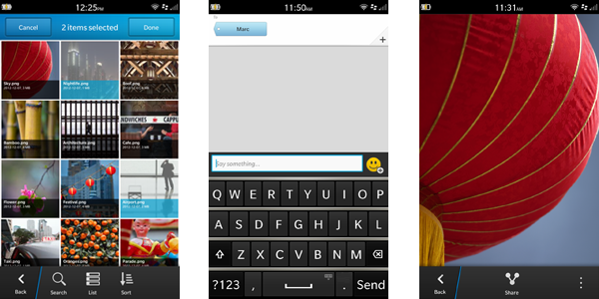
Card Styles
Three styles
Composer
Previewer
Picker
Determines
Peek behavior
Transition style

Slide 15
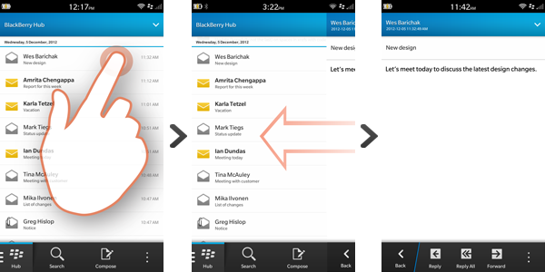
Transitions – Fly in from right
Used for Previewers

Slide 16
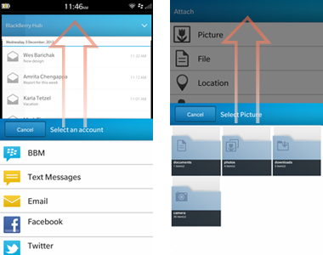
Transitions – Fly in from bottom
Used for Composers and Pickers

Slide 17
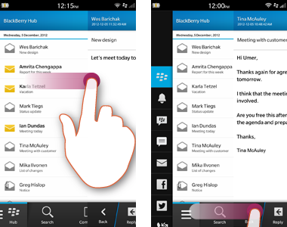
Previewers and Pickers Navigational Peek to Parent
Peeked from content
Peeks parent
Releasing above a threshold closes the Card
Releasing under threshold re-centers the Card

Slide 18
Demo
Let’s see invocation in action!
Demo will use the invocation framework and BBM to…
Start a chat session and send the file with custom data (card)
Open the file when touched in BBM (unbound invocation)
Let’s run the demo

Slide 19
Invocation Framework
How was that done?
Let’s see the code for:
Sending Data
Receiving Data
Sending Data
Create File to Send
Invoke BBM and send file

Slide 20
Sending Data
QString path =
QDir::current().absoluteFilePath("data/bucketItemToShare.buk");
m_pInvocation = Invocation::create(
InvokeQuery::create().parent(this).uri(
QUrl::fromLocalFile(path)).invokeTargetId("sys.bbm.sharehandler"));
QObject::connect(m_pInvocation, SIGNAL(armed()), this, SLOT(onArmed()));

Slide 21
Sending Data
//Respond to the signal
void BucketModel::onArmed()
{
m_pInvocation->trigger("bb.action.SHARE");
}

Slide 22
Sharing Custom Data over BBM
Receive the data…
Add the target to the bar-descriptor.xml
Connect the invocation signal to a slot in our application
Take action when the signal is received

Slide 23
Receiving Data
<invoke-target id="com.samples.rim.bucketlist_share">
<invoke-target-type>application</invoke-target-type>
<invoke-target-name>bucketlist_share</invoke-target-name>
<icon>
<image>icon.png</image>
</icon>
<filter>
<action>bb.action.VIEW</action>
<action>bb.action.OPEN</action>
<mime-type>*</mime-type>
<property var="exts" value="buk"/>
<property var="uris" value="file://"/>
</filter>
</invoke-target>

Slide 24
Receiving Data
//Connect the Signal to our Slot
QObject::connect(m_invokeManager,
SIGNAL(invoked(const bb::system::InvokeRequest&)),
this,
SLOT(handleInvoke(const bb::system::InvokeRequest&)));

Slide 25
Receiving Data
void BucketListApp::handleInvoke(const bb::system::InvokeRequest& invoke)
{
//Get the file the application was invoked with.
QUrl uri = invoke.uri();
QFile file(uri.toLocalFile());
<… snip read in the file…>
m_bucketItemTitle = the_title_we_just_read;
//Send a signal to notify the UI to display the new item
emit incomingBucketItem();
}

Slide 26

PIM: Personal Information Management
JAM318
Kamel Lajili, @KLAJILI
5 – 6 February, 2013

Slide 27
PIM API Quick Walkthrough

Slide 28
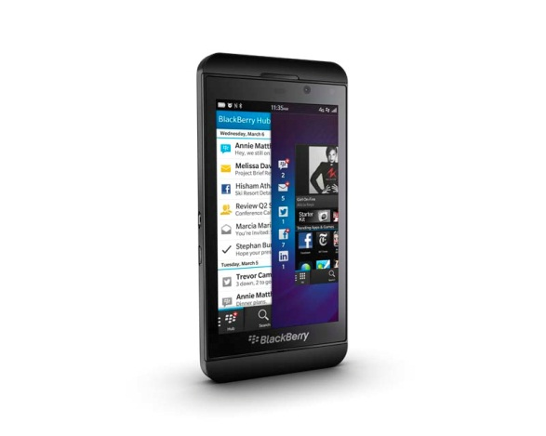
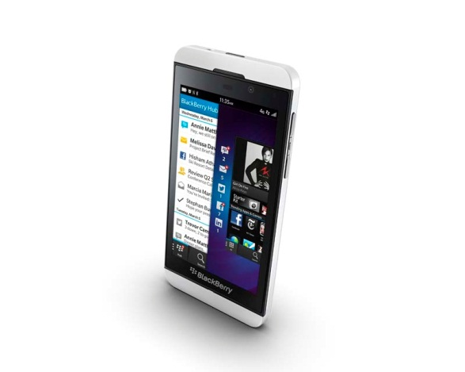
What is PIM?
Personal
Information
Management
Events
Messages
Contacts
Notes
bb::pim
Notes:
This slide has animations. PIM flys in word by word, then the rest fades in all at once

Slide 29
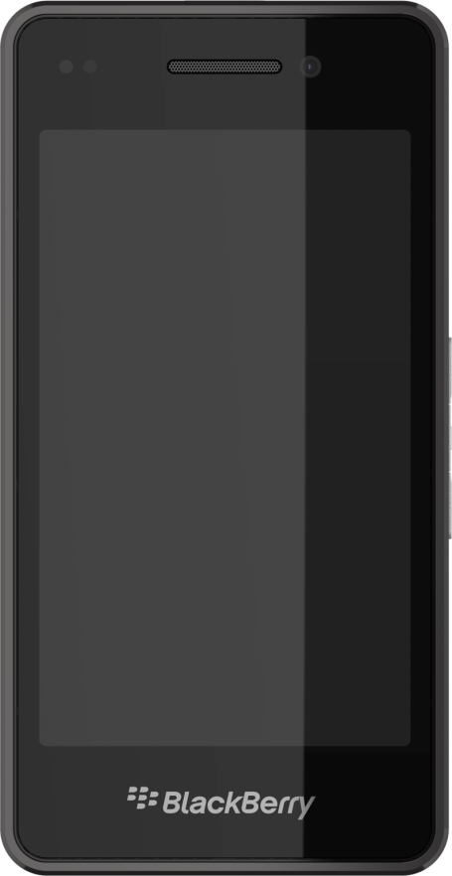
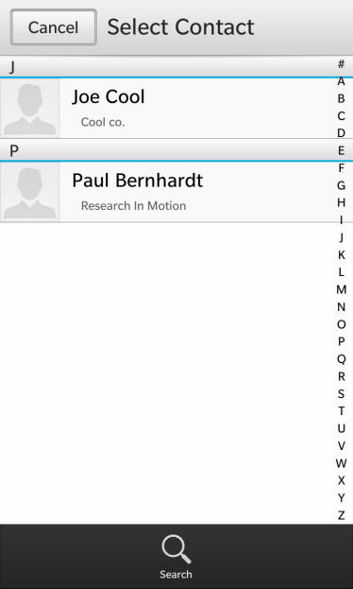
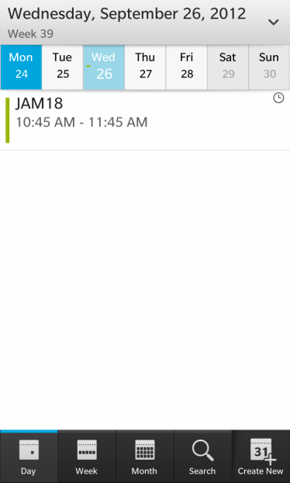
What can you do?
CRUD
Create, read, update, delete
Listeners and Filters as well
APIs very similar
Use cards/pickers when appropriate

Slide 30
Setup
Add PIM libraries to <project>.pro file
LIBS += -lbbpim
Set needed permissions in bar-descriptor.xml
access_pimdomain_calendars
access_pimdomain_contacts
access_pimdomain_messages
access_pimdomain_notebooks
Notes:
Link the pim lib to your projects. If you haven‘t added any libs then copy-paste

Slide 31
PIM API Walkthrough
Contacts

Slide 32
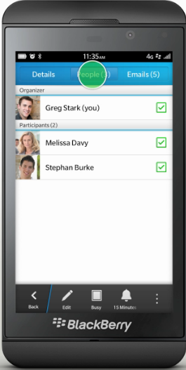
ContactService
bb::pim::contacts::ContactService* m_contactService;
AddressBook::AddressBook(QObject *parent)
: QObject(parent)
, m_contactService(new ContactService(this))
Notes:
The ContactService is the main obj that you will be interacting with
You only need one in your application so create it when the app is started
Most PIM APIs also include a service class, which is identified with the suffix "Service" (such as ContactService). These service classes provide access to the corresponding database on the device, and you use these classes when you want to perform an operation on data in the database. For example, consider the ContactService class. This class lets you add new contacts to the database of contacts on the device (by using createContact()), update the entries of existing contacts (by using updateContact()), and delete a contact (by using deleteContact()).

Slide 33
Create
ContactBuilder builder;
// Set the first name
builder.addAttribute(ContactAttributeBuilder()
.setKind(AttributeKind::Name)
.setSubKind(AttributeSubKind::NameGiven)
.setValue(m_firstName));
//Do more stuff
m_contactService->createContact(builder, false);
A lot of Contact attribute kinds: bb/pim/contacts/ContactConsts.hpp>
Notes:
The contact service uses the ContactBuilder pattern
The ContactBuilder class lets you create, and specify properties for, a new Contact or edit an existing Contact.
This class uses the builder pattern to create a Contact and set its properties. Each of the functions returns a self reference to the builder, allowing you to chain function calls together.
Any changes that you make to a Contact using this builder are temporary until the changes are persisted by using the ContactService.
See also:

Slide 34
Read
const Contact contact = m_contactService-> contactDetails(m_contactId);
m_firstName = contact.firstName();
m_birthday = QDateTime::currentDateTime();
const QList<ContactAttribute> dateAttributes = contact.filteredAttributes(AttributeKind::Date);
foreach (const ContactAttribute &dateAttribute, dateAttributes) {
if (dateAttribute.subKind() == AttributeSubKind::DateBirthday)
m_birthday = dateAttribute.valueAsDateTime();
Notes:
You can also Update and delete contacts by using the contacts service and contactID. Before updating the atributes need to be deleted

Slide 35
Listeners
// Do something when a contact changes
// The QList is a list of the contact IDs involved
connect(m_contactService, SIGNAL(contactsAdded(QList<int>)), SLOT(doStuff(QList<int>)));
connect(m_contactService, SIGNAL(contactsChanged(QList<int>)), SLOT(doStuff(QList<int>)));
connect(m_contactService, SIGNAL(contactsDeleted(QList<int>)), SLOT(doStuff(QList<int>)));
Notes:
When added, changed or deleted you get a list of the Contacts Ids
The contactSerice allows also to filter

Slide 36
Contact Picker Setup
Add libraries to <project>.pro file
LIBS += -lbbcascadespickers -lbbpim
Expose contact picker to qml
#include <bb/cascades/Pickers/ContactPicker>
ContactPickerTest::ContactPickerTest(bb::cascades::Application *app) : QObject(app) {
qmlRegisterType<ContactPicker>("bb.cascades.pickers", 1, 0, "ContactPicker");
QmlDocument *qml = QmlDocument::create("asset:///main.qml").parent(this);
Notes:
There are few pickers in the Cascades.
The ContactPicker is a full screen control that allows the user to select a contact, multiple contacts, or an attribute of a contact. The picker can be configured to show only contacts that match specific criteria. When selection is completed, a signal is emitted from the picker with the selected information. A canceled() signal is emitted if the user cancels the selection.

Slide 37
Contact Picker QML
import bb.cascades.pickers 1.0
//...
Button {
text: "Open picker"
onClicked: {
contactPicker.open(); }
attachedObjects: [
ContactPicker {
id: contactPicker
onContactSelected: {
console.log(“Contact: " + contactId);

Slide 38
ContactPicker Demo
Free available on Github: https://github.com/blackberry/Presentations/tree/master/2012-BlackBerryJam-Americas/JAM18

Slide 39
PIM API Walkthrough
Calendar

Slide 40
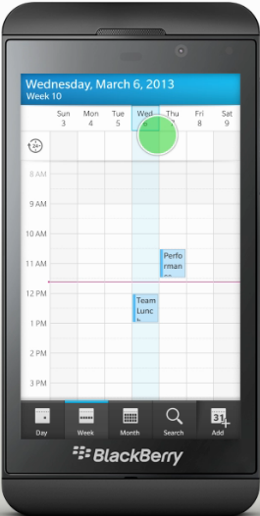
CalendarService
bb::pim::calendar::CalendarService* m_calendarService;
CalendarInvoker::CalendarInvoker(bb::cascades::Application *app) :
QObject(app), m_invokeManager(new InvokeManager(this)), m_calendarService(
new CalendarService()) {…}
Notes:
The ContactService is the main obj that you will be interacting with
You only need one in your application so create it when the app is started

Slide 41
Calendar Create
CalendarEvent event;
event.setAccountId(m_accountId);
event.setFolderId(m_folderId);
event.setSubject(m_subject);
event.setLocation(m_location);
event.setStartTime(m_startTime);
event.setEndTime(m_endTime);
m_calendarService->createEvent(event);
Notes:
No Builder pattern as not much attributes as in contacts

Slide 42
Calendar Invocation Framework
Cards let you use the UI provided by the target inside your app
Setup:
Add this line to your <project>.pro file:
LIBS += -lbbsystem -lscreen -lbbdata
Create an instance of InvocationManager
Only need one for your app
May want to hook up to the childCardDone() signal
QObject::connect(m_invokeManager,
SIGNAL(childCardDone(const bb::system::CardDoneMessage &)), this,
SLOT(onChildCardDone(const bb::system::CardDoneMessage &)));
Notes:
No picker control for calendar
Only one Invocation manager is needed in the app

Slide 43
Calendar Event Picker Card
InvokeRequest invokeRequest;
invokeRequest.setTarget("sys.pim.calendar.viewer.nav");
invokeRequest.setAction("bb.calendar.PICK");
invokeRequest.setMimeType("text/calendar");
InvokeTargetReply *invokeReply = m_invokeManager-> invoke(invokeRequest);

Slide 44
Calendar View Event
void CalendarInvoker::onChildCardDone(const bb::system::CardDoneMessage &message) {
QVariantMap data;
data["accountId"] = 1; // default calendar account id
data["icsbytes"] = QString(message.data());
data["type"] = "ics";
// do something
}

Slide 45
Calendar Event Creation Card
QVariantList participants = QVariantList();
participants.append("bob@emails.com");
QVariantMap data = QVariantMap();
data.insert(QString("participants"), QVariant(participants));
data["subject"] = “My Sweet Event";
cardRequest.setTarget("sys.pim.calendar.viewer.eventcreate");
cardRequest.setAction("bb.action.CREATE");
cardRequest.setMimeType("text/calendar");
QByteArray encData = PpsObject::encode(data);
cardRequest.setData(encData);
InvokeTargetReply* reply = m_invokeManager-> invoke(cardRequest);

Slide 46
CalendarInvoker Demo
Free available on Github: https://github.com/blackberry/Presentations/tree/master/2012-BlackBerryJam-Americas/JAM18

Slide 47
BlackBerry Hub

Slide 48
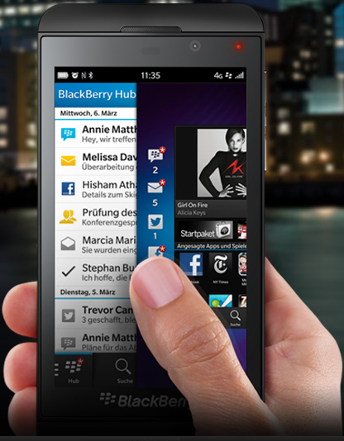
BlackBerry Hub How?
Notification Framework
Create/Edit/Delete a notification
Flash LED
Sound/vibration
Add entry to BlackBerry Hub
Use Invocation framework to invoke your app
Notes:
don‘t recommend to customize the sounds of notifications

Slide 49
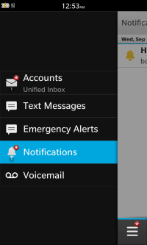
Notifications Basics
bb::platform::Notification *notification = new bb::platform::Notification();
notification->setTitle(“Title");
notification->setBody("Body");
notification->setInvokeRequest(invocationRequest)
notification->notify();

Slide 50
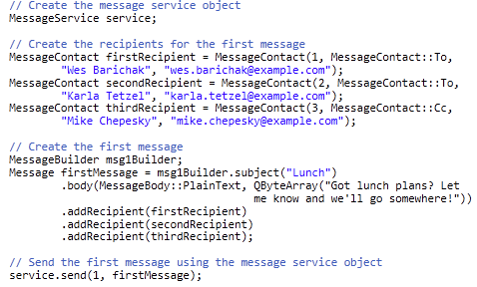
Messages
Notes:
The MessageService is the main obj that you will be interacting with
You only need one in your application so create it when the app is started
It uses the Builder pattern

Slide 51
Real World Demos
ekke (Ekkehard Gentz) @ekkescorner
Sources available at Github: https://github.com/blackberry/opendataspace-cascades Download Application for free from BlackBerry World: 'OpenDataSpace'

Slide 52
Demos
Live Demo from OpenDataSpace Application:
ImageViewer
MediaPlayer (Video, Audio)
BBM (Chat, ShareLink)
BlackBerry World (Review)
App as Target (invoked as Card from another APP)
Live Demo from SerCar10:
RouteMapInvoker
Sources:
https://github.com/blackberry/opendataspace-cascades
https://github.com/OpenDataSpace/file-upload2ods

Slide 53
THANK YOU
Jam 318
Mark Sohm
Kamel Lajili
ekke (Ekkehard Gentz)
5 – 6 February, 2013

