Slide 1
Alligator | Application | L7 | HTTP | HTTPS, FTP, SFTP, Telnet, SSH, DNS
Pet | Presentation
Steve’s | Session
Touch | Transport | L4 | TCP | UDP, SCTP
Not | Network | L3 | IP | IPv6, ARP
Do | Data Link | L2 | Ethernet | Frame Relay
Please | Physical

Slide 2
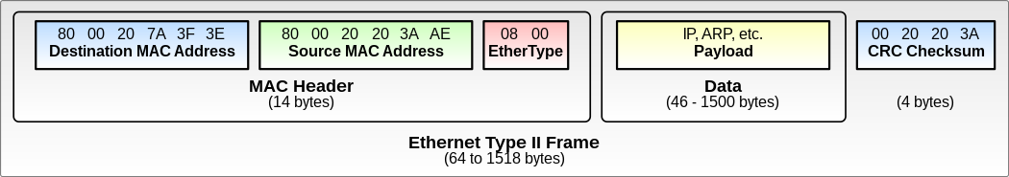
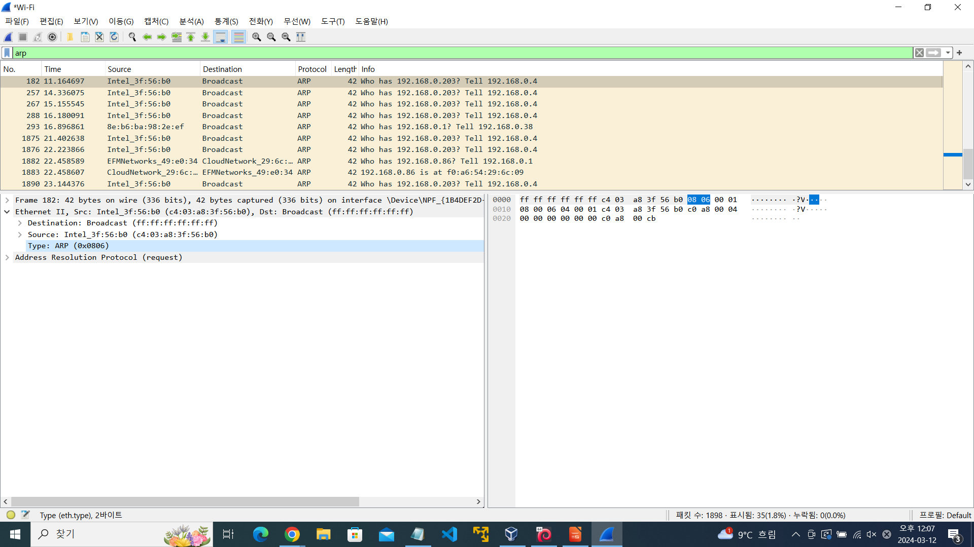
Ethernet
IPv4
기억해야되는 그림

Slide 3
