Slide 1
Blackboard System Building Block Update
Blackboard

Slide 2
B2 확인 하기
Building Block – Blackboard 본체의 기능 확장을 위한 plugin

Slide 3
B2 Manager
Tool | Description
B2Manager.bat | Standalone tool to manage building blocks. For Basic Licenses.
Usage: B2Manager.{bat,sh} [-o] <-i | -r | -s STATUS> <FILENAME | B2HANDLER>
B2Manager.{bat,sh} <-l | -v> [FILENAME | B2HANDLER]
-i Install the given building block
-l List all currently installed building blocks (short listing)
Shows single plugin if FILENAME or B2HANDLER are specified
-r Remove the given building block
-s Change the building block status (INACTIVE, AVAILABLE, UNAVAILABLE)
-v List all currently installed building blocks (verbose listing)
Shows single plugin if FILENAME or B2HANDLER are specified
-o Override safety measures for mandatory B2s
*BLACKBOARD USE ONLY* Usage can put your system in an unstable state.
-d Override safety measures for B2 dependency checks
*BLACKBOARD USE ONLY* Usage can put your system in an unstable state.

Slide 4
3. B2 Update - Recommended Building Block Upgrade Order and Best Practices
Bulding Block Update 시 최적의 Update 순서
https://blackboard.secure.force.com/btbb_articleview?id=kA270000000L10NCAS
Building Block Update 이후 Service Restart 필요
Building Block 설치 중에도 멈춤 현상이나 오류 발생시에도 Service Restart 후 업그레이드 진행

Slide 5
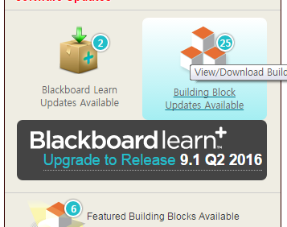
1. B2 등록 확인
시스템 관리자>소프트웨어 업데이트> ”Building Block 업데이트 사용 가능“ 클릭

Slide 6
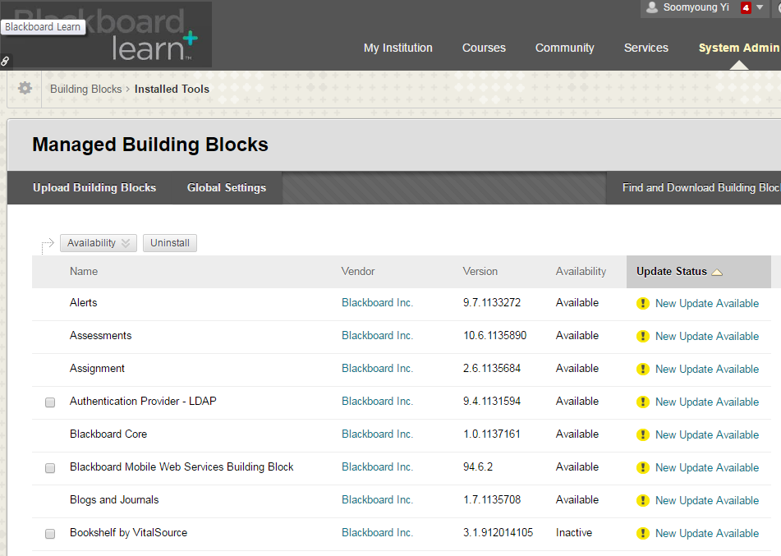
2. 패치 문서 확인
System Admin>Building Blocks>Installed Tools>Managed Building Blocks
Building Block 목록 확인

Slide 7
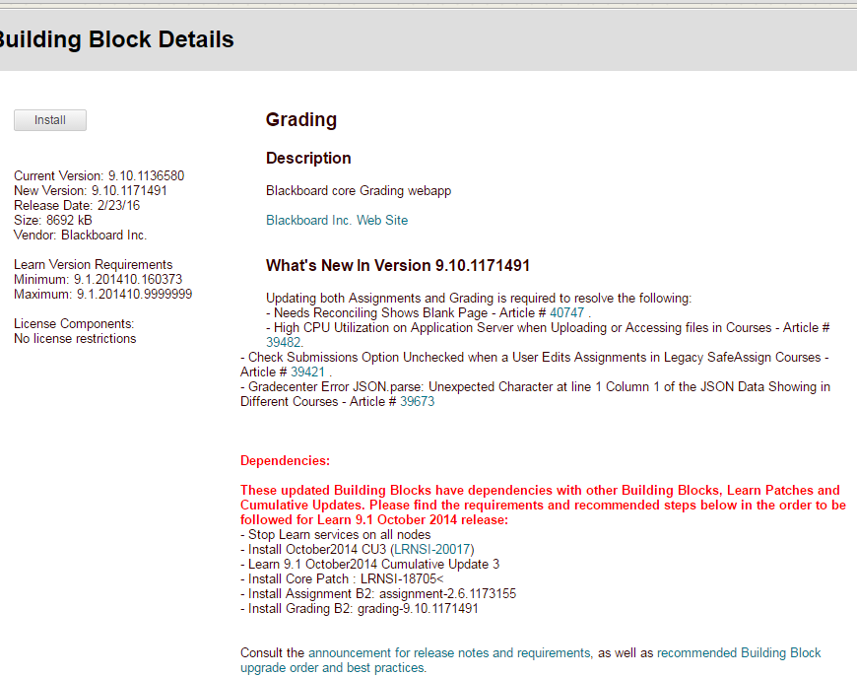
4. 세부사항 확인
화면의 예시 – Grading B2
What’s New
Needs Reconciling Shows Blank Page - Article # 40747 .
High CPU Utilization on Application Server when Uploading or Accessing files in Courses - Article #39482.
Check Submissions Option Unchecked when a User Edits Assignments in Legacy SafeAssign Courses - Article # 39421 .
Gradecenter Error JSON.parse: Unexpected Character at line 1 Column 1 of the JSON Data Showing in Different Courses - Article # 39673
Dependencies 확인
October2014 CU3 Patch 필요 (패치 코드는 LRNSI-20017)
Core Patch 필요(LRNSI-18705)
Assignment B2 버전 확인 - 최소버전: assignment-2.6.1173155

Slide 8
4. 세부사항 확인 – 업그레이드 절차
시스템 서비스 종료
October2014 CU3 설치
BbPatch download LRNSI-20017
BbPatch apply –force LRNSI-20017
Core Patch 설치
BbPatch download LRNSI-18705
BbPatch apply –force LRNSI-18705
Assignment B2 업데이트 - assignment-2.6.1173155
Grading B2 최신 버전 설치 - grading-9.10.1171491

Slide 9
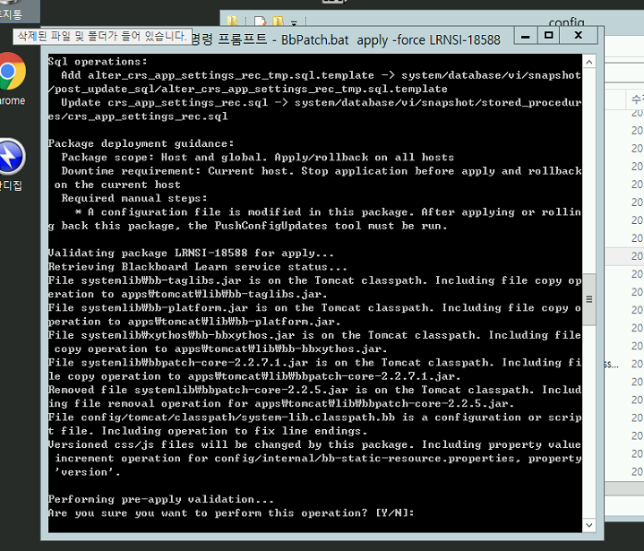
5. 시스템 적용
설치가 완료되고 나면 각각 서버에서 약 5분 간격으로 PushConfigUpdate.bat 를 실행하여 변경사항을 적용 후, 서비스가 시작되었는지 확인 (Tomcat Service가 시작되면 OK)

