Slide 1



Course Outline Day 2
Introduction
Installation
Installation
Android SDK
Prepare Device
Create RF Script
Demo

Slide 2
Automated Android App

Slide 3
Environment Installation
Install Android SDK
Install Appium
Prepare Android real device
Install application on real device
Install Robot Framework Appium Library

Slide 4
Install Android SDK
Go to https://developer.android.com/studio/
Click Download Android Studio
After downloaded, double click to install
Unselect Virtual Device, use the default value in the installation wizard (click next until finish)
After finished, launch Android Studio to install additional SDK components
Clink next until finish
Now you can close Android Studio
Copy C:\Users\Administrator\AppData\Local\Android\Sdk to C:\Sdk
Chane folder name from C:\Sdk to C:\android-sdk
Add 3 variables into System Variable Path
C:\android-sdk\tools
C:\android-sdk\platform-tools
C:\android-sdk\tools\bin
Add New 2 User Variables
Name: ANDROID_HOME, Value: C:\android-sdk
Name: ANDROID_SWT, Value: C:\android-sdk\tools\lib\x86_64

Slide 5
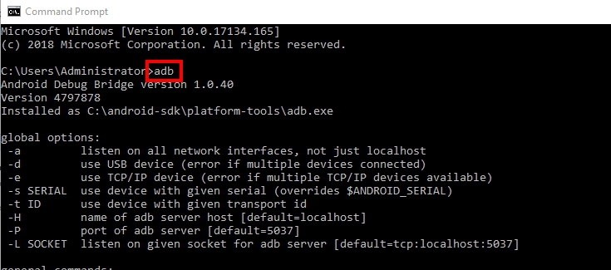
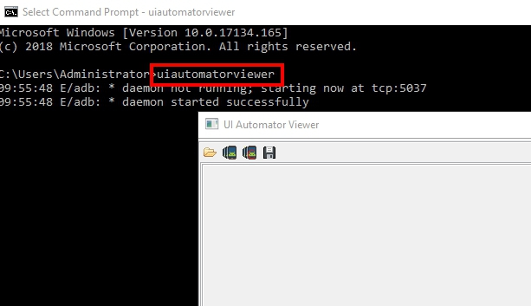
Install Android SDK (Cont.)
Open CMD to verify the installation, If it completed you will see output as below
Type: adb
Type: uiautomatorviewer

Slide 6
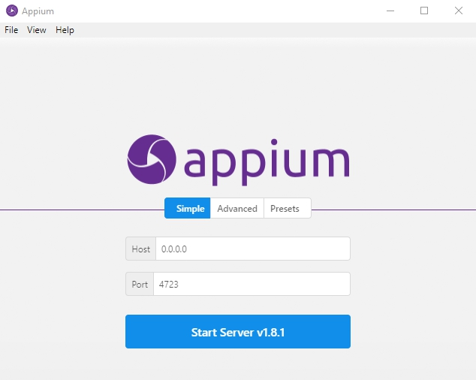
Install Appium
Go to http://appium.io/
Click Download Appium, select the right package for your OS
After downloaded, double click to install
Use the default value in the installation wizard (click next until finish)
Appium will be opened after install

Slide 7
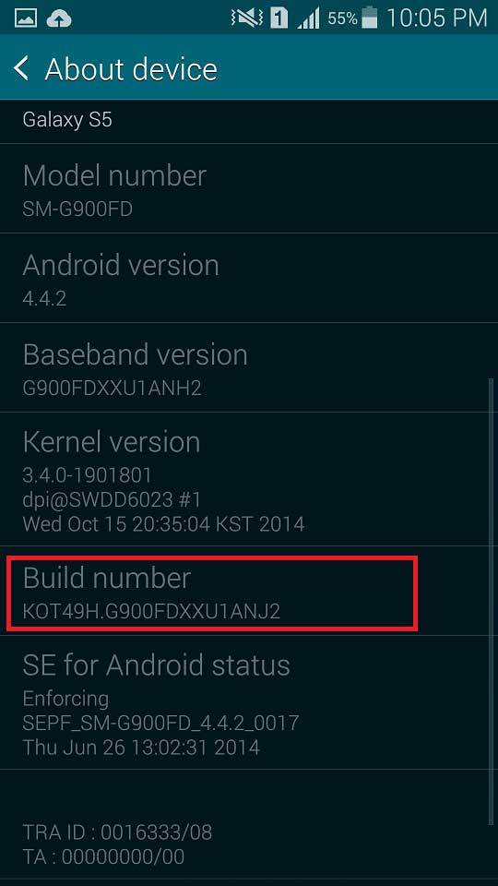
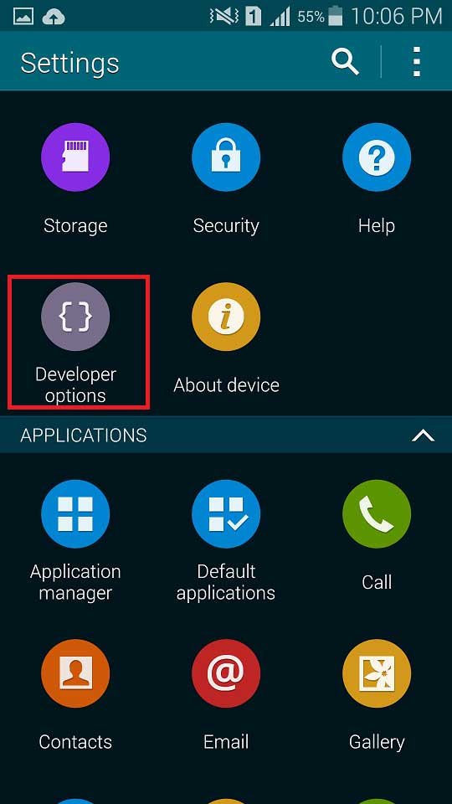
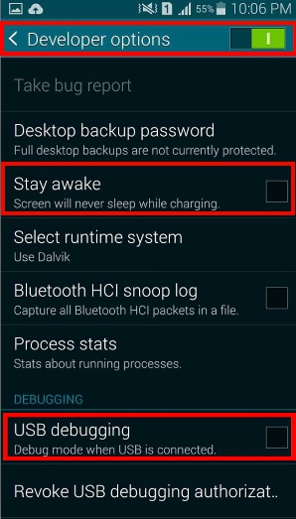
Prepare Real Android Device
Tap Apps
Tap Settings
Tap About device
Scroll down the screen. If you see Build number, touch it seven times. ...
Go back to Settings, the Developer options menu will now appear under Settings > General > Developer options

Slide 8


Install Application on Real Device
We will install the PreciseUnitConversion application for testing
To install app
Open CMD
Type adb devices to verify that your device is already connected to PC
Type adb install PreciseUnitConversion.apk

Slide 9
Appium

Slide 10

What is Appium?
Appium is an open-source tool for automating native, mobile web, and hybrid applications.
It allows you to run the automated tests on real devices, or simulators.
Support both iOS and Android
And also you can use Robot Framework to create automation script

Slide 11



How does Appium do?
Receive connection from client
Listen command
Execute command
Response back the command execution status
Robot Framework
Script
Appium Server
Mobile App

Slide 12
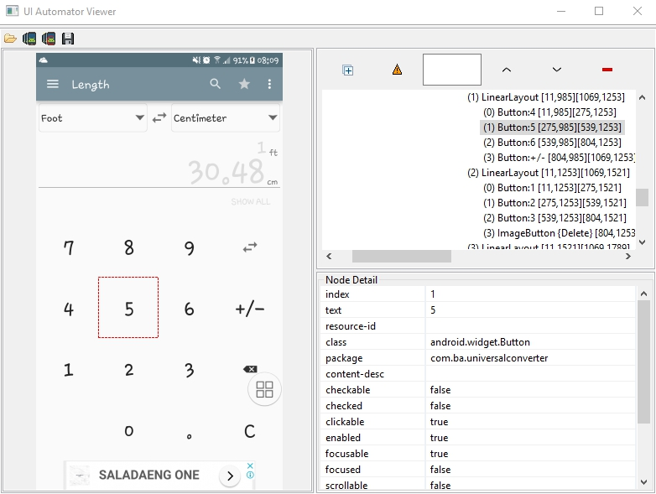
What is UIAutomatorviewer?
UIAutomatorviewer is a GUI tool to scan and analyze the UI components of an Android application
Image of
Application
Object
hierarchy
Object
prpperty

Slide 13
Create First Script

Slide 14
Create First Mobile Testing Script
Install robotframework-appiumlibrary
Test Step
Open Unit Converter Application
Click 7 Button
Click 9 Button
Verify that application convert data correctly
Click Menu
Verify that menu is opened

Slide 15
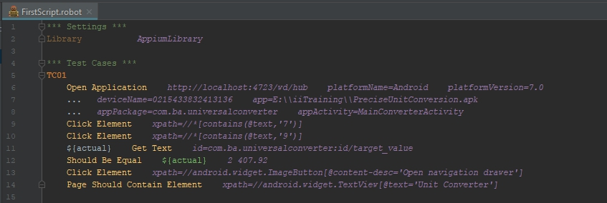
Example Robot Framework Script
Robot Framework Appium Library Document
http://serhatbolsu.github.io/robotframework-appiumlibrary/AppiumLibrary.html
Use UIAutomatorviewer to help locate element

Slide 16

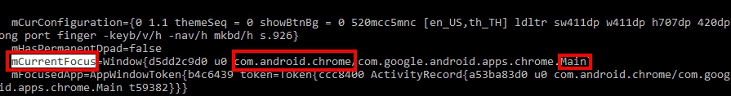
How to start automation with your own app?
Get the apk file from your device
Get appPackage and appActivity
Open app on your mobile device
Search mCurrentFocus in the result
appPackage
appActivity

Slide 17
Automated iOS App

Slide 18
Environment Installation
System requirement
Install Appium
http://appium.io/docs/en/about-appium/getting-started/
Install Xcode
Appium XCUITest Driver Real Device Setup
brew install libimobiledevice
npm install -g ios-deploy
brew install ios-deploy
Follow the full manual configuration to setup WedDriverAgent
http://appium.io/docs/en/drivers/ios-xcuitest-real-devices/#full-manual-configuration

Slide 19
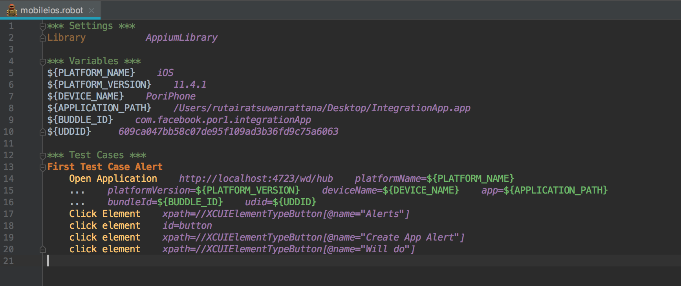
Example Robot Framework Script
Robot Framework Appium Library Document
http://serhatbolsu.github.io/robotframework-appiumlibrary/AppiumLibrary.html
Use Appium to help locate element

Slide 20
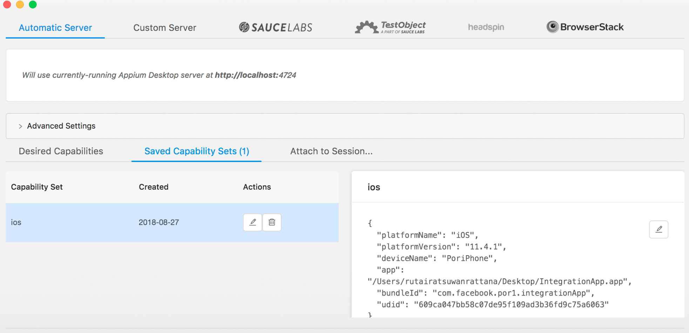
Appium

