Slide 1

Cloud Computing Security Challenges and Solutions
Presented By: Sana Khatun
Ankita Yadav
Prachi Pal

Slide 2
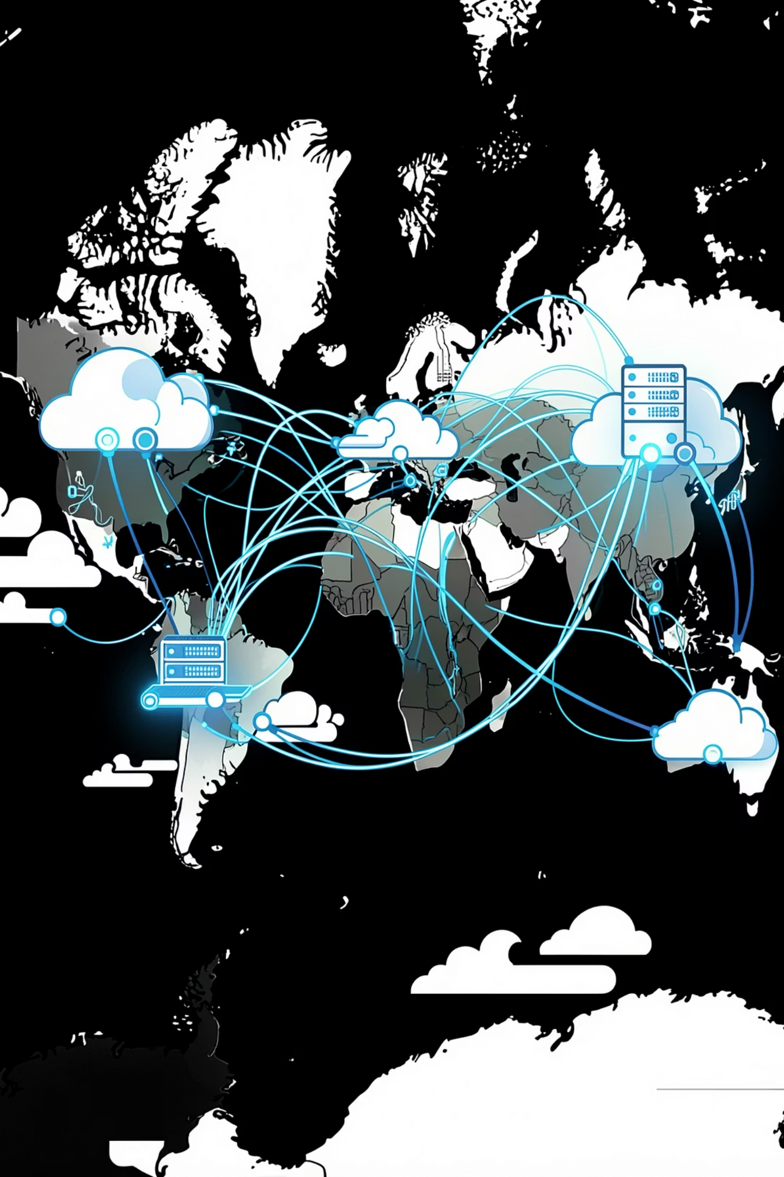

INTRODUCTION
What Is Cloud Computing?
Definition
On-demand delivery of compute, storage, and services over the internet
Scalability
Elastic resources that scale with demand — no hardware procurement delays
Cost Efficiency
Pay-as-you-go models reduce capital expenditure significantly
Accessibility
Global reach — work from anywhere, on any device, at any time

Slide 3

WHY IT MATTERS
The Growing Need for Cloud Security
Accelerating Dependency
Over 90% of enterprises now rely on cloud services for critical operations
Data Exposure Risk
Centralized storage creates high-value targets for attackers
Trust & Compliance
Regulatory pressure demands provable security and audit trails

Slide 4
CORE CHALLENGES
Major Security Challenges
Data Breaches
Data Loss
Insecure APIs
Unauthorized access to sensitive data
Accidental deletion or destruction
Weak interfaces expose backend systems
Account Hijacking
Insider Threats
Credential theft and privilege escalation
Malicious or negligent internal actors

Slide 5
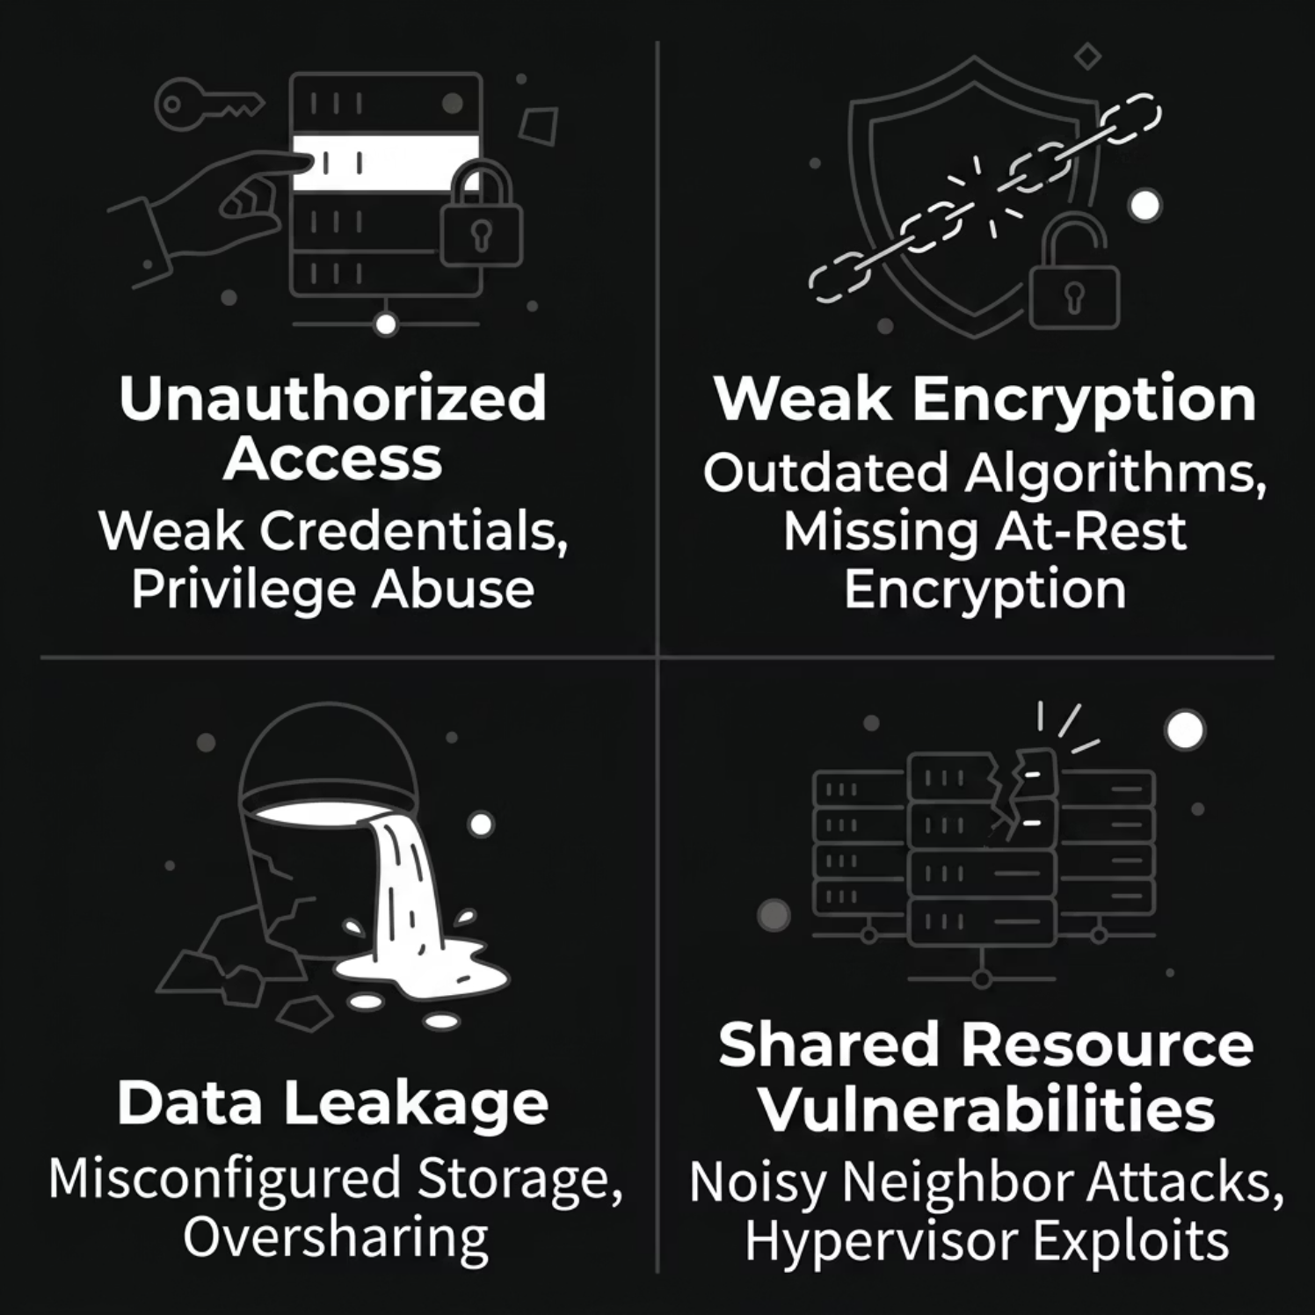

DEEP DIVE
Data Security Issues
Key Vulnerabilities
Unauthorized access via weak credentials or privilege escalation
Weak encryption — outdated algorithms or missing at-rest encryption
Data leakage through misconfigured buckets or oversharing
Shared resource exploits in multi-tenant environments

Slide 6
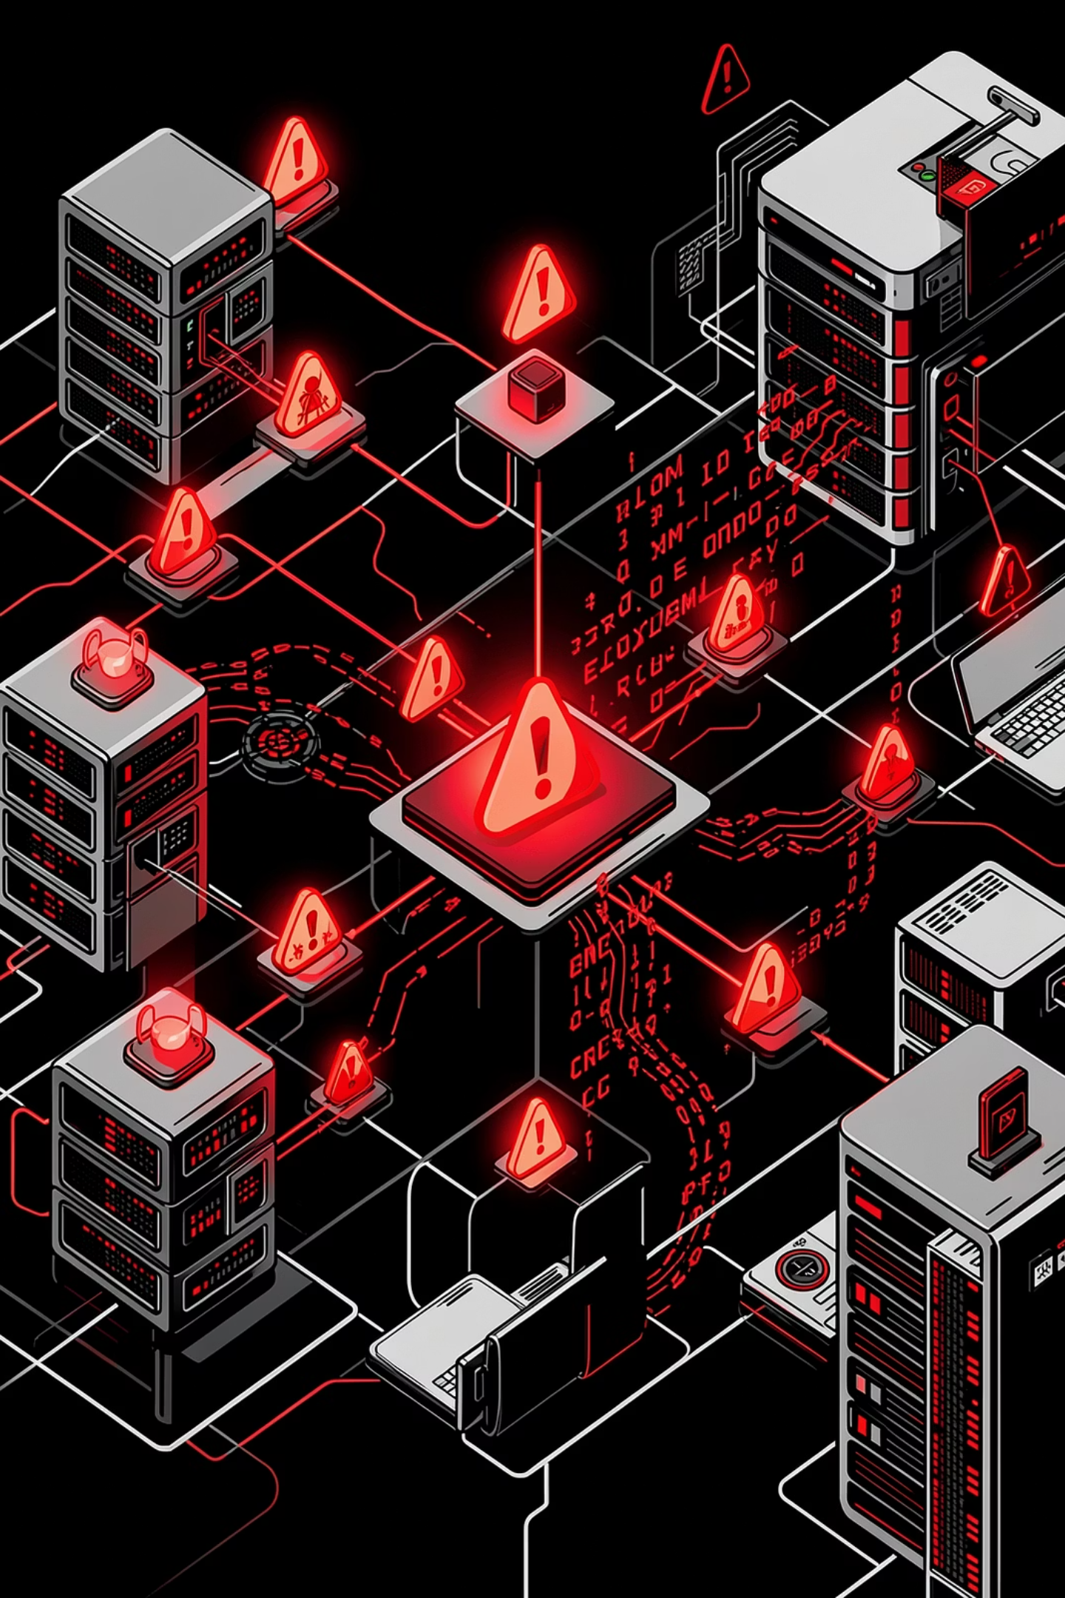




THREAT LANDSCAPE
Advanced Threats
Identity Theft
Stolen credentials used to impersonate legitimate users
Malware & Ransomware
Encrypts or exfiltrates data for extortion
Insider Misuse
Privileged users abusing access rights
Weak Authentication
Password-only systems easily compromised

Slide 7

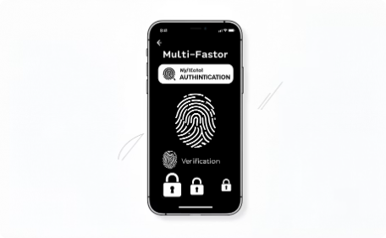
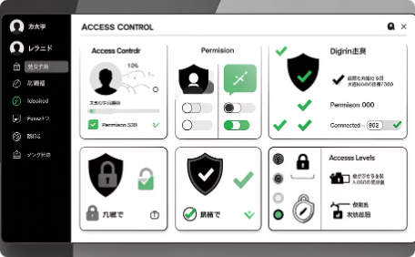
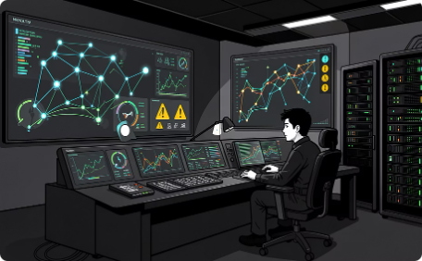
DEFENSIVE MEASURES
Security Solutions
Data Encryption
MFA
Access Control
Intrusion Detection
Encrypt data in transit and at rest using strong standards (AES-256, TLS 1.3)
Multi-Factor Authentication blocks 99% of automated credential attacks
Least-privilege policies and role-based access (RBAC)
Real-time IDS/IPS monitors and blocks anomalous traffic

Slide 8
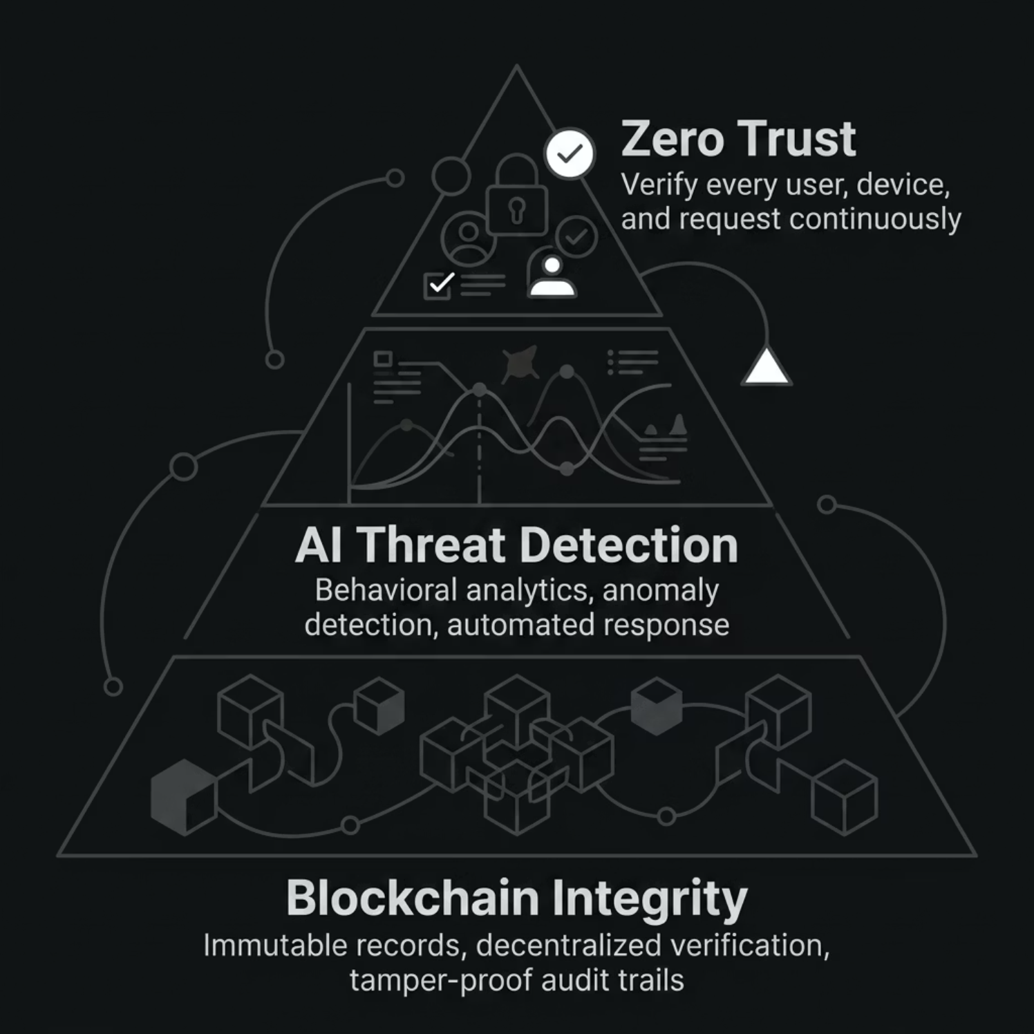
NEXT-GEN SECURITY
Modern Security Approaches
Zero Trust Model
Never trust, always verify — every access request is authenticated and authorized
AI & Machine Learning
Anomaly detection and behavioral analytics identify threats in real time
Blockchain Integrity
Immutable ledgers ensure tamper-proof audit trails and data provenance

Slide 9
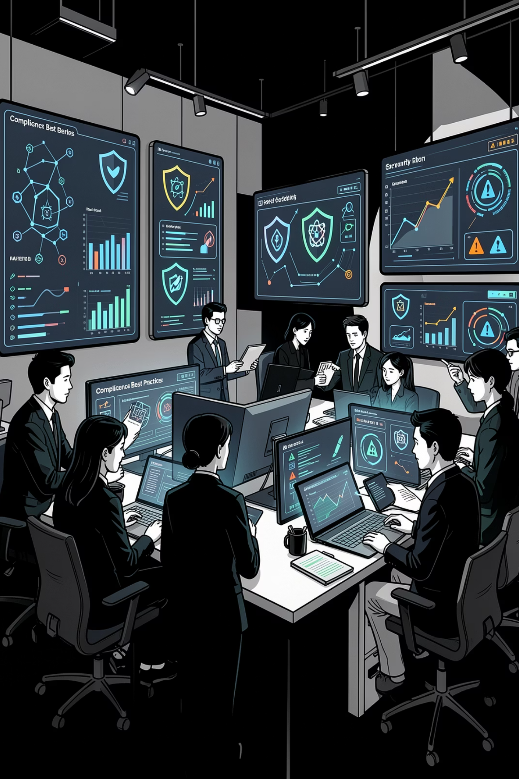
BEST PRACTICES
Building a Resilient Cloud Posture
1
Regular Backups
Automated, encrypted, off-site backups with tested recovery procedures
2
Monitoring & Logging
Centralized SIEM with full visibility across all cloud assets
3
User Training
Security awareness programs reduce human error — the #1 attack vector
4
Compliance
Align with GDPR, ISO 27001, SOC 2, and industry-specific regulations

Slide 10
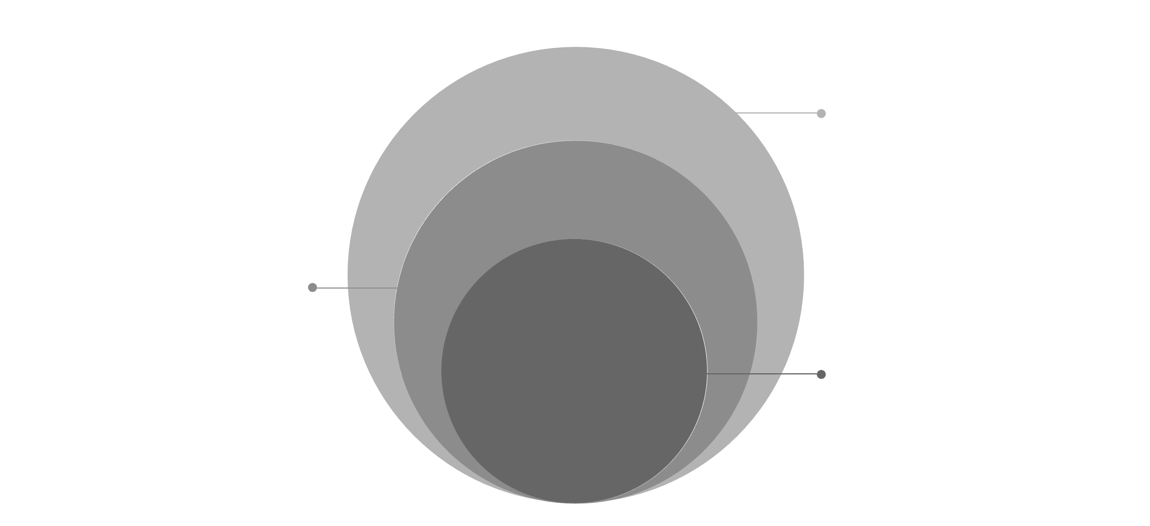
CONCLUSION
The Future of Cloud Security
Future Outlook
AI automation, Zero Trust, quantum-safe encryption
Shared Responsibility
Provider secures infrastructure; customer secures data and access
Layered Security
Defense in depth across people, process, technology
Cloud security is not a one-time configuration — it is a continuous, evolving discipline requiring layered defenses, clear accountability, and proactive investment in modern tooling and practices.
Layered Defense
Shared Responsibility
Continuous Evolution
No single control is sufficient
Provider + customer both accountable
Adapt to emerging threats proactively

