Slide 1







Stack Overflow Developer survey 2019- Data Analysis Report
Nithin Jayaprakash
02/09/2023

Slide 2



OUTLINE
Executive Summary
Introduction
Methodology
Results
Visualization – Charts
Dashboard
Discussion
Findings & Implications
Conclusion
Appendix

Slide 3

INTRODUCTION
Stack Overflow’s annual Developer Survey is the largest and most comprehensive survey of people who code around the world.
Each year, we field a survey covering everything from developers’ favorite technologies to their job preferences. 2019 marks the ninth year , published annual Developer Survey results, and nearly 90,000 developers took the 20-minute survey .
Despite survey’s broad reach and capacity for informing valuable conclusions, have acknowledged that the results don’t represent everyone in the developer community evenly and have further work to do to make Stack Overflow the welcoming, inclusive, and diverse platform wanted it to be, and this is reflected in their survey sample.
The survey indicates the trend where the developer are heading
The data was further divided demographics throughout the analysis
2019 survey had new highlights of hours worked per week and best music to listen

Slide 4

EXECUTIVE SUMMARY
Data analysis and different goals
Different Methodologies used
Data gathering
Data Visualization
Data analysis
Finding the results and implications and displaying trends with the usage of different graphs
Discussion about the findings
Conclusion

Slide 5

METHODOLOGY
Collection of survey data
Web scrapping
API's
Request Library
Data wrangling
Checking the quality of data, cleansing data
Analyzing data
Data distribution
Finding outliers
Finding correlation
Data Visualization and building dashboards
Highlighting data distribution , composition, relation

Slide 6
RESULTS

Slide 7
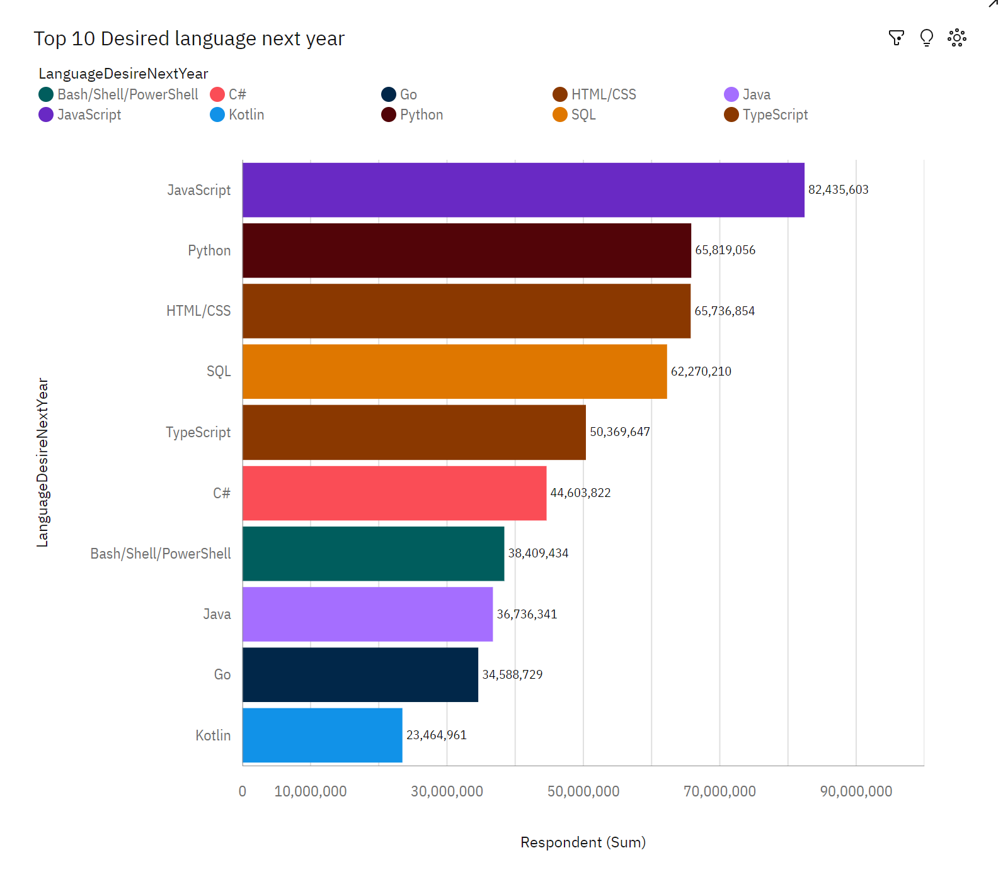
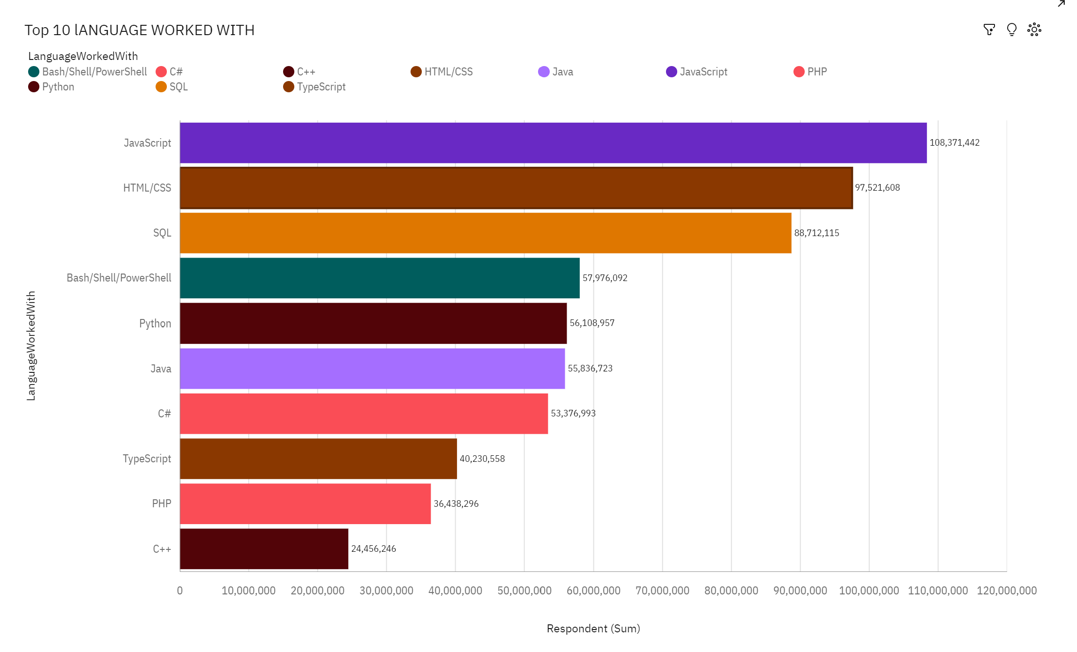
PROGRAMMING LANGUAGE TRENDS
Current Year
Next Year

Slide 8
PROGRAMMING LANGUAGE TRENDS - FINDINGS & IMPLICATIONS
Findings
Java Script is the leading language as per the analysis
Python can be considered as the fastest growing language
There is a high interest shown towards TypeScript
There is rise in interest for new languages GO and Kotlin
Implications
Migration of developer from Java script to TypeScript
Migration from java to python and C#
Rise of new languages GO and Kotlin, decrease in the use of PHP and C++

Slide 9
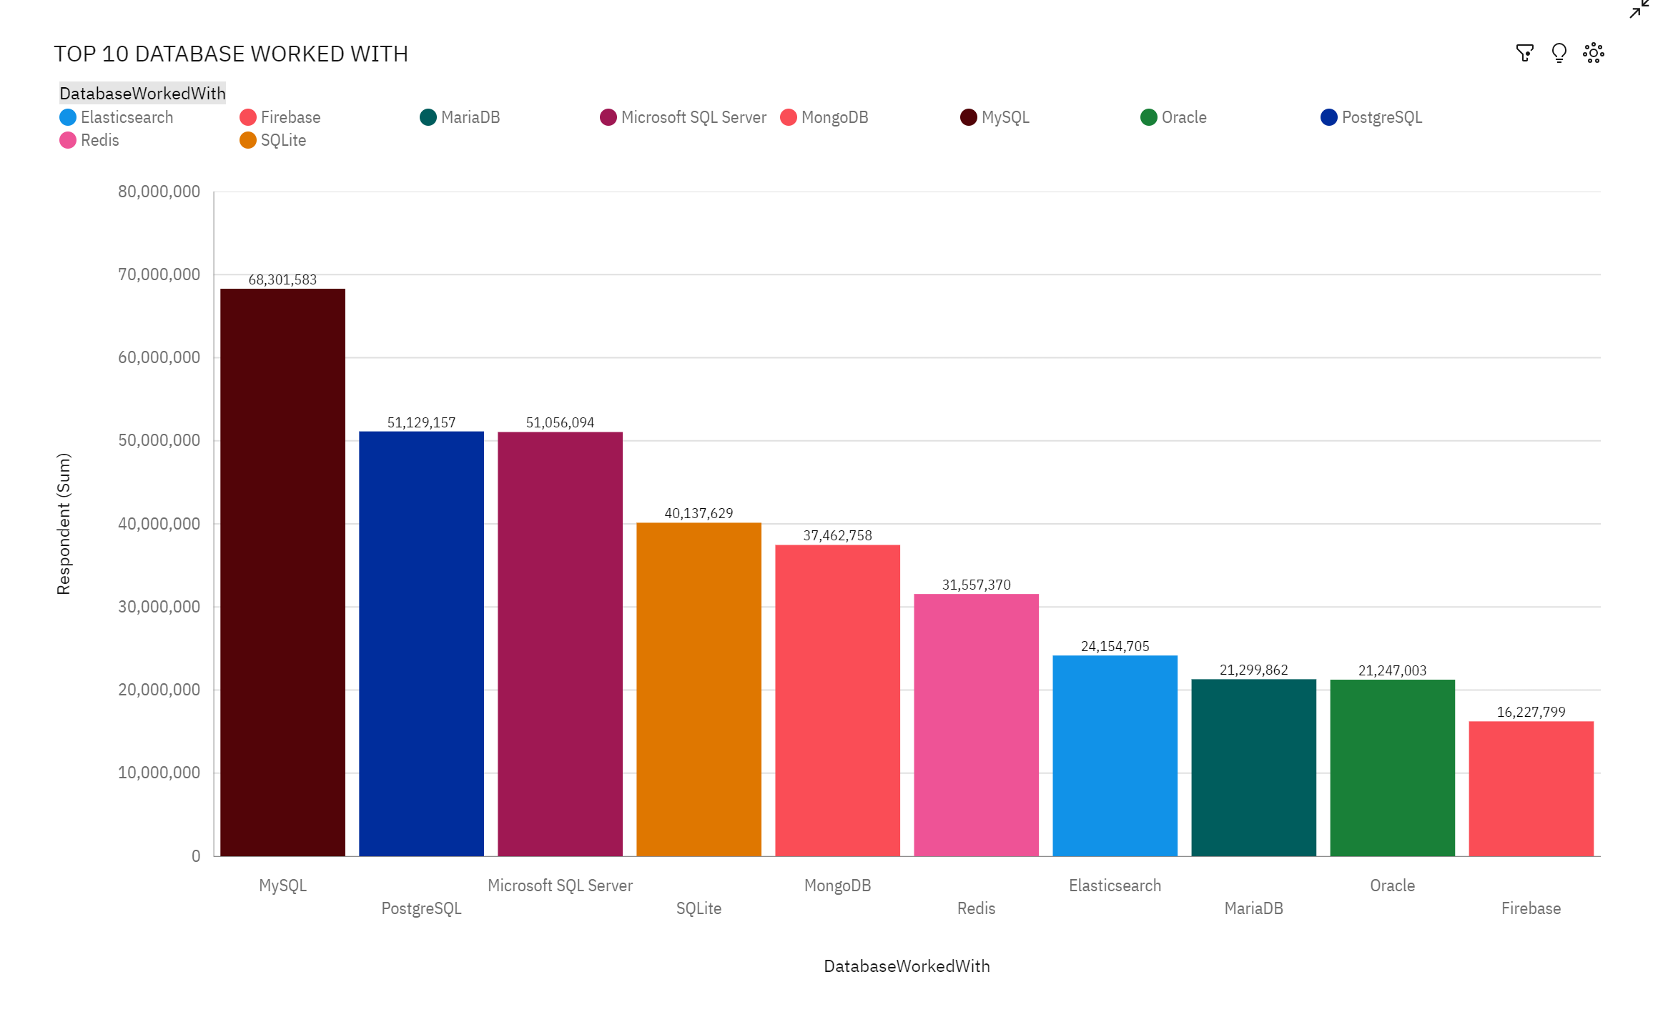
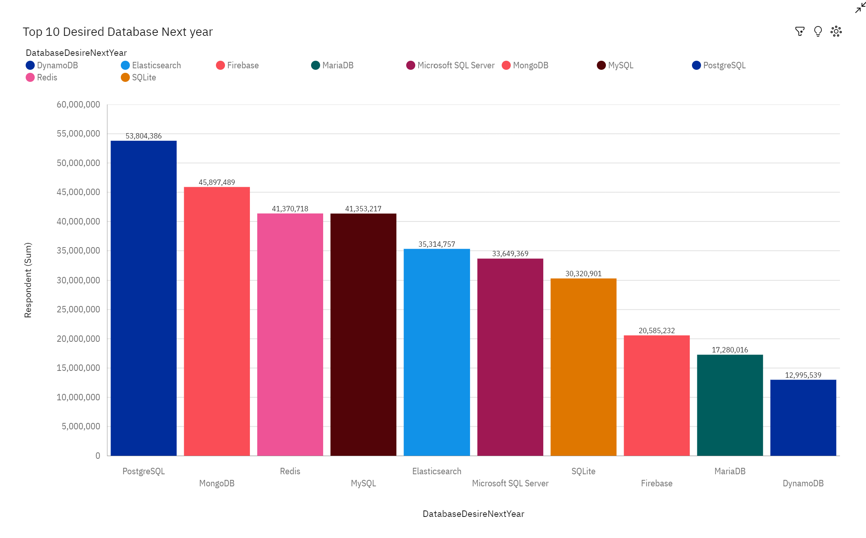
DATABASE TRENDS
Current Year
Next Year

Slide 10
DATABASE TRENDS - FINDINGS & IMPLICATIONS
Findings
MySQL stands as the leading Database
Trend is moving towards PostgreSQL and MongoDB while Microsoft SQL server and SQL Lite is losing interest
High interest shown towards Redis and Elasticsearch as well
Implications
Developers move from conventional MySQL to MongoDB, Redis, Elasticsearch
MS SQL and SQL Lite is on the verge of fall
PostgreSQL and MongoDB finds the top place in the market

Slide 11

DASHBOARD
https://github.com/blackdevil30/IBM-capstone-Project/blob/main/capstone.pdf

Slide 12
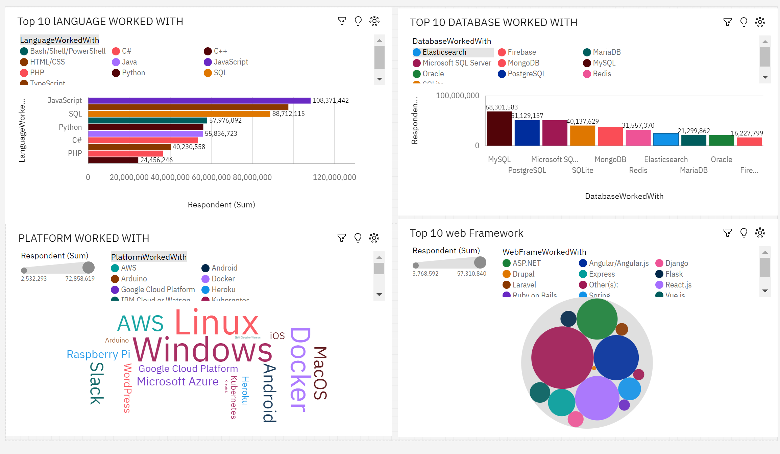
Current technology usage

Slide 13
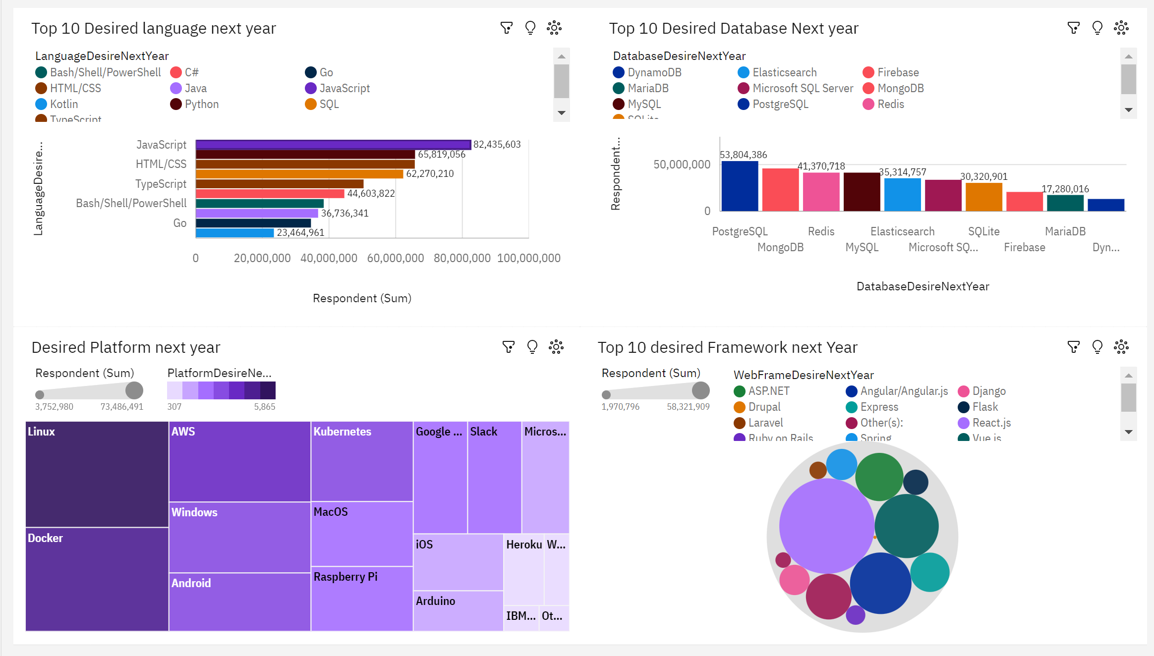
Future technology Trend

Slide 14
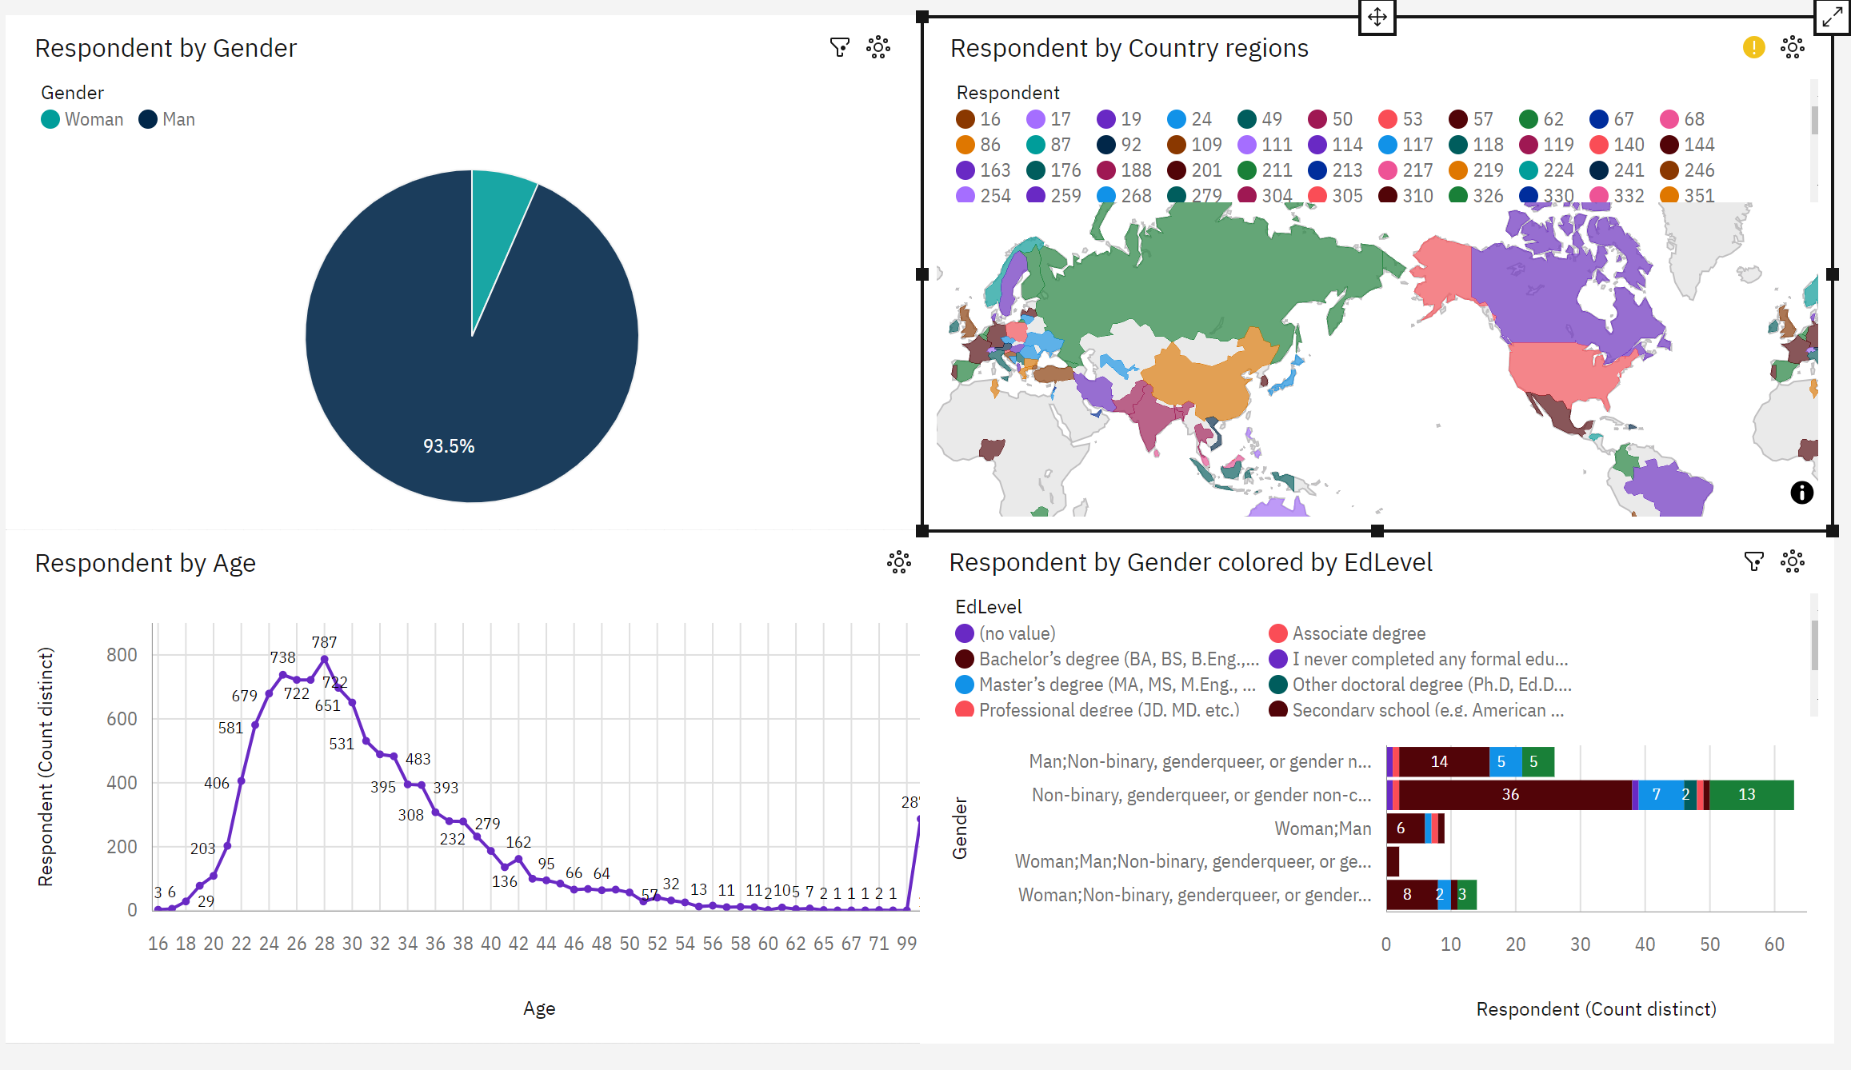
Demographics

Slide 15
DISCUSSION

Slide 16
OVERALL FINDINGS & IMPLICATIONS
Findings
JavaScript is the popular language
Losing interest on MS SQL server SQL Lite and MySQL
React, Vue and Angular are web framework developer interested on
26-30 age group was the majority in the survey
Most people are from developed countries
Majority of the developer have done under graduation
Implications
JavaScript and TypeScript are attracting web developers
MS SQL and SQL lite is falling behind, PostgreSQL and MongoDB rules the market
Majority of the gender is male
Majority developers does not have a master's degree

Slide 17

CONCLUSION
A great analyzation on moving trend, the future aspect of growth of different tool and shape of technology from the current time
Understanding the wide and wild characteristics of developers
There can be changes made in the accessibility of the technology and tool to the developing nation along bringing equality in participation among gender, attracting more females to IT industry and development jobs

Slide 18

APPENDIX
Include any relevant additional charts, or tables that you may have created during the analysis phase.

Slide 19
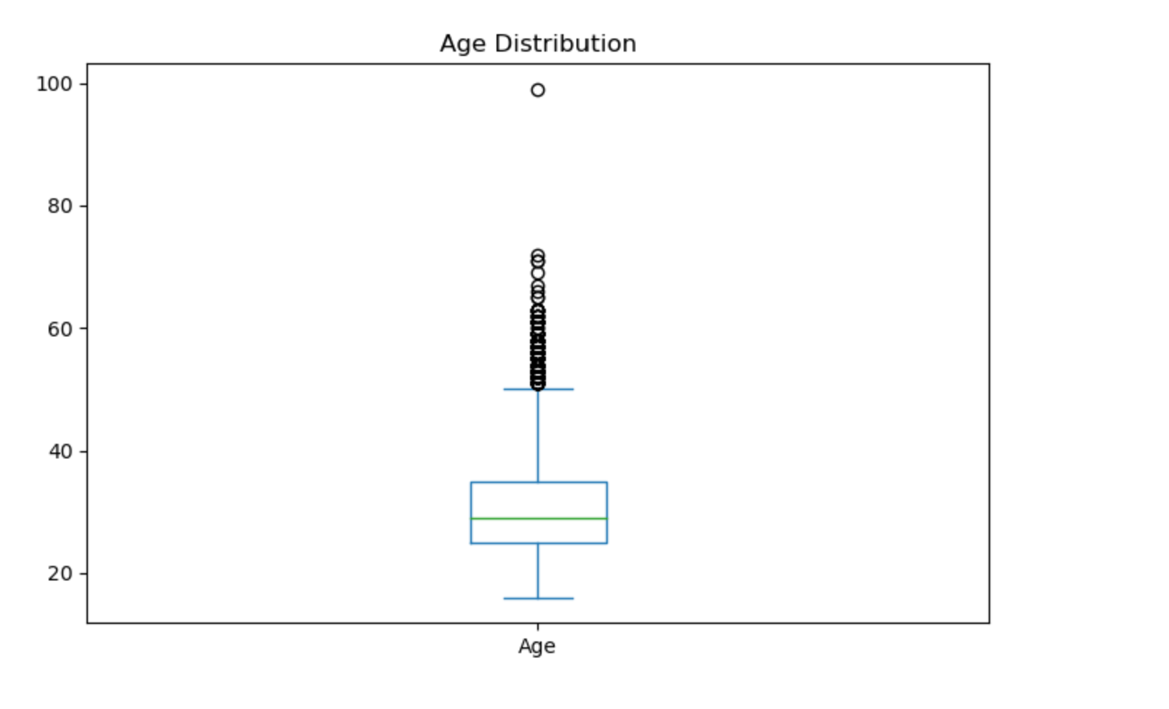
Age Distribution

Slide 20
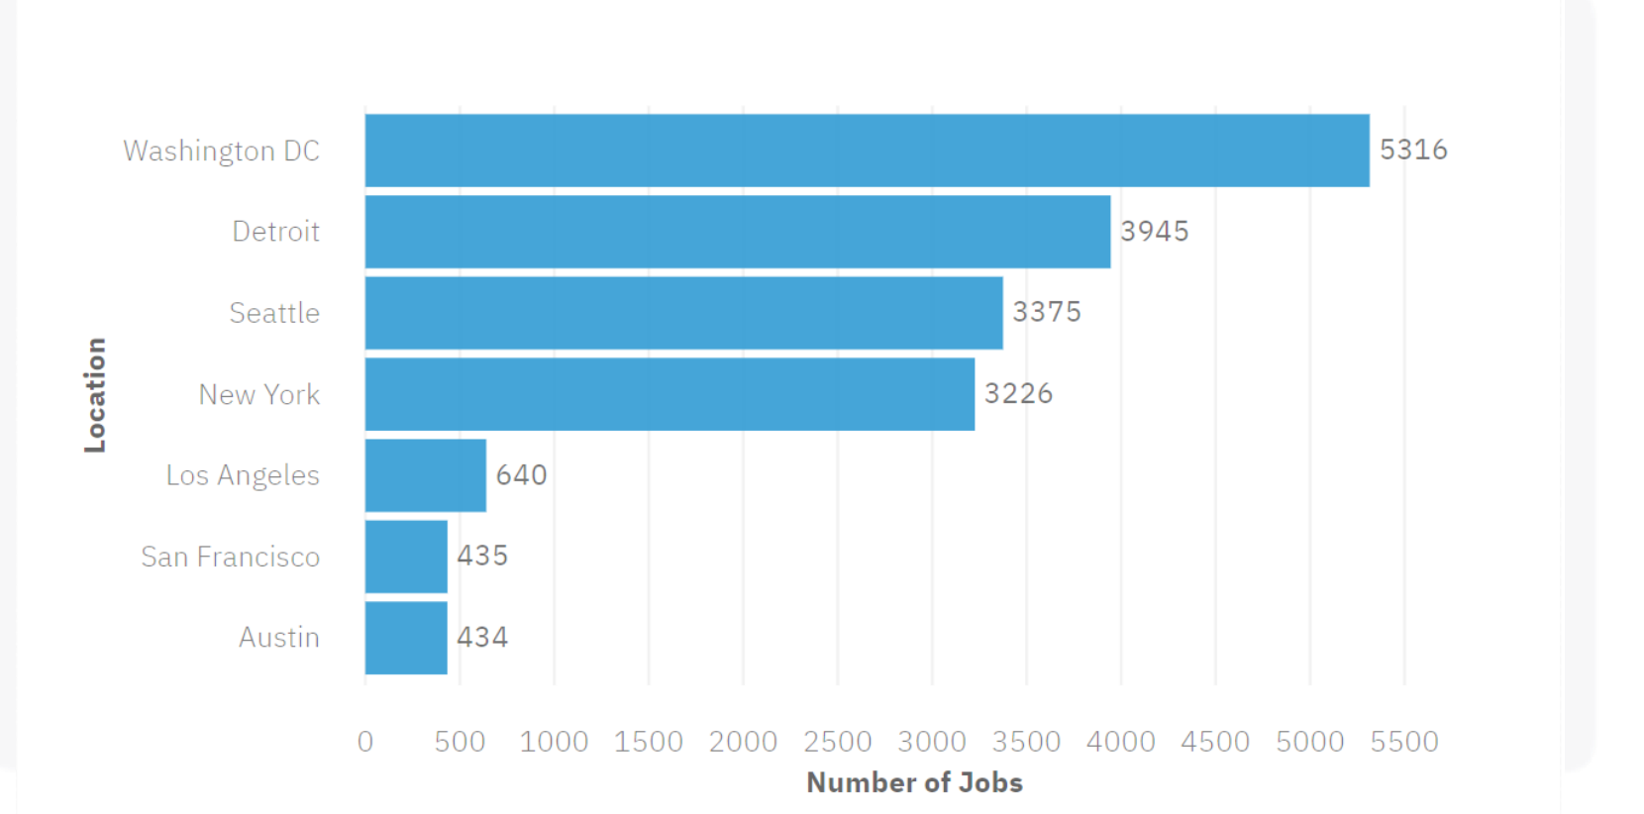
JOB POSTINGS

Slide 21
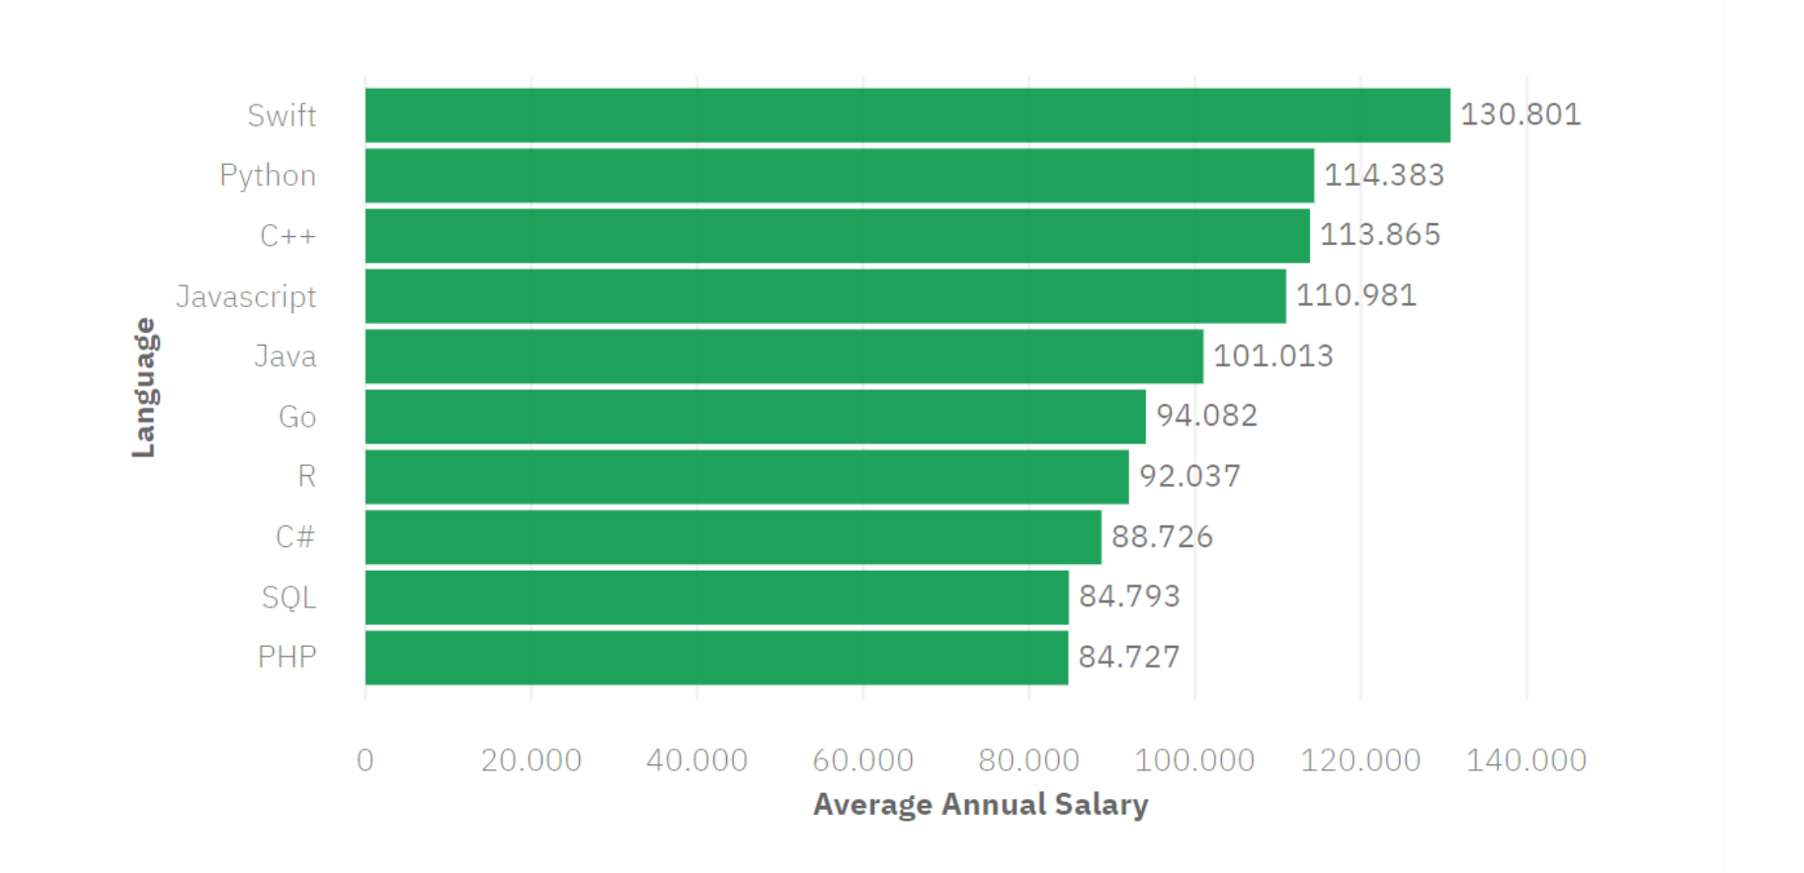
POPULAR LANGUAGES

