Slide 1

IBM Capstone Assignment – COGNOS dashboard

Slide 2
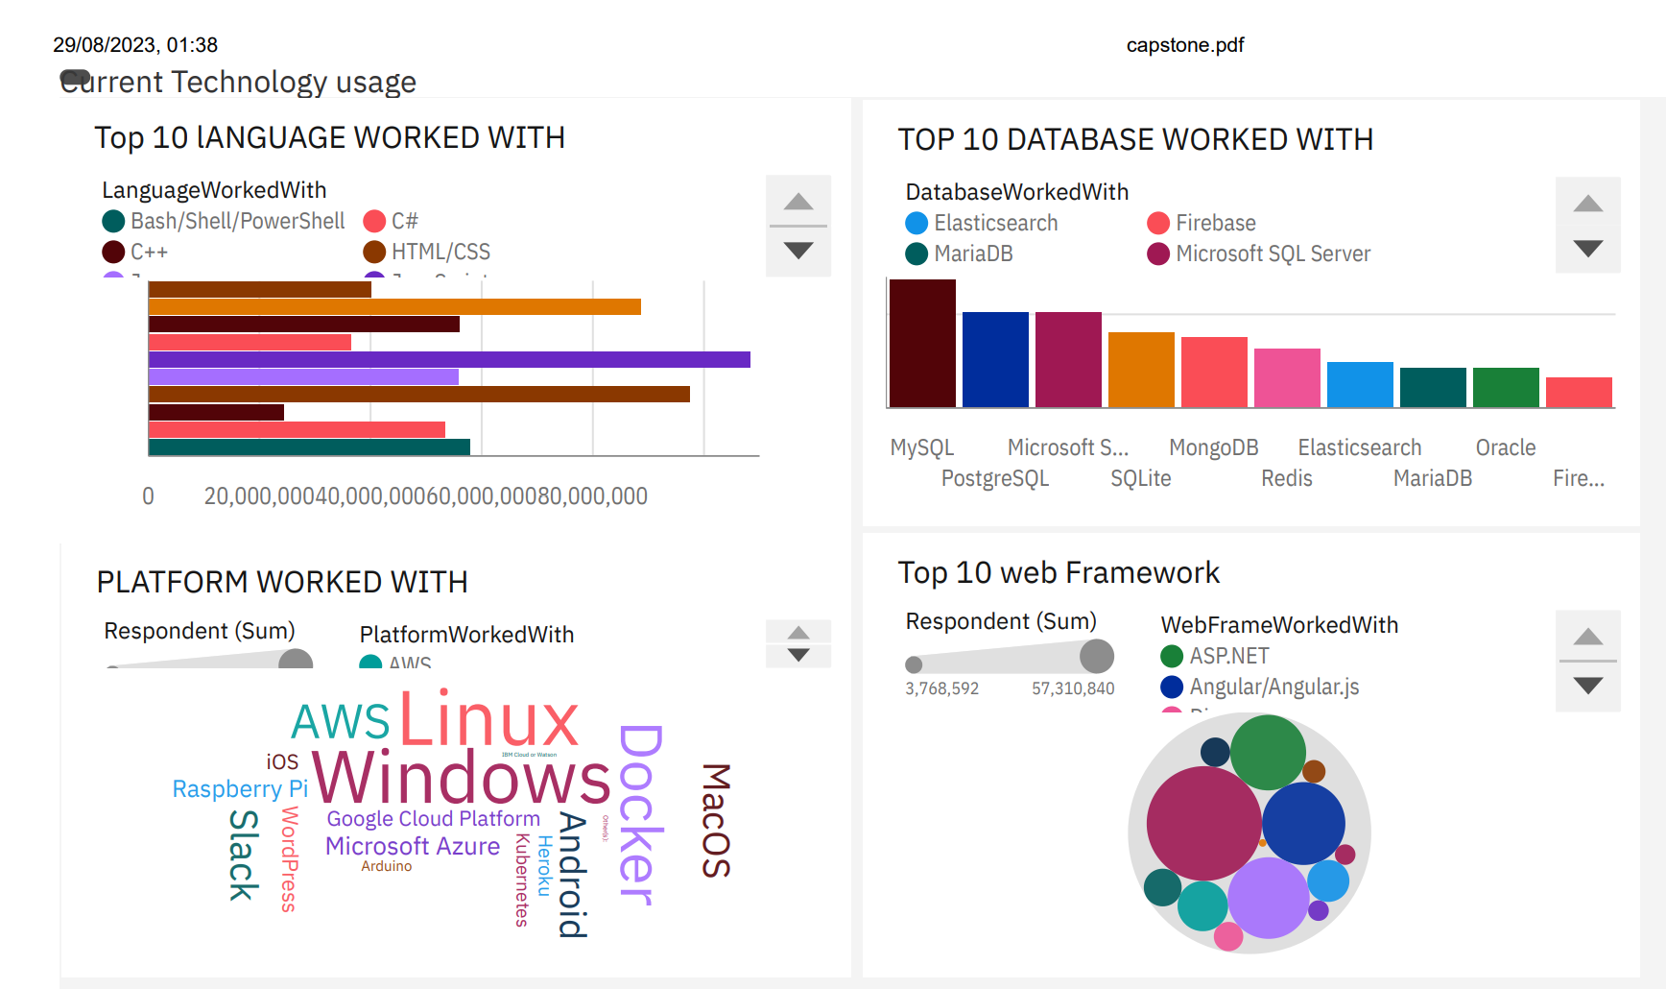
Current Technology usage

Slide 3
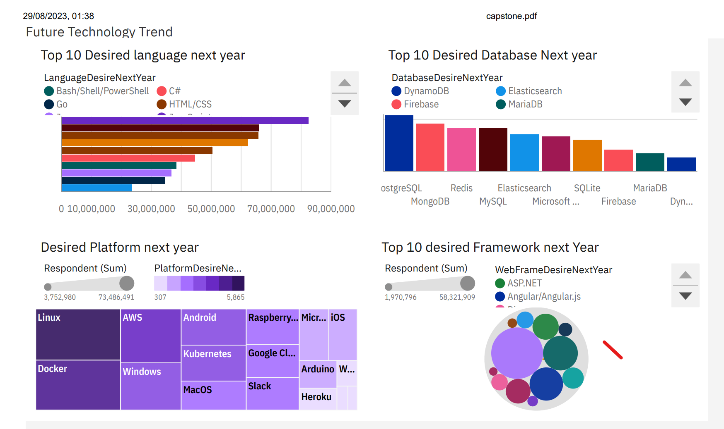
Future Technology Trend

Slide 4
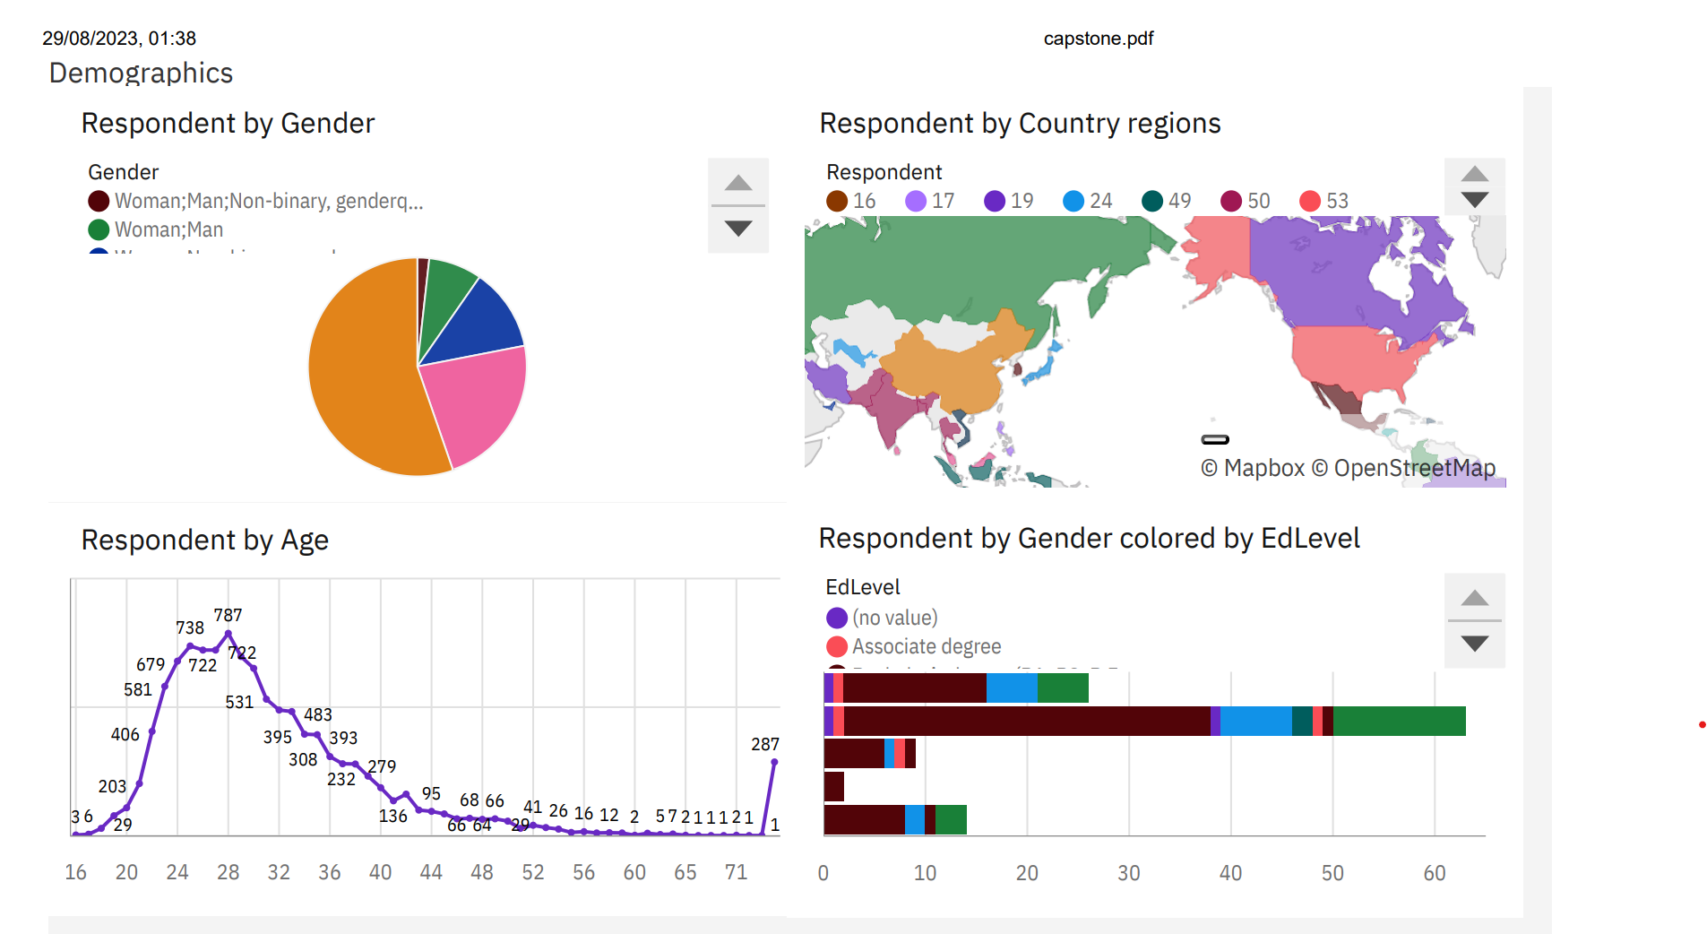
Demographics

