Slide 1

Solr for newbies
https://hectorcorrea.com/solr-for-newbies
Hector Correa
hector_correa@princeton.edu
code{4}lib 2023
Princeton, NJ

Slide 2
Workshop Outline
Introduction
Concepts, quick tour, installation
Schema
Types, Fields, Tokenizers, Filters
Searching
Search parameters, Facets, Highlighting
Miscellaneous
Configuration, Synonyms, Spell checking

Slide 3
Code4Lib Community Code of Conduct
Code4Lib seeks to provide a welcoming, fun, and safe community and conference experience and ongoing community for everyone. We do not tolerate harassment in any form. Discriminatory language and imagery (including sexual) is not appropriate for any event venue, including talks, or any community channel such as the chatroom or mailing list.
https://2023.code4lib.org/conduct/

Slide 4
I. Introduction
https://github.com/hectorcorrea/solr-for-newbies/blob/main/tutorial.md#part-i-introduction

Slide 5
What is Solr?
“Solr is the popular, blazing-fast, open source enterprise search platform built on Apache Lucene.” - Solr’s Home Page
“Solr is a scalable, ready-to-deploy enterprise search engine that’s optimized to search large volumes of text-centric data and return results sorted by relevance.” - Solr in Action [p. 4]

Slide 6
Why Solr is popular in libraries?
We have lots of text centric searches
Relevance in results is important to us
Solr is free and open-source
Facets
A few examples:
Library Catalogs: Princeton and Stanford
Institutional Repositories: Penn State and Brown
Finding Aids: Princeton and NYU

Slide 7
Related tools and concepts
Apache Solr
The Java app that we use, uses Lucene under the hood
Accessible via HTTP requests, no need to use Java to index or query
Apache Lucene - brains behind Solr, used internally by Java applications
Apache Software Foundation (ASF)*
ElasticSearch
Another product like Solr that also uses Lucene, increasingly popular
Not from ASF, weird license, not entirely open-source
Indexing - when we ingest data into Solr
Querying - when we search for data in Solr
Tokenizing - a process of splitting a large text into smaller pieces (tokens)
* I also think they should change their name
https://blog.nativesintech.org/apache-appropriation/

Slide 8
Solr in our apps
Our search app
HTTP requests
App searches for data in Solr
External Source Data
(e.g. data dumps from a 3rd party
HTTP requests
One way sync copies data to Solr
Java only needed on the server where Solr runs

Slide 9
Solr in our apps (cont.)
Our read-write app
App saves data in database and in Solr …
HTTP requests
App searches for data in Solr
PostgreSQL
HTTP requests
Java only needed on the server where Solr runs

Slide 10
Is Solr a database?
Technically yes
Solr is a document-oriented database (a NoSQL database)
Solr is not a relational database like PostgreSQL, MySQL, Oracle, MS Access
In practice no
Although we use Solr to store data…
…we do this to power the search feature of our applications
…and the source data lives somewhere else, in a “real” database

Slide 11
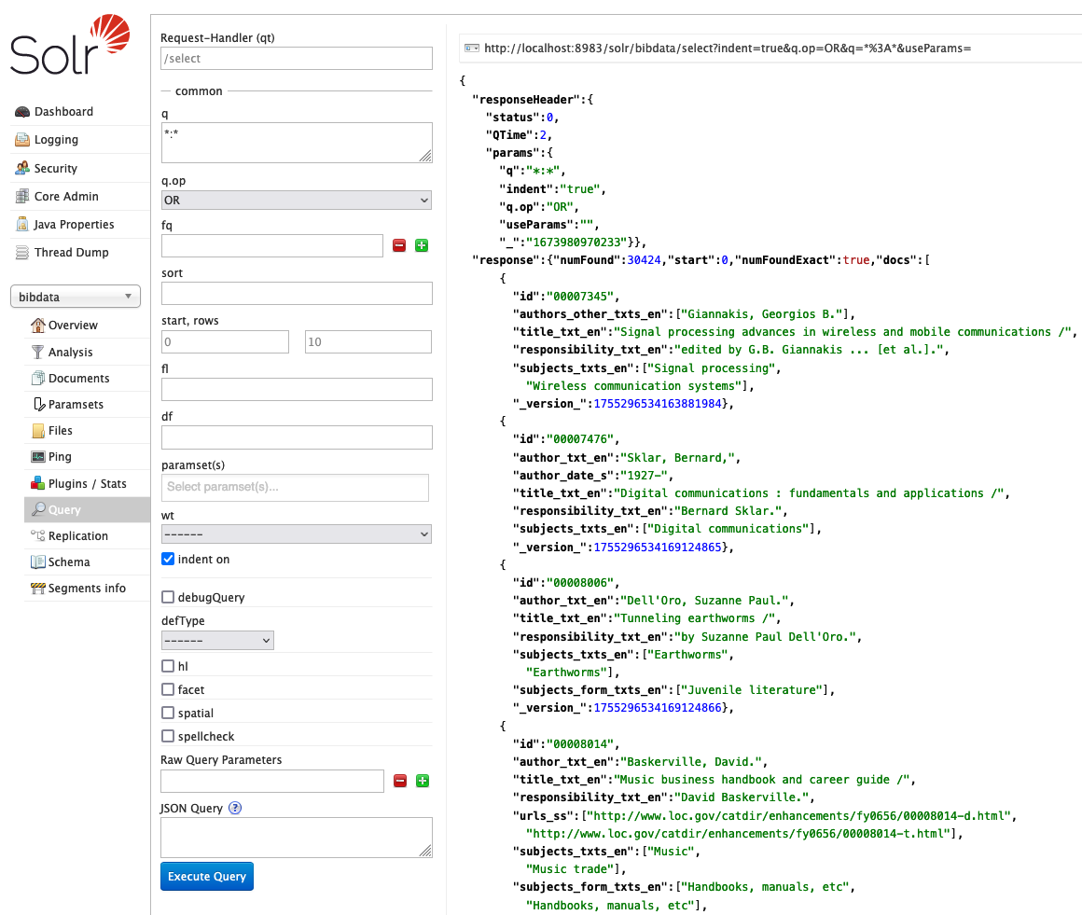
Demo time

Slide 12
Your turn: Installing Solr
https://github.com/hectorcorrea/solr-for-newbies/blob/main/tutorial.md#installing-solr-for-the-first-time
Install Docker
Create a Solr core named bibdata
Load data to our bibdata Solr core
Run basic queries
https://github.com/hectorcorrea/solr-for-newbies/blob/main/tutorial.md#searching-for-documents
If don’t want to install Solr

Slide 13
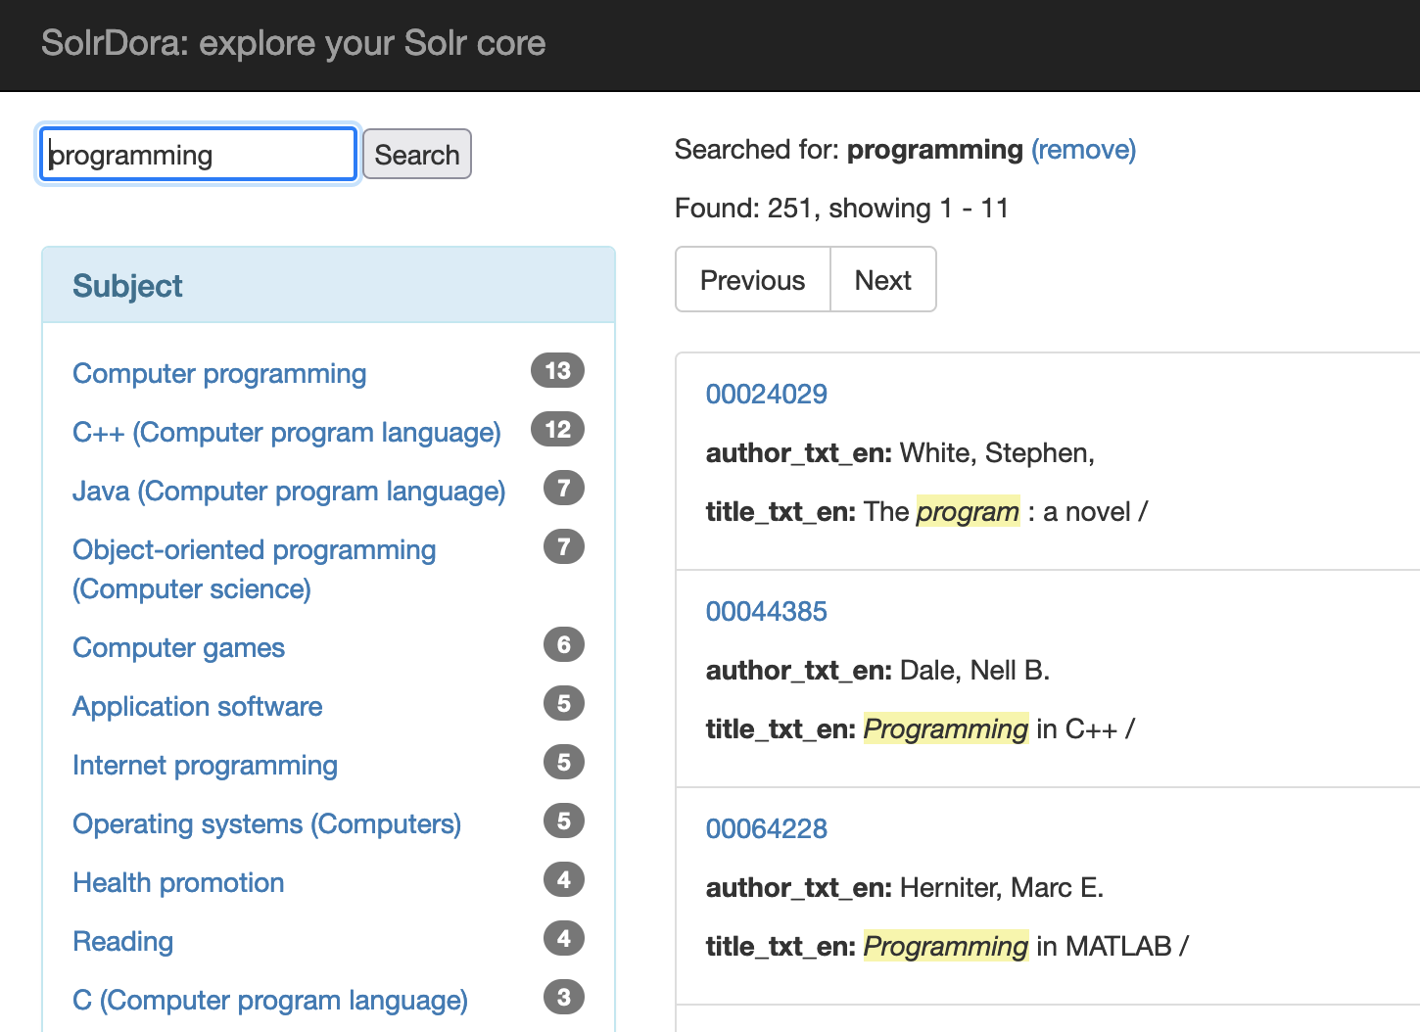
Your turn (optional): Use SolrDora to view the data
Download SolrDora for macOS
$ curl -OL https://github.com/hectorcorrea/solrdora/releases/download/v0.4/solrdora_mac.zip
$ unzip solrdora_mac.zip
run it:
$ ./solrdora settings.json
…and point your browser to http://localhost:9001/
Note
On Windows download solrdora_win.zip
On Linux download solrdora_linux.zip

Slide 14
II. Schema
https://github.com/hectorcorrea/solr-for-newbies/blob/main/tutorial.md#part-ii-schema

Slide 15
Solr’s Document Model
id | book_title | subjects
1 | Princeton guide for dog owners | guides, animals
2 | Princeton tour guide | guides
3 | Cats and dogs | animals
Relational Model
Solr Document Model
solr_doc {
id: “1”,
book_title: “Princeton guide for dog owners”,
subjects: [“guides”, “animals”]
}
books
subjects
books_subjects

Slide 16
Inverted indexes - How Solr indexes our data
id | book_title | subjects
1 | Princeton guide for dog owners | guides, animals
2 | Princeton tour guide | guides
3 | Cats and dogs | animals
Inverted Index
key | ids
princeton | 1, 2
owners | 1
dogs | 1, 3
guide | 1, 2
tour | 2
cats | 3
Traditional Index
id | book_title
3 | cats and dogs
1 | princeton guide for dog owners
2 | princeton tour guide

Slide 17
Storing information in Solr
It’s very different from what we do in other databases
Remember that we use Solr to power our searches
i.e. we store data for search and display purposes not for preservation
It’s common to store the same field more than once
e.g. display value vs searchable value vs value for facets

Slide 18
A field in Solr…
Can be String, Text, Number, Date, …
Can be single-value or multi-value
String values are stored as-is
No transformations at all, including extra spaces, “hello” != “hello ”
Text supports many transformations
Text General indexes “Mechanism” as “mechanism”
Text English indexes “Mechanism” as “mechan”
A field can be stored and/or indexed
Stored if we need to display it to the user
Indexed if we need to search for values by this field
It is possible to index a field but not store it. In this case you can search values on it, get docs that match, but never retrieve the actual value *head-explodes*

Slide 19
A text field in Solr…
Can have index and query analyzers
These analyzers alter the data as it’s indexed or queried
Two type of analyzers: tokenizer and filters
Tokenizer
Breaks down text in tokens (e.g. “hello world” becomes “hello” and “world”)
Filters
Lower case (“HELLO” becomes “hello”)
Strip punctuation (“hello!” becomes “hello”)
Handle diacritics (“México” becomes “Mexico”)
Extract stems of words (e.g. mechanism => mechan)
Drop stop words (e.g. the, and, or)
Handle Chinese-Japanese-Korean bigrams (examples)
Tons more

Slide 20
Example of text processed with tokenizer + filters
Transformation | Result
Original text | “Princeton guide for dog owners”
Tokenizer | “Princeton”, “guide”, “for”, “dog”, “owners”
Lowercase filter | “princeton”, “guide”, “for”, “dog”, “owners”
Stop word filter | “princeton”, “guide”, “dog”, “owners”
Stem filter | “princeton”, “guid”, “dog”, “owner”

Slide 21
Fields in our bibdata Solr core
Where did the fields in our bibdata Solr core come from?
Fields, dynamic fields, and copy fields
Fields define a type (string, text, date) and other properties like multi-value, stored, indexed, and so on.
Dynamic fields are patterns to create fields on the fly.
Copy fields are directives to copy the value of one field to another.

Slide 22
Fields in our bibdata Solr core (cont)
{
"id":"00000018",
"author_txt_en":"Tarbell, H. S.",
"authors_other_txts_en":["Tarbell, Martha,"],
"title_txt_en":"The complete geography.",
"publisher_s":"New York,",
"subjects_ss":["Geography", “Fluid mechanics”]
}

Slide 23
Fields in our bibdata Solr core (cont)
Field in data | Schema | Action | Resulting field
id | Matches id field defined as string | Saves value | string
author_txt_en | Matches *_txt_en dynamic field | Creates field author_txt_en and saves value | text_en
authors_other_txts_en | Does not match any dynamic field | Creates authors_other_txts_en field (guesses the type), and saves value | text_general
publisher_s | Matches *_s dynamic field | Creates field publisher_s | string
subjects_ss | Matches *_ss dynamic field | Creates field subjects_ss | String (multi-value)

Slide 24
Your turn: Customizing our schema
https://github.com/hectorcorrea/solr-for-newbies/blob/main/tutorial.md#customizing-our-schema
Recreating our Solr core
Handling _txts_en fields
Customizing the title field
Customizing the author field
Customizing the subject field (optional)
Populating the _text_ field
Testing our changes
https://github.com/hectorcorrea/solr-for-newbies/blob/main/tutorial.md#putting-it-all-together
Use the Analysis Screen to visualize the differences

Slide 25
III. Searching
https://github.com/hectorcorrea/solr-for-newbies/blob/main/tutorial.md#part-iii-searching

Slide 26
Query Parsers
Standard, DisMax, and eDisMax
Searching
Basic parameters (deftype, q, sort, rows, start, fl, fq)
qf
debug
Ranking
Ranges
Faceting
Hit highlighting

Slide 27
Your turn: Searching
https://github.com/hectorcorrea/solr-for-newbies/blob/main/tutorial.md#part-iii-searching
Searching
Basic parameters (deftype, q, sort, rows, start, fl, fq)
qf
debug
Ranking
Ranges
Faceting
Hit highlighting

Slide 28
IV. Miscellaneous
https://github.com/hectorcorrea/solr-for-newbies/blob/main/tutorial.md#part-iv-miscellaneous-optional

Slide 29
Solr’s directories and configuration files
Synonyms
Request Handlers
Search Components
Spell checking

Slide 30
Recommended resources
Book: Solr in Action by Trey Grainger and Timothy Potter
Old but still relevant
Great for general overview and in-depth analysis of some features
Solr’s official reference guide
Relevant search with applications for Solr and Elasticsearch by Doug Turnbull and John Berryman
Let's build a Full-Text Search engine by Artem Krylysov
The technology behind GitHub’s new code search by Timothy Clem

Slide 31
Thank you for attending!
Stay in touch
hector_correa@princeton.edu
https://hectorcorrea.com/solr-for-newbies

