Slide 1
AI1215 ML PROJECT
Hospital Readmission Prediction
Readmission Risk Team
Arthur Leontev
Mohamed Hamdan
Omar Ibrahim
Patient-safe risk ranking for 30-day diabetic readmission
Dataset
UCI Diabetes 130-US Hospitals
0.2414
2.19x
36.2%
Final test PR-AUC
Over PR-AUC baseline
Recall at validation threshold
Readmission Risk Team
1
Notes:
Arthur: Introduce team, project title, and the goal: predicting 30-day readmission as a risk-ranking problem.

Slide 2
AI1215 ML PROJECT
Presentation Roadmap
1
Problem & motivation
Why readmission prediction matters
2
Data collection
UCI Diabetes 130-US Hospitals dataset
3
Methodology
Preprocessing, feature engineering, metrics, models
4
Results & insights
Final performance, risk ranking, limitations
5
Demo
Manual patient prediction using the final pipeline
Readmission Risk Team
2
Notes:
Arthur: Walk through the structure and mention that it follows the assignment: problem, data, methodology, results, demo, and conclusion.

Slide 3
AI1215 ML PROJECT
Problem & Motivation
Objective
Predict whether a diabetic hospital encounter will be followed by readmission within 30 days.
• Hospitals can focus follow-up calls and appointment reminders
• Care teams can prioritize medication review or case-manager attention
• The model should rank risk, not replace clinical judgment
1 in 9
30 days
eligible encounters are positive
short-term readmission target
Readmission Risk Team
3
Notes:
Arthur: Readmission is stressful and expensive. The practical use is prioritizing follow-up resources, not automatic clinical decision-making.

Slide 4
AI1215 ML PROJECT
Data Source and Target
Scope
Rows
Patients
Positive rate
Target
Raw UCI file
101,766
71,518
11.16%
readmitted_30 = 1
if readmitted == <30
else 0
Eligible after removal
99,343
69,990
11.39%
First encounter view
69,990
69,990
8.98%
• Raw data downloaded from UCI
• Hospice and expired discharges removed
• Target and IDs removed from model inputs
Readmission Risk Team
4
Notes:
Arthur: Explain that the dataset is public and accepted by the assignment. Define readmitted_30 exactly.

Slide 5
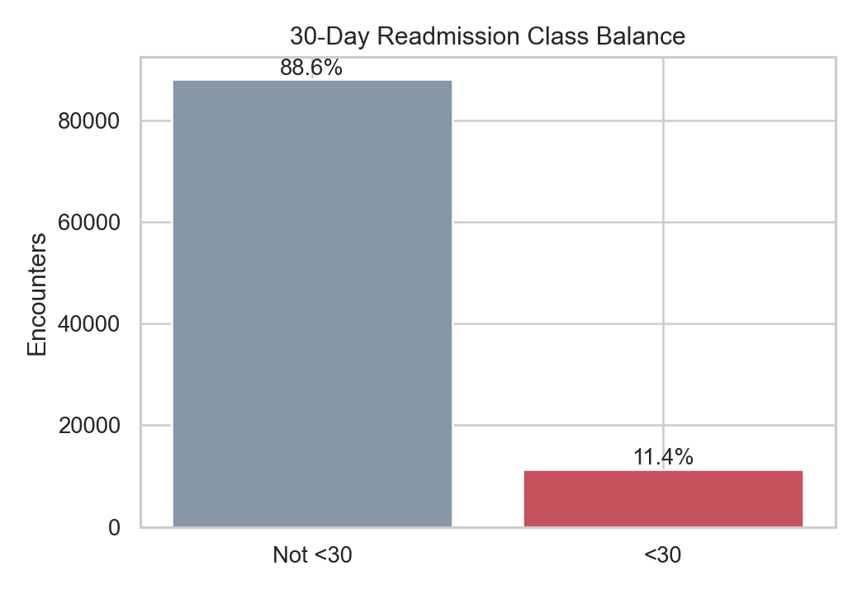
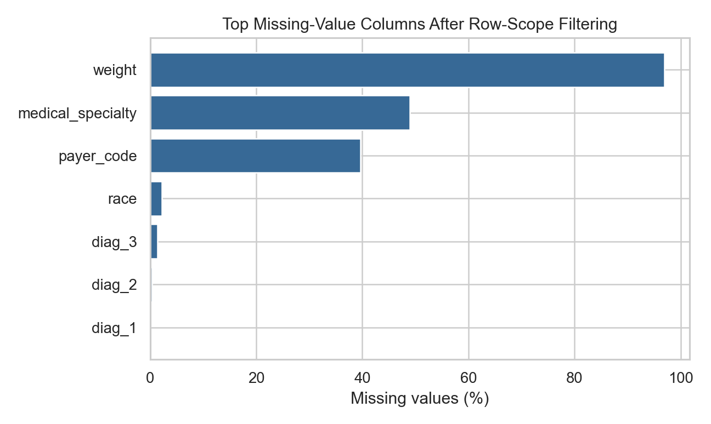
AI1215 ML PROJECT
EDA: Why This Is Hard
Only about 11% are positive; weight, payer code, and specialty have concentrated missingness.
Readmission Risk Team
5
Notes:
Arthur: The two key data problems are imbalance and concentrated missingness. This motivates PR-AUC and careful preprocessing.

Slide 6
AI1215 ML PROJECT
Preprocessing Pipeline
01
Load raw UCI CSV
02
Create readmitted_30 target
03
Remove hospice/expired discharges
04
Split by patient ID
05
Build final features
06
Train CatBoost and evaluate test
Key rule: the same patient never appears in more than one split.
Readmission Risk Team
6
Notes:
Mohamed: Emphasize leakage control. We split by patient ID and only used patient history from earlier encounters.

Slide 7
AI1215 ML PROJECT
Feature Engineering
Feature family
What it adds
Diagnosis
ICD-9 groups, diagnosis detail, comorbidity-style indicators
Medication
Medication burden, changes, insulin and class-level indicators
Utilization
Prior inpatient, emergency, outpatient counts plus log summaries
Labs
A1C and glucose status, keeping None as a real category
Patient history
Prior readmission and prior utilization from earlier visits only
Readmission Risk Team
7
Notes:
Mohamed: Make this concrete. Diagnosis codes were grouped, missing categories kept, medication and utilization summaries created, and prior patient history added safely.

Slide 8
AI1215 ML PROJECT
Evaluation Metric
0.1103
0
0.2414
natural PR-AUC baseline
recall for majority baseline
final test PR-AUC
Why PR-AUC?
• Focuses on the rare positive class
• Matches the risk-ranking use case
• Shows whether true readmissions receive high scores
• Reported with ROC-AUC, recall, precision, F1, accuracy, and confusion matrix
Readmission Risk Team
8
Notes:
Mohamed: Accuracy is misleading. The majority baseline has high accuracy but catches zero readmissions. PR-AUC is the primary metric.

Slide 9
AI1215 ML PROJECT
Models Explored
Baselines
Tree ensembles
Advanced boosting
Extra attempts
Majority class
Logistic Regression
Naive Bayes
Decision Tree
Random Forest
Extra Trees
Gradient Boosting
XGBoost
LightGBM
CatBoost
Optuna tuning
Neural networks
Imbalance methods
Score/rank ensembles
Seed sweeps
Final choice: CatBoost with native categorical handling, patient-history features, and validation-selected threshold.
Readmission Risk Team
9
Notes:
Mohamed: We tried many families, but CatBoost won because the dataset is categorical, sparse, and tabular.

Slide 10
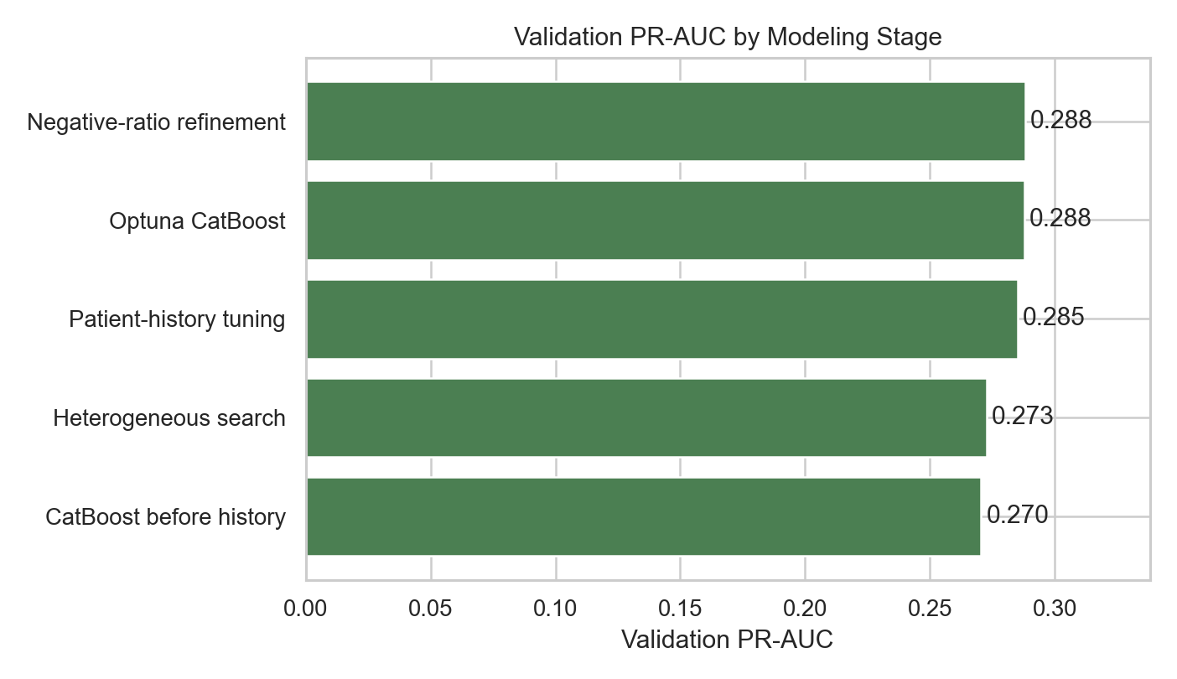
AI1215 ML PROJECT
Validation Model Comparison
Model
Val PR-AUC
CatBoost
0.288
Logistic stacker
0.272
XGBoost
0.271
LightGBM
0.261
Random Forest
0.255
Neural network
0.182
Baseline
0.118
Readmission Risk Team
10
Notes:
Mohamed: CatBoost led validation PR-AUC. Neural networks and resampling did not beat boosted trees.

Slide 11
AI1215 ML PROJECT
Final Test Performance
0.2414
0.6827
36.2%
24.2%
PR-AUC
ROC-AUC
Recall
Precision
Metric
Value
• Majority baseline has higher accuracy but zero recall
• Final model catches 592 of 1,635 readmissions
• Threshold chosen from validation best F1, not from test
F1
0.2898
Accuracy
0.8044
True positives
592
False positives
1,858
False negatives
1,043
True negatives
11,335
Readmission Risk Team
11
Notes:
Omar: Present the final held-out test metrics. Clarify that accuracy is not the headline metric.

Slide 12
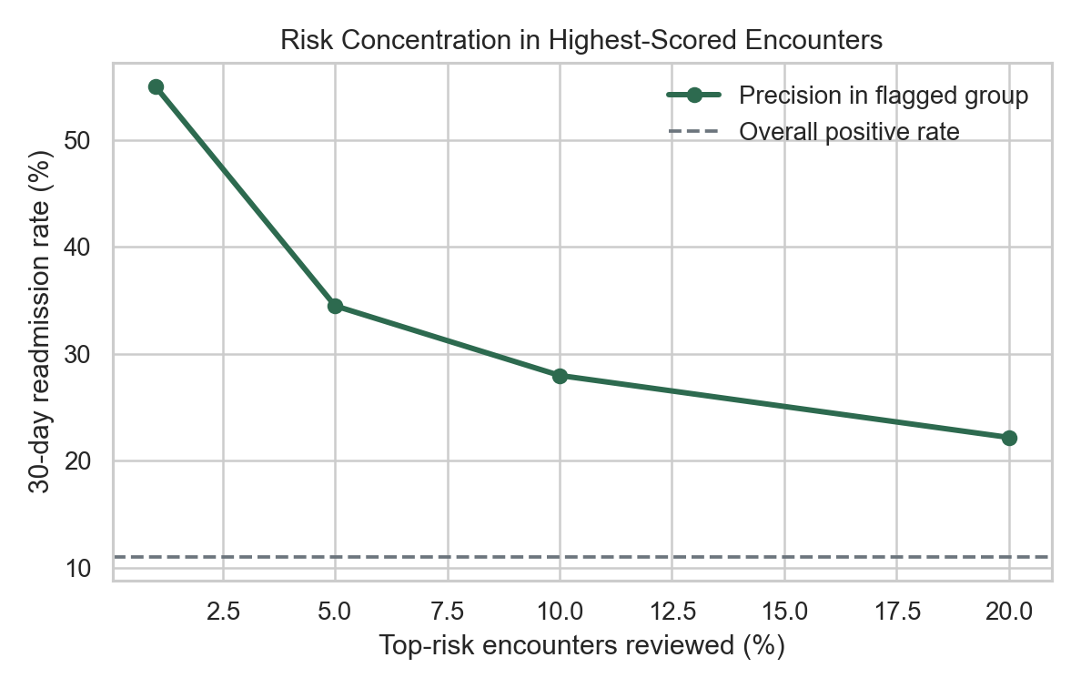
AI1215 ML PROJECT
Risk Stratification
Risk group
Precision
Lift
Top 1%
52.3%
4.75x
Top 5%
33.4%
3.03x
Top 10%
27.8%
2.53x
Top 20%
22.3%
2.02x
If a hospital reviews only the top 10%, the readmission rate is about 27.8% instead of 11.0%.
Readmission Risk Team
12
Notes:
Omar: This is the practical interpretation. Top-risk patients have much higher readmission rates than the overall population.

Slide 13
AI1215 ML PROJECT
What Worked and What Did Not
Worked
Did not beat final CatBoost
• Patient-safe all-encounter framing
• Prior patient-history features
• Native CatBoost categorical handling
• Validation-based threshold selection
• Neural networks and TabNet
• Heavy imbalance handling
• Complex ensembles and stackers
• Optuna and deeper CatBoost variants
Main lesson: the data and feature framing mattered more than simply adding model complexity.
Readmission Risk Team
13
Notes:
Omar: The best improvements came from data framing and patient-history features, not from bigger models alone.

Slide 14
AI1215 ML PROJECT
Why Performance Plateaus
Imbalance
Only about 11% positives makes precision naturally hard.
Missing clinical detail
No vitals, continuous labs, medication doses, notes, or discharge plans.
Missing post-discharge context
No follow-up attendance, transportation, home support, or social determinants.
Honest split
Patient-safe split removes leakage that inflates many online results.
Likely ceiling on this dataset: around PR-AUC 0.24-0.242 for the strict <30 target.
Readmission Risk Team
14
Notes:
Omar: Defend the mid-level performance. The target depends on many post-discharge factors missing from the data.

Slide 15
AI1215 ML PROJECT
Demo and Reproducibility
python FINAL_MODEL_PIPELINE.py
python FINAL_MODEL_PIPELINE.py --interactive-predict
• Loads raw UCI CSV from archive/diabetic_data.csv
• Builds the same final preprocessing and feature engineering
• Trains/evaluates CatBoost and writes final_model_outputs/
• Interactive mode asks for patient fields and prints risk probability
Readmission Risk Team
15
Notes:
Omar: Show the professor exactly how the project can be run and how the optional patient input demo works.

Slide 16
AI1215 ML PROJECT
Conclusion
2.19x
0.2414
27.8%
PR-AUC over baseline
final PR-AUC
top 10% precision
• Built a reproducible end-to-end ML pipeline
• Compared multiple model families and baselines
• Matched the closest paper's reported PR-AUC level
• Best future gains need richer clinical and post-discharge data
Thank you. Questions?
Readmission Risk Team
16
Notes:
Omar: Close with the honest claim: useful risk ranking, not perfect prediction. Invite questions.

