Slide 1
Video Game development in Lua using the LÖVE2d Engine

Slide 2

Overview of the Workshop
Talk briefly about video game History
Overview the common principles/workflow of video game development
Walk through the basics of Lua and LÖVE2d
Write some basic applications in LÖVE2d
Finally we will make Pong!

Slide 3
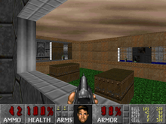
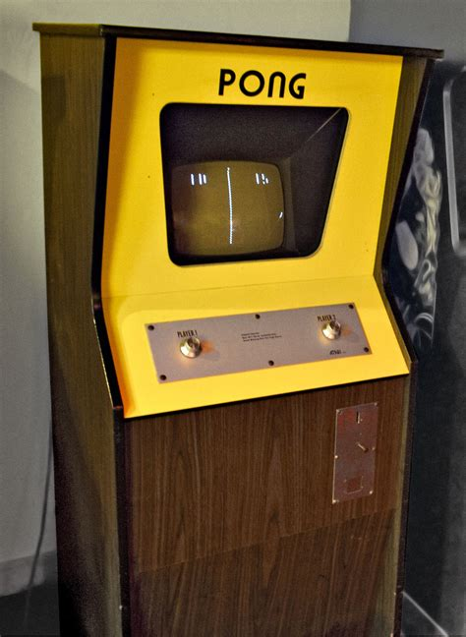
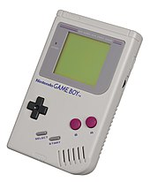
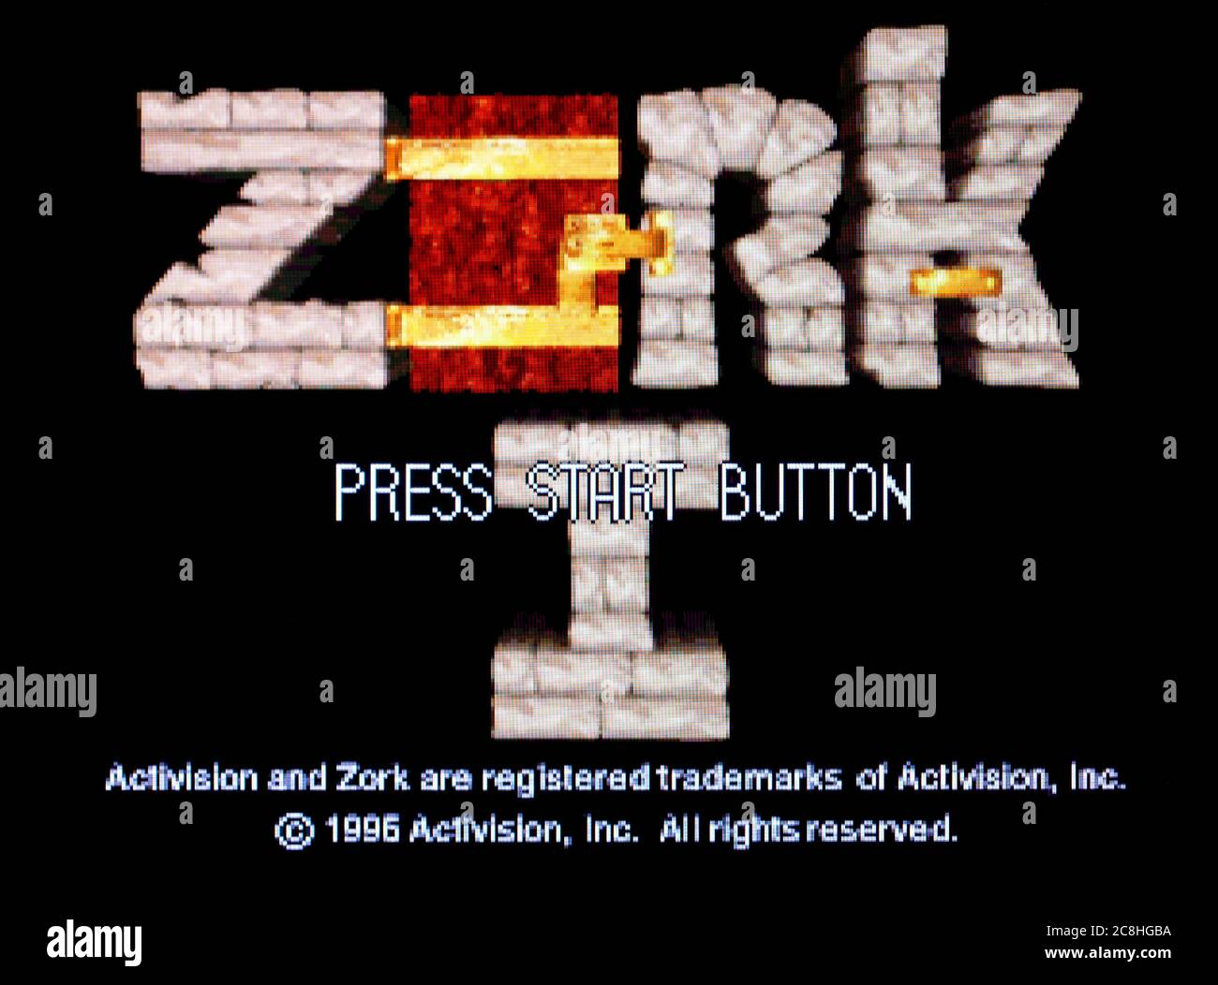
Video game History
Dates back to the 1950s where they were simple electronic games using the display as output
1970 first consumer video game released in arcades was Computer Space
Followed by Pong in 1971 and the first console the Magnavox Odyssey
Today video games are one the largest pieces of popular culture across the world
One of the largest markets in entertainment
One of the top 10 hobbies in the world!

Slide 4
Video game Development Principles
Conceptualize
Brainstorming, research, refinement
Pre-Production
Storyboards, wire frames, mock ups
Game play loop, objectives, prodcution, pacing
Choosing an engine
Lore
Art style
Production
Programming, art design, asset creation
Refining game play loop and inputs
Level design
Testing
Beta testing
Feedback
Refinement
Accessibility
Playability

Slide 5
Video game Development Principles
Launch
Marketing
Profit??
Advertisements
Crowdfunding
Post launch support
Bug fixes
DLC
Community management

Slide 6



Tools of Game Development
Engines
Unreal, Unity, Godot, LOVE2D
Languages: Rust, C++, C#, Lua, python, and more!
Modeling
Blender
Asset Forge
Image editing
Photoshop
Illustrator
Canva
Assets
Kenney
Unity Asset Store
Open Game Art
Sites
Gamedev.net
IndieDB
Gamedev undergound
Education
Unity Learn
Unreal Tutorials
Youtube

Slide 7

Lua Basics
Dynamically typed
Interpreted language
Used quite commonly for configurations, scripting, game dev, and much more!
Demo/Learning Time!

