Slide 1


Hateful Meme Detection
Under Supervision of Prof Vrijendra Singh
Presented by :
Disha Soni (IIT2022260)
Ankit Kumar (IIT2022256)
Taniha Bhutani (IIT2022207)
Shreya Sinha (IIB2022034)
Avantika Soni (IIB2022045)

Slide 2
0 1
Introduction & Application
0 2
Related Work
CONTENT
0 3
Proposed Methodology
0 4
Timeline
0 5
Deliverable
0 6
Challenges/Research Gap
0 7
Conclusion & Future Work

Slide 3

01
Introduction & Application

Slide 4
Introduction
Definition of the hateful meme
Hateful
Meme
Detection
A meme contains direct or indirect attack on people based on characteristics, including ethnicity, race, nationality, immigration status, religion, caste, sex, gender identity, sexual orientation, and disability or disease. We define attack as violent or dehumanizing(comparing people to non-human things, e.g. animals) speech, statements of inferiority, and calls for exclusion or segregation.A meme includes mocking hate crime is also considered hateful meme.

Slide 5
Related Work:
Hate-CLIPper ^{[2]}
Visual BERT ^{[3]}
Large Language Models^{[4]}
Introduction
Motivation:
Online hate speech is increasing, especially through memes.
Memes ^{[1]} combine images and text, making detection difficult.
The project aims to develop an AI system to detect hateful memes using CLIP ^{[5]} and GPT.
Background Information:
Memes are widely used on social media, often blending humor with text and images.
They are sometimes used to spread hate speech, challenging traditional detection methods.
Detecting hate in memes requires multi-modal analysis of both visual and textual elements.
Motivation & Background Information
Related
Work
Method
Extract important features from image
Features are text ,object and facial data
Concat the multimodal features
Classify the meme with multimodal features input

Slide 6
Application
Hateful
Meme
Detection
Application of the hateful meme detection
Content Moderation: Automatically identify and remove hateful memes on social media platforms.
Law Enforcement: Assist authorities in monitoring and addressing online hate speech.
Anti-bullying Measures: Detect harmful content to prevent online harassment and cyberbullying.
Hate Speech Analysis: Provide insights for researchers studying trends in online hate speech.
User Reporting Systems: Enhance user-flagging mechanisms with automated meme analysis.

Slide 7

02
Related Work

Slide 8
Related Work
0 1
Jha, P., Jain, R., Mandal, K., Chadha, A., Saha, S., & Bhattacharyya, P. MemeGuard: An LLMandVLM-based Framework for Advancing Content Moderation via Meme Intervention ^{[6]}.
0 2
Huang, J., Lyu, H., Pan, J., Wan, Z., & Luo, J. (2024). Evolver: Chain-of-Evolution Prompting to Boost Large Multimodal Models for Hateful Meme Detection ^{[7]}. arXiv preprint arXiv:2407.21004.
0 3
Ma, J., & Li, R. (2024). RoJiNG-CL at EXIST 2024: Leveraging Large Language Models for Multimodal Sexism Detection in Memes ^{[8]}. Notebook for the EXIST Lab at CLEF 2024. University of Zurich, Zurich, Switzerland.
0 4
Ji, J., Lin, X., & Naseem, U. CapAlign: Improving Cross Modal Alignment via Informative Captioning for Harmful Meme Detection ^{[9]}. University of Sydney, Sydney, Australia; Shanghai Jiao Tong University, Shanghai, China; Macquarie University, Sydney, Australia.
0 5
Abdullakutty, F., & Naseem, U. (2024). Decoding Memes: A Comprehensive Analysis of Late and Early Fusion Models for Explainable Meme Analysis ^{[10]}. School of Computing, Robert Gordon University, Aberdeen, UK; School of Computing, Macquarie University, Sydney, Australia.

Slide 9

03
Proposed Methodology

Slide 10
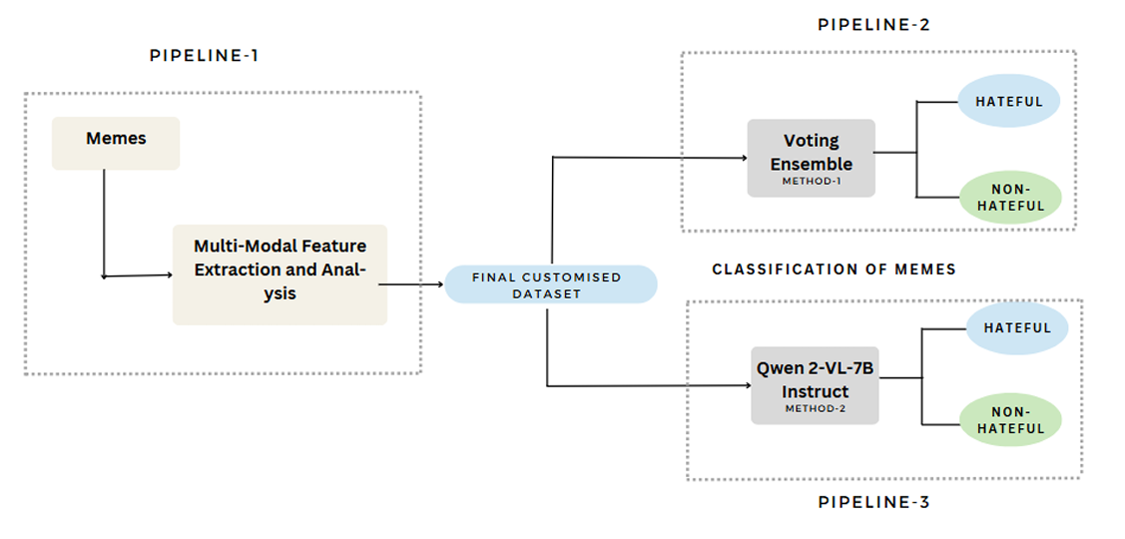
Multimodal Outline
Datasets

Slide 11
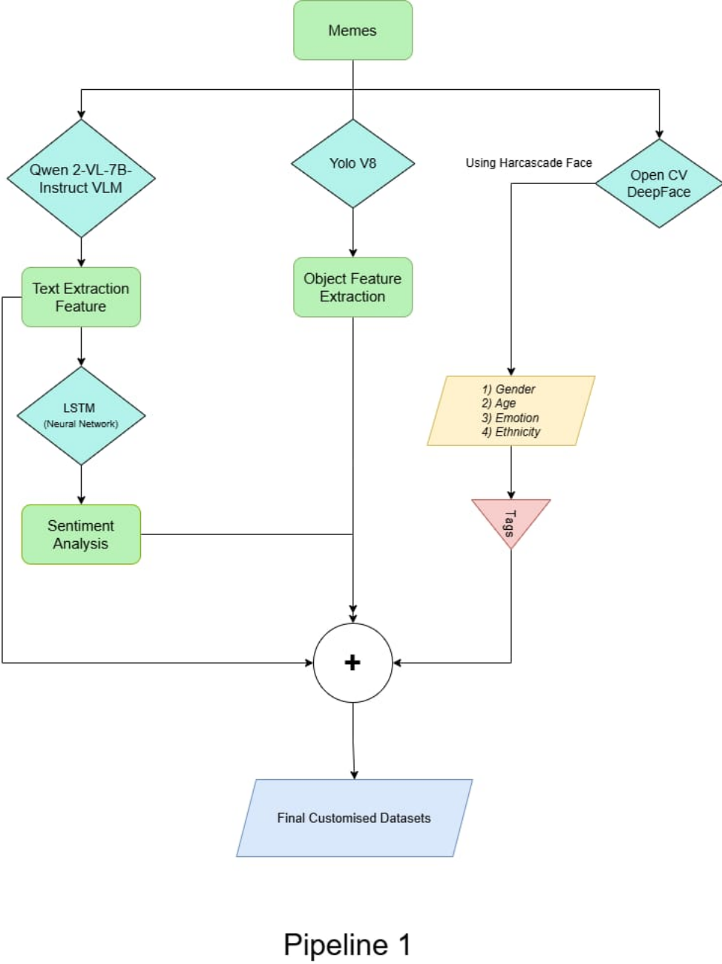
Pipeline 1

Slide 12
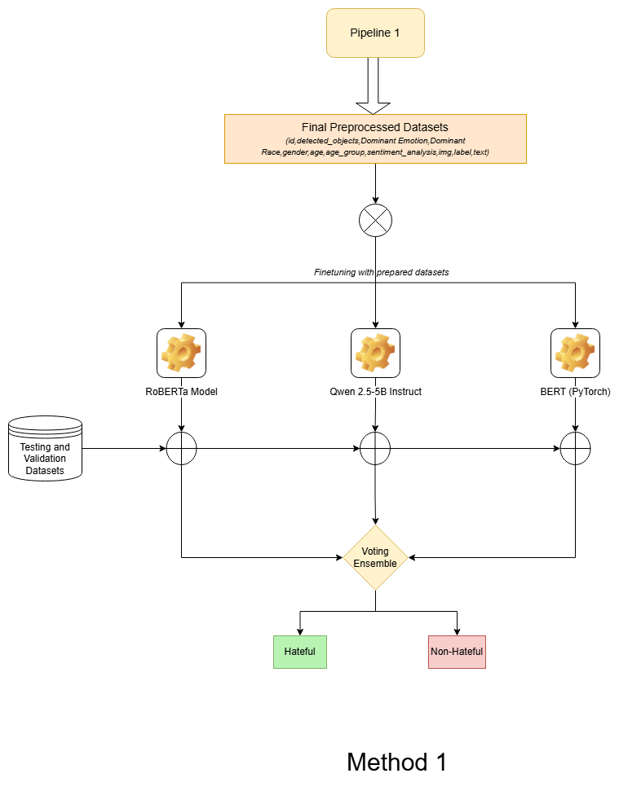
Method 1
Datasets

Slide 13
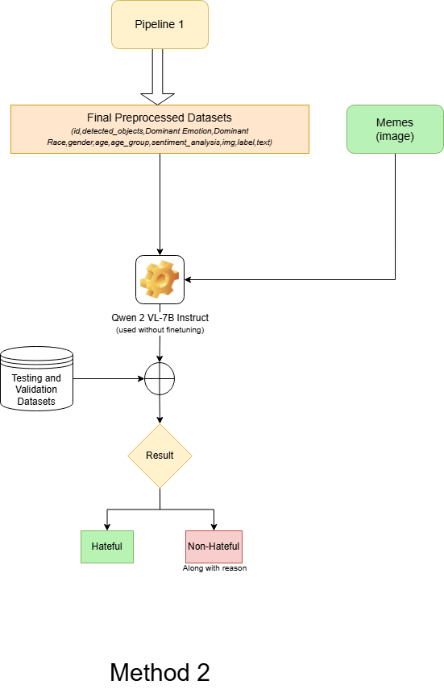
Method 2
Datasets

Slide 14

Flow Chart for the Project
Pipeline 1
Multi-Modal Feature Extraction and Analysis
Used Qwen-2-VL-7B Instruct to extract text from memes
Objects in the meme were detected using YOLOv8. Faces in the memes extracted using the Haar Cascade Classifier.
Using DeepFace, extracted additional features such as gender, age, age group, emotion, and race
All the features (text sentiment, detected objects, facial attributes) were combined into a unified representation for further analysis.
Output

Slide 15
Flow Chart for the Project
Pipeline 2
Fine-Tuned Models for Hateful Meme Classification
The features and labels generated from Pipeline 1 were used to create a custom dataset for training advanced models.
We fine-tuned BERT-based models implemented in PyTorch and TensorFlow.
RoBERTa and Qwen-2.5-5B Instruct were also fine-tuned on this dataset for text and image analysis.
These models combined text and image inputs, leveraging the custom dataset to classify hateful memes with enhanced accuracy.
Output

Slide 16
Flow Chart for the Project
Pipeline 3
Pre-Trained Model with Multimodal Inputs
We utilized the Qwen-2-VL-7B Instruct model to process both the extracted text and image tags simultaneously
This pre-trained model directly provided predictions and explanations for the classification task.
Output

Slide 17
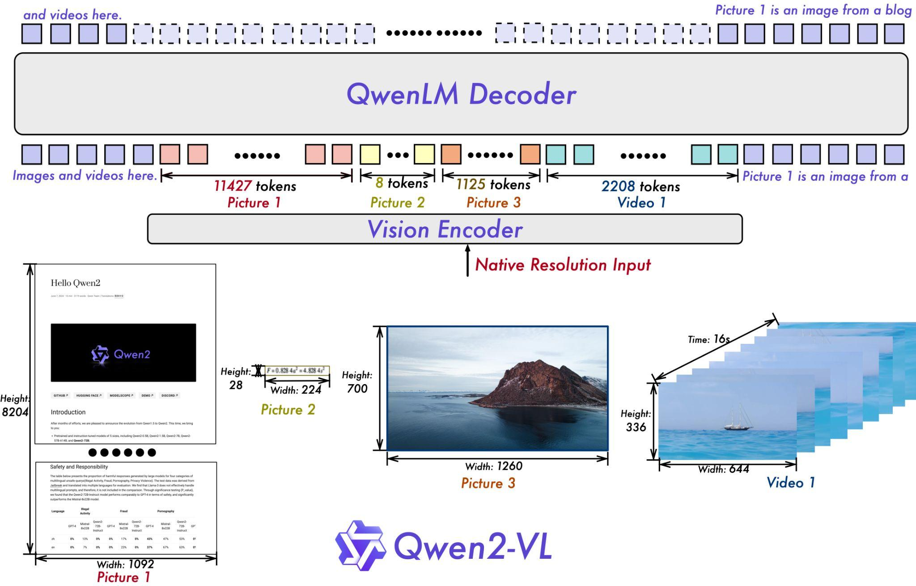
Text Extraction - Qwen2-VL-7B-Instruct
Overview:
Qwen/Qwen2-VL-7B-Instruct^{[11]}: A large multimodal model designed to understand and generate text and images.
Purpose: It can perform tasks like image captioning, visual question answering, and generating responses based on visual inputs.
Working:
Input Processing: Accepts both text and image inputs for understanding context.
Feature Extraction: Uses deep learning techniques to analyze and extract features from images and text.
Multimodal Integration: Combines features from both modalities (text and images) to understand relationships and context.
Response Generation: Generates coherent text responses or captions based on the integrated features.
Fine-tuning: Can be fine-tuned on specific tasks to improve performance and accuracy in diverse applications.

Slide 18
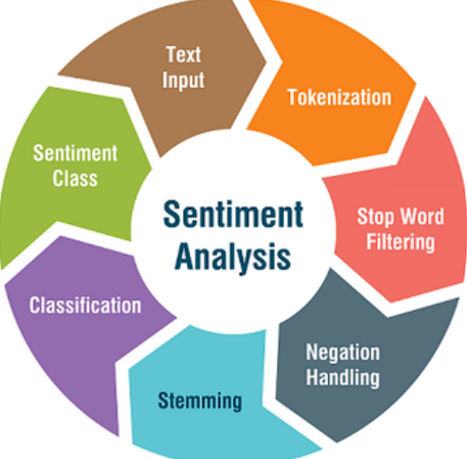
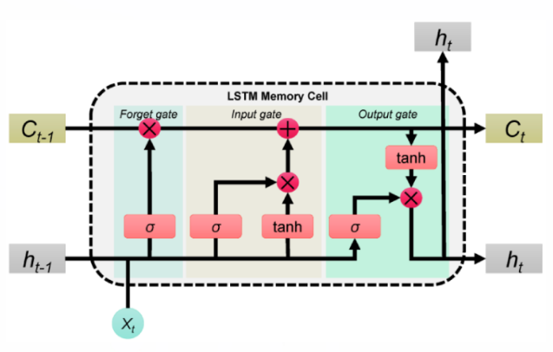
Sentiment Analysis
LSTM Models are used for sentiment analysis, determining the emotional tone of the text (positive, neutral, negative). The LSTM model helps capture long-term dependencies in text, making it effective for understanding context and sentiment in potentially hateful content.

Slide 19
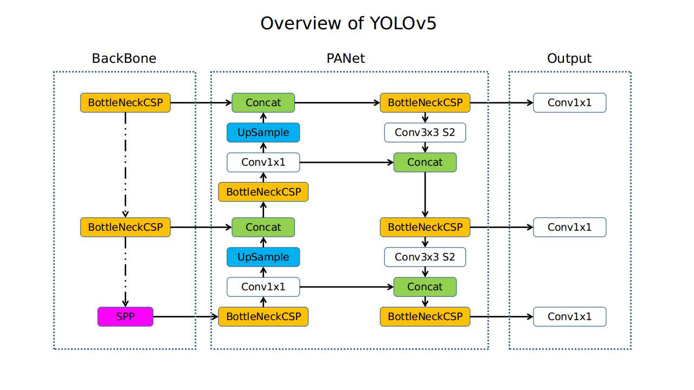
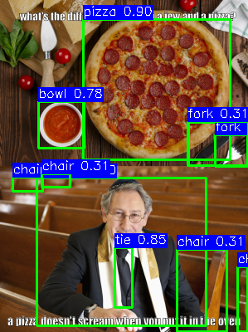
Object Detection with YOLOv8 Model

Slide 20
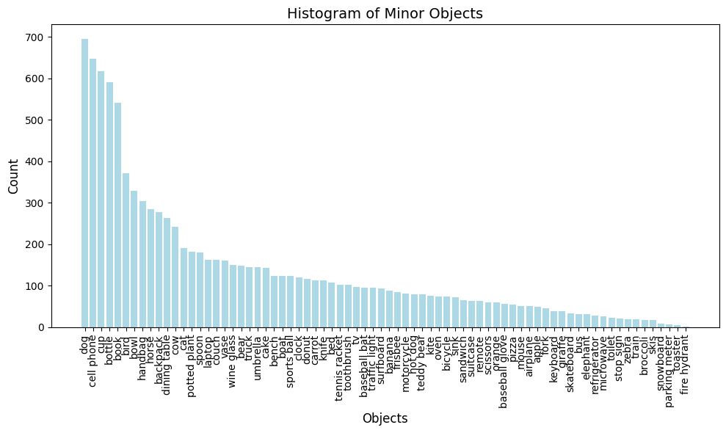
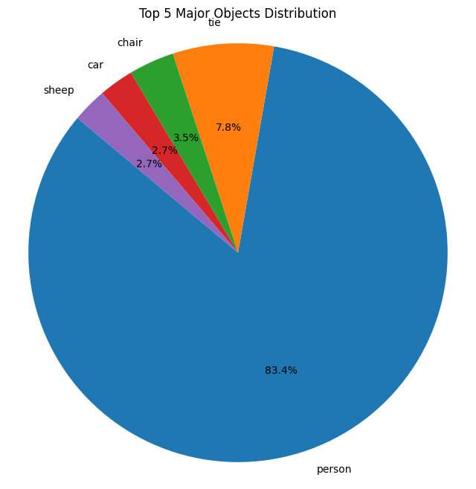
Object Detection Results

Slide 21
YOLO v8 Overview & Working
YOLO v8 ^{[12]}(You Only Look Once): A real-time object detection model that identifies and locates objects in images with high speed and accuracy.
Architecture:
Backbone:
Extracts features from input using a Convolutional Neural Network (CNN).
Neck:
Combines multi-scale features using Feature Pyramid Network (FPN) and Path Aggregation Network (PAN).
Head:
Outputs bounding boxes, class labels, and confidence scores.
How It Works:
Input Image: Resized and passed through the model.
Feature Extraction: Backbone captures key visual features.
Feature Enhancement: Neck refines and combines features at different scales.
Prediction: Head generates bounding boxes and class predictions.
Non-Maximum Suppression (NMS): Removes duplicate boxes, keeping the highest confidence result.

Slide 22

Face Extraction – Haar Cascade^{[13]} Classifier

Slide 23

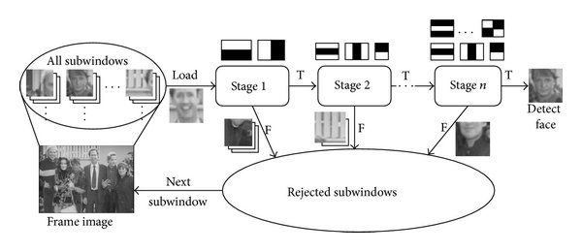
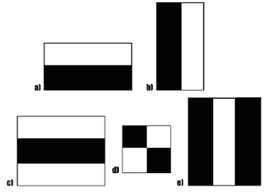

Face Extraction – Haar Cascade^{[13]} Classifier
Haar-like Features:
Compare RGB values with adjacent rectangular areas to extract feature.
Cascaded Classifier:
Input all potential sub-windows into the classifier and reject sub-windows stage by stage.

Slide 24
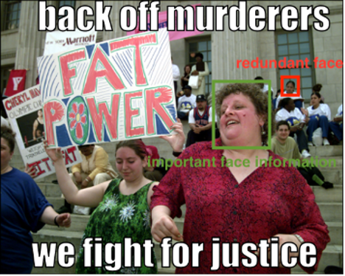
Face Extraction - Multiple Face Problem
Usually redundant and unrelated faces in each image
Solution:
Include only largest face in each image

Slide 25
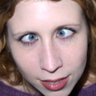

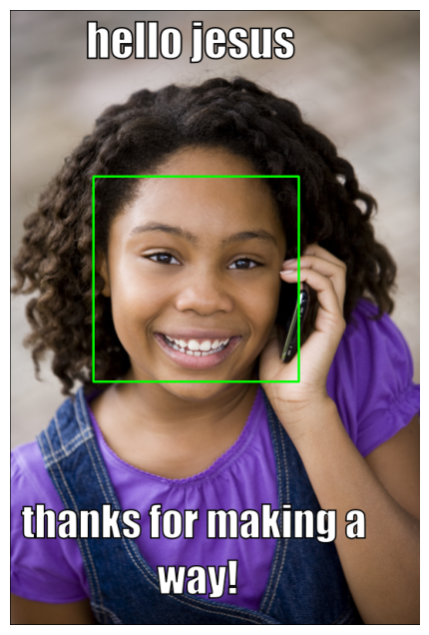
Tag Extraction --
Face Type Detection & Emotion detection Model
This model aims to tackle the task of predicting the age and classifying the gender, race and emotion from facial images.
Pretrained model: DeepFace^{[14]}
Backbone: VGG-16^{[15]} and Resnet50^{[16]}
Pretrained dataset:
Fer2013 dataset https://www.kaggle.com/msambare/fer2013
UTK face dataset
https://susanqq.github.io/UTKFace/
Happy
Black

Slide 26
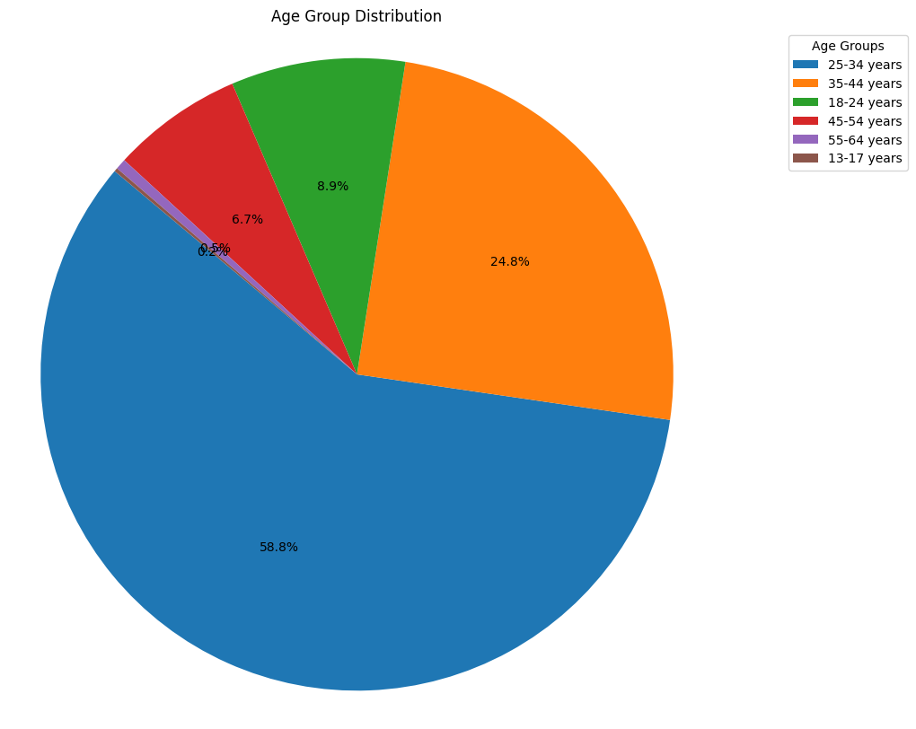
Illustration of Face Type Detection & Emotion detection Model
Image Input
Face Type
Detection
Model
Emotion
Detection
Model
Prediction
Classification
Classification
Race
Gender
Age
Emotion
White
Black
Asian
Indian
Unknown
Male
Female
13-17
18-24
25-34
35-44
45-54
55-64
Above 65
Happy
Sad
Afraid
Angry
Disgusted
Surprised
Neutral

Slide 27
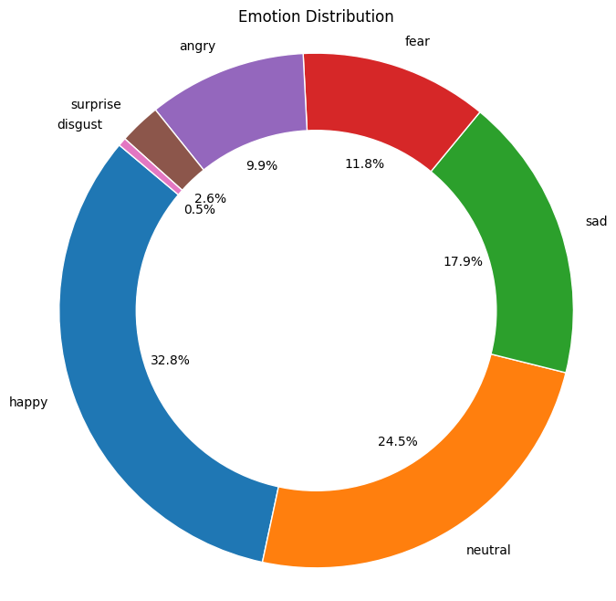
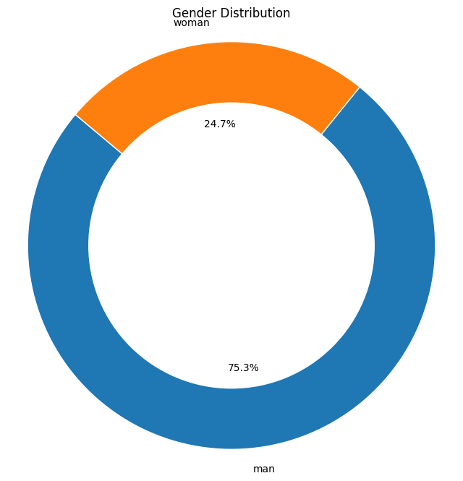
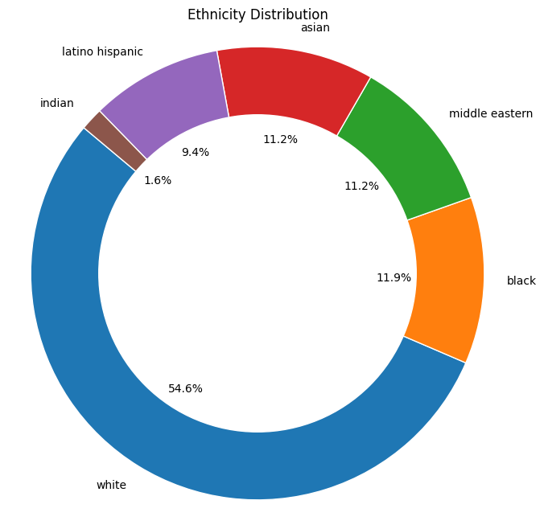
Results of Face Type Detection & Emotion detection Model
Emotion distribution
Gender distribution
Ethnicity distribution

Slide 28
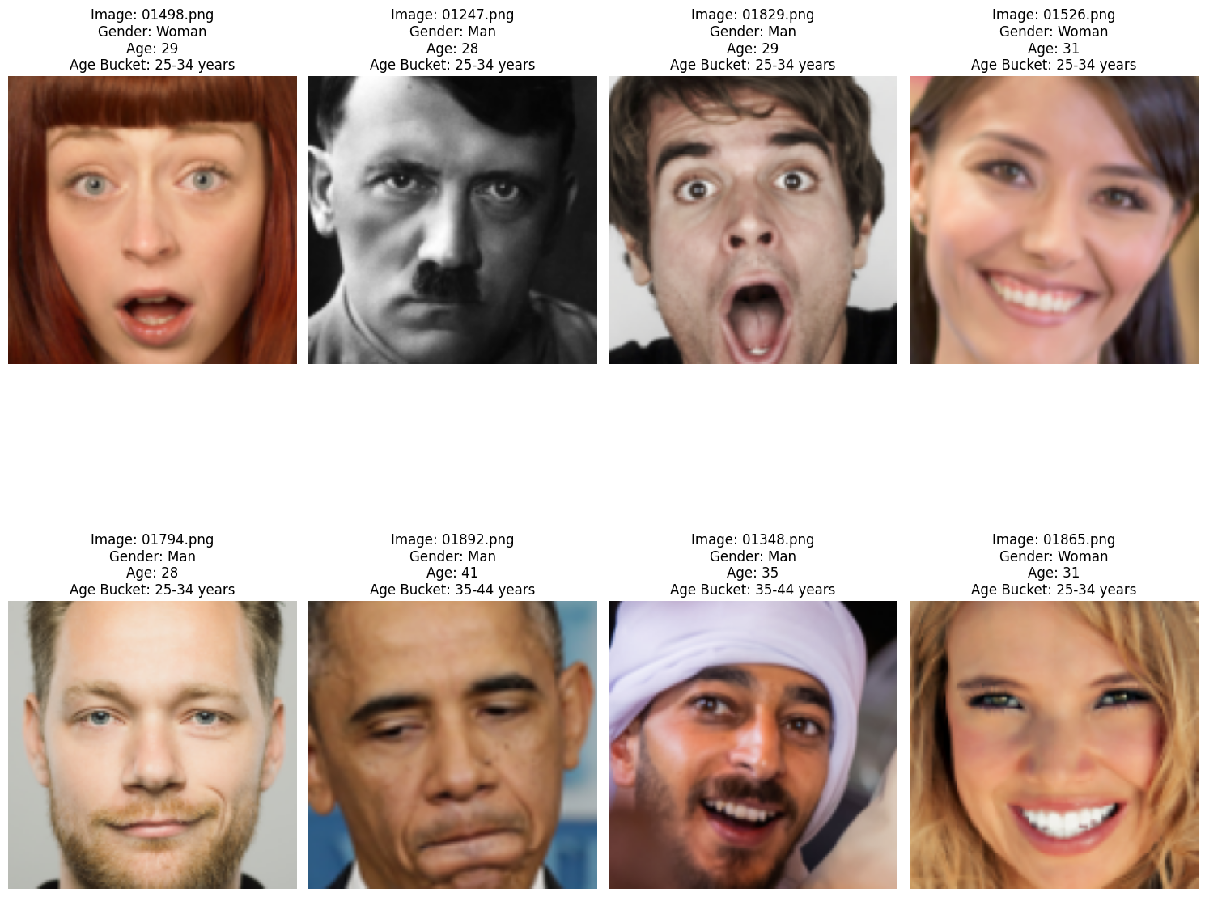
DeepFace Overview and Working
A deep learning facial recognition framework developed by Facebook AI Research (FAIR) that utilizes a convolutional neural network (CNN) to recognize and verify faces in images.
Input Processing:
Input images are pre-processed, including face detection and alignment, to ensure consistent facial orientation and scale.
Feature Extraction:
Uses a CNN architecture (e.g., VGG-Face) to extract facial features from aligned images, transforming them into high-dimensional feature vectors.
Embedding Generation:
Each face image is represented as a fixed-size vector in an embedding space, where similar faces are mapped closer together.
Face Recognition:
Compares the embedding vectors using distance metrics (e.g., Euclidean distance) to determine the similarity between faces, enabling recognition and verification.
Emotion Detection:
Can also predict emotions by using additional classifiers trained on emotion datasets, analyzing facial expressions.

Slide 29
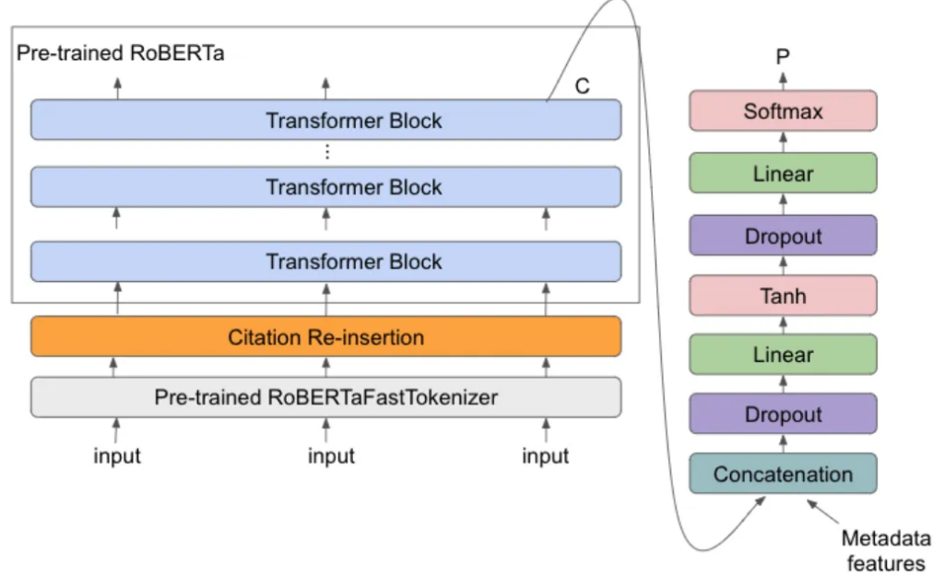
RoBERTa Model
Overview:
RoBERTa : RoBERTa (Robustly Optimized BERT) is a transformer-based model pre-trained on large-scale text data for masked language modeling.
Purpose: It is used for various NLP tasks, such as sentiment analysis, question answering, and text classification, where deep language understanding is essential.
Fine Tuning Process:
Dataset: Combined textual features such as text, objects, emotions, race, gender, age group, and sentiment analysis into a single input string.Target labels (hateful = 1, non-hateful = 0) were used for binary classification.
Tokenizer: – The Roberta Tokenizer tokenized input text with truncation and padding up to a maximum of 512 tokens.
Hyperparameters: The model was fine-tuned with a learning rate of 1×10−51 \times 10^{-5} to preserve pre-trained weights, using a batch size of 32 samples per device. Weight decay of 0.01 helped reduce overfitting over 25 epochs to ensure convergence without overtraining, with evaluations conducted at the end of each epoch.

Slide 30
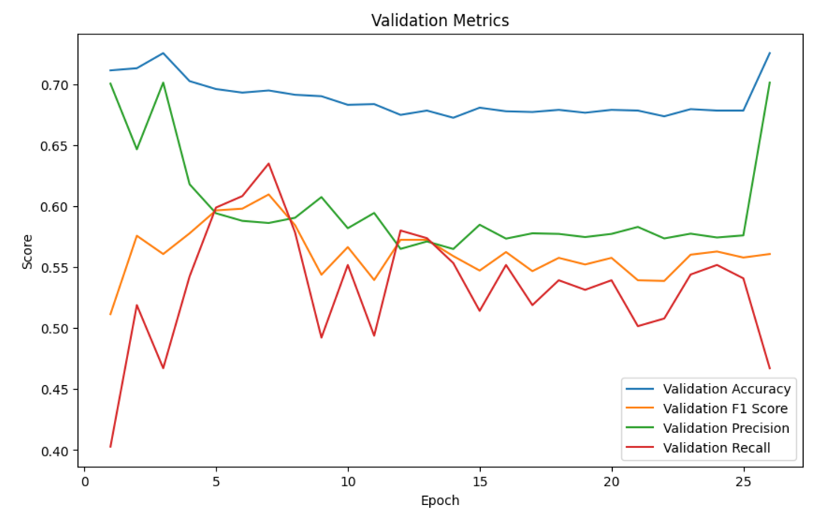
Performance Measure and Statistics : RoBERTa

Slide 31
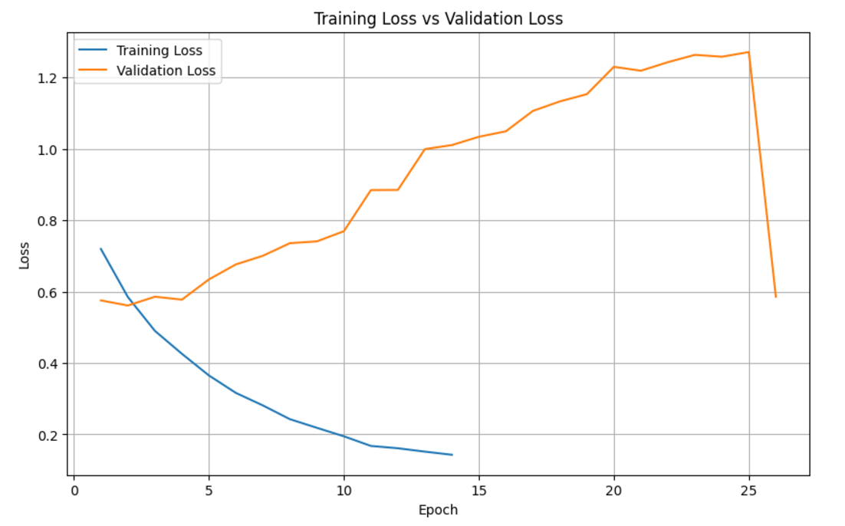
Performance Measure and Statistics : RoBERTa

Slide 32
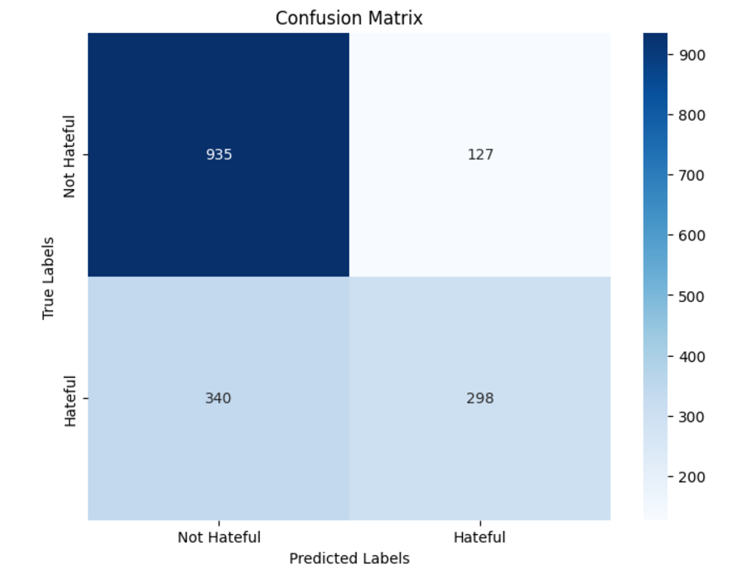
Performance Measure and Statistics : RoBERTa

Slide 33
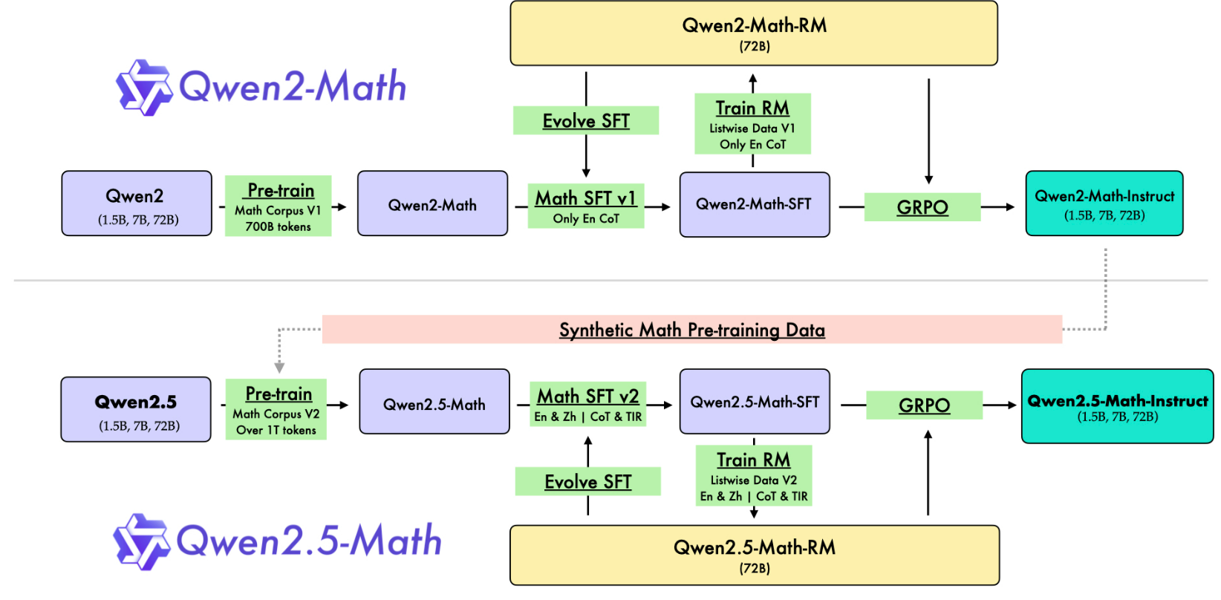
Qwen 2.5-5B Instruct
Overview:
Qwen 2.5-5B Instruct :It is a sequence classification model fine-tuned for binary classification tasks. It uses the Qwen architecture, which has been pre-trained for instruction based tasks.
Purpose: The model is designed to work efficiently with transformer-based architectures and can be adapted to a variety of text classification tasks

Slide 34
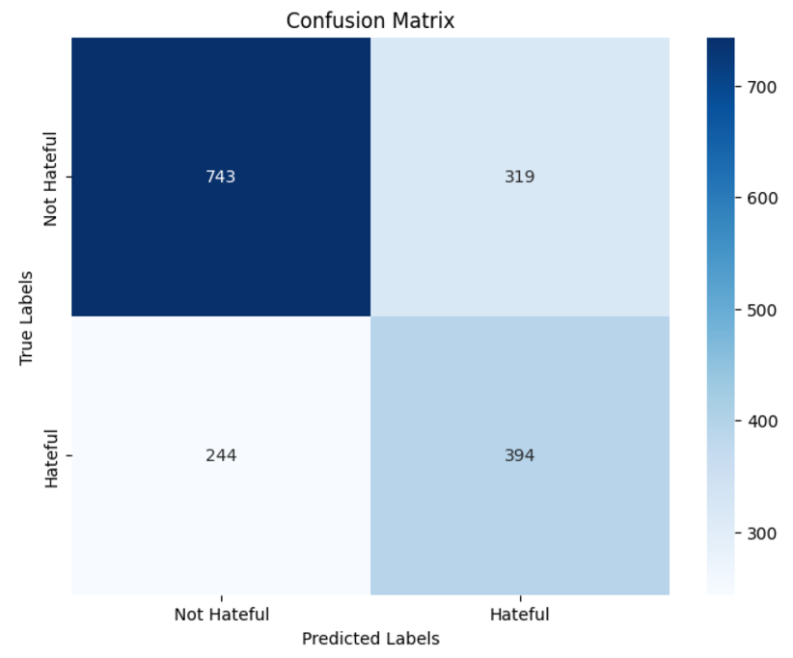
Performance Measure and Statistics : Qwen 2.5-5B Instruct

Slide 35
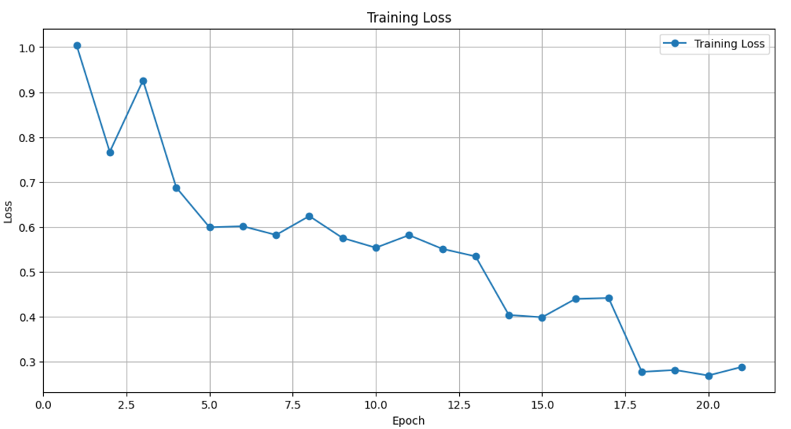
Performance Measure and Statistics : Qwen 2.5-5B Instruct

Slide 36
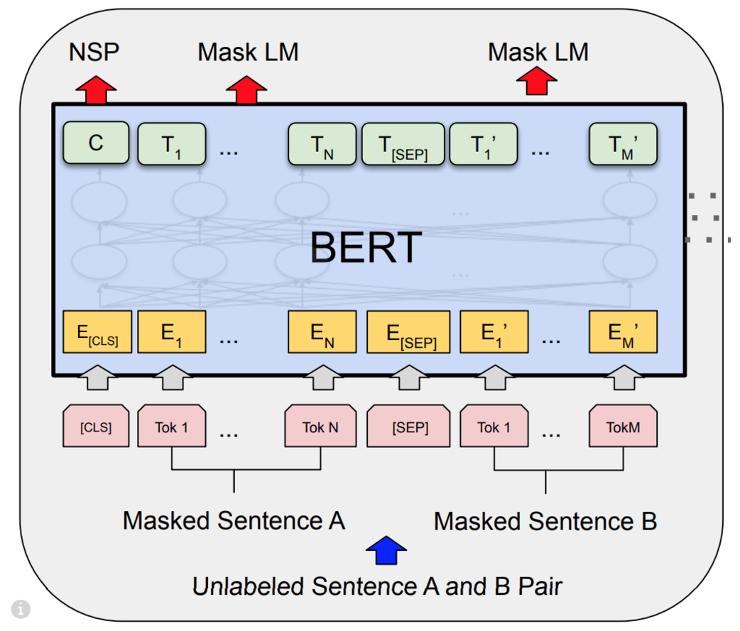
BERT
We have implemented BERT using PyTorch and TensorFlow both
BERT (Bidirectional Encoder Representations from Transformers) is a transformer-based model pre-trained on large text corpora for tasks like masked language modeling (MLM) and next sentence prediction (NSP).The KerasLayer from TensorFlow Hub is used to load a pre-trained BERT preprocessing model. It tokenizes the input text and generates the input word IDs, attention masks, and token type IDs required for BERT.

Slide 37
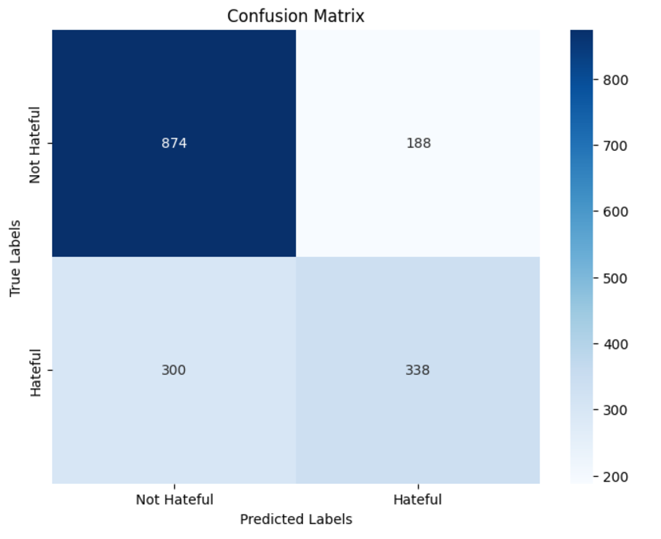
Performance Measure : Bert Implementation using Pytorch

Slide 38
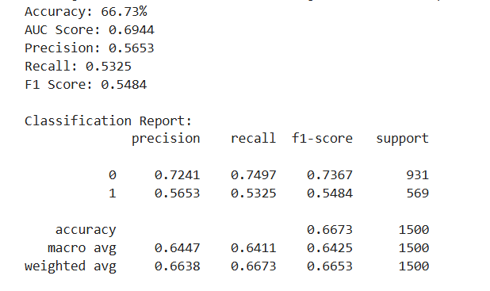
Performance Measure : Bert Implementation using TensorFlow

Slide 39
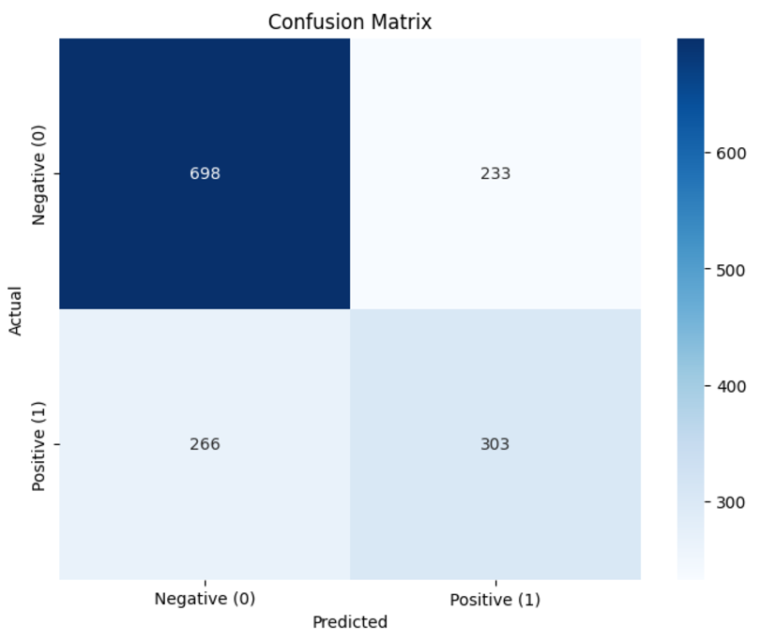
Performance Measure : Bert Implementation using TensorFlow

Slide 40
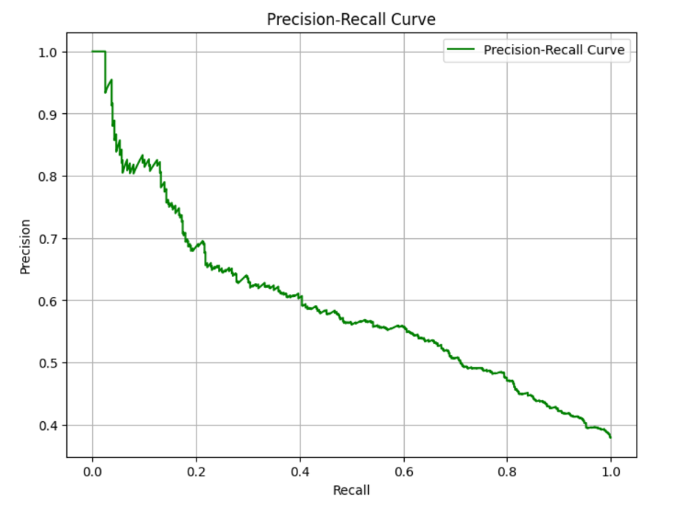
Performance Measure : Bert Implementation using TensorFlow

Slide 41
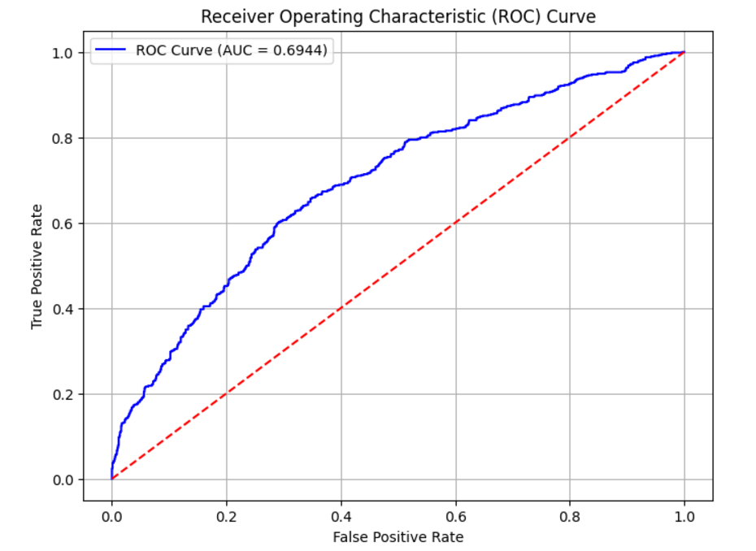
Performance Measure : Bert Implementation using TensorFlow

Slide 42
Method 1: Voting Ensemble

Slide 43
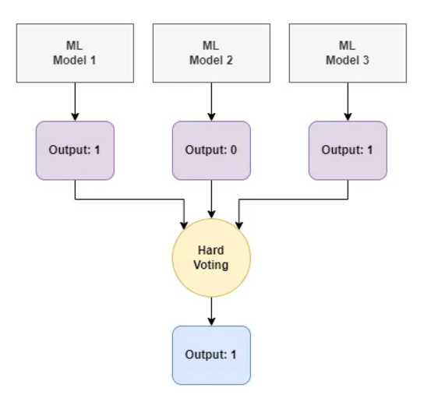
Method 1: Voting Ensemble
RoBERTa
Bert(PyTorch)
Qwen 2.5-5B-Instruct

Slide 44
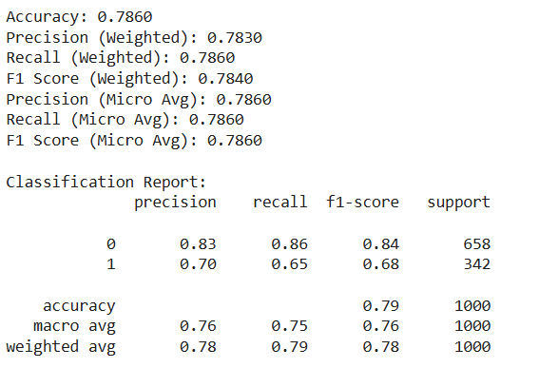
Method 1 using Voting Ensemble

Slide 45
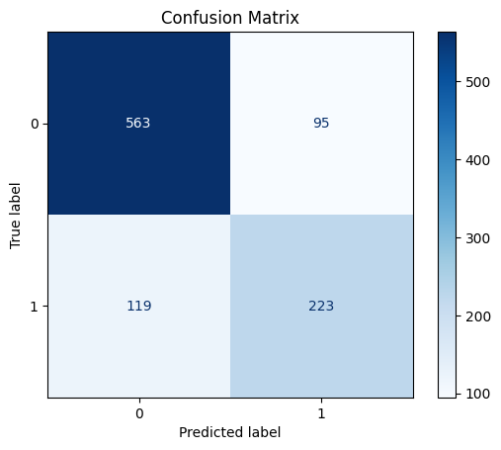
Method 1 using Voting Ensemble

Slide 46

Method 2 using Qwen2-VL-7B-Instruct

Slide 47
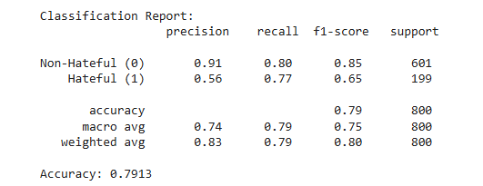
Method 2 using Qwen2-VL-7B-Instruct

Slide 48
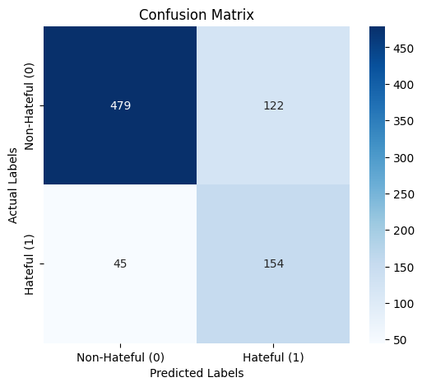
Method 2 using Qwen2-VL-7B-Instruct

Slide 49
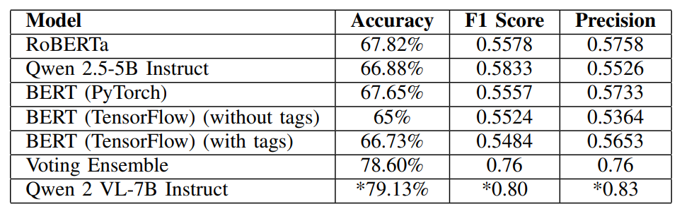
Result and Analysis

Slide 50

04
Timeline

Slide 51
Timeline
Phase 1: Research and Literature Review (July - mid Aug) Conduct a comprehensive review of existing literature and current models for hateful meme detection. Analysed about it and understands the working and the shortcomings of all the related works in this field.
Phase 2: Dataset Collection and Preprocessing (mid Aug - mid Sep) Gather and preprocess datasets, including labeled examples of hateful memes and related content. Finding datasets was really complex tasks as very limited no of datasets are available for this task.
Phase 3: Model Development and Evaluation (mid Sep -Oct) We developed Pipeline 1 for feature extraction, resulting in the final preprocessed dataset. This dataset was then utilized in Pipeline 2, where it was trained using three models: RoBERTa, Qwen, and BERT. Additionally, Pipeline 3 was also designed as a second method to train Qwen2-VL-7B Instruct on both the datasets and images.
Phase 4: Final Model Optimization (end Oct) The outputs from the three models (RoBERTa, Qwen, and BERT) were combined using a Voting Ensemble model to classify memes.
Phase 5: Documentation and Reporting (Starting Nov)) Compile findings, document methodologies, and prepare a final report and work on the future scope if implemented successfully whatever we wanted to achieve.

Slide 52

05
Deliverable

Slide 53
Deliverable
Platform for hateful Meme Detection

Slide 54
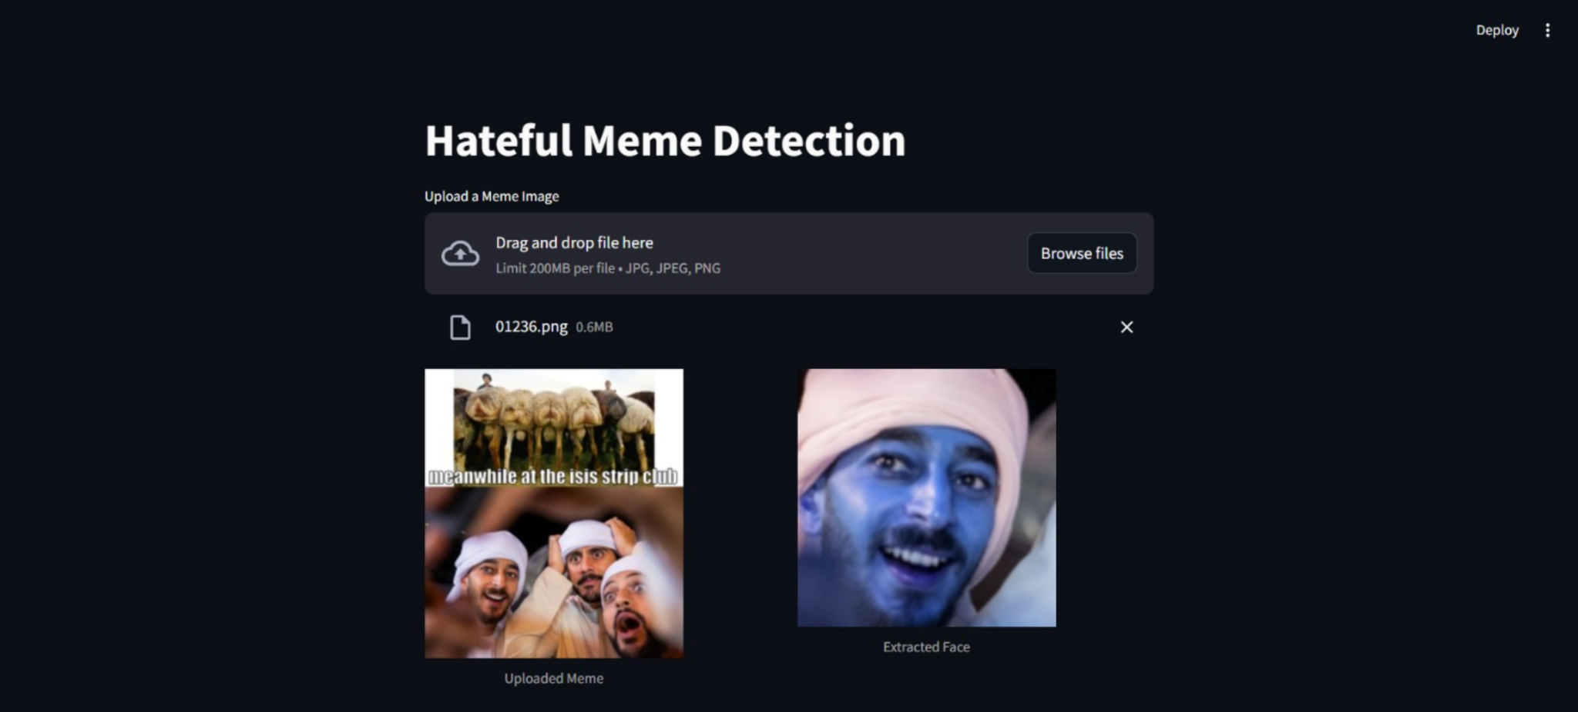
User Interface of Our Model

Slide 55
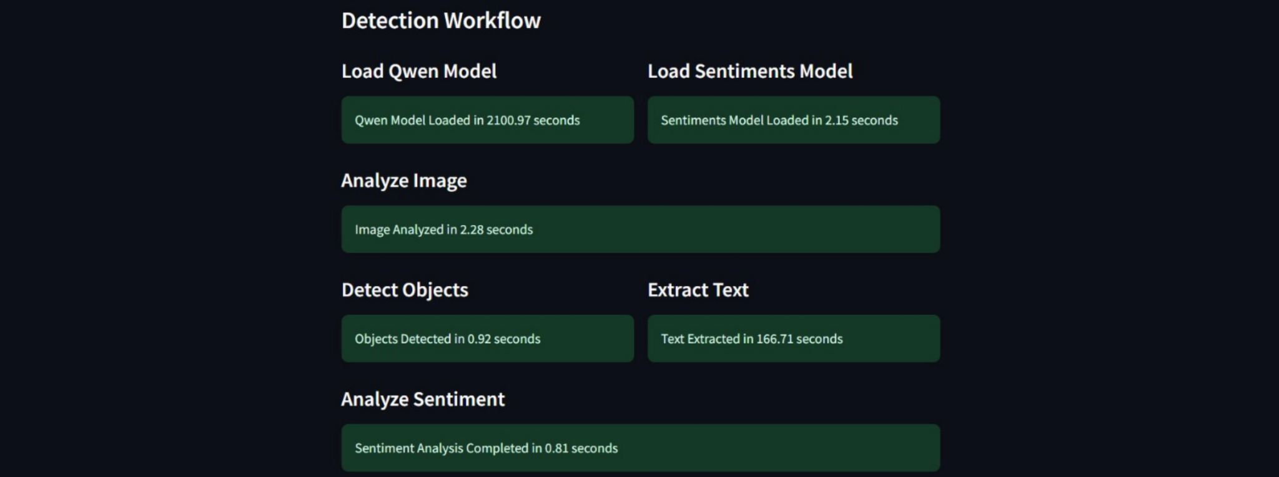

Slide 56
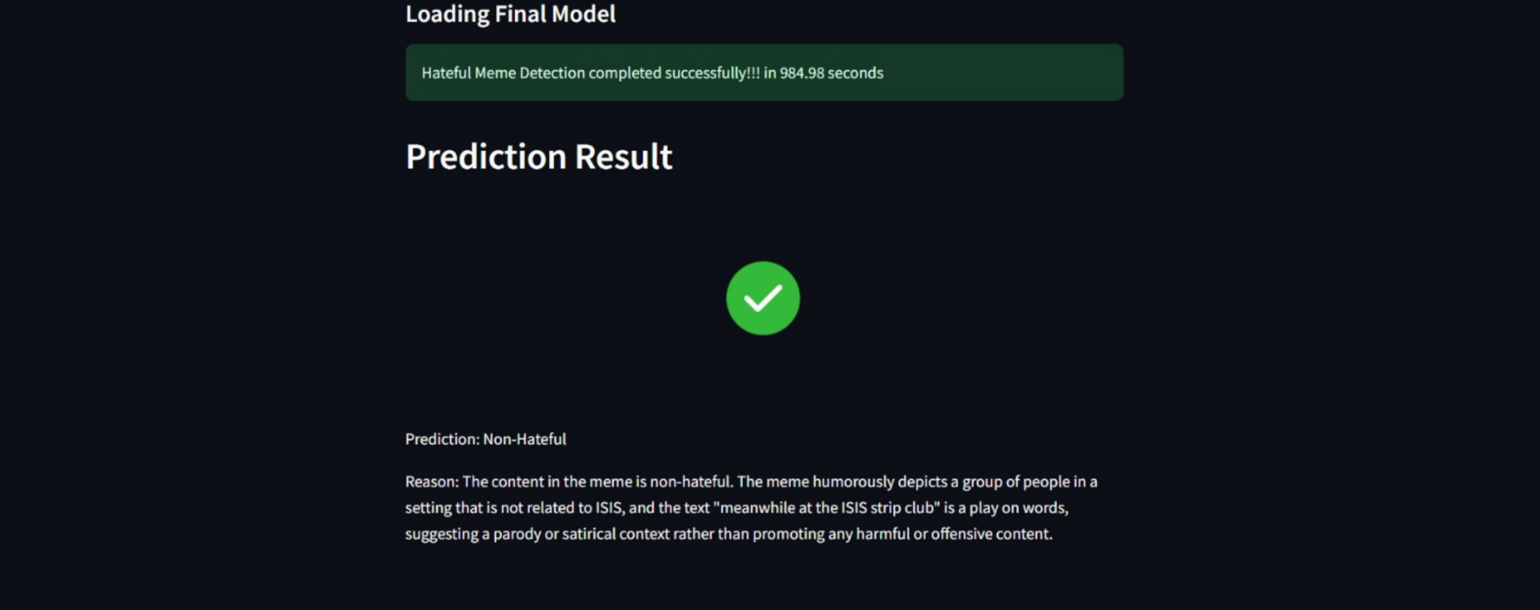

Slide 57
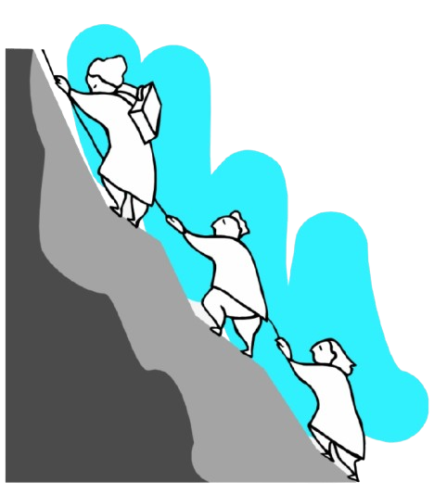
06
Challenges/Research Gap

Slide 58
Challenges
Multi-modal Complexity:
Analyzing both image and text in memes requires advanced models that understand the intricate relationship between visual and textual elements. Current models struggle with this multi-modal fusion.
Logical Reasoning:
Memes detection includes some more complicated logic reasoning that is hard for machines to detect. Memes often contain subtle or sarcastic hate speech that is difficult to detect. Existing models face challenges in interpreting implicit meanings and context behind the humor or sarcasm..
Real-time Detection:
Scalability and performance of current models are insufficient for real-time detection of hateful memes on large platforms, affecting their practical deployment in content moderation systems.

Slide 59

07
Conclusion & Future Works

Slide 60
Conclusions
In this study, we developed a multi-modal pipeline to classify hateful memes by integrating text and image processing techniques. Utilizing advanced models like Qwen2-VL-7B Instruct for multimodal analysis, YOLOv8 for object detection, and DeepFace for facial feature extraction, we achieved a comprehensive understanding of meme content. Despite computational constraints preventing fine-tuning of larger models, our pipeline demonstrated the effectiveness of pre-trained models in handling the complex task of hateful meme detection. This work highlights the potential of multi-modal approaches to improve content moderation in online platforms.

Slide 61
Future Work
Fine Tuning of existing Models
Add Batch Normalization; Increase Dropout Rate;
Run more epoches
Categorizing Hateful Meme
Developing nuanced classifications, exploring subcategories, and adapting detection models to evolving trends in hate speech.
Evolutionary Memes
Adaptive learning, contextual evolution, cross-meme analysis, multimodal integration, and continuous dataset enrichment to improve hateful meme detection.

Slide 62
References
[1] Memes - https://en.wikipedia.org/wiki/Meme
[2] Hate-CLIPper: Multimodal Hateful Meme Classification based on Cross-modal Interaction of CLIP features - https://github.com/gokulkarthik/hateclipper
[3] Visual Bert (Hugging Face) - https://huggingface.co/docs/transformers/en/model_doc/visual_bert
[4] Large Language Models - https://en.wikipedia.org/wiki/Large_language_model
[5] Contrastive Language-Image Pre-Training (CLIP) Transformers - https://huggingface.co/docs/transformers/en/model_doc/clip
[6] Jha, P., Jain, R., Mandal, K., Chadha, A., Saha, S., & Bhattacharyya, P. MemeGuard: An LLMandVLM-based Framework for Advancing Content Moderation via Meme Intervention - https://arxiv.org/abs/2406.05344
[7] Huang, J., Lyu, H., Pan, J., Wan, Z., & Luo, J. (2024). Evolver: Chain-of-Evolution Prompting to Boost Large Multimodal Models for Hateful Meme Detection. - https://arxiv.org/abs/2407.21004
[8] Ma, J., & Li, R. (2024). RoJiNG-CL at EXIST 2024: Leveraging Large Language Models for Multimodal Sexism Detection in Memes]. Notebook for the EXIST Lab at CLEF 2024. University of Zurich, Zurich, Switzerland. - https://scholar.google.com/citations?view_op=view_citation&hl=en&user=FyqKMXkAAAAJ&citation_for_view=FyqKMXkAAAAJ:u5HHmVD_uO8C

Slide 63
References
[9] Ji, J., Lin, X., & Naseem, U. CapAlign: Improving Cross Modal Alignment via Informative Captioning for Harmful Meme Detection. University of Sydney, Sydney, Australia; Shanghai Jiao Tong University, Shanghai, China; Macquarie University, Sydney, Australia. - https://dl.acm.org/doi/10.1145/3589334.3648146
[10] Abdullakutty, F., & Naseem, U. (2024). Decoding Memes: A Comprehensive Analysis of Late and Early Fusion Models for Explainable Meme Analysis. School of Computing, Robert Gordon University, Aberdeen, UK; School of Computing, Macquarie University, Sydney, Australia. - https://dl.acm.org/doi/10.1145/3589335.3652504
[11] Qwen2-VL-7B-Instruct : https://huggingface.co/Qwen/Qwen2-VL-7B-Instruct
[12] YOLO v5 : https://huggingface.co/docs/transformers/en/model_doc/yolos
[13] Haar Cascade Classifier : https://huggingface.co/spaces/johko/haar-cascade-frontal-face-detection
[14] Deep Face : https://github.com/serengil/deepface
[15] VGG-16 : https://huggingface.co/models?other=vgg16
[16] Resnet50 : https://huggingface.co/docs/transformers/en/model_doc/resnet
[17] Chat GPT Neo-2.7B : https://huggingface.co/EleutherAI/gpt-neo-2.7B

Slide 64
Thank You
THANK YOU

