Slide 1


Hateful Meme Detection
Under Supervision of Prof Vrijendra Singh
Presented by :
Disha Soni (IIT2022260)
Ankit Kumar (IIT2022256)
Ram Krishan (IIB2022035)
Shreya Sinha (IIB2022034)
Avantika Soni (IIB2022045)
Notes:
https://docs.google.com/presentation/d/1i3pn7lEETwaSFRcuupUvHcqlvC8FIa1P0PL6zaOQ24M/edit?usp=sharing

Slide 2
0 1
Introduction & Application
CONTENT
0 2
Related Work
0 3
Proposed Methodology
0 4
Models Used
0 5
Conclusion and Future works
0 6
Timeline

Slide 3

01
Introduction & Application

Slide 4
Introduction
Definition of the hateful meme
Hateful
Meme
Detection
A meme contains direct or indirect attack on people based on characteristics, including ethnicity, race, nationality, immigration status, religion, caste, sex, gender identity, sexual orientation, and disability or disease. We define attack as violent or dehumanizing(comparing people to non-human things, e.g. animals) speech, statements of inferiority, and calls for exclusion or segregation.A meme includes mocking hate crime is also considered hateful meme.

Slide 5

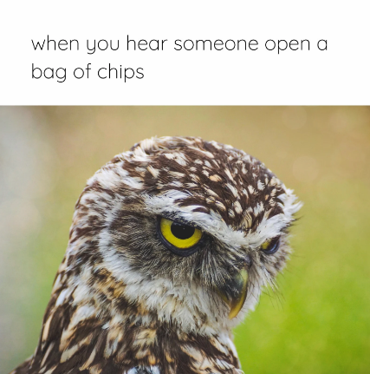
Introduction
Hateful Meme
Non-Hateful Meme

Slide 6
Related Work:
Hate-CLIPper ^{[2]}
Visual BERT ^{[3]}
Large Language Models^{[4]}
Introduction
Motivation:
Online hate speech is increasing, especially through memes.
Memes ^{[1]} combine images and text, making detection difficult.
The project aims to develop an AI system to detect hateful memes.
Background Information:
Memes are widely used on social media, often blending humor with text and images.
They are sometimes used to spread hate speech, challenging traditional detection methods.
Detecting hate in memes requires multi-modal analysis of both visual and textual elements.
Motivation & Background Information
Related
Work
Method
Extract important features from image
Features are text ,object and facial data
Concatenated the multimodal features
Classify the meme with multimodal features input

Slide 7
Application
Hateful
Meme
Detection
Application of the hateful meme detection
Content Moderation: Automatically identify and remove hateful memes on social media platforms.
Law Enforcement: Assist authorities in monitoring and addressing online hate speech.
Anti-bullying Measures: Detect harmful content to prevent online harassment and cyberbullying.
Hate Speech Analysis: Provide insights for researchers studying trends in online hate speech.
User Reporting Systems: Enhance user-flagging mechanisms with automated meme analysis.

Slide 8

02
Related Work

Slide 9
Related Work
Paper 1 : Multimodal Meme Dataset (MultiOFF) for Identifying Offensive Content in Image and Text
Authors: Shardul Suryawanshi, Bharathi Raja Chakravarthi, Mihael Arcan, Paul Buitelaar Conference: LREC 2020.
Paper 2 : MemoSen: A Multimodal Dataset for Sentiment Analysis of Memes
Authors: Eftekhar Hossain, Omar Sharif, Mohammed Moshiul Hoque Conference: LREC 2022
Paper 3 : MET-Meme: A Multimodal Meme Dataset Rich in Metaphors
Authors: Tingting Li, Junzhe Zheng, Bo Xu, Mehdi Naseriparsa, Zhehuan Zhao, Hongfei Lin, Feng Xia SIGIR ’22, July 11–15, 2022, Madrid, Spain.
Paper 4 : The Hateful Memes Challenge: Detecting Hate Speech in Multi-Modal Memes
Authors: Narine Marutyan, Alissa Jouljian,American University of Armenia May 9, 2024
Paper 5 : Mapping Memes to Words for Multimodal Hateful Meme Classification
Authors: Lorenzo Agnolucci, Alberto Baldrati, Giovanni Burbi, Marco Bertini, Alberto Del Bimbo Conference:ICCVW 2023

Slide 10
Dataset Overview:
Merged Multiple Datasets to create a comprehensive multimodal dataset.
Datasets Used:
MET-Meme Dataset:
10,045 text-image pairs.
Includes 6,045 Chinese and 4,000 English images.
Manually annotated.
CM-Offensive Meme Dataset:
4,372 memes.
Contains Hindi-English offensive content.
Facebook Hateful Meme Dataset:
10,000 examples.
Designed specifically for hateful content detection.
Content Diversity:
Each example includes a meme image + associated text.
Covers a wide variety of offensive content targeting race, gender, ethnicity, and other personal traits.
Final Merged Dataset:
Total of 26,432 images after concatenation and feature integration.
Facial Feature Extraction:
Extracted from 8,724 images for enhanced multimodal analysis.

Slide 11

03
Proposed Methodology

Slide 12
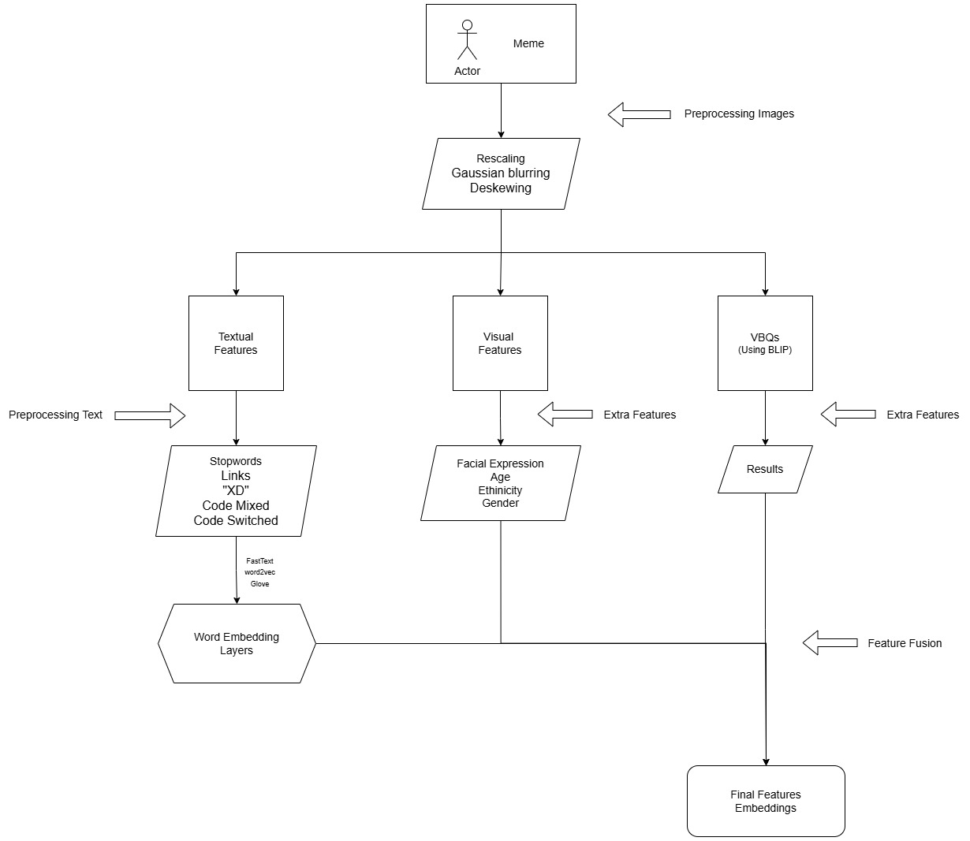
Pipeline - 01 : Multi-Modal Feature Extraction and Analysis

Slide 13
Text Processing and Normalization
Text Extraction : We extract text embedded within memes using optical character recognition techniques. This process captures all textual elements regardless of font, style, or placement within the image.
Language Normalization : All extracted text is converted to standard English to ensure consistent processing. This step handles slang, code-switching, and non-English content, creating uniformity for downstream analysis.
Text Preprocessing : We implement standard NLP preprocessing including removal of stopwords, normalization of links, handling of special characters (”XD”), and processing of code-mixed and code-switched content for improved analysis.

Slide 14
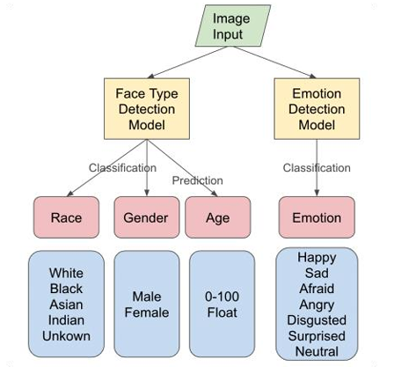
Image Feature Extraction
Image Preprocessing : Images undergo rescaling, Gaussian blurring, and deskewing for standardization before feature extraction, ensuring consistent input quality for all models.
Facial Analysis : We use DeepFace to extract facial attributes like age, gender, ethnicity, and emotion, aiding hate speech detection. It adds valuable demographic and emotional context to detected faces.
Visual Question Answering (VQA) : The BLIP model is employed for visual question-answering to extract contextual cues from images, helping identify subtle indicators of harmful content.

Slide 15
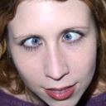


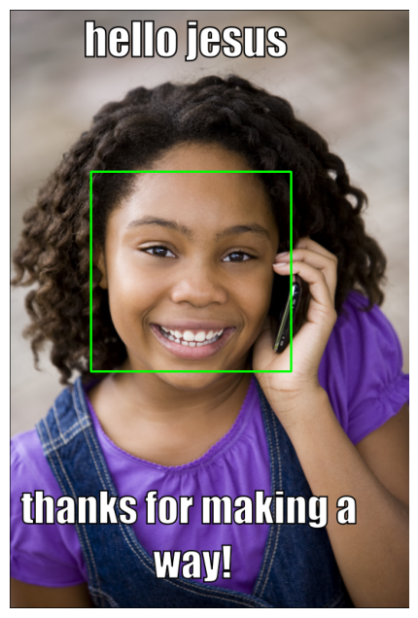
Tag Extraction --
Face Type Detection & Emotion detection Model
This model aims to tackle the task of predicting the age and classifying the gender, race and emotion from facial images.
Pretrained model: DeepFace^{[14]}
Backbone: VGG-16^{[15]} and Resnet50^{[16]}
Pretrained dataset:
Fer2013 dataset https://www.kaggle.com/msambare/fer2013
UTK face dataset
https://susanqq.github.io/UTKFace/
Happy
Black

Slide 16
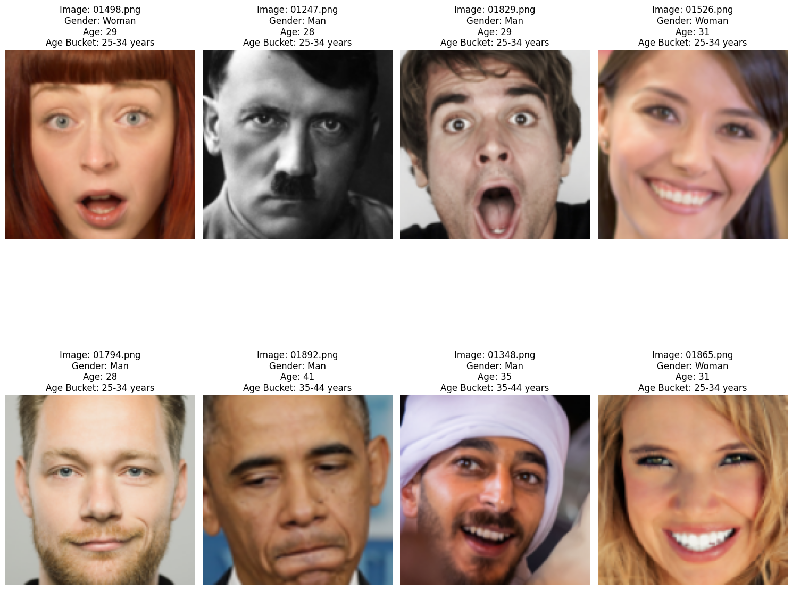
DeepFace Overview and Working
A deep learning facial recognition framework developed by Facebook AI Research (FAIR) that utilizes a convolutional neural network (CNN) to recognize and verify faces in images.
Input Processing:
Input images are pre-processed, including face detection and alignment, to ensure consistent facial orientation and scale.
Feature Extraction:
Uses a CNN architecture (e.g., VGG-Face) to extract facial features from aligned images, transforming them into high-dimensional feature vectors.
Embedding Generation:
Each face image is represented as a fixed-size vector in an embedding space, where similar faces are mapped closer together.
Face Recognition:
Compares the embedding vectors using distance metrics (e.g., Euclidean distance) to determine the similarity between faces, enabling recognition and verification.
Emotion Detection:
Can also predict emotions by using additional classifiers trained on emotion datasets, analyzing facial expressions.

Slide 17
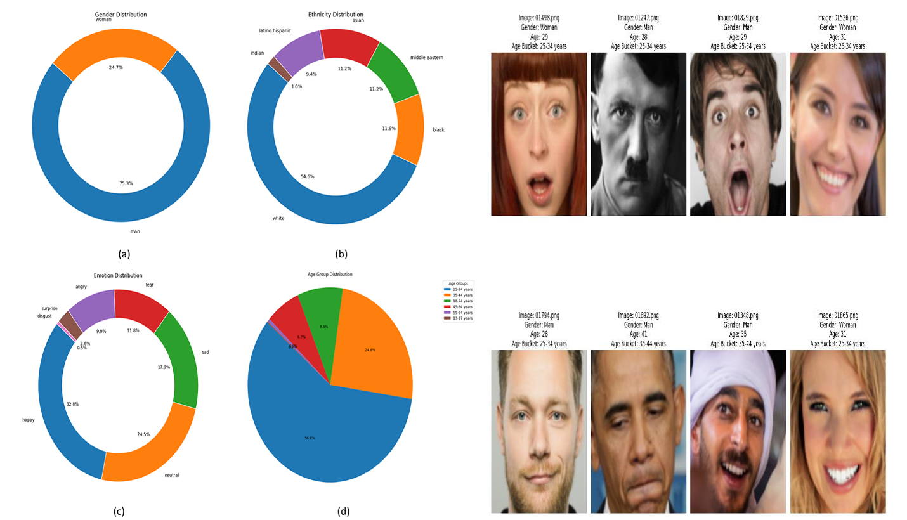
Illustration of (a) Gender Distribution (b) Ethnicity Distribution (c)
Emotion Distribution (d) Age Group Distribution across the dataset.

Slide 18
Multi-modal Integration
Feature Fusion : We combine word embeddings (using FastText, Word2Vec, and GloVe) with visual features from object detection, facial analysis, and visual question answering.
VQA and Facial Feature Integration : Results from the BLIP visual question answering model are merged with facial attribute data to create a rich representation of visual content, particularly focusing on potentially harmful representations of demographics.
Consolidated Feature Set : The final feature embeddings incorporate textual, visual, demographic, emotional, and contextual information to provide a comprehensive basis for classification.

Slide 19
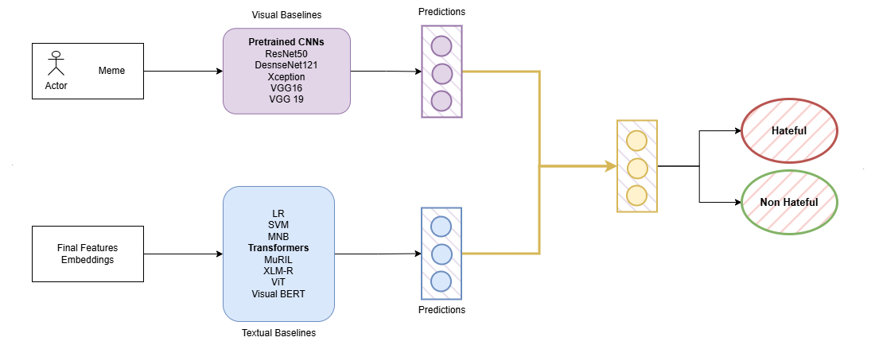
Pipeline - 02 : Advanced Model Training and Ensemble
Classification

Slide 20
Visual Baselines :
We utilized ResNet50, DenseNet121, Xception, VGG19, and VGG16 models to extract deep visual features from the meme images. These networks, pretrained on large-scale image datasets, provide robust visual representations that capture different aspects of image content.
Textual Baselines :
Traditional ML Models : Logistic Regression (LR), Support Vector Machines (SVM), and Multinomial Naive Bayes (MNB) classifiers process structured text features.
Transformer Models: BERT, XLM-R (cross-lingual version of Robustly Optimized BERT), ViT (Vision Transformer), MuRIL (for multilingual representation of Indian languages), and Visual BERT handle complex textual and multimodal inputs.

Slide 21
Ensemble Learning & Multimodal Fusion :
Model Fine-tuning: All models are fine-tuned on the custom dataset (from Pipeline 1) for hateful meme detection.
Voting Ensemble: Final classification is based on a voting mechanism combining predictions from multiple models.
Decision Fusion: Enhances accuracy by aggregating outputs from different model types to reduce errors.
Multimodal Fusion:
Combines predictions from visual and textual models.
Uses weighted confidence scores and model reliability.
Final decision via majority voting across ensemble components.
Input Features: Models use features like dominant emotion, demographics, and sentiment from the pre-processed dataset.
Independent Predictions: Each model outputs whether a meme is hateful or non-hateful.

Slide 22
04
Models Used

Slide 23
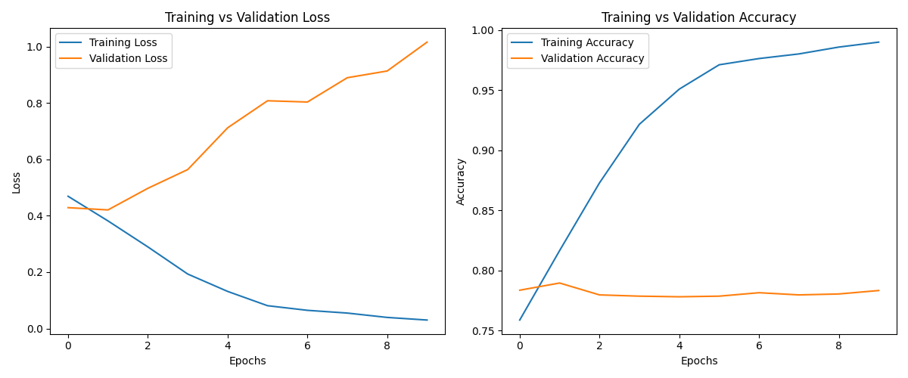
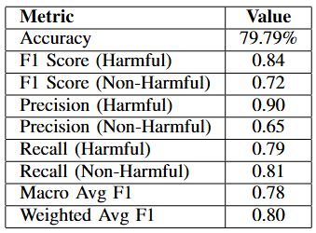
ResNet50-BERT Multimodal Model
ResNet50-BERT Multimodal Model Overview
Image Features: ResNet50 (2048-dim, pretrained, final layer removed)
Text Features: Multilingual BERT (CLS token, 768-dim)
Fusion: Concatenated image + text → 2816-dim
Classification Head: 2816 → 512 → 256 → 2 (with ReLU & Dropout 0.3/0.2)
Training Details:
Optimizer: AdamW (LR = 2e-5), Loss: Cross-Entropy
Batch Size: 16, Scheduler: ReduceLROnPlateau
Fine-tuned last 2 layers only; others frozen

Slide 24
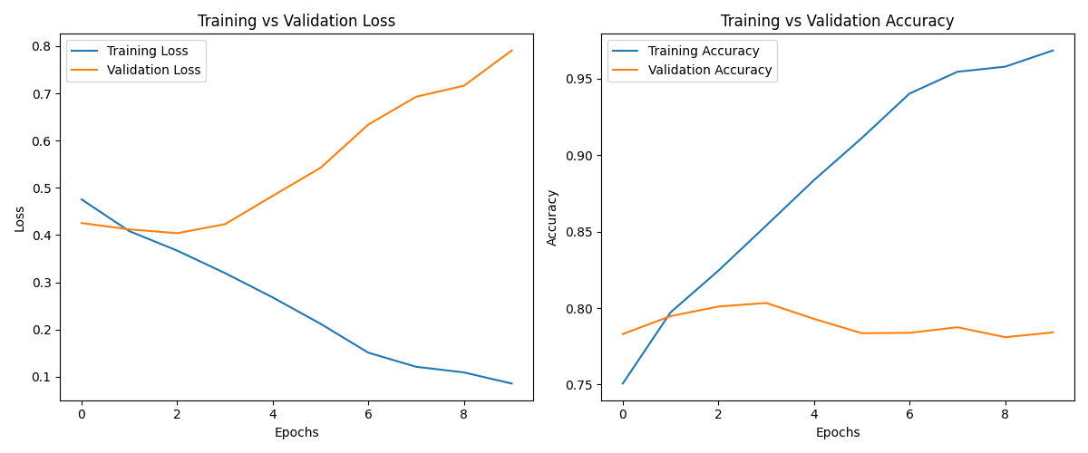
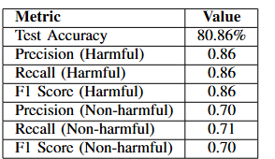
DenseNet121 + BERT Classifier
DenseNet121-BERT Multimodal Model Overview
Image Features: DenseNet121 (1024-dim, pretrained, final layer removed)
Text Features: Multilingual BERT (CLS token, 768-dim)
Fusion: Concatenated image + text → 1792-dim
Classification Head: 1792 → 512 → 256 → 2 (with ReLU & Dropout)
Training Details:
Transfer Learning: Only final layers trainable
Partial Freezing: Earlier layers of DenseNet & BERT frozen

Slide 25
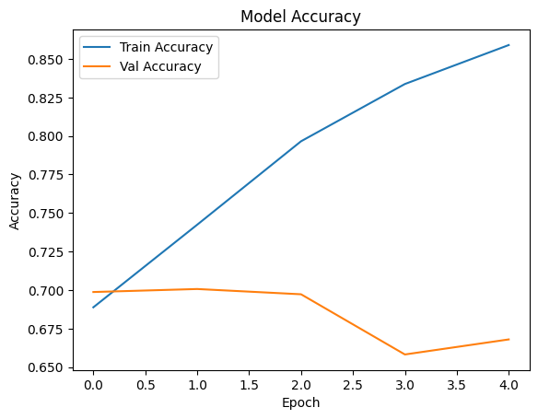
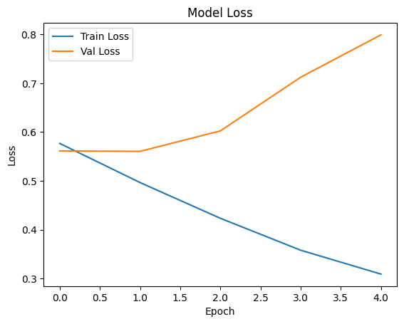
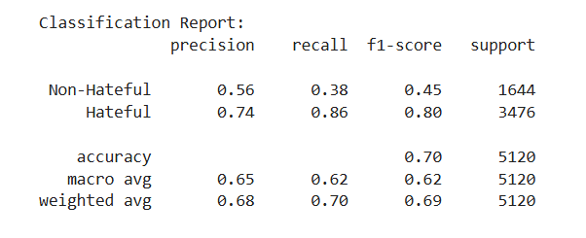
Bidirectional Long Short-Term Memory (BiLSTM)
BiLSTM Text Classification Model Overview
Text Features: Tokenized multilingual text (vocab size = 10,000, padded sequences)
Age Feature: Standardized using StandardScaler
Embedding Layer: 10,000 vocab size, 64-dim embeddings
BiLSTM Layers:First BiLSTM: 64 units (return sequences = True), Dropout: 0.5, Second BiLSTM: 64 units (return sequences = False)
Classification Head: Dense: 128 units with ReLU, Dropout: 0.5, Output: 1 unit with Sigmoid (binary classification)
Training Details: Loss Function: Binary Cross-Entropy, Optimizer: Adam (default learning rate), Batch Size: 32, Validation Split: 10%, Early Stopping: Patience = 3 (monitored val_loss)

Slide 26
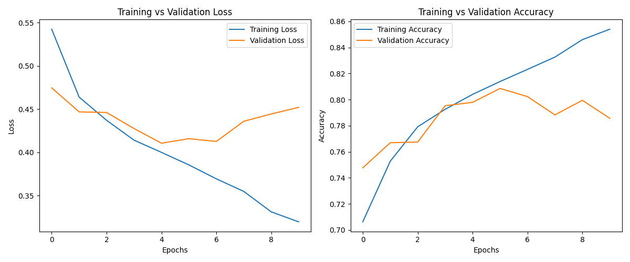
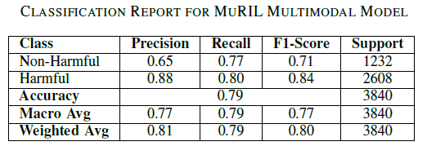
MuRIL Multimodal Classifier
MuRIL (Multilingual Representations for Indian Languages) is a BERT-based model pre-trained on 17 Indian languages and English. This implementation combines MuRIL with a custom CNN for image processing, creating a multimodal classifier specifically designed for multilingual meme analysis and harmful content detection.

Slide 27
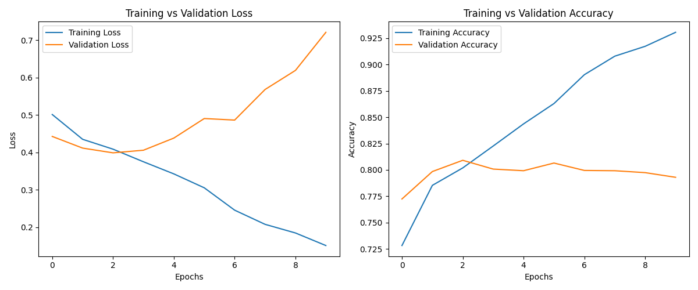
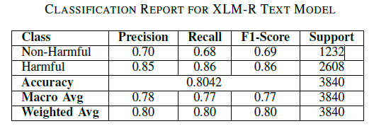
XLM-R Text Classifier
XLM-RoBERTa (XLM-R) is a multilingual transformer-based model pretrained on 100 languages. This implementation uses XLM-R with an enhanced classification head specifically designed for multilingual harmful content detection across diverse text inputs.

Slide 28
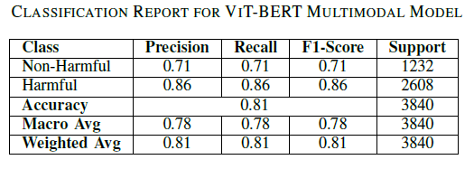
ViT-BERT Multimodal Classifier
This implementation combines a Vision Transformer (ViT) for image processing with a multilingual BERT model for text analysis, creating a robust multimodal classifier for multilingual harmful content detection across both visual and textual elements.

Slide 29
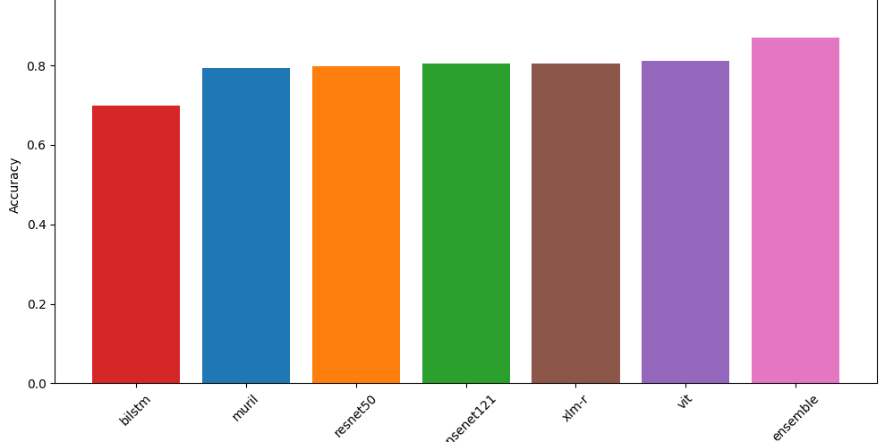
Model Accuracy Comparison

Slide 30
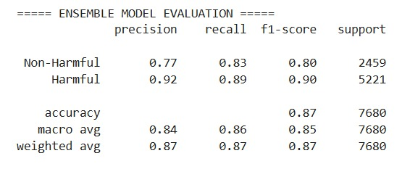
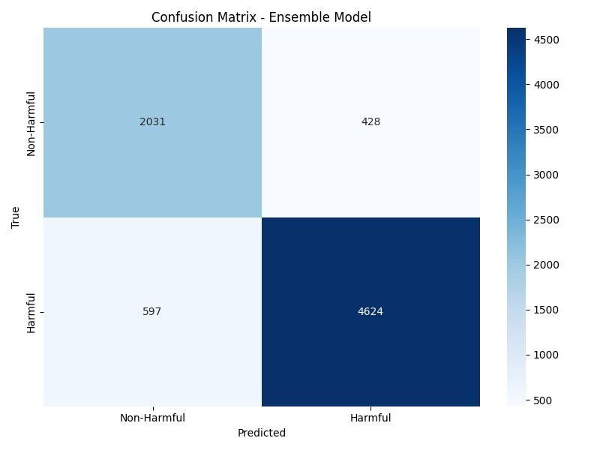
Voting Ensemble
Using the outputs of six models (XLM-R, MuRIL, BiLSTM, ViT-BERT, ResNet50, and DenseNet121), we apply a majority voting ensemble to classify memes as either hateful or non-hateful. This approach leverages the predictions from all models, selecting the final label based on the majority vote.

Slide 31
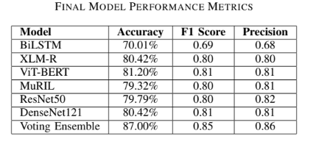
Final Results

Slide 32

05
Conclusion & Future Works

Slide 33
Conclusion and Future Work
The system integrates multiple architectures — XLM-R, MuRIL (text), ViT, ResNet50, DenseNet121 (image), and BiLSTM (sequence) — to handle multilingual, multimodal hateful meme detection. Majority voting ensemble ensures robust and reliable performance across diverse inputs.
Future Work :
Replace majority voting with trainable ensemble methods (e.g., stacking)
Expand dataset with underrepresented languages and nuanced hate expressions
Explore lightweight transformer models for improved inference speed and scalability

Slide 34
Limitations of the Project
OCR Inaccuracies: Errors during Optical Character Recognition (OCR) affect the quality of text fed into downstream models.
Translation Limitations: Translating non-English text to English may lead to semantic distortion, weakening multilingual understanding.
Computational Overhead: Running multiple large-scale models (e.g., ViT, BERT, ResNet) increases memory, inference time, and energy use — limiting real-time deployment.
Dataset Imbalance: A skewed class distribution biases the models toward the majority class, leading to lower sensitivity to hateful content.
Lack of Interpretability: The ensemble system provides a final label without offering explainability, making it difficult to justify decisions in sensitive applications.
Simple Majority Voting: All models are equally weighted, ignoring individual model confidence, reducing ensemble accuracy and adaptability.

Slide 35

06
Timeline

Slide 36
Timeline
Phase 1: Research and Literature Review (Jan - mid Feb) Conduct a comprehensive review of existing literature and current models for hateful meme detection including memes with different languages. Analysed about it and understands the working and the shortcomings of all the related works in this field.
Phase 2: Dataset Collection and Preprocessing (Mid Feb - March) Gather and preprocess datasets, including labeled examples of hateful memes and related content. Finding datasets was really complex tasks as very limited number of datasets are available for this task. We did text processing and normalization, feature extraction and multimodal integration to get the final feature embeddings.
Phase 3: Model Development and Evaluation (March - mid April) The final feature embeddings was utilized in Pipeline 2, where it was trained using six models (XLM-R, MuRIL, BiLSTM, ViT-BERT, ResNet50, and DenseNet121).
Phase 4: Final Model Optimization (mid April) The outputs from the six models (XLM-R, MuRIL, BiLSTM, ViT-BERT, ResNet50, and DenseNet121) were combined using a Voting Ensemble model to classify memes.
Phase 5: Documentation and Reporting (end April) Compile findings, document methodologies, and prepare a final report and work on the future scope if implemented successfully whatever we wanted to achieve.

Slide 37
References
Abdullakutty, F., & Naseem, U., Decoding Memes: A Comprehensive Analysis of Late and Early Fusion Models for Explainable Meme Analysis. Robert Gordon University, UK & Macquarie University, Australia. Link
Ma, J., & Li, R., RoJiNG-CL at EXIST 2024: Leveraging Large Language Models for Multimodal Sexism Detection in Memes. University of Zurich, Switzerland.
Ji, J., Lin, X., & Naseem, U., CapAlign: Improving Cross Modal Alignment via Informative Captioning for Harmful Meme Detection. University of Sydney, Shanghai Jiao Tong University, Macquarie University. Link
Huang, J., Lyu, H., Pan, J., Wan, Z., & Luo, J., Evolver: Chain-of-Evolution Prompting to Boost Large Multimodal Models for Hateful Meme Detection. Link
Karthik, G., Hate-CLIPper: Multimodal Hateful Meme Classification based on CLIP Features. GitHub
Li, L. et al., VisualBERT: A Simple and Performant Baseline for Vision and Language.
Conneau, A. et al., XLM-R: Unsupervised Cross-lingual Representation Learning at Scale. ArXiv
Dosovitskiy, A. et al., An Image is Worth 16x16 Words: Transformers for Image Recognition at Scale (ViT). ArXiv
Kakwani, D. et al., MuRIL: Multilingual Representations for Indian Languages.ArXiv
Schuster, M., & Paliwal, K.K., Bidirectional Recurrent Neural Networks (BiLSTM).IEEE
He, K., Zhang, X., Ren, S., & Sun, J., Deep Residual Learning for Image Recognition (ResNet50). ArXiv
Huang, G., Liu, Z., Van Der Maaten, L., & Weinberger, K.Q., Densely Connected Convolutional Networks (DenseNet).ArXiv

Slide 38
Thank You
THANK YOU

