Slide 1
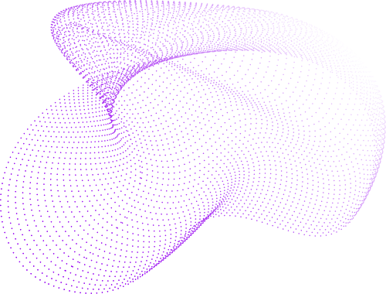

Multi-Source Data Integration Framework
Semester 6 SNA Project
Assignment 10
Guided By: Prof. Vrijendra Singh
IIT2022052 Swaroop Dora
IIT2022256 Ankit Kumar
IIT2022205 Sarvaiya Pratik Kumar

Slide 2



Objective
Problem statement: “Merging data from social media, telecom logs, and incident reports into a single unified hoax call network.”
Goal: Build an integrated multi-layer network while maintaining the identity of each data source and ensuring high integration accuracy using Social Network Analysis (SNA).
Motivation: The need for accurate, real-time entity resolution and conflict resolution in multi-source scenarios.

Slide 3

Datasets Used
1. Incident Reports Dataset
Source: Python Library called Faker
Purpose: Captures verified hoax call incidents, linking reporter to suspect.
Processing:
Renamed columns for standardization: reporter_id/name ➝ source/source_name, suspect_id/name ➝ target/target_name.
Each entry tagged with "incident" layer.
Edges in the graph encode incident type, location, and timestamp.
Importance:
Serves as the ground truth for identifying hoax-related interactions.
Crucial for labeling and evaluating suspicious communication paths.

Slide 4
Datasets Used
2. Social Media Dataset
Source: Python Library called Faker
Purpose: Represents digital conversations (e.g., messages on Reddit or Twitter).
Processing:
Unified schema: sender_id/name ➝ source/source_name, receiver_id/name ➝ target/target_name.
Tagged with "social_media" layer.
Edges encode messages and timestamps.
Importance:
Adds context and behavioral signals around users.
Helps in identifying propagation patterns of misinformation or hoax-related influence.

Slide 5
Datasets Used
3. Telecom Logs Dataset
Source: Python Library called Faker
Purpose: Details Call Detail Records (CDRs) from telecom data.
Processing:
Standardized columns: caller_id/name ➝ source/source_name, receiver_id/name ➝ target/target_name.
Layer set as "telecom".
Edges include call duration, type (e.g., voice, missed), and timestamp.
Importance:
Provides real-world communication insights.
Helps trace frequent or unusual call behavior between individuals.

Slide 6
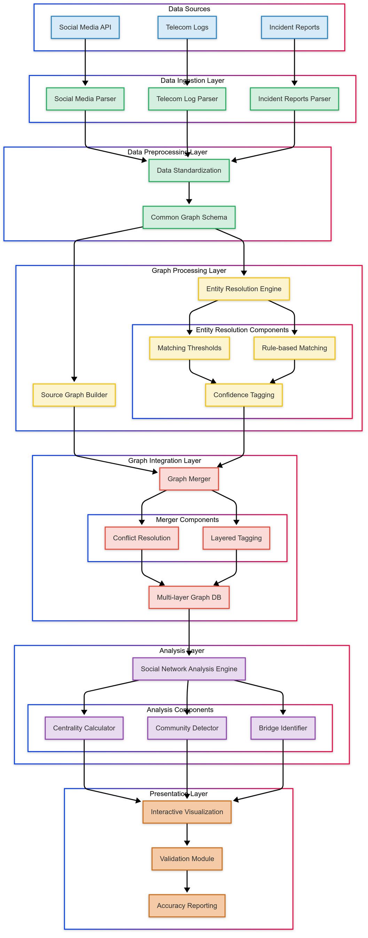
Methodology
Data Cleaning & Standardization: Outline converting raw data to a common node-edge format.
Entity Resolution Techniques: Explain matching based on name, ID, behavior similarity (reference fuzzy matching with fuzzywuzzy).
Confidence Scoring: Describe how you assign scores to each resolved entity.
Source Labelling: Add labels (e.g., Layer 1 for Social Media, Layer 2 for Telecom).
Conflict Resolution: Use trusted source prioritization rules to reconcile mismatches.

Slide 8
Key Features Implemented
Unified Graph Structure: Conversion to a common node-edge schema across data sources.
Layered Data Representation: Clear source identification with different layers.
Entity Resolution with Confidence Scores: Detailed matching and scoring mechanism.
Conflict Resolution: Rule-based system to resolve attribute conflicts.
Progressive Updates: Ability to integrate and update the graph as new data is received.
SNA Analysis: Calculation of centrality, community detection, and visualization of network bridges.

Slide 9
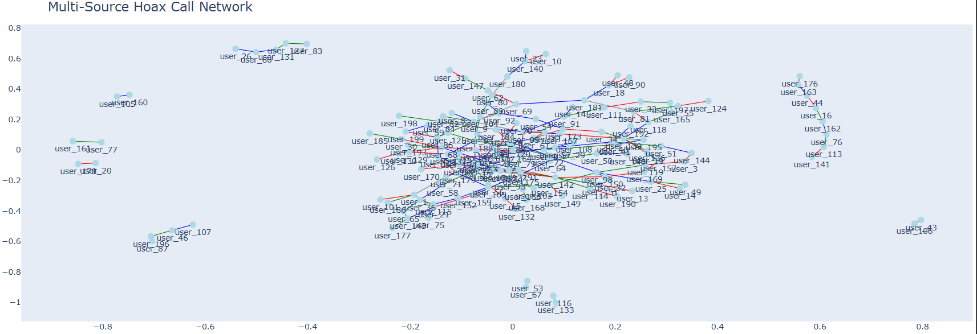
Visualizations & Results
Graph Visualizations: Interactive network graphs (using pyvis or plotly) showing layered connections.
Analysis Outcomes: Centrality metrics, community structures, and confidence levels for entity matches.

Slide 10
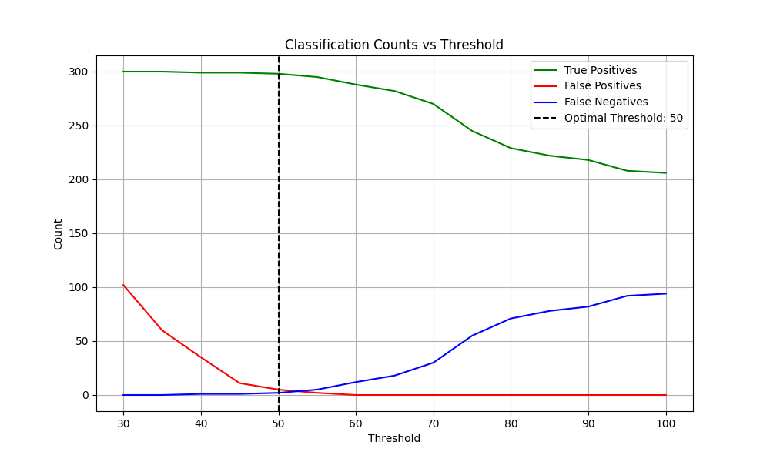
Visualizations & Results

Slide 11
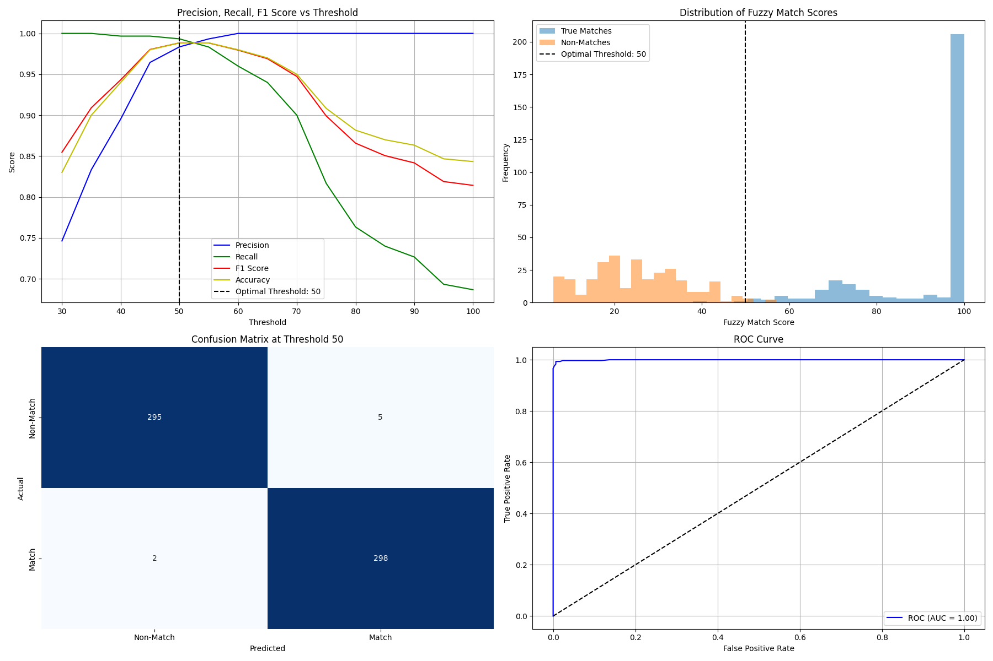
Visualizations & Results

Slide 12
Challenges Faced
Key Challenges:
Data Standardization: Handling diverse formats and missing fields.
Entity Resolution Complexity: Balancing threshold levels for accurate matching.
Conflict Resolution: Determining trusted sources for reliable data.
Scalability: Progressive integration of real-time data while ensuring performance.

Slide 13
Evaluation Metrics/Accuracy
Metrics to Present:
Integration Accuracy: Quantitative measures (precision, recall) for entity resolution.
Confidence Scores Distribution: Summary charts that show the confidence levels across merged entities.
Performance Metrics: Time taken for processing and scalability factors if applicable.
Graphical Elements: Include bar charts, histograms, or pie charts representing the evaluation outcomes.

Slide 14
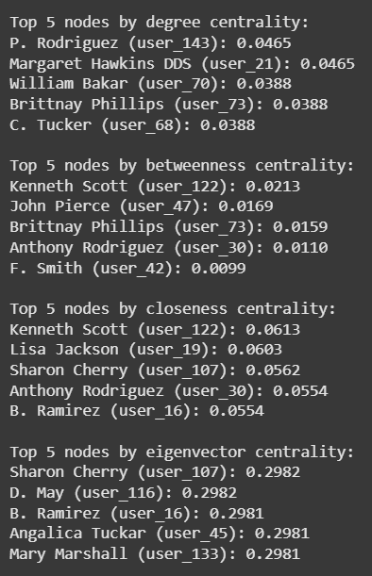
Evaluation Metrics/Accuracy

Slide 15
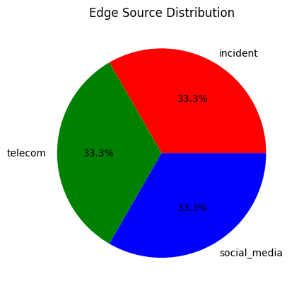
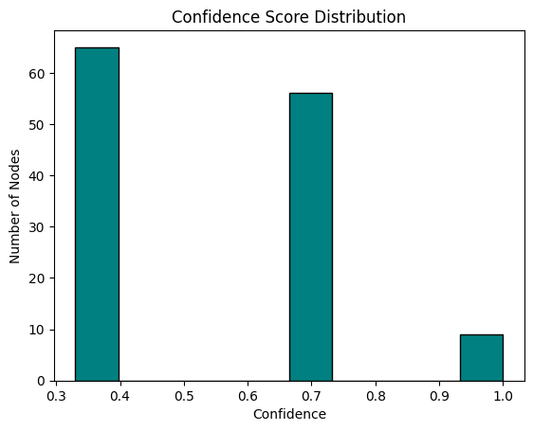
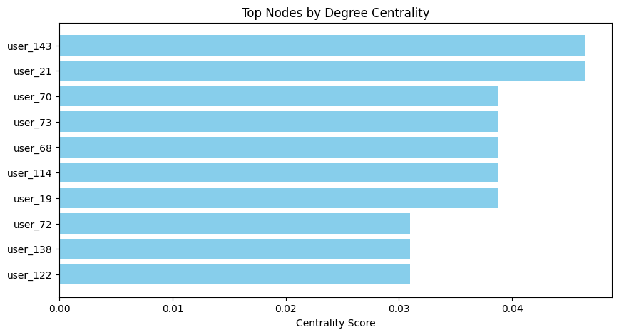
Evaluation Metrics/Accuracy

Slide 16
Future Work / Conclusion
Future Work Ideas:
Integration of additional data sources (e.g., more social media platforms or IoT sensor data).
Enhanced real-time data processing and visualization.
Further optimization of entity resolution algorithms.
Conclusion:
Recap of the successful creation of a multi-layer social graph.
Emphasis on the balance of integration accuracy and real-time processing.
Final thoughts on the impact of the framework in detecting and mitigating hoax call networks.

Slide 17
Thank You

