Slide 1
Add-on: importing contact lists
Upload a CSV or Excel file, invite people one after another, and follow each person from first message to connected @handle.
Project update · November 2026
Notes:
Follow-up to the main project update. This covers one new feature: loading a list of phone numbers from a file instead of typing them in one by one, and tracking every person on that list.

Slide 2
What the add-on changes
Before
After
Numbers typed in one at a time
No record of whether the WhatsApp message was actually sent
The list showed links, not people
Numbers had to include the country code
Hundreds of numbers from one CSV or Excel file
Opening WhatsApp or copying the message marks the person as Sent
One row per person: Not invited → Sent → Connected
Filter, search and export the list; +91 added automatically
Notes:
Before, the dashboard only knew about links that had been created. Now it knows about people, including the ones we haven't contacted yet, and where each one is in the process.

Slide 3
The new workflow
1
2
3
4
5
Import file
Check preview
Invite
Send
Next →
Upload a .csv or .xlsx list. Phone and name columns are picked from the titles.
See how many numbers are new, repeated or unreadable before anything is saved.
Press Invite on a row. The one-time link is created now, so it's fresh.
Open in WhatsApp or copy the message. The row turns Sent, with the time.
Jumps to the next person who still needs a message. Repeat.
Links are made at Invite, not at import: they expire after 24 hours, so a list imported today can be worked through over several days.
Notes:
Nothing is sent automatically. The admin still sends each WhatsApp message by hand, but the dashboard now lines the people up and moves to the next one.

Slide 4
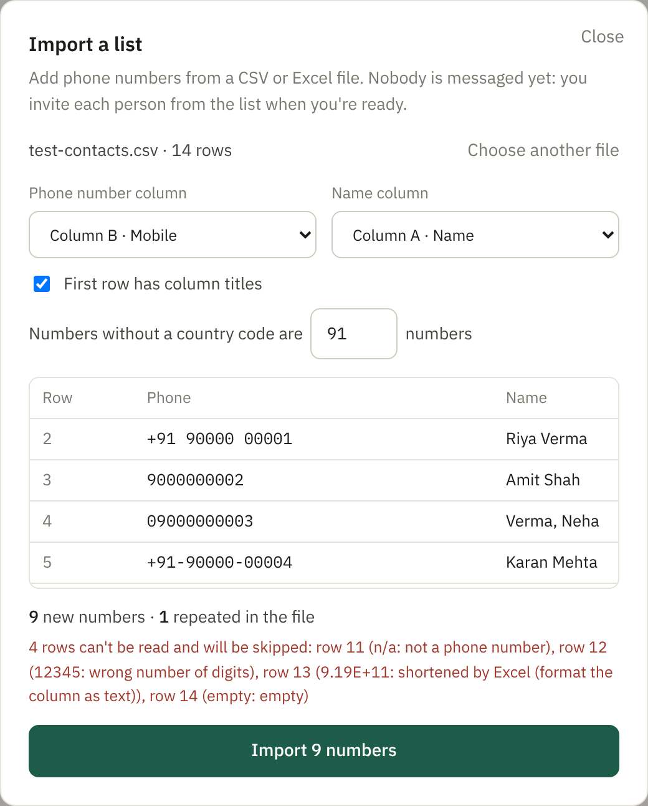
The import checks the file before saving
In the file | What happens
98765 43210 | Saved as +91 98765 43210
91-98765-43210 | Same: spaces, dashes, brackets, leading 0 cleaned up
+44 7700 900123 | Kept as a UK number
Same number twice | Saved once
9.19E+11 | Skipped: Excel shortened it, digits are lost
n/a, 12345, empty | Skipped, with the row number and reason
Old .xls file | Asked to save it as .xlsx or CSV
Sample file: 14 rows → 9 imported, 1 repeat, 4 skipped with reasons
Notes:
The preview runs the same checks as the real import, so what you see is what gets saved. Rows that can't be read are listed with the reason, so the file can be fixed and imported again.

Slide 5
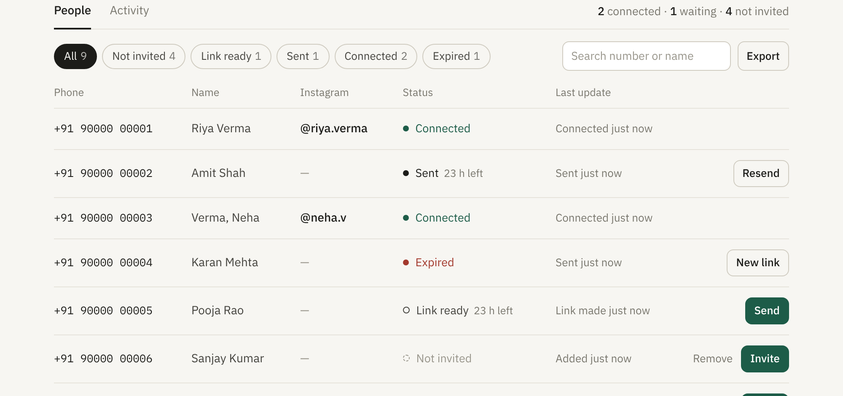
Every person has a status
Not invited
Imported, no link yet
Link ready
Link made, not sent yet
Sent
Message sent; link valid 24 h
Connected
@handle saved to the number
Expired
Timed out; one click for a new link
Also: filter by status, search by number, name or @handle, and Export the rows shown as CSV (phone, name, status, @handle, Instagram ID, and when each step happened).
Notes:
Each row is one phone number, whether it came from a file or was typed in. Older entries made before this change show up in the same list.

Slide 6




Under the hood
Stored in MongoDB
New API, same login
New contacts collection and a sentAt time on each invite. Existing invites and links are untouched and appear in the same list.
File parsing, import with a dry-run preview, delete, and mark-as-sent. All behind the admin login.
CSV and Excel
Tested
.csv and .xlsx read on the server. Up to 3 MB or 5,000 rows per file. Default country code is a setting (+91).
29 automated checks pass, including the new import ones. Clicked through in a browser with the sample files.
Notes:
Everything goes through the existing backend and database; there is no new service to run or pay for.

Slide 7
What this doesn't solve yet
Sending is still manual
Not checked on live data yet
No delete after inviting
Each WhatsApp message is still sent by hand. Bulk sending needs the WhatsApp Business Platform.
The MongoDB part runs only once deployed; check one small import on the live site.
Remove works only for people not yet invited, to keep the record of who connected.
Numbers aren't proven
Old .xls files
File size
A number in a file is just a claim until the person taps Step 2 on their own phone.
Must be saved as .xlsx or CSV first.
3 MB or 5,000 rows per file; split larger lists.
Notes:
Import fixes the typing and the tracking. The sending itself is still manual, which is the real limit for large lists.

Slide 8
Next steps
Merge and deploy; import the sample file on the live site and check it in MongoDB Atlas
Pilot: import a real list of 20–50 people and measure how many reach each status
Use that drop-off to make the case for the WhatsApp Business Platform (bulk sending)
Decide whether invited and connected people can be deleted (needed for data-deletion requests)
Notes:
The deletion question matters beyond tidiness: the privacy and data-deletion pages Meta requires will need a way to remove a person's record completely.

